Slide 1
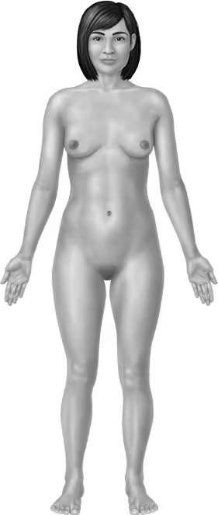
A&P BIOL 206 Lab Report #1
My first & last name is: _____________________________________________
2
How would you describe the indicated direction?
1.
2.
3.
How about the labeled region?
4.
5.
6.
7.
8.
What is the position called that we assume when describing anatomy?
9.
In which quadrant or region would you feel pain in if your appendix was inflamed?
10.
4
5
1
3
7
6
8

Slide 2
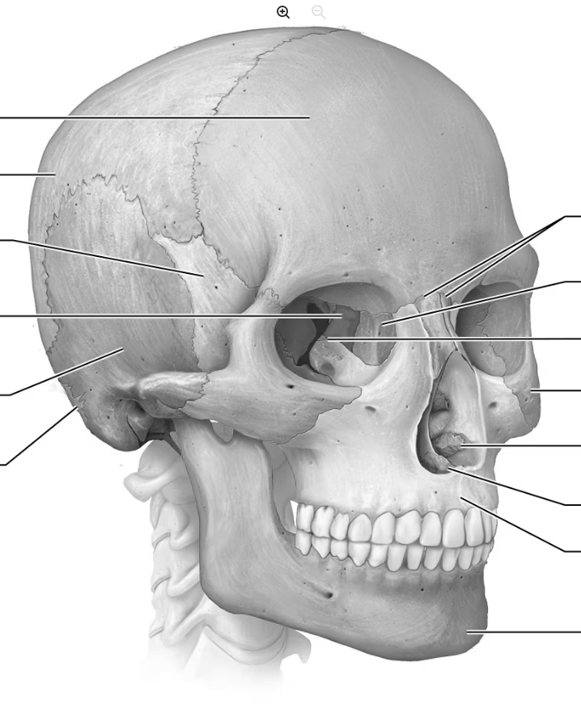
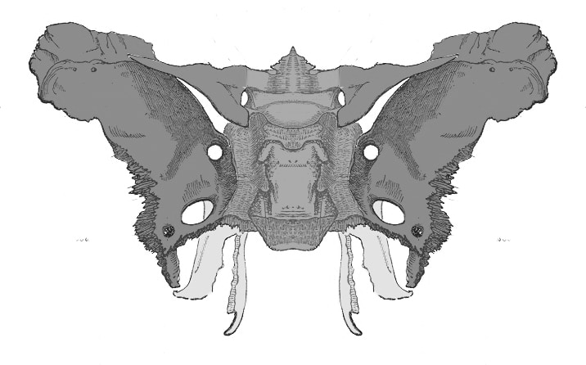
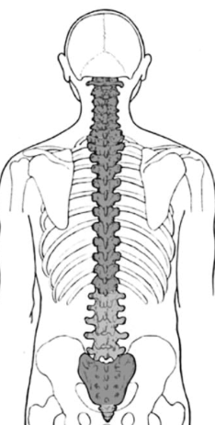
A&P BIOL 206 Lab Report #2
My first & last name is: _____________________________________________
What is the name of the marked bones?
1.
2.
3.
4.
Which bone is shown in detail below the skull?
5.
Can you identify these bone markings?
6.
7.
8.
What do you call this section of the spine?
9.
10.
2
4
3
8
1
7
6
9
10

Slide 3
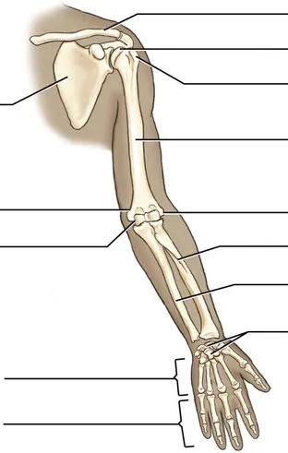
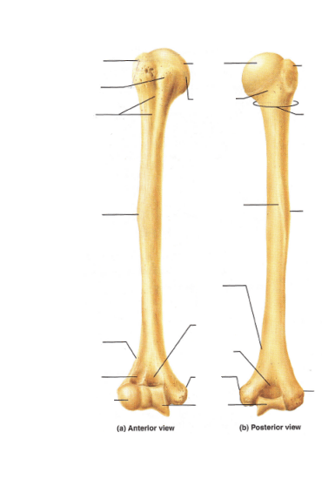
A&P BIOL 206 Lab Report #3
My first & last name is: _____________________________________________
2
1
What is the name of the marked bones?
1.
2.
3.
4.
5.
6.
Can you identify these bone markings?
7.
8.
9.
10.
3
4
5
6
7
8
9
10

Slide 4
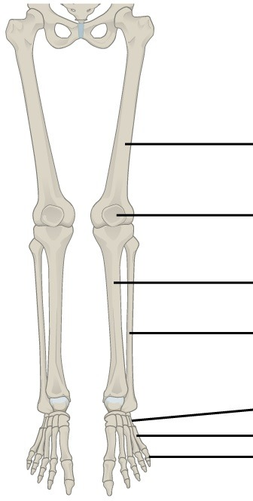
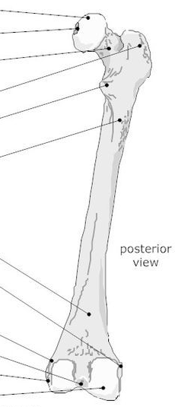
A&P BIOL 206 Lab Report #4
My first & last name is: _____________________________________________
What is the name of the marked bones?
1.
2.
3.
4.
5.
What bone is shown in the lower picture?
6.
Can you identify these bone markings?
7.
8.
9.
10.
3
1
2
4
5
7
8
6
10
9

Slide 5
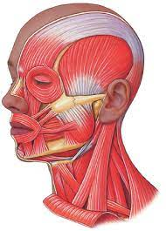
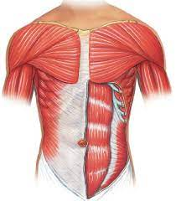
A&P BIOL 206 Lab Report #5
My first & last name is: _____________________________________________
2
1
What is the name of the labeled muscle?
1.________________________________
2. ________________________________
3. ________________________________
4. ________________________________
5. ________________________________
6. ________________________________
7. ________________________________
8. ________________________________
9. ________________________________
10. _______________________________
3
6
4
5
9
7
8
10

Slide 6
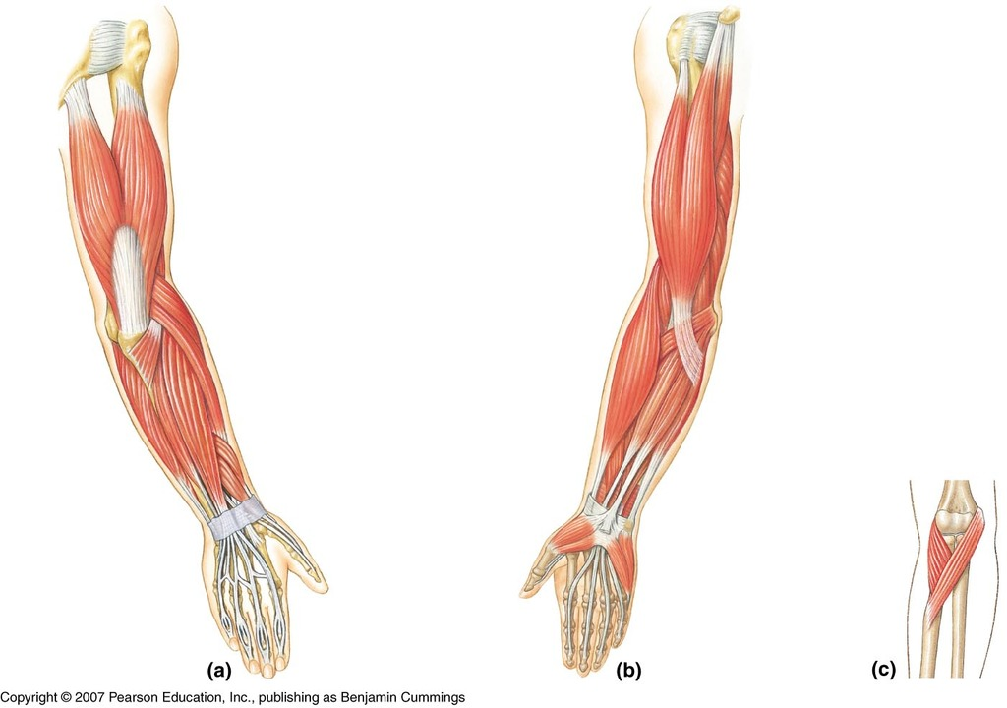
A&P BIOL 206 Lab Report #6
My first & last name is: _____________________________________________
What is the name of the labeled muscle?
1.________________________________
2. ________________________________
3. ________________________________
4. ________________________________
5. ________________________________
6. ________________________________
7. ________________________________
8. ________________________________
9. ________________________________
10. _______________________________
1
2
3
4
9
5
8
7
6
10

Slide 7
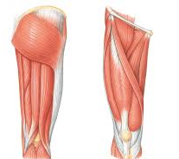
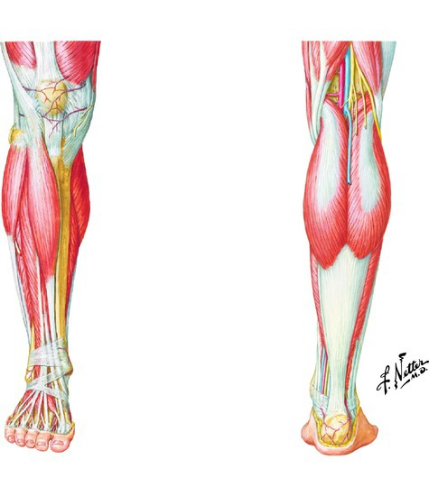
A&P BIOL 206 Lab Report #7
My first & last name is: _____________________________________________
What is the name of the labeled muscle?
1.________________________________
2. ________________________________
3. ________________________________
4. ________________________________
5. ________________________________
6. ________________________________
7. ________________________________
8. ________________________________
9. ________________________________
10. _______________________________
1
4
5
2
3
9
6
7
10
8

