Slide 1
IC3

Slide 2
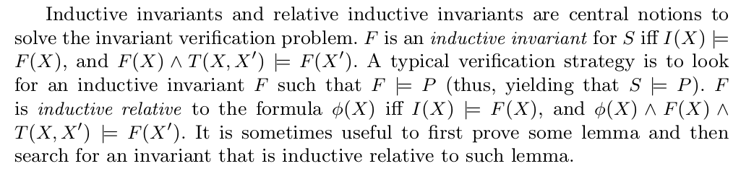
Invariant Verification Problems

Slide 3
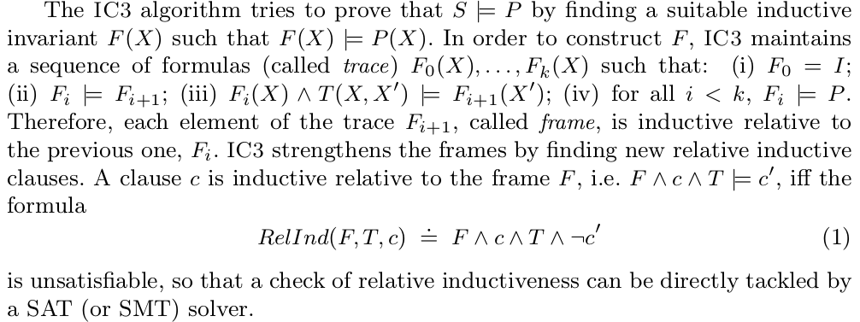
IC3 main idea

Slide 4

implementation
if Fk&!P is satifiable, then Fk is intersected with bad states(!P)
construt a cube c which lead to the bad states Fk & !P
c contains literals that if and(them) is satisfiable then Fk&!P is satisfiable

Slide 5
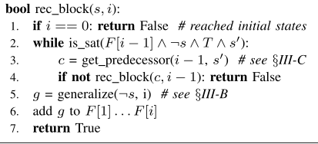

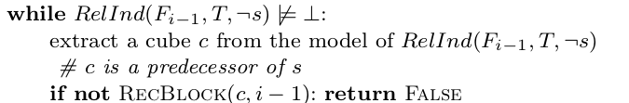
implementation
finding new relative inductive clauses.
If the formula RelInd is unsatisfiable, then ¬s is inductive relative to F(i-1), and the bad state s can be blocked at i, then generalize ¬s to ¬g and add ¬g to Fi (i <k)
if the formula RelInd is satisfiable, then the overapproximation F(i-1) is not strong enough to show that s is unreachable,let c be a subset of the states in F(i-1)∧¬s such that all the states in c lead to a state in s in one transition step. Then, IC3 continues by trying to show that c is not reachable in one step from F(i-2)(that is, it tries to block the pair(c, i-1) )

Slide 6
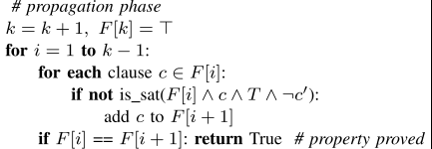

implementation
因为在blocking phase中，s |=Fk&¬P可能在小于k的位置上被block掉
但不可能在0位置处被block，所以从1开始(i=1...k-1)
对于Fi每个子句c，如果不满足(not is_sat)RelInd
则clause c is inductive relative to the frame Fi
即有 F ∧ c ∧ T |= c‘
将c添加到F(i+1), 则之前用来block掉s的子句也能被传播到Fk

Slide 7
A Simple Abstraction Refinement Technique for Property Directed Reachability

Slide 8

Property Directed Reachability
Given a transition system and a predicate, the property directed reachability algorithm aims to compute an inductive invariant of the system stronger than the predicate.

Slide 9
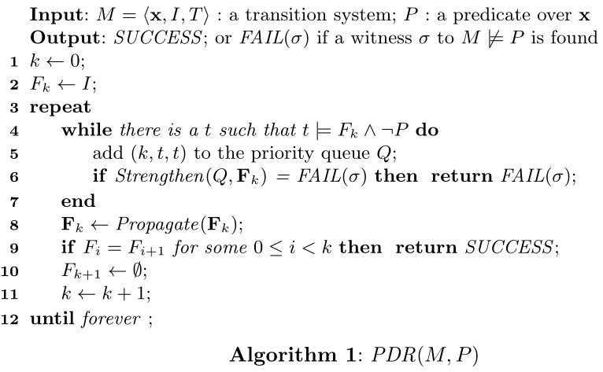
Property Directed Reachability
- a clause set F is strengthened by adding a clause ¬t
- propagates clauses in Fk and check if an inductive invariant found
- [F(k+1)] = [tt]

