Slide 1
Better Generalization in IC3

Slide 2
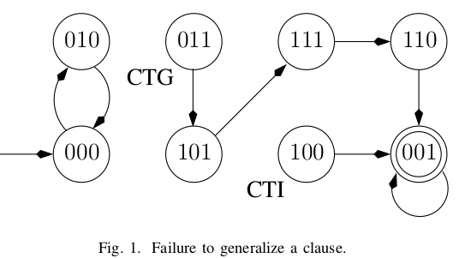
state 100 is the first CTI, but fails induction because of the predecessor 011 to state 101.
A state that hinders a generalization attempt (011 in the example) is called a counterexample to generalization (CTG)
Since the negation of the CTG is inductive, IC3 can block that CTG.
Addressing them reduces the depth of
the explicit backward search IC3 performs and allows stronger inductive generalizations

Slide 3
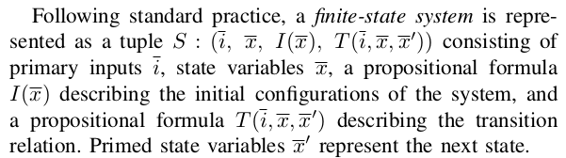
P is invariant for the system S (that is, S-invariant) if indeed only P-states are reachable. If P is not invariant, then there exists a finite counterexample run
While an inductive property P is invariant, the converse is
not necessarily true.In this case, it is customary to seek an inductive strengthening of P , which is a formula F such that F ^ P is inductive.

Slide 4
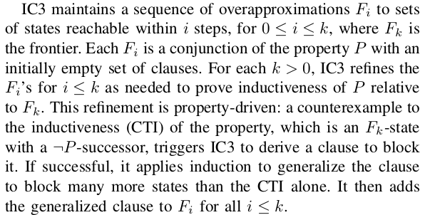
property directed reachability

Slide 5
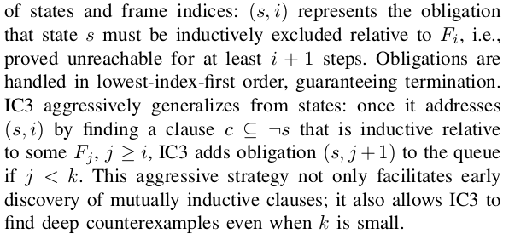
blocking phase

Slide 6
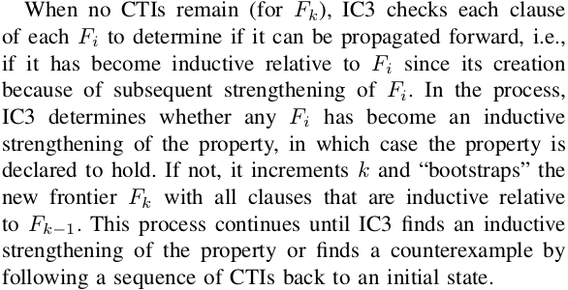
propagating phase

Slide 7
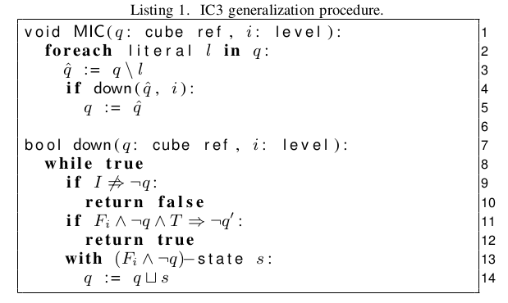
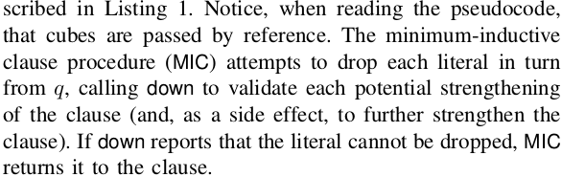
generalize - MIC
if !q is not inductive relative , then there is a predecessor s that is a (Fi & !q)-state
a new cube is formed by taking the common literals in the original cube and the predecessor s
The number of literals in the cube thus strictly decreases in every iteration.
“Checking safety by inductive generalization of ounterexamples to induction” -- up procedure

Slide 8
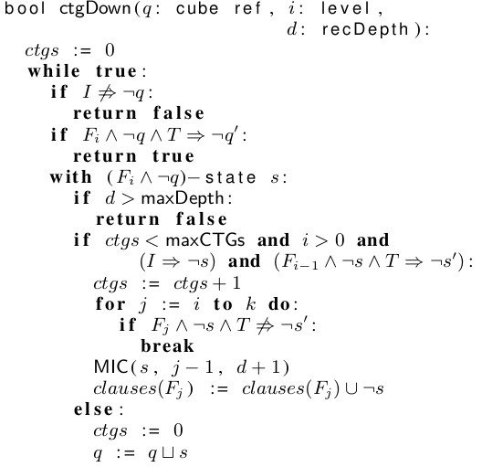
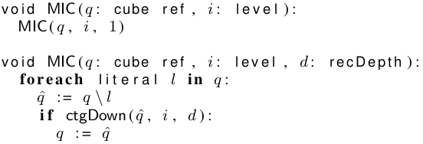
addressing CTG

