Slide 2
A Guided Tour

Slide 3
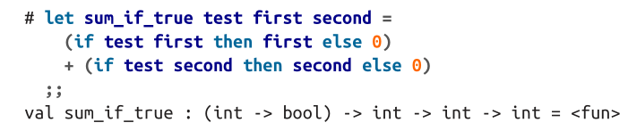
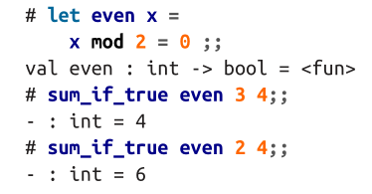
Functions
in the definition of even, we used = in two different ways: once as the part ofthe let binding that separates the thing being defined from its definition; and once asan equality test, when comparing x mod 2 to 0.

Slide 4
Type Inference
OCaml requires that both branches of an if statement have the same type

Slide 5
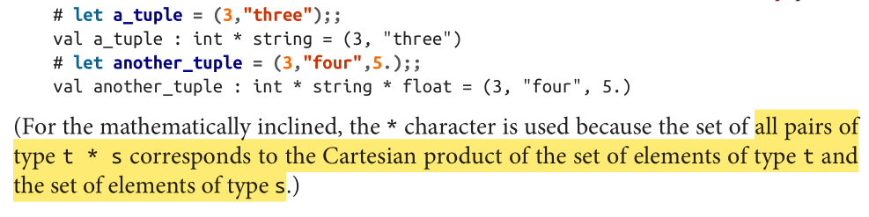
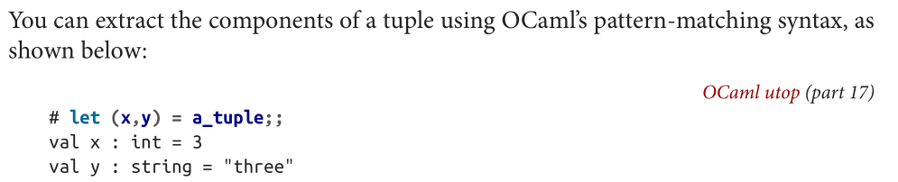
Tuples

Slide 6

Lists
lists let you hold any number of items of the same type
Core comes with a List module that has a rich collection of functions for working with lists
labeled argument ~f
OCaml uses semicolons to separate list elements in lists rather than commas. Commas, instead, are used for separating elements in a tuple.

Slide 7
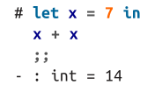

Nesting lets with let and in
The in marks the beginning of the scope within which the new variable can be used

Slide 8


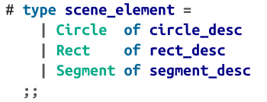
Records and Variants
include newly defined types as components in larger types
representing objects together in a single type -- variants

Slide 9
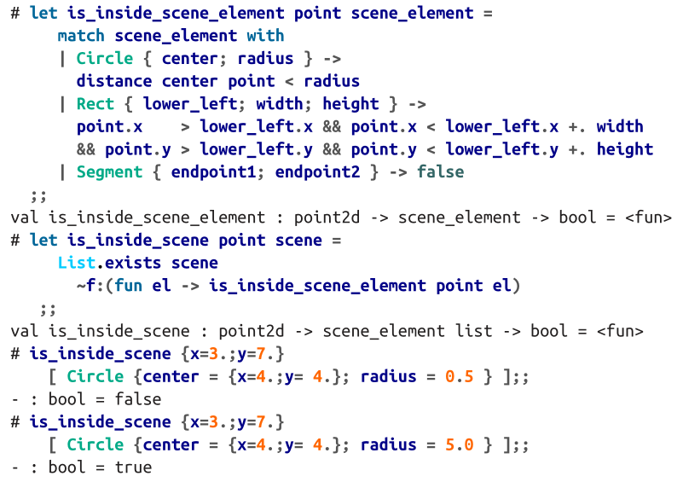
Records and Variants
option and list are really just examples of variant types that happen to be important enough to be defined in the standard library (and in the case of lists, to have some special syntax)

Slide 10
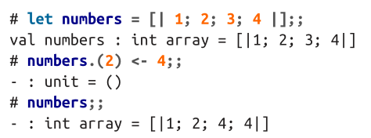
Imperative Programming
imperative programming, where computations are structured as sequences of instructions that operate by making modifications to the state of the program
mutable data structures like arrays and hash tables
control-flow constructs like for and while loops

Slide 11
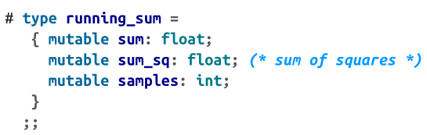
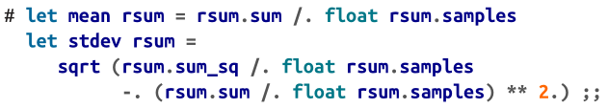
Mutable Record Fields
Records, which are immutable by default, can have some of their fields explicitly declared as mutable

Slide 12


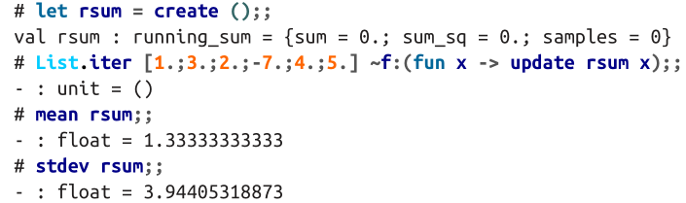
Mutable Record Fields

Slide 13
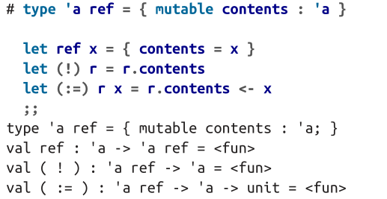
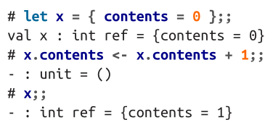
Ref
It’s just a record type with a single mutable field called contents

Slide 14
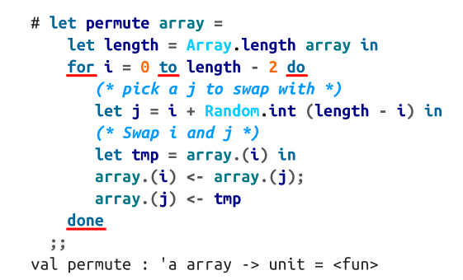
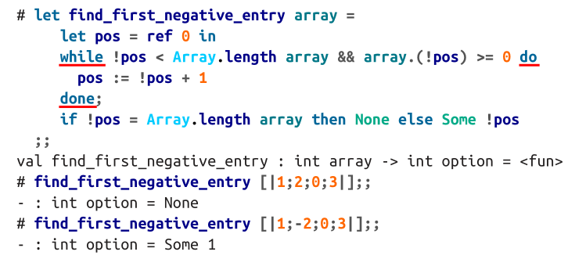
for and while loops

Slide 15
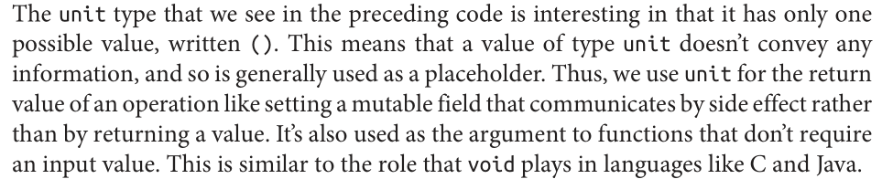
unit type

Slide 16
A Complete Program
sum.ml
$ corebuild sum.native
$ ./sum.native

Slide 17
Variables and Functions

Slide 19
Lists and Patterns

