Slide 2
A Guided Tour

Slide 3
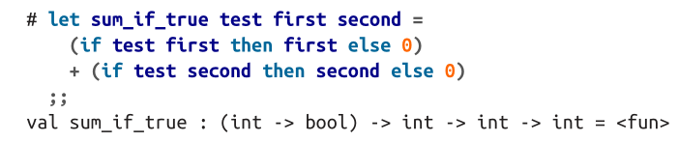
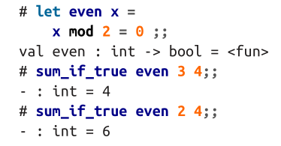
Functions
in the definition of even, we used = in two different ways: once as the part ofthe let binding that separates the thing being defined from its definition; and once asan equality test, when comparing x mod 2 to 0.

Slide 4
Type Inference
OCaml requires that both branches of an if statement have the same type

Slide 5
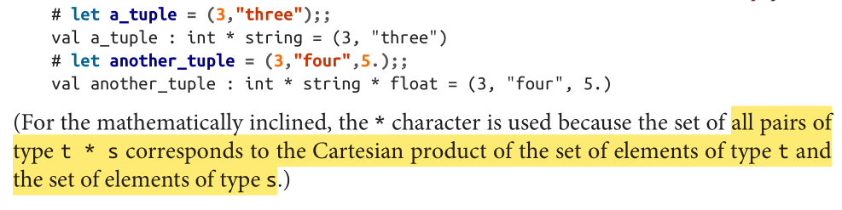
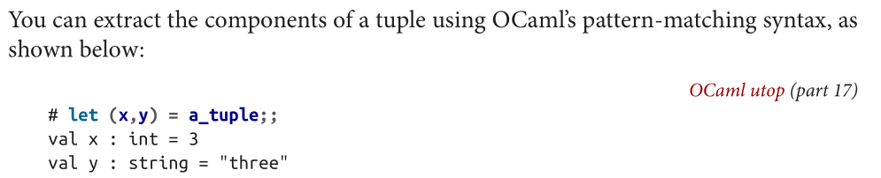
Tuples

Slide 6

Lists
lists let you hold any number of items of the same type
Core comes with a List module that has a rich collection of functions for working with lists
labeled argument ~f
OCaml uses semicolons to separate list elements in lists rather than commas. Commas, instead, are used for separating elements in a tuple.

Slide 7
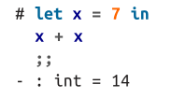

Nesting lets with let and in
The in marks the beginning of the scope within which the new variable can be used

Slide 8


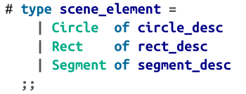
Records and Variants
include newly defined types as components in larger types
representing objects together in a single type -- variants

Slide 9
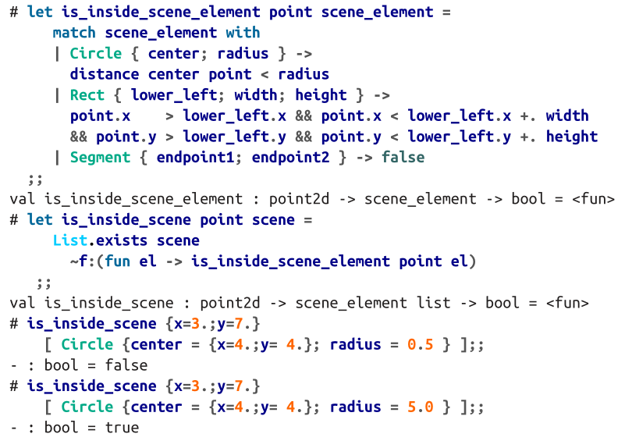
Records and Variants
option and list are really just examples of variant types that happen to be important enough to be defined in the standard library (and in the case of lists, to have some special syntax)

Slide 10
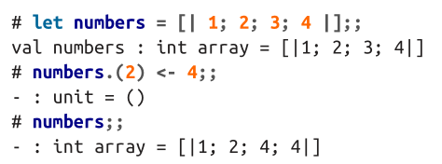
Imperative Programming
imperative programming, where computations are structured as sequences of instructions that operate by making modifications to the state of the program
mutable data structures like arrays and hash tables
control-flow constructs like for and while loops

Slide 11
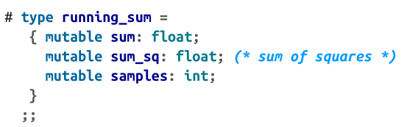
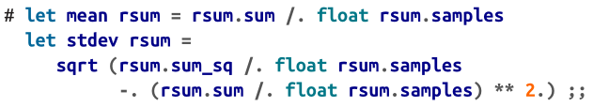
Mutable Record Fields
Records, which are immutable by default, can have some of their fields explicitly declared as mutable

Slide 12


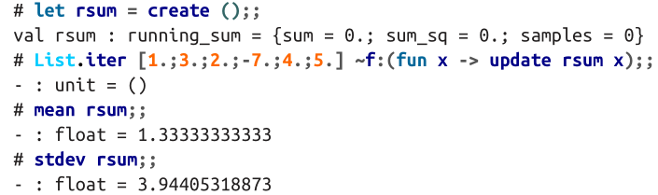
Mutable Record Fields

Slide 13
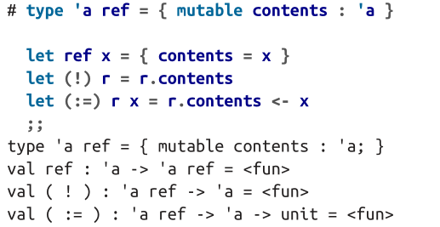
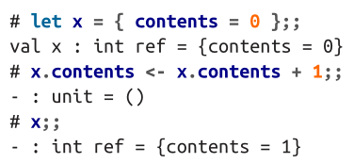
Ref
It’s just a record type with a single mutable field called contents

Slide 14
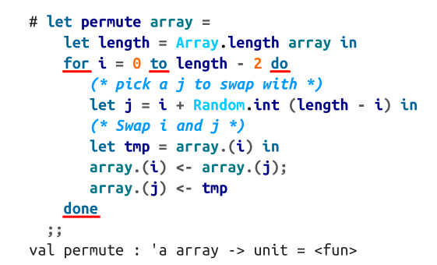
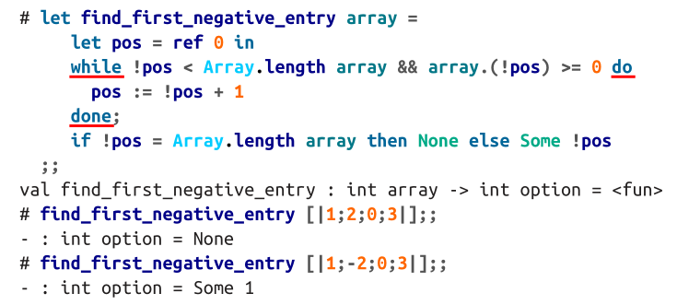
for and while loops

Slide 15
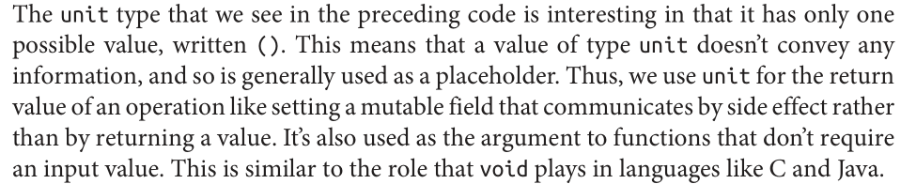
unit type

Slide 16
A Complete Program
sum.ml
$ corebuild sum.native
$ ./sum.native

Slide 17
Variables and Functions

Slide 19
Lists and Patterns

Slide 21
Files, Modules, and Programs

Slide 22
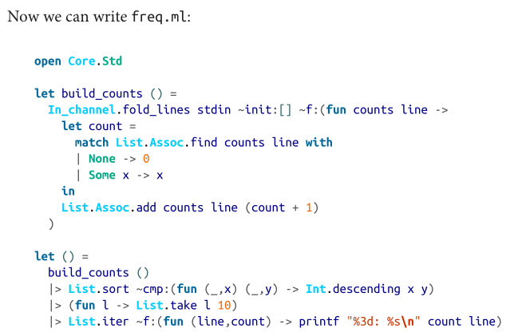
Single-file Program

Slide 23

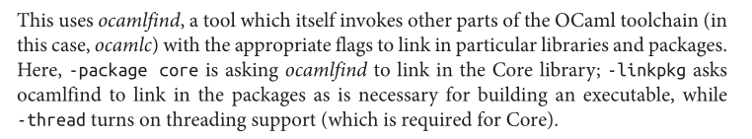
Single-file Program
If we weren‘t using Core or any other external libraries

Slide 24
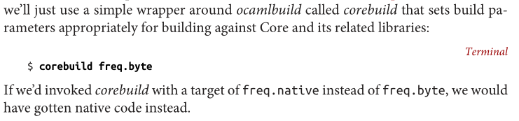
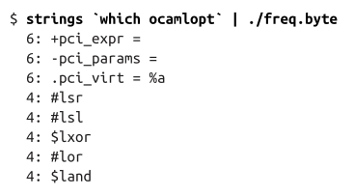
Single-file Program

Slide 25
Single-file Program
two compilers
ocamlc bytecode compiler -- interpreted by a virtual machine
ocamlopt native-code compiler -- compiled to native machine code
ocamlbuild
.byte for bytecode executable
.native for native code

Slide 26
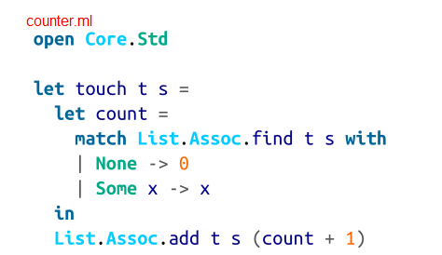
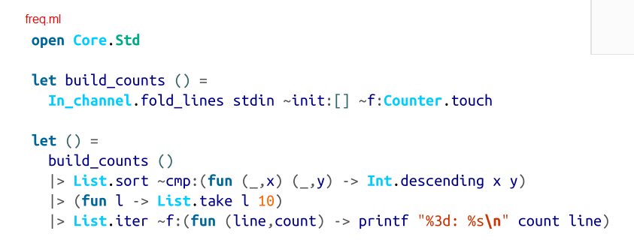
Multifile Programs and Modules
$ocamlbuild freq.byte
it will automaticly discover dependencies and realize that counter.ml needs to be compiled

Slide 27
Signatures and Abstract Types
the terms interface, signature, and module type are all used interchangeably.
val declarations are used to specify values in a signature(.mli)

Slide 28
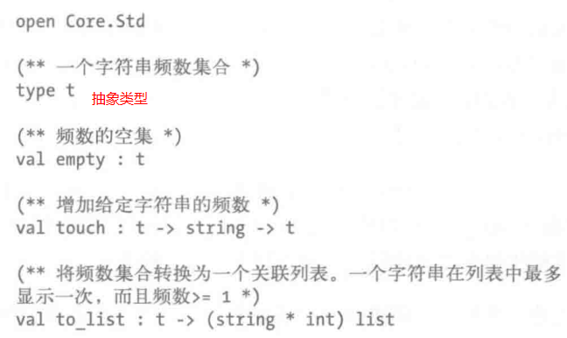
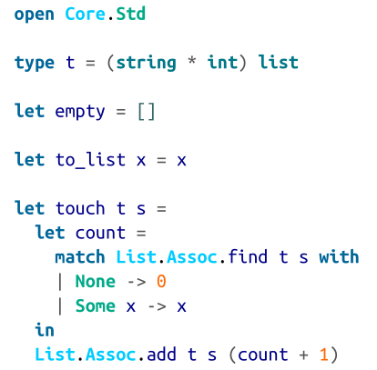
Signatures and Abstract Types
Counter.mli
Counter.ml
Note that we needed to add empty and to_list to Counter, since otherwise there would be no way to create a Counter.t or get data out of one.

Slide 29
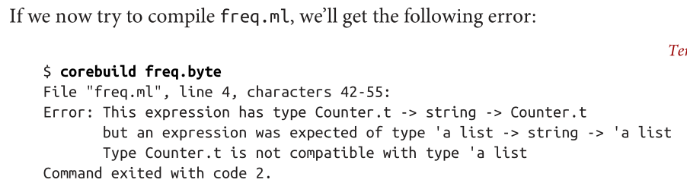
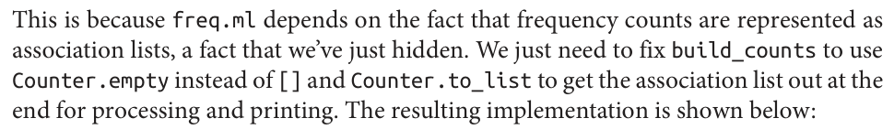
Signatures and Abstract Types

Slide 30
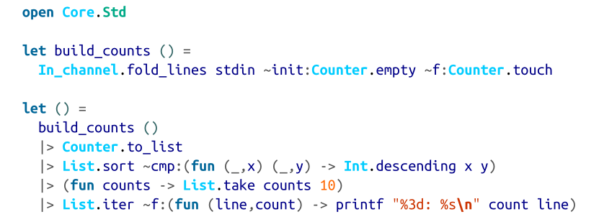
Signatures and Abstract Types
Counter.mli
Counter.ml
FIXED

Slide 31
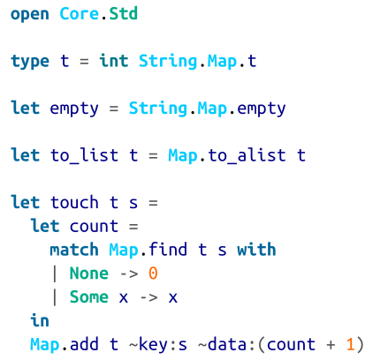

Signatures and Abstract Types

Slide 32
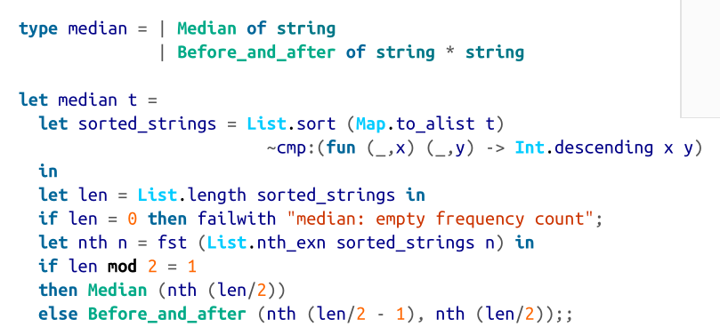
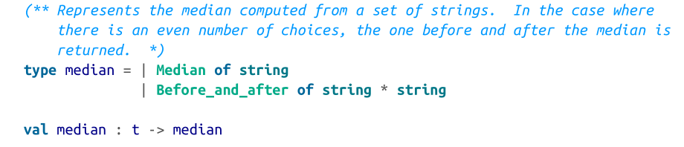
Concrete Types in Signatures
add to counter.ml
add to counter.mli

Slide 33
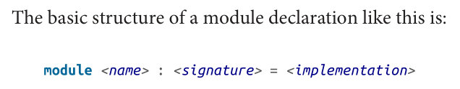
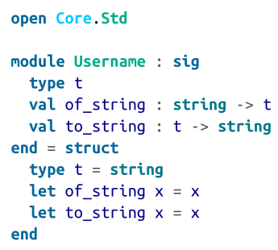
Nested Modules

Slide 34
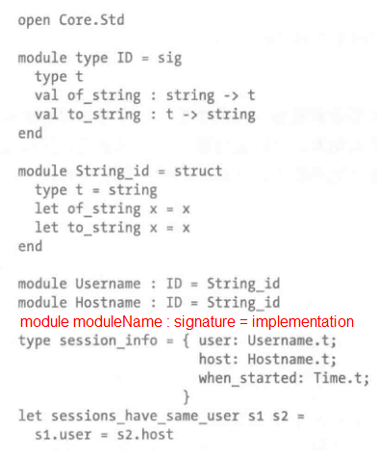
Nested Modules
the combination of signature and impletation
here is a bug!

Slide 35
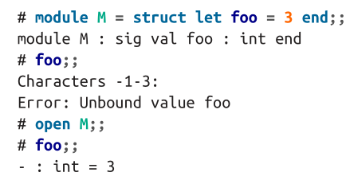
Opening Modules
In general, opening a module adds the contents of that module to the environment that the compiler looks at to find the definition of various identifiers

Slide 36
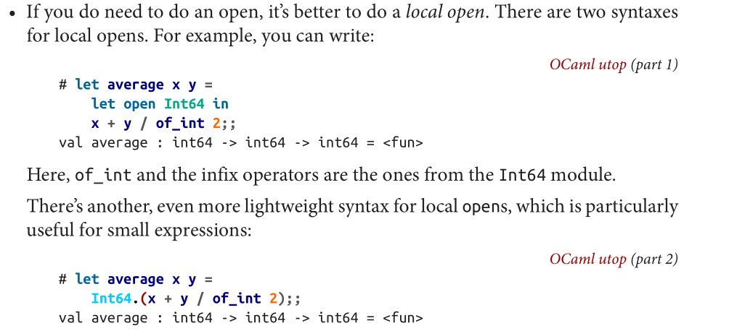
Opening Modules
local opening

Slide 37
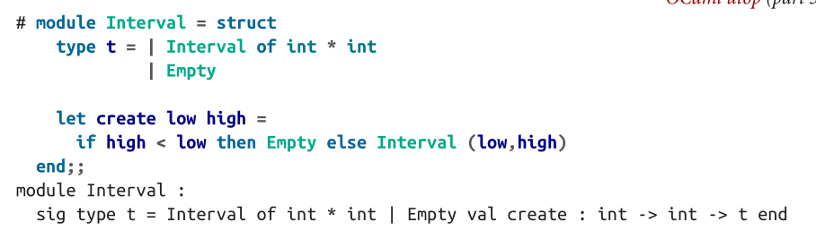
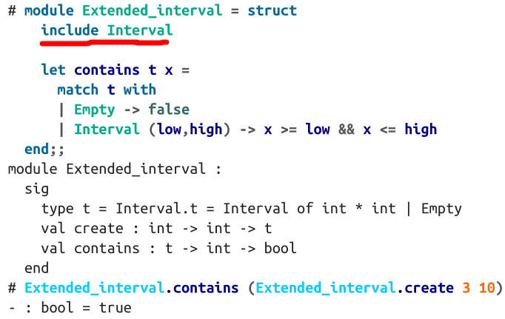
Including Modules
We can use the include directive to create a new, extended version of the existing module

Slide 38
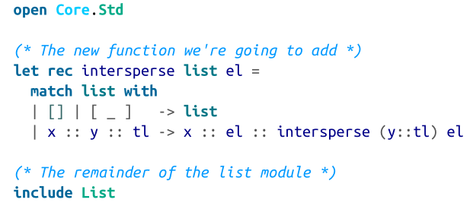
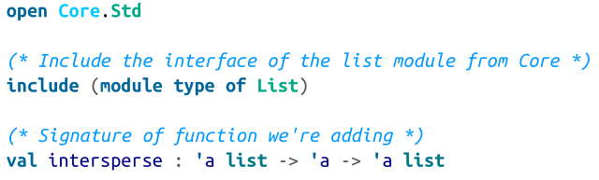
Including Modules
extended List module.ml
extended List module.mli (signature)

Slide 39
Common Errors with Modules
cyclic dependencies between modules are not allowed, and cyclic dependencies among files are never allowed.

Slide 40
Records

Slide 41
Records
record field names must start with a lowercase letter
record patterns are irrefutable,a pattern can mention only a subset of the fields in the record.

Slide 42
Variants

Slide 44
Error Handling

Slide 46
S-expression

