Slide 1
paraverifier

Slide 2
Overview
paraVerifier is composed of two parts: an invariant finder invFinder and a proof generator proofGen.
Given a protocol P and a property inv, invFinder tries to find useful auxiliary invariants and causal relations which are capable of proving inv.
proofGen generalizes the auxiliary invariants and causal relations into a parameterized form, which are then used to construct a completely parameterized formal proof in a theorem prover (e.g., Isabelle) to model P and to prove the property inv.
Problem
Input: a parameterized (symbolic) protocol P(N) where N is arbitrary, an invariant property Inv
Task: P(N)╞ Inv for any N

Slide 3
Two Central Problems
automatically searching auxiliary invariants
soundness problem: formally proving all the steps

Slide 4
Preliminary
A protocol is formalized as a pair (ini, rules), where
ini is a formula to specify initial states
rules is a set of guarded commands. Each rule r ∈ rules is defined as g → S, where g is a predicate specifying the guard, and the update S is a parallel assignment to distinct variables
Inductive Invariant
Definition: Let P := (ini, rules) be a protocol. A formula inv is an inductive invariant of P if
Proposition: Assume given a protocol P=(I,R) and an requirement(invariant) req, P satisfies req if there exists an inductive invariant inv of P such that╞inv→req

Slide 5
Main Ideas
concretize the requirement req
concretize the guarded commands r with regard to req above, i.e. we concretize each pair (req, r) and record all the necessary actual parameter indics for each r seperately.
check whether the concretized requirement req is an inductive invariant and if necessary find a strengthening aux that will be used as candicate auxiliary invariant
generalize the strengthend requirement aux back to a prameterized one

Slide 6
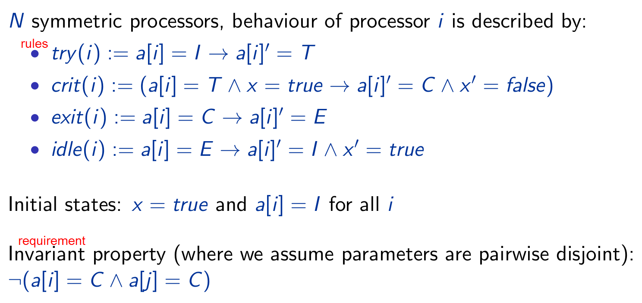
Example: Mutual Exclusion Protocol

Slide 7
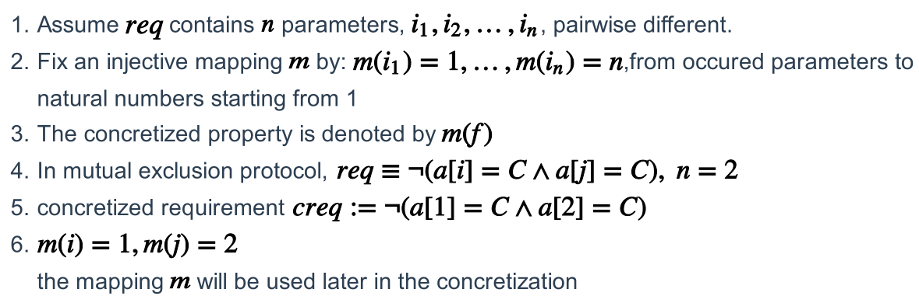
Concretize the requirement

Slide 8
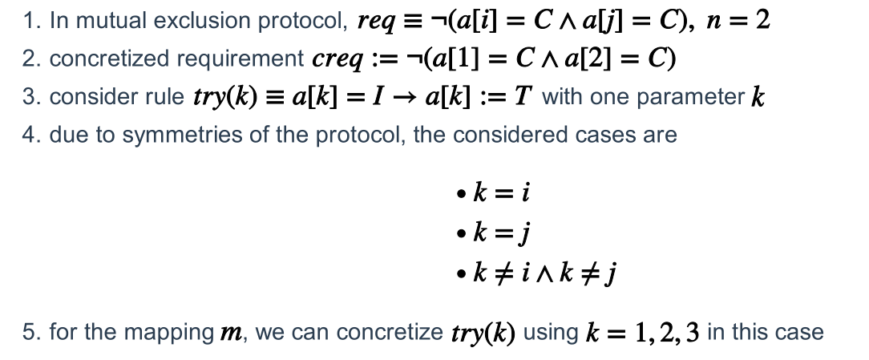
Concretize the guarded command
Rule with one parameter

Slide 9
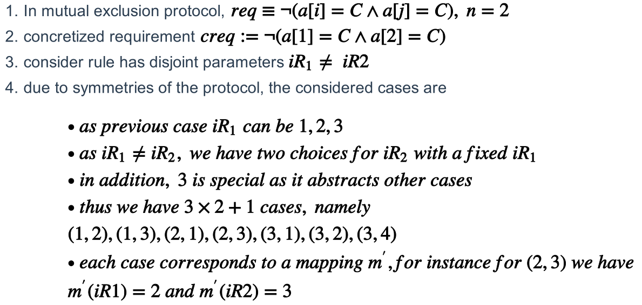
Concretize the guarded command
Rule with two parameters

Slide 10
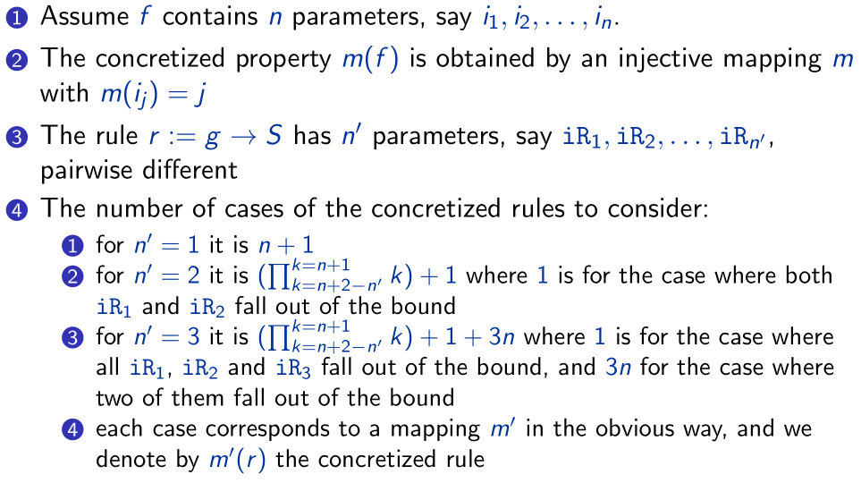
Concretize the guarded command
Generally. (f/req/inv)

Slide 11
Finding Inductive Invariants
“for each r∈ R, we have ╞inv∧guard(r) →WP(action(r), inv) ”
We distinguish the following three cases:
╞guard(r) →WP(action(r), inv) : precondition inv not needed
╞inv →WP(action(r), inv) : guard not needed
╞inv∧guard(r)∧inv' →WP(action(r), inv) :strengthening inv' needed
Key Point
find all the invariants and they relations (such as inv' -> inv aboved) in case 3

Slide 12
Finding Inductive Invariants
“for each r∈ R, we have ╞inv∧guard(r) →WP(action(r), inv) ”
We distinguish the following three cases:
╞guard(r) →WP(action(r), inv) : precondition inv not needed
╞inv →WP(action(r), inv) : guard not needed
╞inv∧guard(r)∧inv' →WP(action(r), inv) :strengthening inv' needed
For concretized m(inv) and m'(r), which is m'(g)→m'(S), we use m(f), m'(g), m'(S) accordingly
╞m'(g)→WP(m'(S), inv) : precondition m(inv) not needed
╞m(inv)→WP(m'(S), inv) : guard not needed
╞m(inv)∧m'(g)∧inv' →WP(m'(S), m(inv)) :strengthening inv' needed

Slide 13

Finding Inductive Invariants
Case3:
construct a strengthening
an obvious choice is m'(g)→WP(m'(S), m(inv)), such that (the logic formula in case holds)
the choice above is complex, rewrite it into a form
consider subformulas from its simplified form
exploit a model checker(NuSMV, Murphi) to explore an auxilary invariant

Slide 14
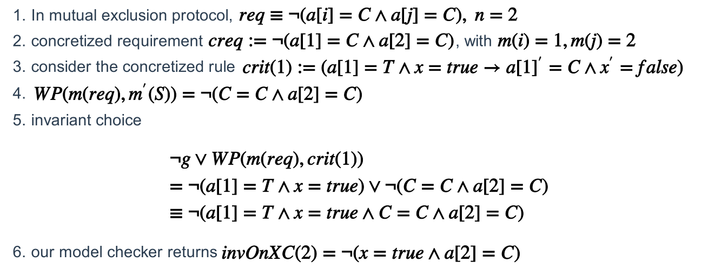
Example: mutual exclusion protocol

Slide 15
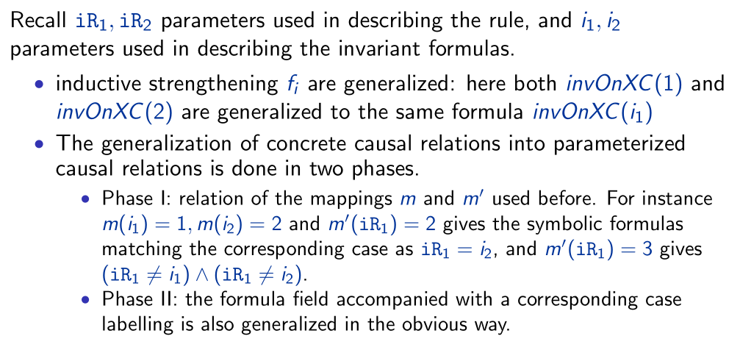
Generalization

Slide 16
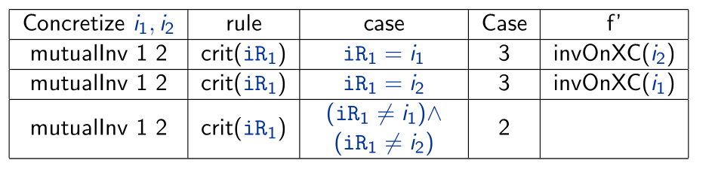
Generalization

Slide 17
Implementation

Slide 18
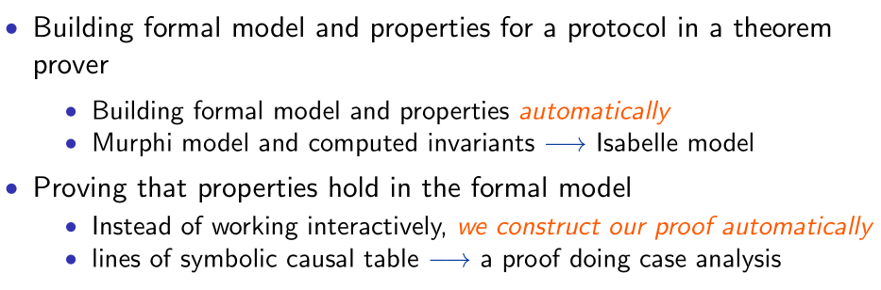
Automatic Generation of Isabelle Proof

