Slide 1
分析协议的流程
Formulate the protocol
Add an adversary to the system
State the desired correctness condition
Run the protocol for some specific choice of system size parameters
Experiment with alternate formulations and repeat.

Slide 2

NSPK
a simplified version
modeling the protocol

Slide 3
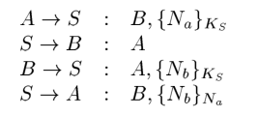
The TMN Protocol
key distribution protocol for digital mobile communication systems

Slide 4
Kerberos
mutual authentication between a client C and a server S.

