Slide 1
Module 5: Cell Type Identification with Seurat
NCSU scRNA Workshop, 2024
Bruce Corliss, PhD and Allison Dickey, PhD

Slide 2
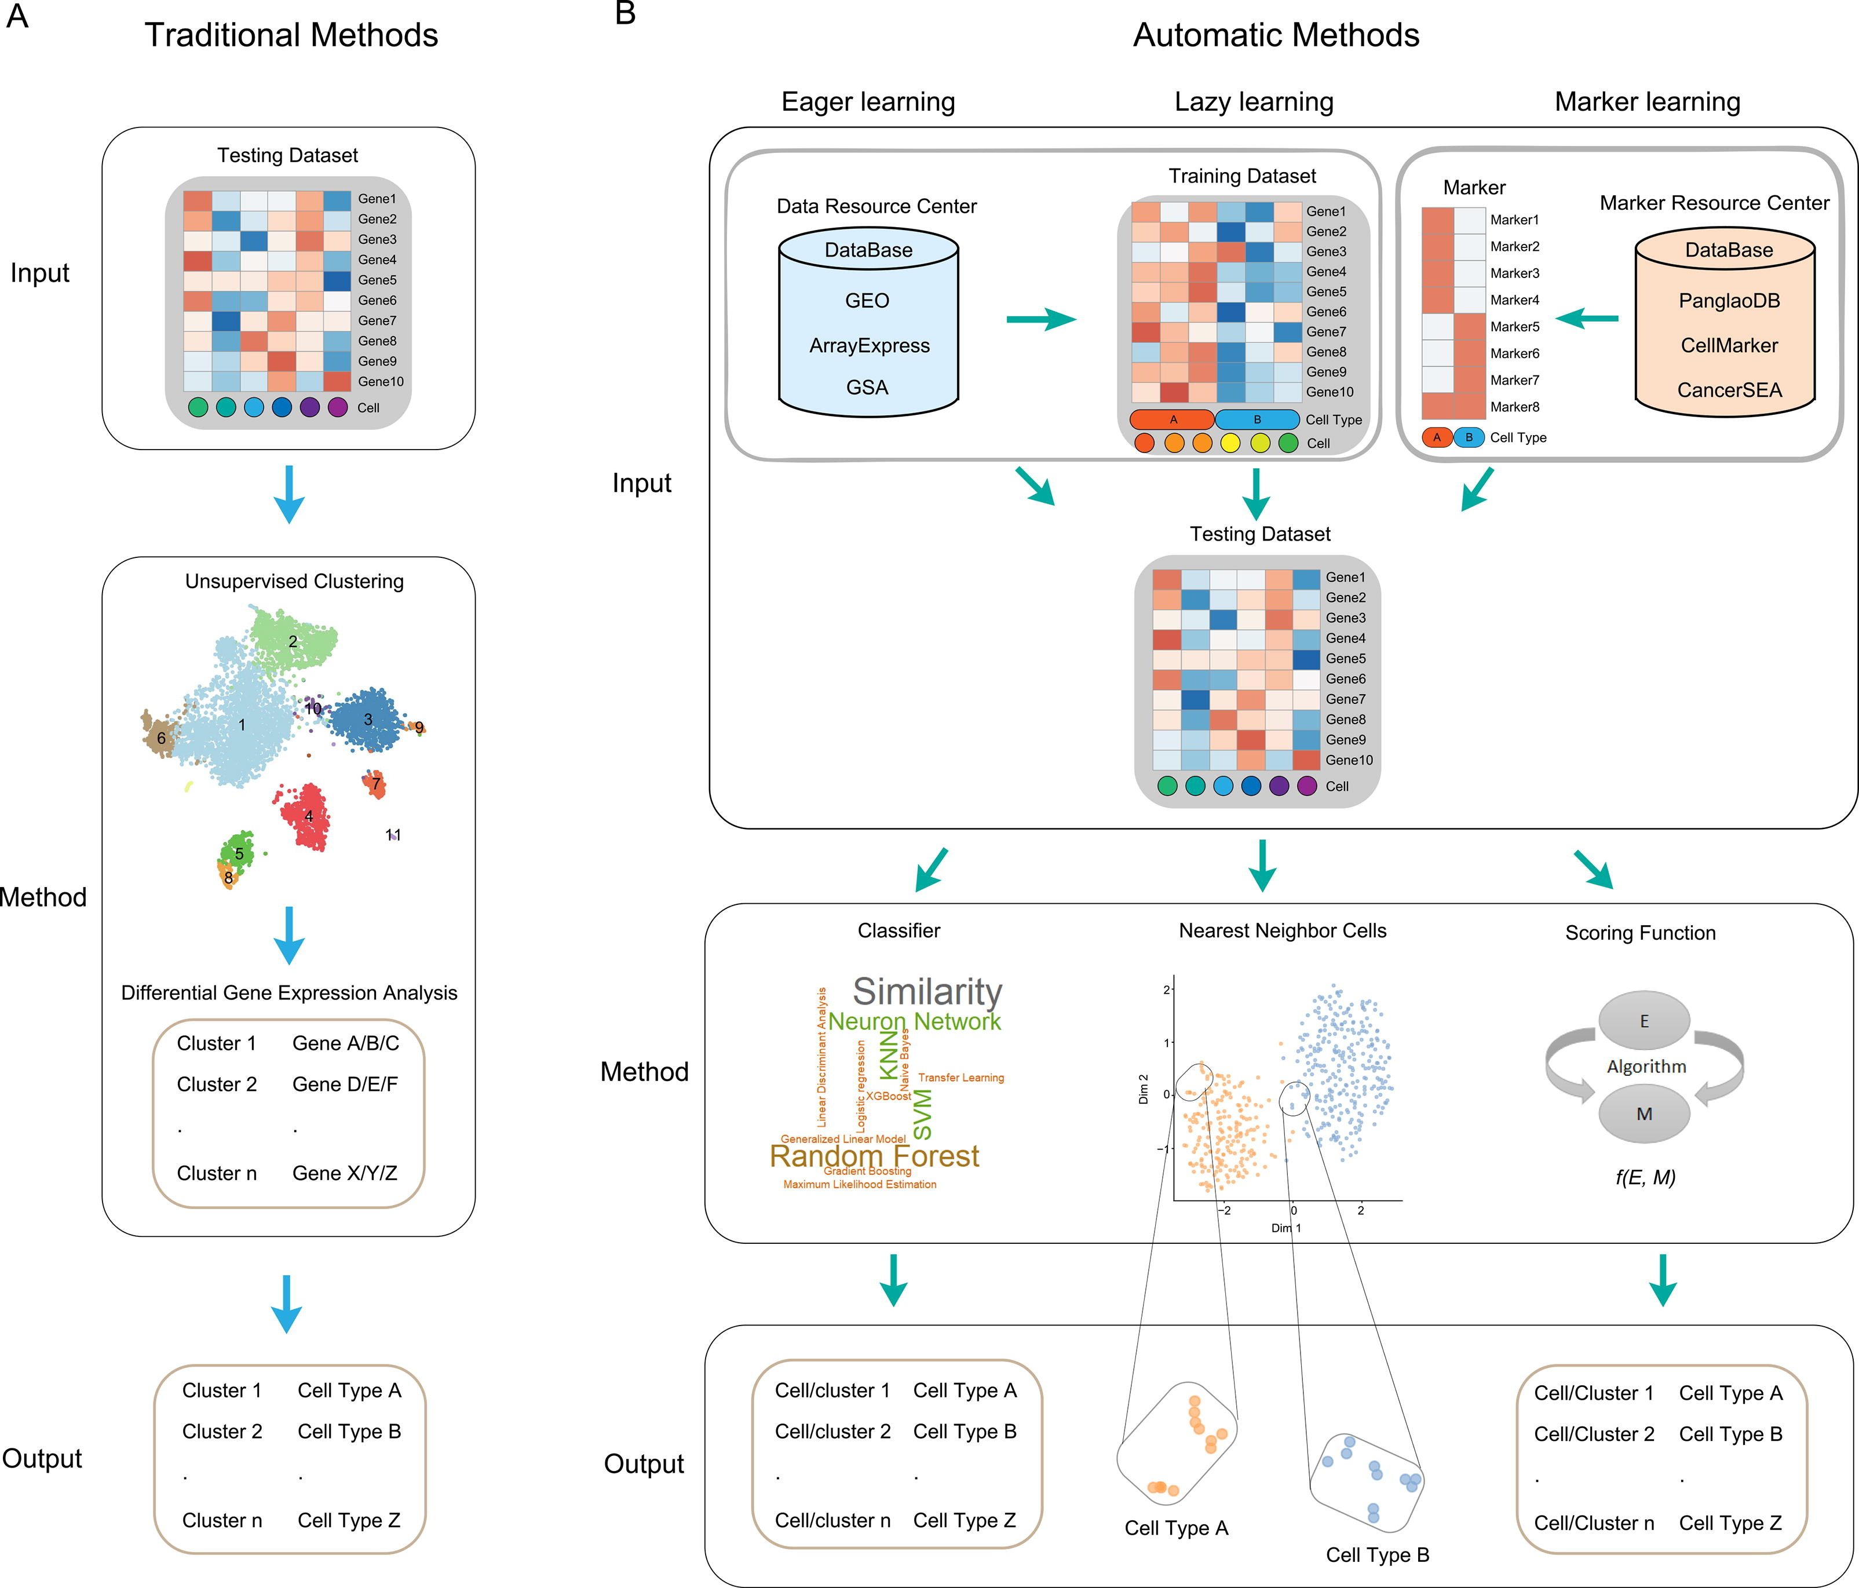
https://www.nature.com/articles/s41467-022-28803-w
Xie. Comp. And Str. Biotech J. (2021). 19: 5874-5887
Notes:
https://www.dreamstime.com/stock-illustration-dna-vector-illustration-human-structure-image49975743

Slide 3
Multitude of Packages Available for Cell Type Annotation
Marker Gene: highly expressed genes are identified for each cluster, compare against databases of reference cell type hierarchies and marker lists.
Correlation: uses correlation measures to compare gene expression profiles to reference dataset, uses “average cell” (centroid) for each cluster as a reference point.
Supervised Classification: uses machine learning techniques to train a classifier based on reference labeled scRNA-Seq datasets.
Pasquini. Comp. & Str. Biotech. J. (2021). 19:P961-969.

Slide 4
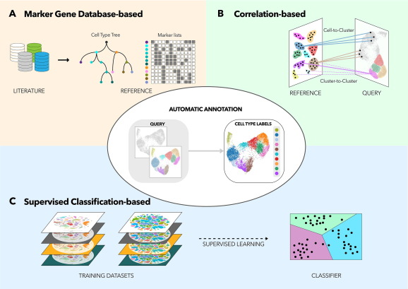
Pasquini. Comp. and Str. Biotech. J. (2021). 19:961-969.

