Slide 1
Module 3: Processing scRNA-Seq with Seurat
NCSU scRNA Workshop, 2024
Bruce Corliss, PhD and Allison Dickey, PhD

Slide 2
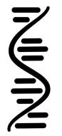
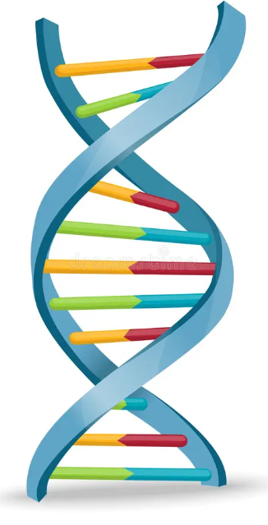
Processing Pipeline Overview
Raw Binary
Sequence
Demultiplexed Reads
Aligned Reads
Filtered feature-
barcode matrices
BCL
FastQ
BAM
SFF
Reference
Genome
VCF
HDF5
GTF
QC
GFF
Seurat
Normalization
and Scaling
Dimensionality
Reduction
Importation
Metadata Curation
Filtering
Marker Identification
Differential Gene
Expression
Biological
Interpretation
Visualization
Clustering
Notes:
https://www.dreamstime.com/stock-illustration-dna-vector-illustration-human-structure-image49975743

Slide 3
Processing Pipeline Overview
Importation
CreateSeuratObject()
Metadata Curation
PercentageFeatureSet()
Filtering
subset()
Normalization
NormalizeData()
Seurat 4 versus 5
FindVariableFeatures()
Scaling
ScaleData()
Linear Dimensional
Reduction
RunPCA(), ElbowPlot()
Clustering
FindNeighbors(), FindClusters()
Nonlinear Dimension Reduction
RunUMAP(), DimPlot()
Notes:
https://www.dreamstime.com/stock-illustration-dna-vector-illustration-human-structure-image49975743

Slide 4
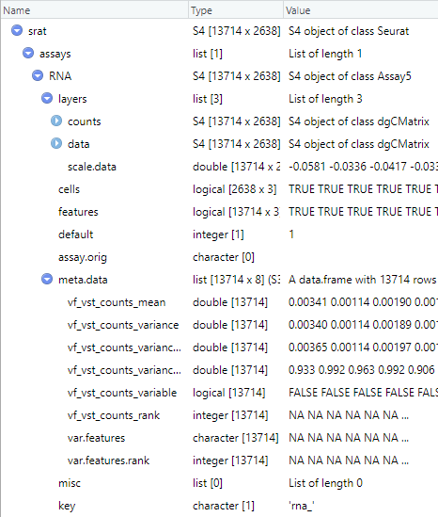
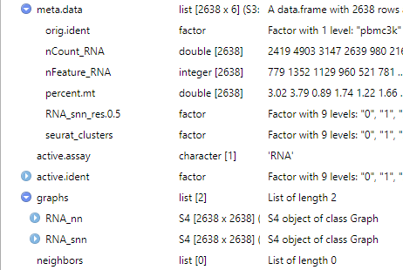

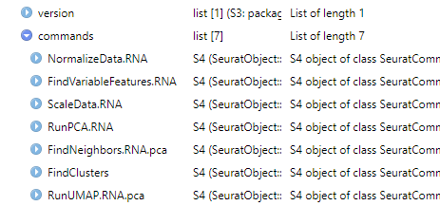
Seurat S4 Class Object Stores Pipeline Intermediate Outputs
1
Importation
CreateSeuratObject()
2
Metadata Curation
1
PercentageFeatureSet()
3
Filtering
2
subset()
1
7
4
8
4
Normalization
NormalizeData()
5
FindVariableFeatures()
3
5
Scaling
7
ScaleData()
7
Linear Dimensional
Reduction
7
6
6
8
RunPCA(), ElbowPlot()
4
7
Clustering
4
FindNeighbors(), FindClusters()
5
5
6
Nonlinear Dimension Reduction
7
8
7
8
RunUMAP(), DimPlot()
Notes:
https://www.dreamstime.com/stock-illustration-dna-vector-illustration-human-structure-image49975743

Slide 5

Count Matrix Importation
Importation
An initial minimal filtering can be used on importation
CreateSeuratObject()
Metadata Curation
PercentageFeatureSet()
Filtering
subset()
Cell 1
Cell 2
Cell 3
Cell 4
Cell 5
Cell 6
COUNT
COUNT
COUNT
COUNT
COUNT
COUNT
Normalization
NormalizeData()
FindVariableFeatures()
GENE
GENE
GENE
GENE
GENE
GENE
Scaling
ScaleData()
…
…
…
…
…
…
Linear Dimensional
Reduction
RunPCA(), ElbowPlot()
Cell 1
Cell 2
Cell 3
Cell 4
Clustering
COUNT
COUNT
COUNT
COUNT
FindNeighbors(), FindClusters()
Nonlinear Dimension Reduction
GENE
GENE
GENE
GENE
…
…
…
…
RunUMAP(), DimPlot()
Notes:
https://www.dreamstime.com/stock-illustration-dna-vector-illustration-human-structure-image49975743

Slide 6
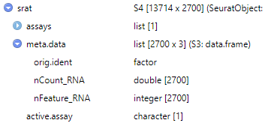
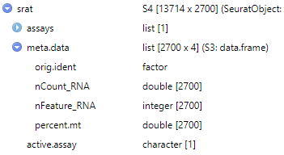
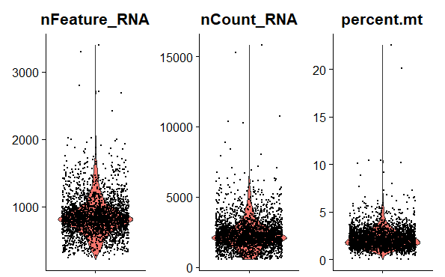
Count Matrix Importation
Importation
CreateSeuratObject()
Typical QC: calculate for fraction of mitochondrial genes
Metadata Curation
PercentageFeatureSet()
Filtering
subset()
Normalization
NormalizeData()
Accessors
FindVariableFeatures()
srat@meta.data$percent.mt
srat[["percent.mt"]]
Scaling
ScaleData()
Some public datasets already perform QC based on MT genes, and all MT genes are removed.
Genes may be labeled at “MT…” or “mt…”, first inspect and confirm what the prefix is.
Linear Dimensional
Reduction
Visualize QC Metrics
RunPCA(), ElbowPlot()
Clustering
FindNeighbors(), FindClusters()
nFeature_RNA: total read count in each cell.
nCount_RNA: total cell count for each gene.
Percent.mt: fraction of mitochondrial gene.
Nonlinear Dimension Reduction
RunUMAP(), DimPlot()
Notes:
https://www.dreamstime.com/stock-illustration-dna-vector-illustration-human-structure-image49975743

Slide 7
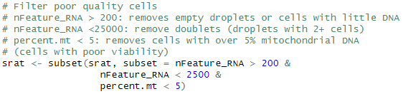
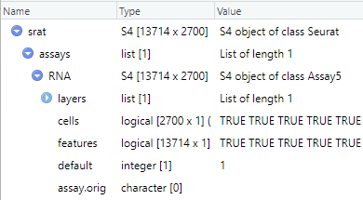
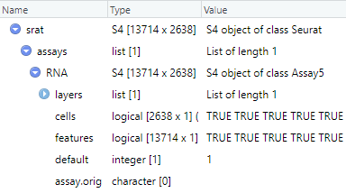
Count Matrix Importation
Importation
CreateSeuratObject()
Remove poor quality cells with the subset() command.
Uses any metadata in Seurat object.
Metadata Curation
PercentageFeatureSet()
Filtering
subset()
Normalization
NormalizeData()
FindVariableFeatures()
Scaling
ScaleData()
Linear Dimensional
Reduction
Plots showing example of normalization
RunPCA(), ElbowPlot()
Clustering
Accessors
FindNeighbors(), FindClusters()
srat[["RNA"]]@cells
srat@assays$RNA@cells
Nonlinear Dimension Reduction
RunUMAP(), DimPlot()
Notes:
https://www.dreamstime.com/stock-illustration-dna-vector-illustration-human-structure-image49975743

Slide 8
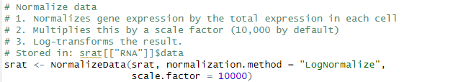
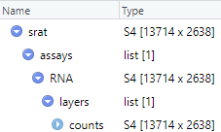
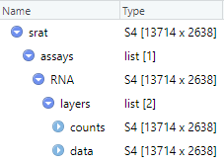

Count Data Normalization
Importation
An initial minimal filtering can be used on importation
CreateSeuratObject()
1) Higher raw count values could be from cells with larger library size (total reads from that cell).
2,3) Convention to scale values a useful scale (similar to conventions found in bulk RNA seq).
Metadata Curation
PercentageFeatureSet()
Filtering
subset()
Normalization
NormalizeData()
FindVariableFeatures()
Scaling
ScaleData()
Linear Dimensional
Reduction
Plots showing example of normalization
RunPCA(), ElbowPlot()
Clustering
FindNeighbors(), FindClusters()
Nonlinear Dimension Reduction
Accessors
RunUMAP(), DimPlot()
srat[["RNA"]]$data
srat@assays$RNA@data
Notes:
https://www.dreamstime.com/stock-illustration-dna-vector-illustration-human-structure-image49975743

Slide 9
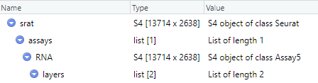
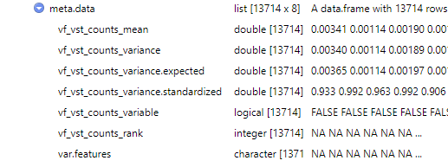
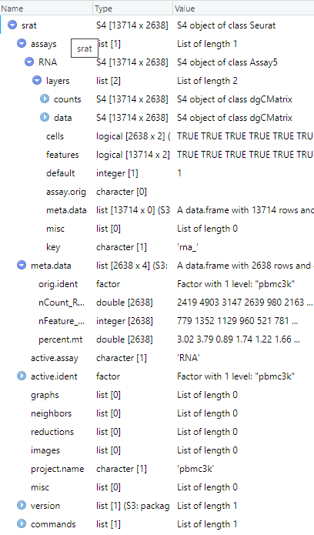

Count Data Normalization: Variable Features
Importation
CreateSeuratObject()
Identify genes with high variation (used for improved clustering)
Metadata Curation
PercentageFeatureSet()
Filtering
Highly variably expressed genes are used as input points for dimension reduction (statically expressed genes only add noise to the transform).
subset()
Normalization
NormalizeData()
Instead of just calculating gene expression variance across cells (variance is a noisy random variable), normalization and modeling
FindVariableFeatures()
Scaling
ScaleData()
Linear Dimensional
Reduction
Accessors
srat[["RNA"]]@meta.data$var.features
srat@assays$RNA@meta.data$var.features
RunPCA(), ElbowPlot()
Clustering
FindNeighbors(), FindClusters()
Nonlinear Dimension Reduction
RunUMAP(), DimPlot()
Notes:
https://www.dreamstime.com/stock-illustration-dna-vector-illustration-human-structure-image49975743

Slide 10

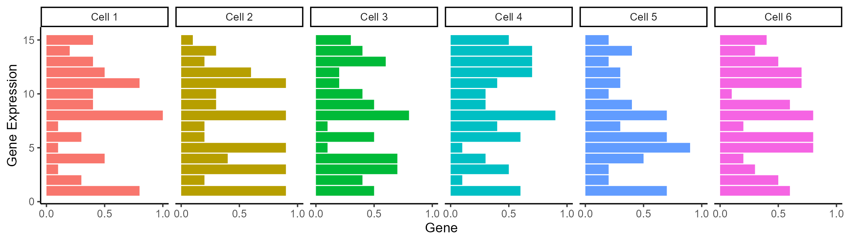
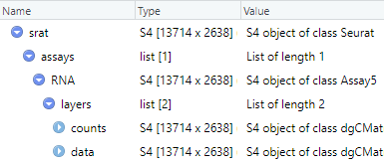
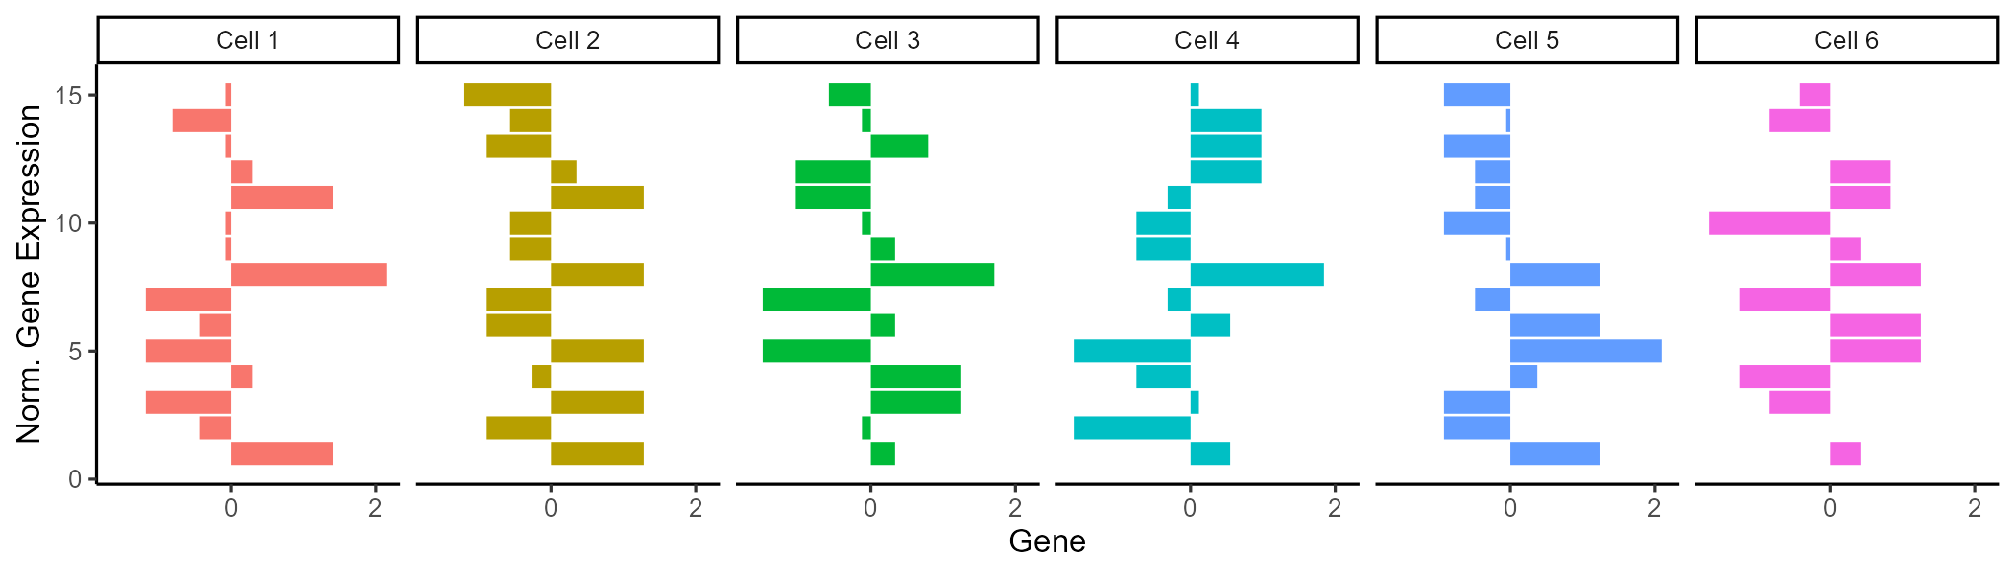
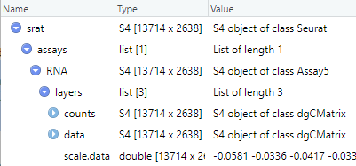
Count Matrix Importation
Importation
Gene expression is scaled (row wise z-scored) to compare across genes
CreateSeuratObject()
Z-score = (x-mean(x))/std(x)
Metadata Curation
# of SD from mean
PercentageFeatureSet()
Centers gene expression by subtracting the average expression for that gene.
Scales expression for each gene by dividing the centered gene expression by their standard deviations.
Filtering
subset()
Normalization
NormalizeData()
FindVariableFeatures()
Scaling
ScaleData()
Linear Dimensional
Reduction
RunPCA(), ElbowPlot()
Clustering
FindNeighbors(), FindClusters()
Nonlinear Dimension Reduction
RunUMAP(), DimPlot()
Notes:
https://www.dreamstime.com/stock-illustration-dna-vector-illustration-human-structure-image49975743

Slide 11
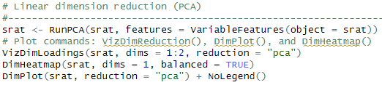
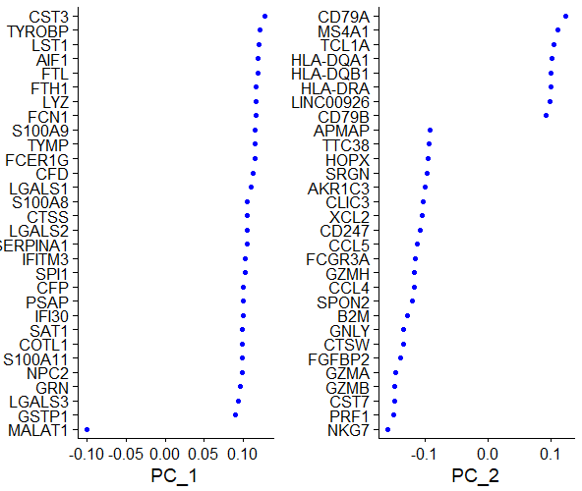
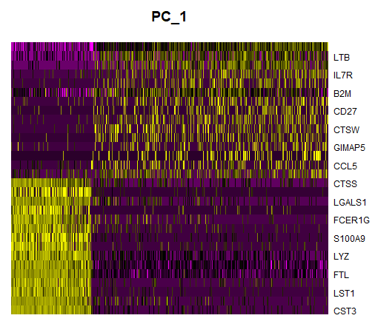
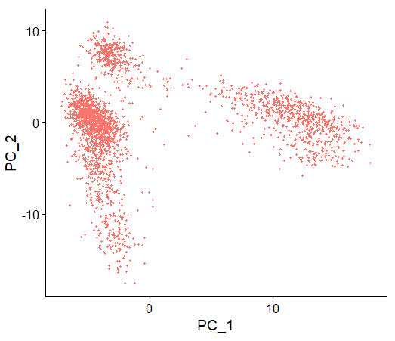

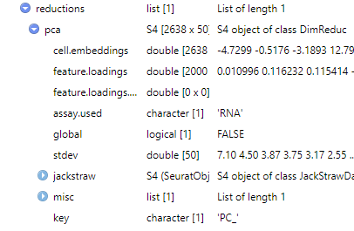
Count Matrix Importation
Importation
CreateSeuratObject()
Metadata Curation
PercentageFeatureSet()
Filtering
subset()
Normalization
NormalizeData()
FindVariableFeatures()
Scaling
ScaleData()
Linear Dimensional
Reduction
RunPCA(), ElbowPlot()
Clustering
1. PCA linearly transforms data onto a new coordinate system such that the principal components (linear combination features) maximizes the variation in the data.
2. Can be used as “anchor points” for nonlinear dimensionality reduction, examine sources of heterogeneity.
FindNeighbors(), FindClusters()
Nonlinear Dimension Reduction
RunUMAP(), DimPlot()
Notes:
https://www.dreamstime.com/stock-illustration-dna-vector-illustration-human-structure-image49975743

Slide 12

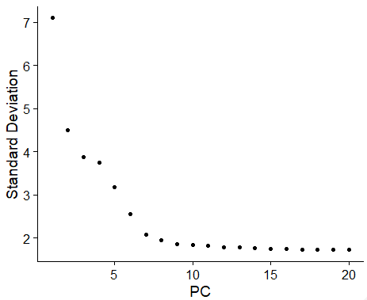
Linear Dimension Reduction
Importation
Select the range of principal component (PC) dimensions that capture the majority of variance.
CreateSeuratObject()
Metadata Curation
PercentageFeatureSet()
For the nonlinear clustering (next steps), we wish to discard as many PCs as possible while still capturing the
variability in the data.
Filtering
subset()
Normalization
NormalizeData()
Elbow plots display variation captured by each PC, choose a point of diminishing returns for the threshold (dimensions 8-15 would be reasonable for this plot).
FindVariableFeatures()
Scaling
ScaleData()
Linear Dimensional
Reduction
RunPCA(), ElbowPlot()
Too few PCs: key biological variability in the dataset is discarded.
Too many PCs: biological variation is masked by other sources of variation (signal to noise decreases from other sources of variation).
Clustering
Nonlinear Dimension Reduction
RunUMAP(), DimPlot()
Notes:
https://www.dreamstime.com/stock-illustration-dna-vector-illustration-human-structure-image49975743

Slide 13
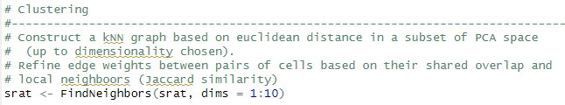
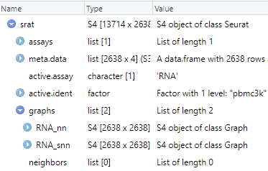
Identifying Neighboring Cells
Importation
CreateSeuratObject()
Before clustering the data, we need to identify the nearest neighbors and score their
similarity in gene expression.
Metadata Curation
PercentageFeatureSet()
Filtering
subset()
Normalization
NormalizeData()
FindVariableFeatures()
Scaling
ScaleData()
Linear Dimensional
Reduction
RunPCA(), ElbowPlot()
Two-tiered graph analysis:
kNN: k nearest neighbor graph
sNN: shared nearest neighbor graph (secondary graph based on kNN, performs better than kNN in high dimesionality)
Clustering
FindNeighbors(), FindClusters()
Nonlinear Dimension Reduction
RunUMAP(), DimPlot()
Notes:
https://www.dreamstime.com/stock-illustration-dna-vector-illustration-human-structure-image49975743

Slide 14
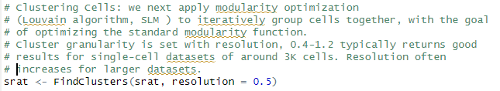
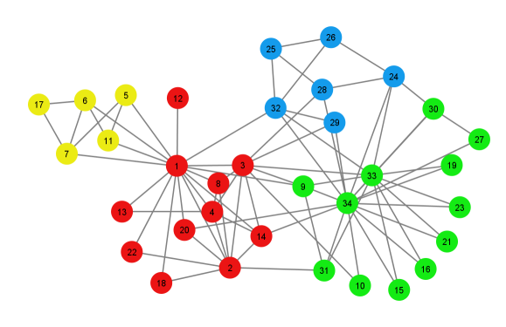
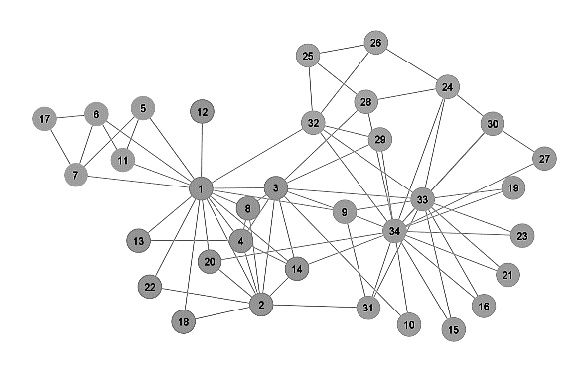
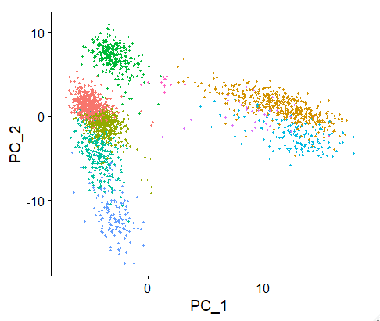
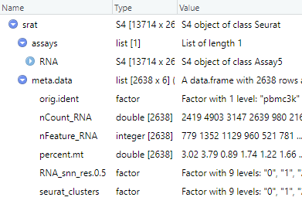
Use Neighbor Graphs to Identify Clusters
Importation
Use kNN and SNN graphs to identify clusters by optimizing a modularity function
CreateSeuratObject()
Metadata Curation
PercentageFeatureSet()
Filtering
subset()
Normalization
Modularity
Function
NormalizeData()
FindVariableFeatures()
Scaling
ScaleData()
Linear Dimensional
Reduction
RunPCA(), ElbowPlot()
Clustering
FindNeighbors(), FindClusters()
Nonlinear Dimension Reduction
RunUMAP(), DimPlot()
Notes:
https://www.dreamstime.com/stock-illustration-dna-vector-illustration-human-structure-image49975743

Slide 15

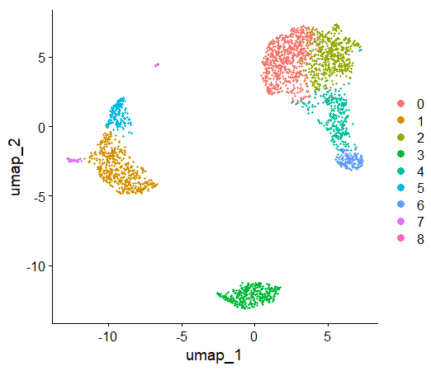
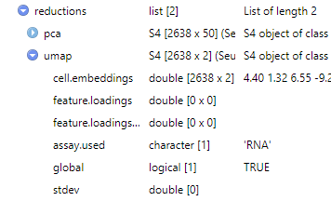
Nonlinear Dimension Reduction
Importation
CreateSeuratObject()
Perform and visualize nonlinear dimension reduction of cluster with the Uniform Manifold Approximation and Projection (UMAP)
Metadata Curation
PercentageFeatureSet()
Filtering
subset()
Normalization
NormalizeData()
FindVariableFeatures()
Scaling
ScaleData()
Linear Dimensional
Reduction
RunPCA(), ElbowPlot()
Clustering
FindNeighbors(), FindClusters()
Nonlinear Dimension Reduction
RunUMAP(), DimPlot()
Notes:
https://www.dreamstime.com/stock-illustration-dna-vector-illustration-human-structure-image49975743

Slide 16
UMAP versus t-SNE
notably increased speed and better preservation of the data's global structure

Slide 18
Seurat Adjustable Parameters
Find Variable
Genes
Count Matrix
Seurat Import
Normalize Data
Min features
Min cells
Max % mito. genes
Normalization method
Scale factor
Selection method
Loess span width
Number of bins
Binning method
Number of Features
Scale Data
Find Neighbors
Find Clusters
Output
Variables to regress
Scale max
Dimension reduction
K-neighbors
Prunning for SNN
Resolution (UMAP)
______. (t-SNE)
Appropriated from:
Schneider, J Transl Genet Genom 2021;5:37-49.
Notes:
https://www.oaepublish.com/articles/jtgg.2020.48

