Slide 1
Module 7: Summary and Best Practices
NC State scRNA Workshop, 2024

Slide 2
The Pipelines
Cell Trajectory Analysis
Normalization
Single Cell Gene Expression with Seurat
preprocess_cds()
Order Cells
order_cells()
Importation
Integration
align_cds()
Subset Trajectory
CreateSeuratObject()
Curation
Integration
Nonlinear Dimensional
Reduction
choose_graph_
segments()
PercentageFeatureSet()
IntegrateLayers()
Filtering
Reprocess Trajectory
subset()
Clustering
reduce_dimension()
FindNeighbors(),FindClusters()
Normalization
NormalizeData()
FindVariableFeatures()
Clustering &
Partitioning
Find Altered Genes
Scaling
Nonlinear Dimension Reduction
find_gene_modules()
ScaleData()
cluster_cells ()
RunUMAP(), DimPlot()
Aggregate to Gene Modules
Linear Dimensional
Reduction
Cell Type Annotation
aggregate_gene_
expression()
RunPCA(), ElbowPlot()
Trajectory Graph
Visualize Gene Modules
learn_graph()

Slide 3





Moving data from Seurat to Another Package
Be sure to check these before you convert from the Seurat object to another S4 class:
Does the other package assume that some portion of the Seurat pipeline needs to be completed?
Data Import? Normalization? Linear or Nonlinear Dimension Reduction? Clustering?
Does a certain assay need to be set as default?
DefaultAssay(object = pbmc) <- "RNA“
3. Does a certain layer/ slot need to be set as default?
LayerData(pbmc, assay = "RNA", layer = "counts")
4. Do a certain cell identify need to be set first?
Idents(object = pbmc) <- pbmc $seurat_annotations
Layer | Description
counts | raw counts
data | normalized data
scale.data | z-scored/variance-stabilized data

Slide 4
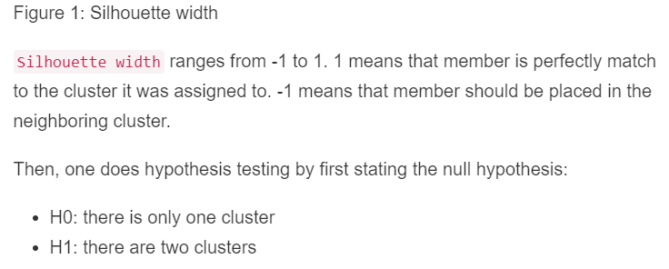
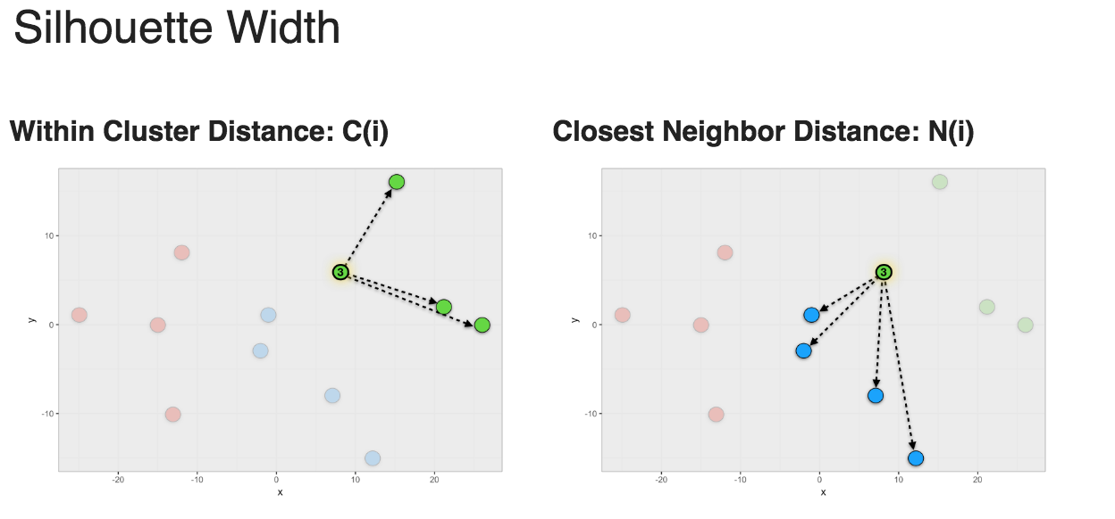
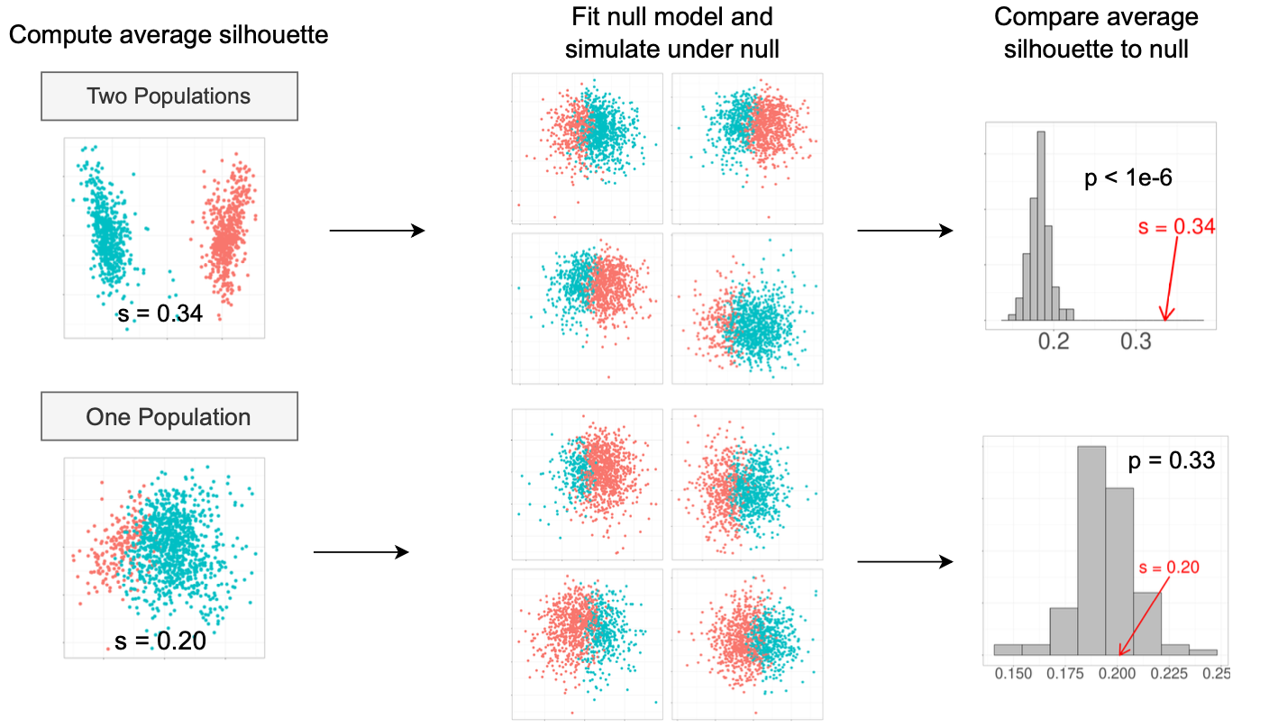
Topics Not Covered: Optimal Cluster Parameters
In Depth: Optimal Cluster Parameters
Semi-automated: do clusters separate the cell types of interest.
Automated: is there evidence that a pair of clusters could be represented by one cluster (a static set of poison distributions).
Grabski IN, et al. Nat Methods. 2023 Aug;20(8):1196-1202.
https://divingintogeneticsandgenomics.com/post/scrnaseq-clustering-significant-test-an-unsolvable-problem/

Slide 5
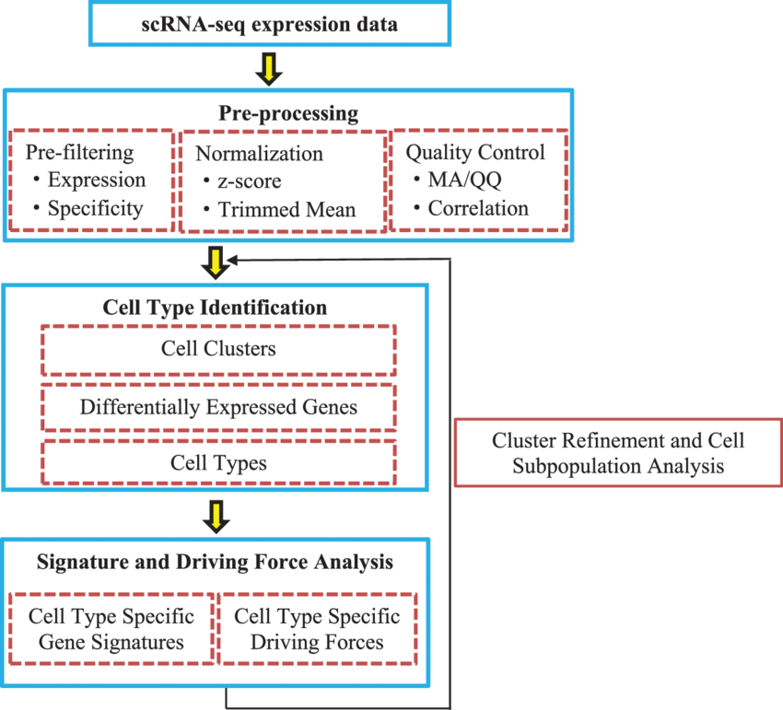
Topics Not Covered: High Fidelity Cell Annotation
Markers from Alternative Measurement Techniques
Literature Consensus of Cell Type Markers
Empirical Confirmation
Peng L. RNA Biol. 2020 Jun;17(6):765-783.

Slide 6
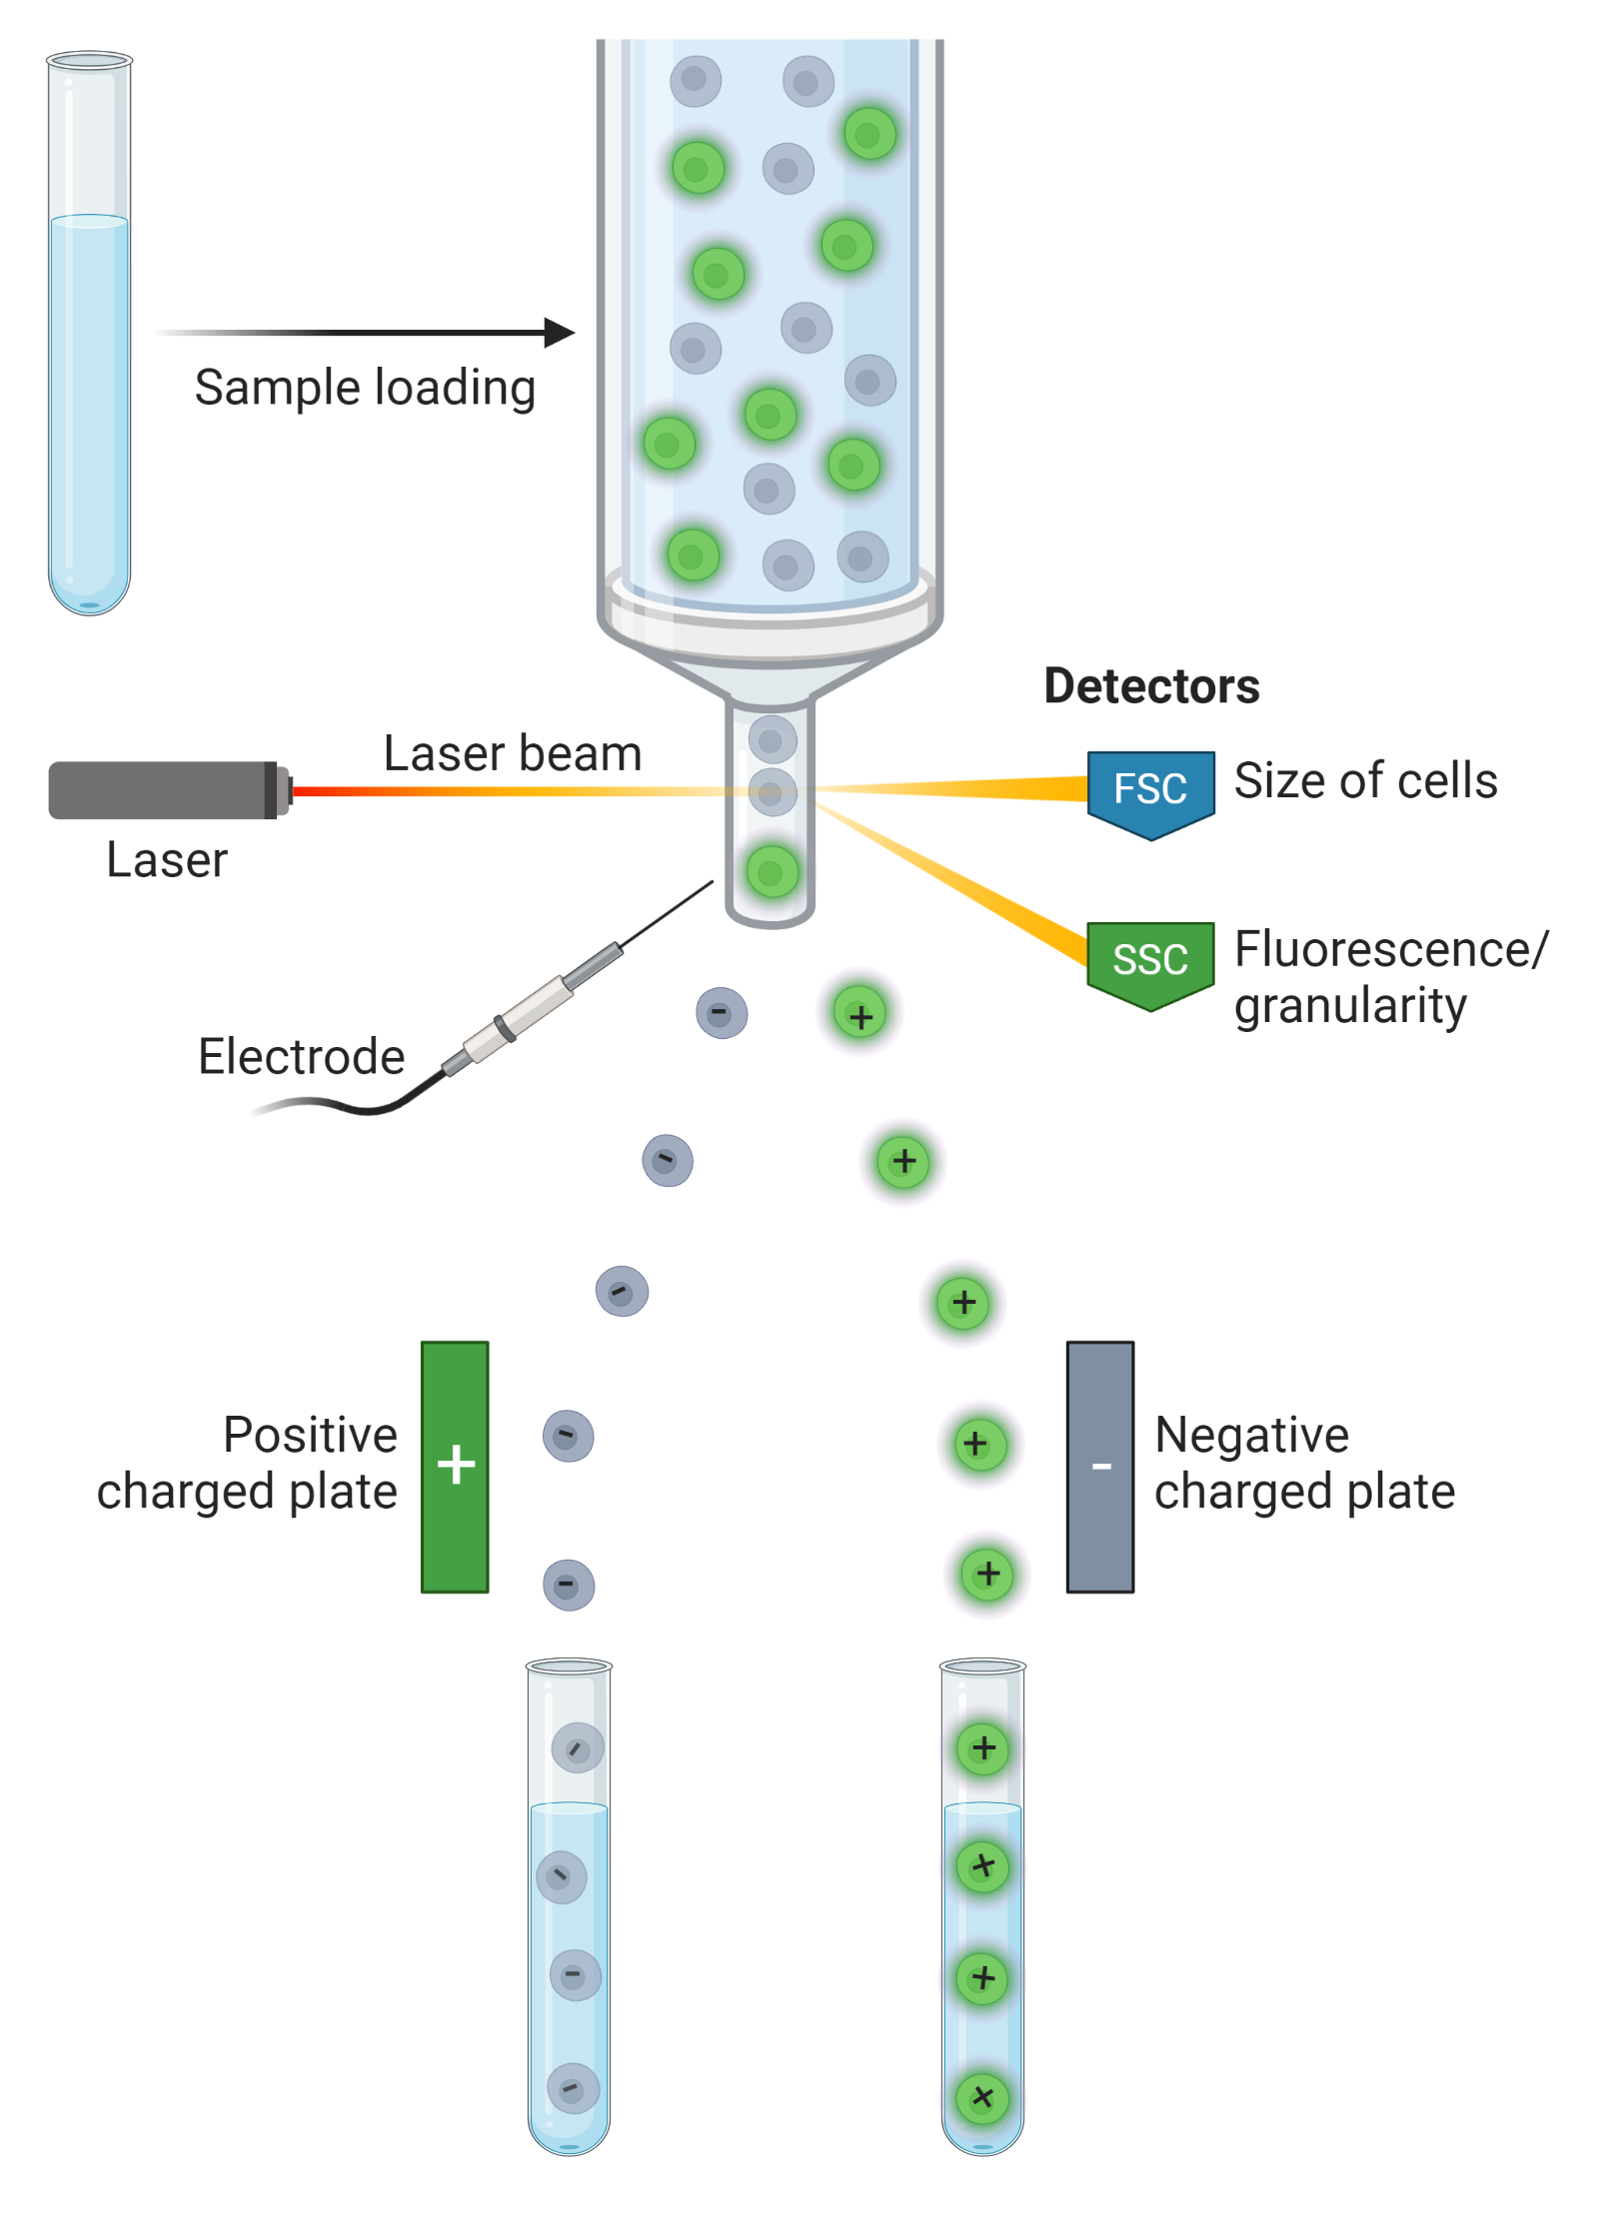
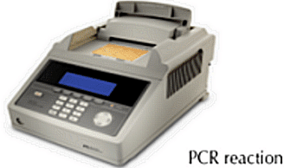
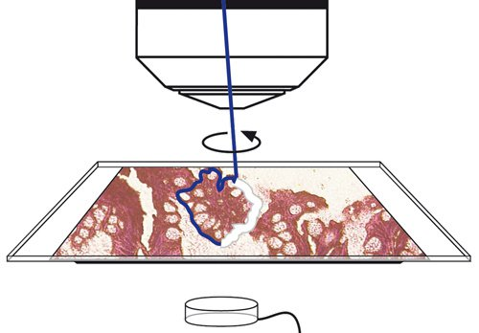
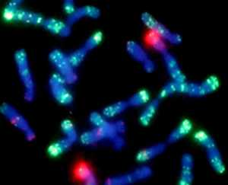
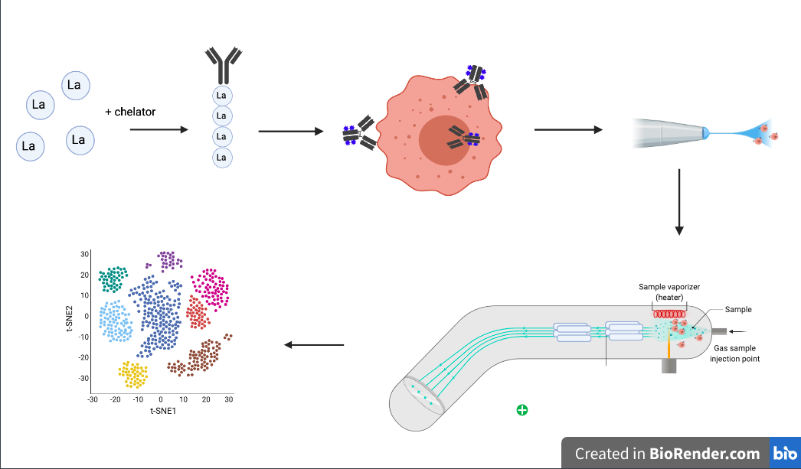
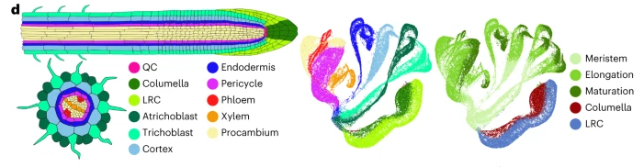
Confirming Cell Types and Clustering
Polymerase Chain Reaction (PCR)
Fluorescent Activated Cell Sorting
Laser-capture microdissection
Florescent In Situ Hybridization (FISH)
https://www.leica-microsystems.com/products/light-microscopes/laser-capture-microdissection/
Cytometry by time of flight (CyTOF)
https://www.sinobiological.com/category/fcm-facs-facs
https://molcyt.org/2013/12/19/insitu/
PHYTOMap (FISH for plants)
Nobori, T. Nat. Plants. (2023).
https://en.wikipedia.org/wiki/CyTOF

Slide 7
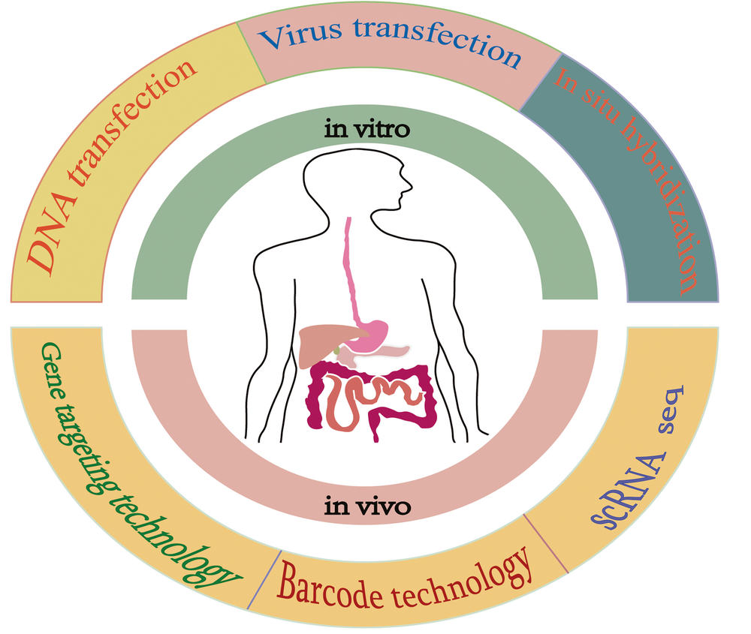
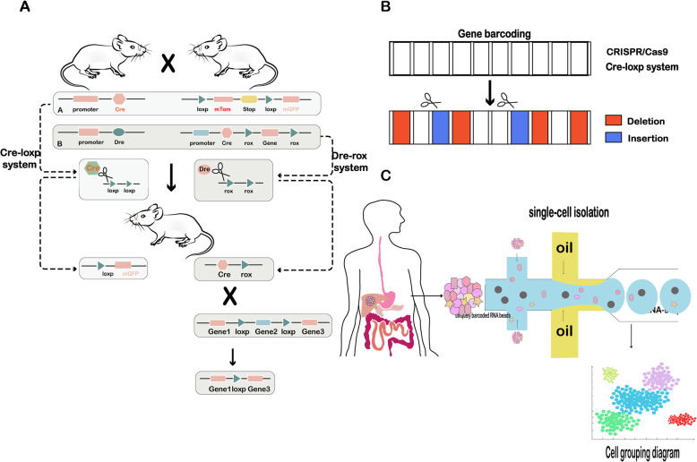
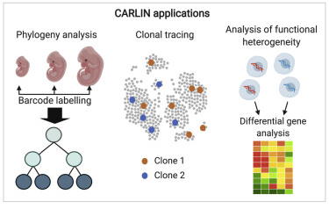
Confirmation of Inferred Cell Trajectory
CRISPR–Cas9
Zhang, Y et al. Stem Cell Res Ther. (2020)
Bowling. Cell (2020) 181(6).

Slide 8

Advantages and Disadvantages
Zhang, Y et al. Stem Cell Res Ther. (2020)

Slide 9


Code Availability and Readability
A Plea for Open Science
Please post you code to a software repository (GitHub or bitbucket, etc.) so that other researchers can make use of your contribution.
Please take the extra 10% time to document your code with code comments and other information so that your shared code is not useless to other people.
Other researchers should be able to reproduce all the figures in your study by simply running your source code files.
Consider how many person-hours science has wasted on researchers futilely trying to reproduce a previous publication’s result or process a new dataset with a previously developed pipeline.
FAIR Data
Findable
Accessible
Interoperable
Reusable
https://www.nature.com/articles/s41559-020-1109-6

Slide 10
The Challenge of Reproducibility
Part of the challenge of making

Slide 11
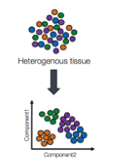
Learning Objectives
Overarching Purpose: to discuss the basics of processing and interpreting scRNA-Seq Data. Participants will learn new analysis techniques through technical summaries and gain an understanding of the workflow from this workshop.
Understand the basic process of how single cell RNA-seq is analyzed.
Familiarity with standard processing pipeline with Seurat.
Intuitive understanding of the need and concept for each part of the pipeline.
Perform basic DGE and cell type labelling.
Use Monocle to perform cell trajectory and cell fate analysis.
What does this workshop not cover?
How to experimentally confirm your single cell results following the standard of practice for your subfield.
How to generate high fidelity cell type labels (can take months/ years of effort).
A mathematical understanding of the processing pipeline.
How to tailor these standard concepts to your specific research needs.

Slide 12
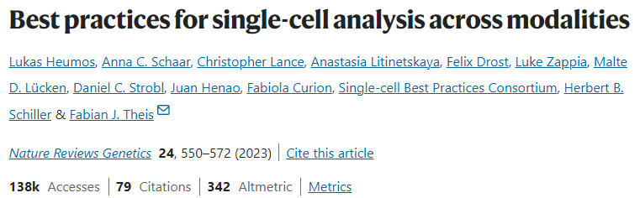
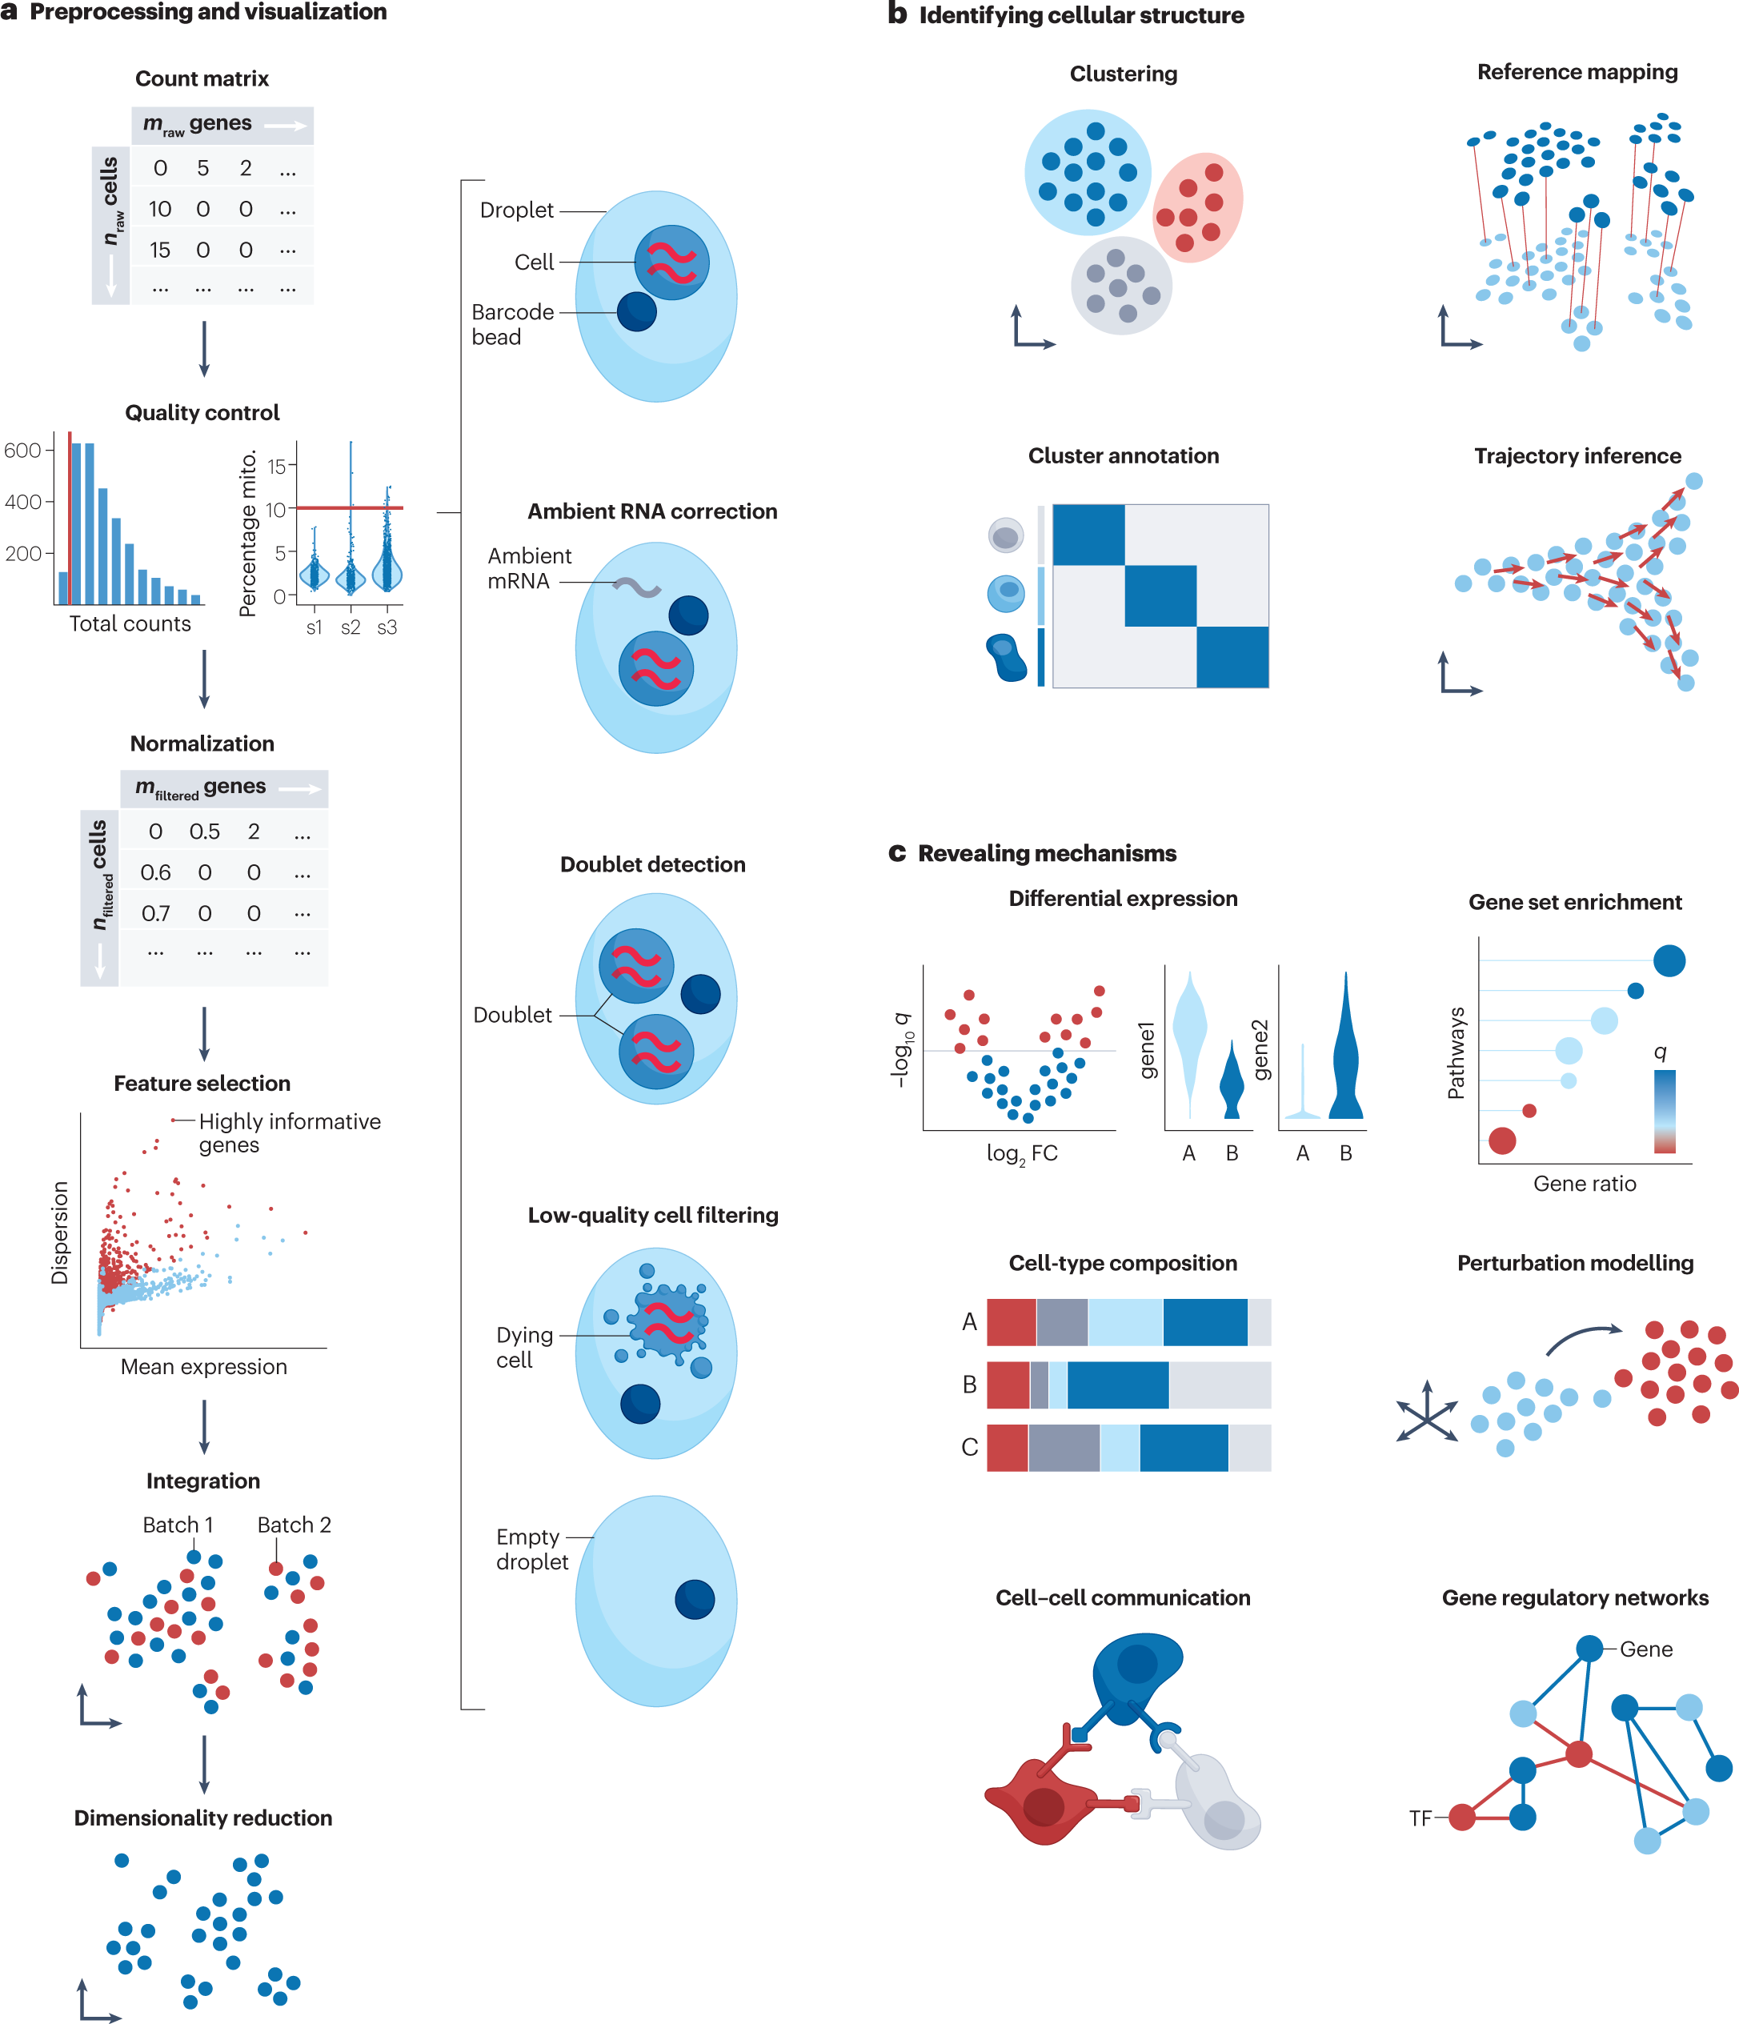
Post Workshop Assignment

