Slide 1
Module 4: Differential Gene Analysis and Exploratory Analysis with Seurat
NCSU scRNA Workshop, 2024
Bruce Corliss, PhD and Allison Dickey, PhD

Slide 2
Conserved Marker Analysis
For a single study group, identify differentially expressed genes for each cluster in pairwise fashion.
For a single study group, identify conserved genes for each cluster in pairwise fashion.
For a single study group, identify conserved genes for each cluster in pairwise fashion.
For a single study group, identify conserved genes for each cluster in pairwise fashion.
Notes:
https://www.dreamstime.com/stock-illustration-dna-vector-illustration-human-structure-image49975743

Slide 3
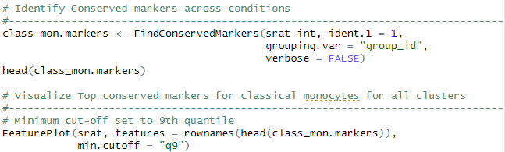
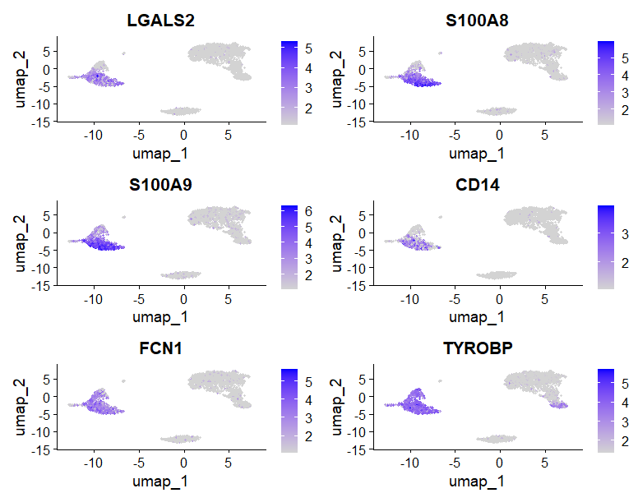
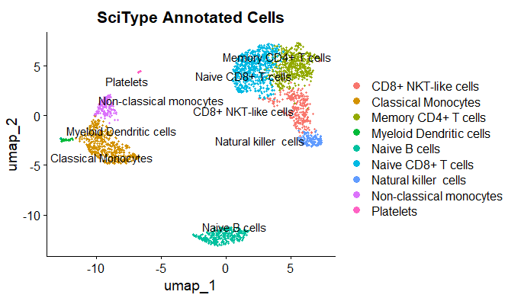
Conserved Marker Analysis
Classical Monocytes
Top Conserved Markers
Notes:
https://www.dreamstime.com/stock-illustration-dna-vector-illustration-human-structure-image49975743

Slide 4

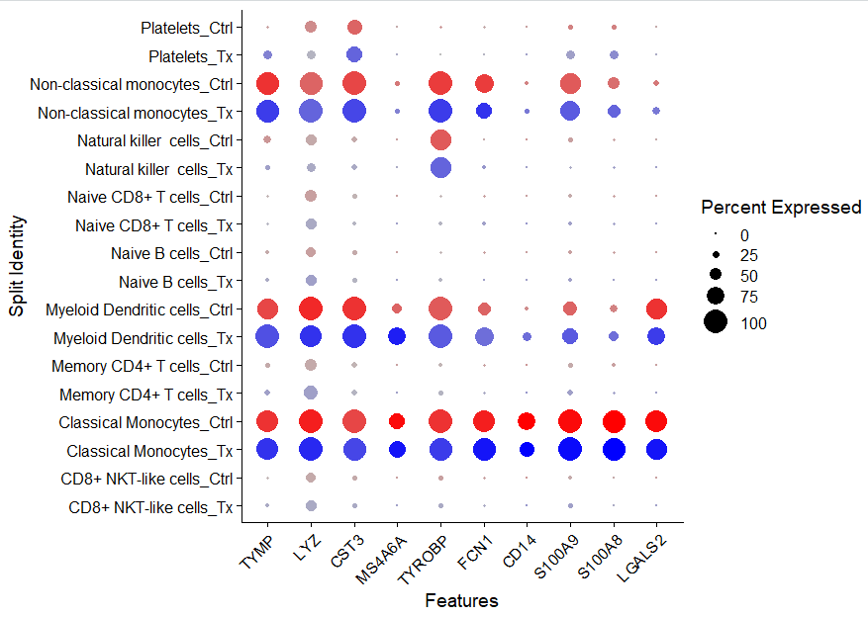
Visualizing Conserved Markers

Slide 5
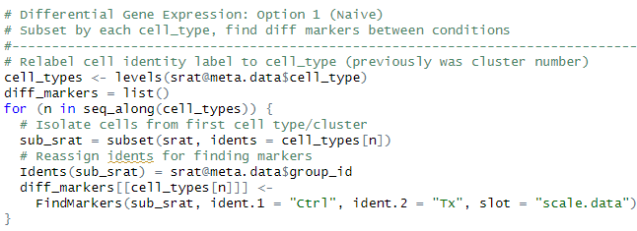
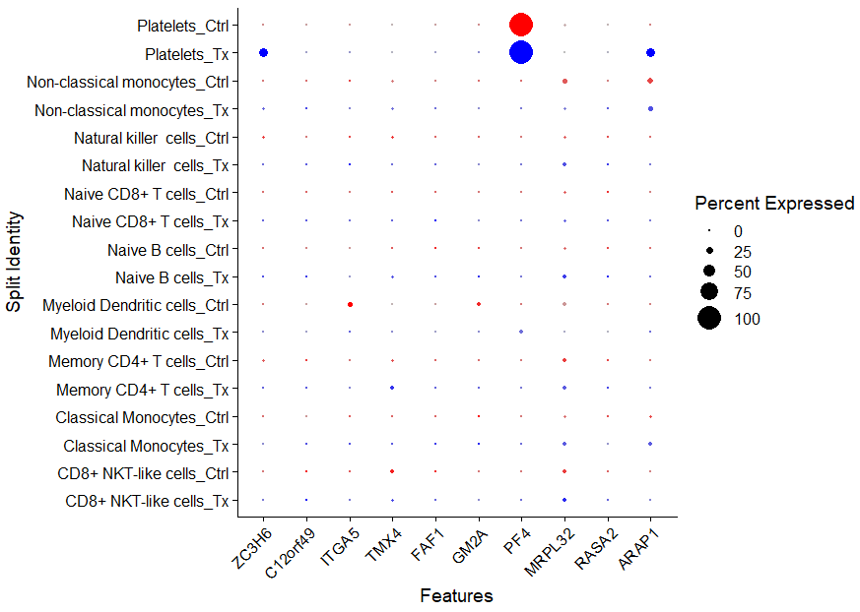
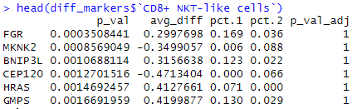
Differential Gene Expression Analysis: Single Sample
Caution: This test treats each cell as an independent replicate and ignores inherent correlations between cells originating from the same sample (false positives).

Slide 6
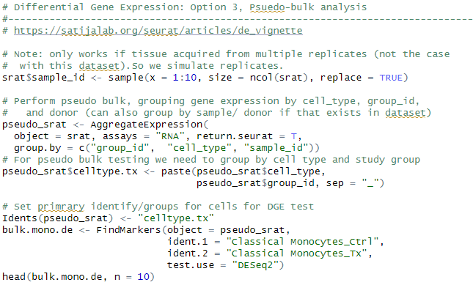
Differential Gene Expression Analysis: Pseudobulk
Pseudobulk: gene expression aggregated per sample and cell type.
independent observations = samples, rather than the individual cells (therefore accounts for within-sample correlation).

Slide 7
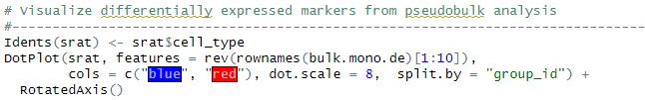
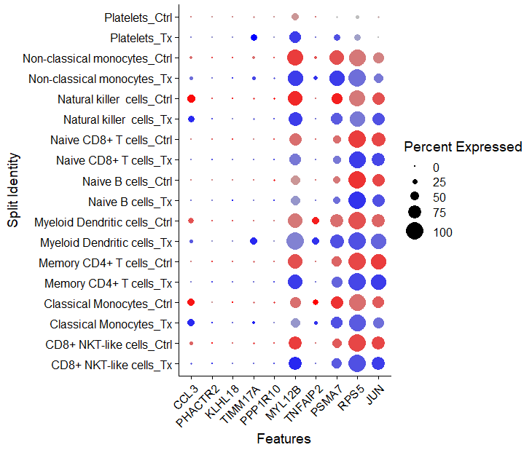
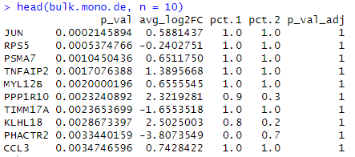
Differential Gene Expression Analysis: Pseudobulk

Slide 8
PCA Loadings

