Slide 1
Module 5: Differential Gene Analysis and Exploratory Analysis with Seurat
NC State scRNA Workshop, 2024

Slide 2
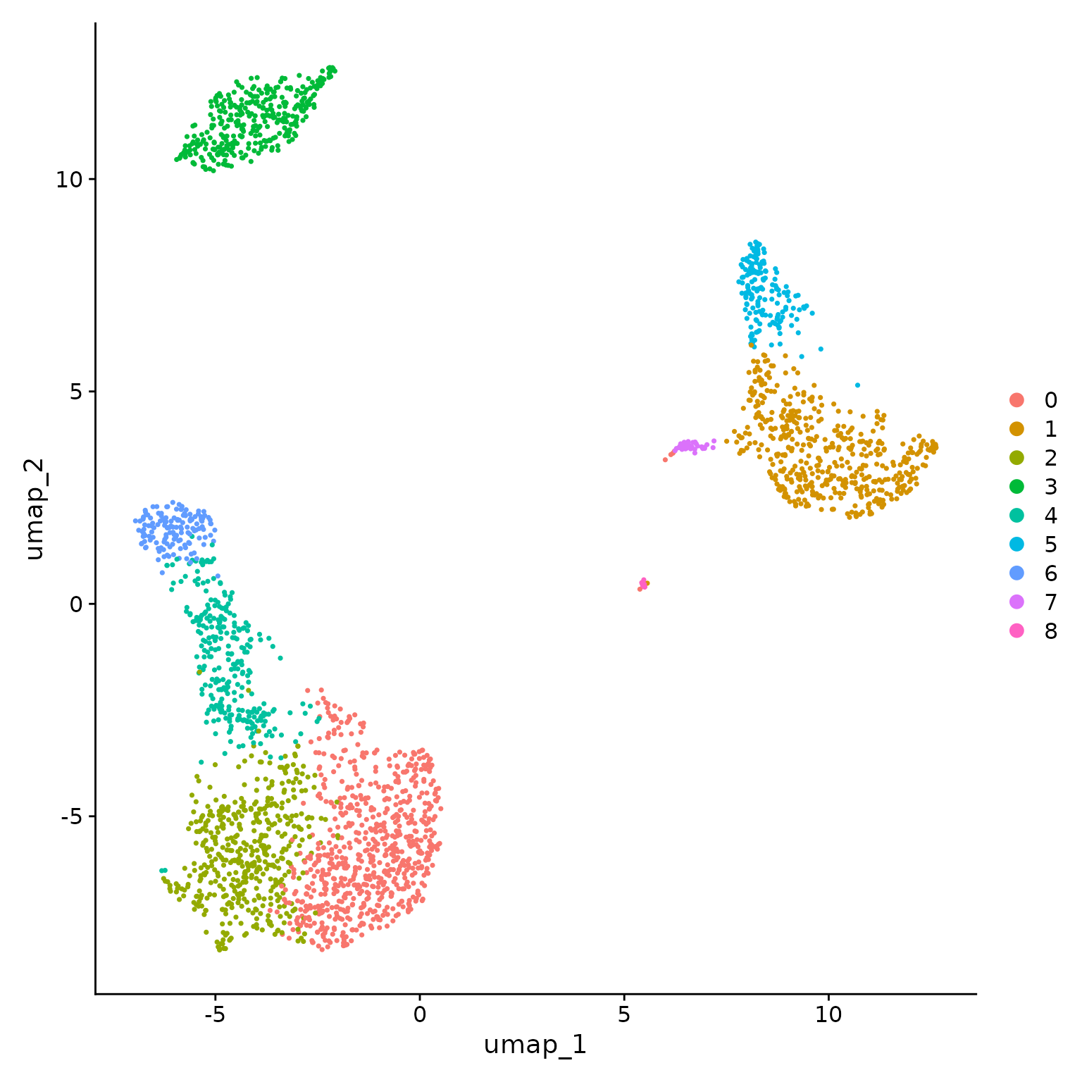
Types of DGE with Single Cell Data
For a single study group, identify differentially expressed genes for each cluster versus all clusters (already covered in previous slides).
Ctrl
Tx
For two study groups, find markers that are conserved between a pair of clusters and differentially expressed versus all other clusters.
For two study groups, identify differentially expressed genes for a pair of clusters.
Ctrl
Tx
For a two study groups (with replicates), identify differentially expressed genes for each cluster in paired fashion.
Notes:
https://www.dreamstime.com/stock-illustration-dna-vector-illustration-human-structure-image49975743

Slide 3

Seurat Functions for DGE
FindMarkers: will find markers between two specified groups (clusters).
FindAllMarkers: will find markers differentially expressed in each identity group by comparing it to all others.
FindConservedMarkers: will find markers that are conserved between two groups. It means they are differentially expressed compared to all other groups but have similar expression between the two groups you're comparing.
Source
https://www.biostars.org/p/409790/

Slide 4
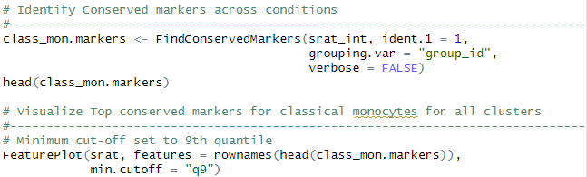
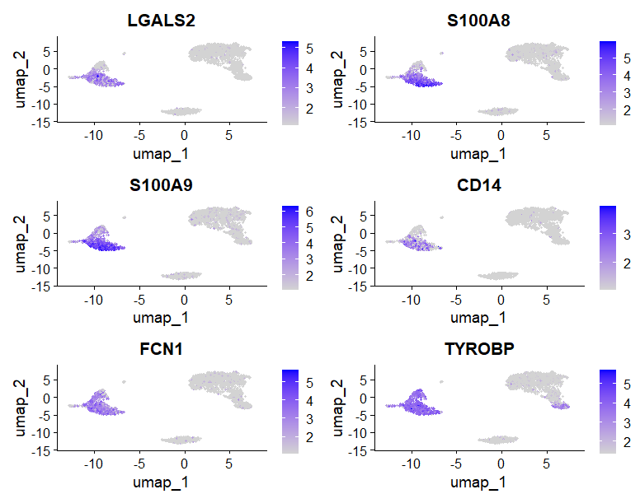
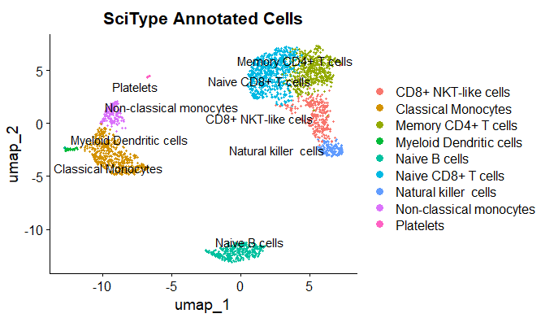
Conserved Marker Analysis
Classical Monocytes
Top Conserved Markers
Notes:
https://www.dreamstime.com/stock-illustration-dna-vector-illustration-human-structure-image49975743

Slide 5

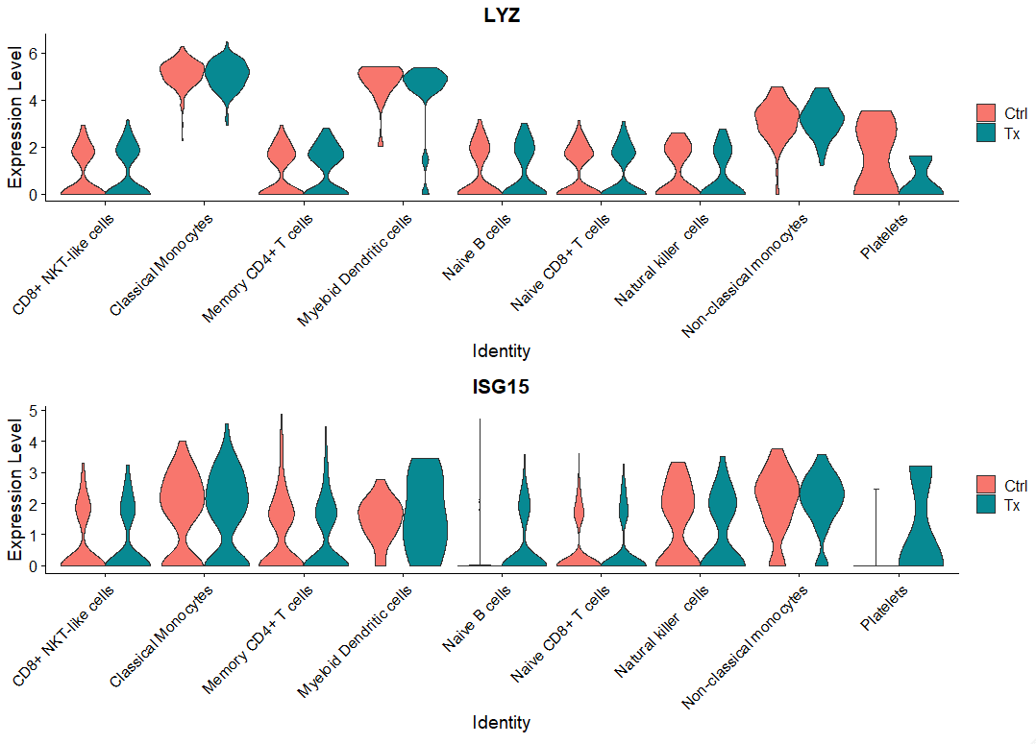
Differential Gene Expression Analysis: Single Study Group
Visualization only,
no analysis.

Slide 6

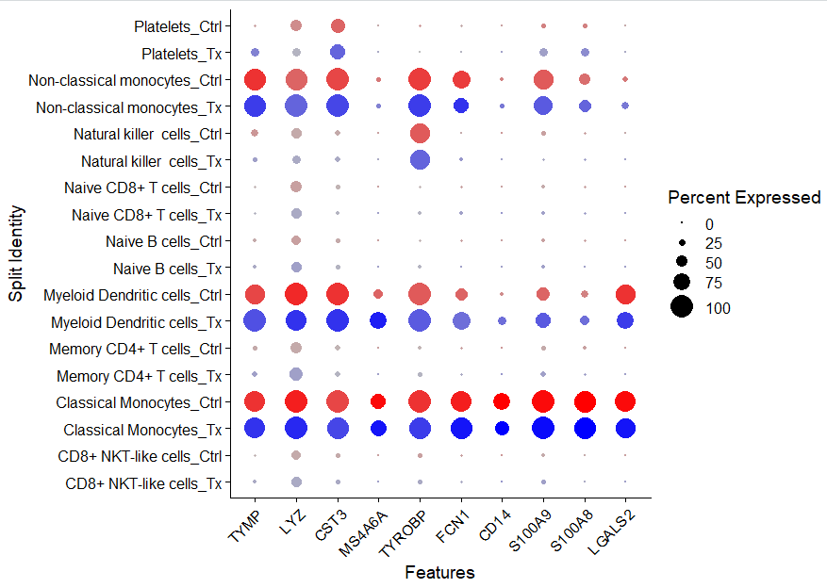
Visualizing Conserved Markers

Slide 7
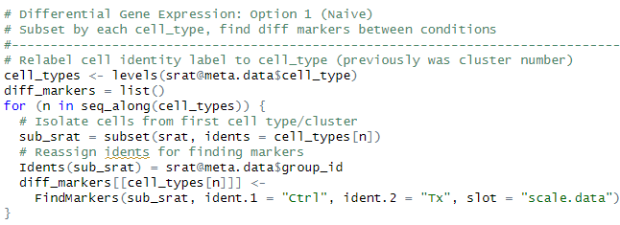
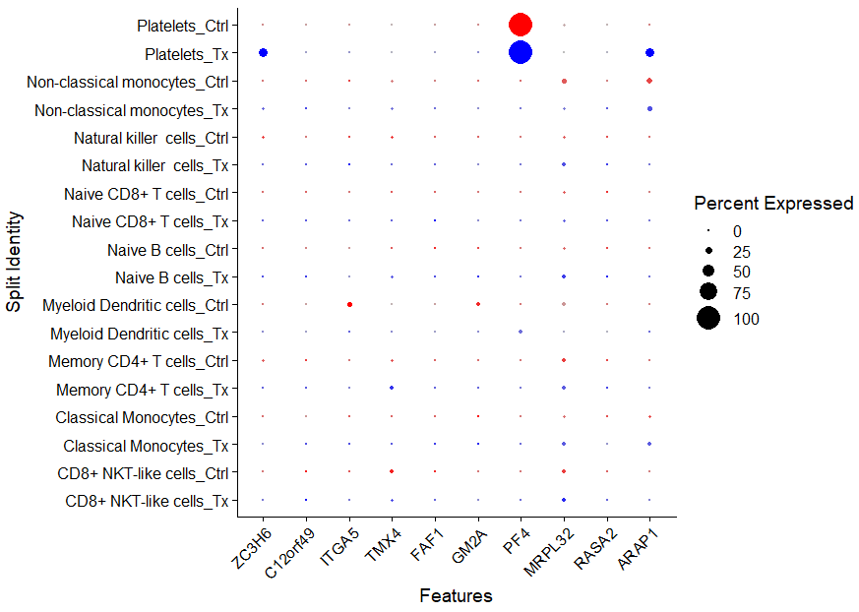
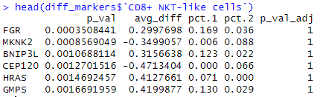

Differential Gene Expression Analysis: Single Study Group
Caution: This test treats each cell as an independent replicate and ignores inherent correlations between cells originating from the same sample (false positives).

Slide 8

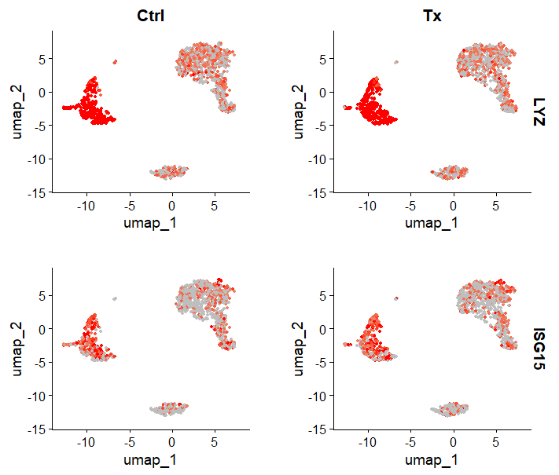
Visualize Specific Gene Expression Across Conditions.
Visualization only,
no analysis.

Slide 9
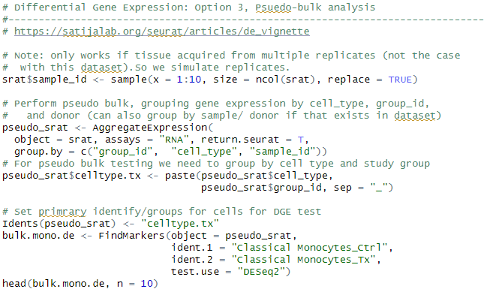
Differential Gene Expression Analysis: Pseudobulk
Pseudobulk: gene expression aggregated per sample and cell type.
independent observations = samples, rather than the individual cells (therefore accounts for within-sample correlation).

Slide 10
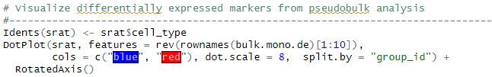
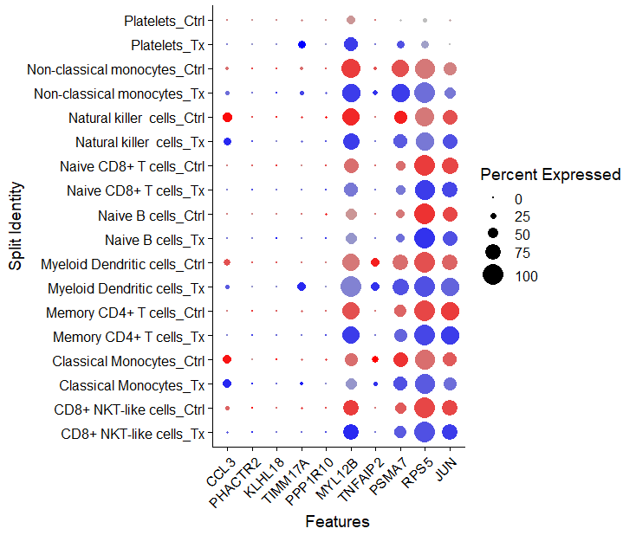
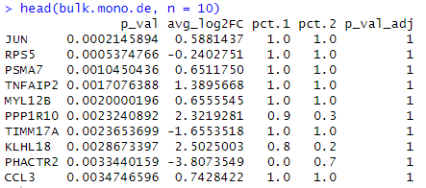
Differential Gene Expression Analysis: Pseudobulk

Slide 11
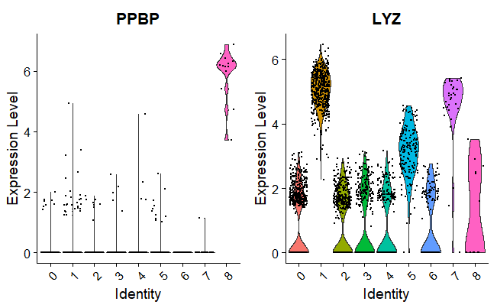
Specific Gene Expression in Each Cluster
Exploratory plot after clustering is performed.
Each datapoint is a cell, each plot is a gene, plots are Cluster X Expression.

Slide 12
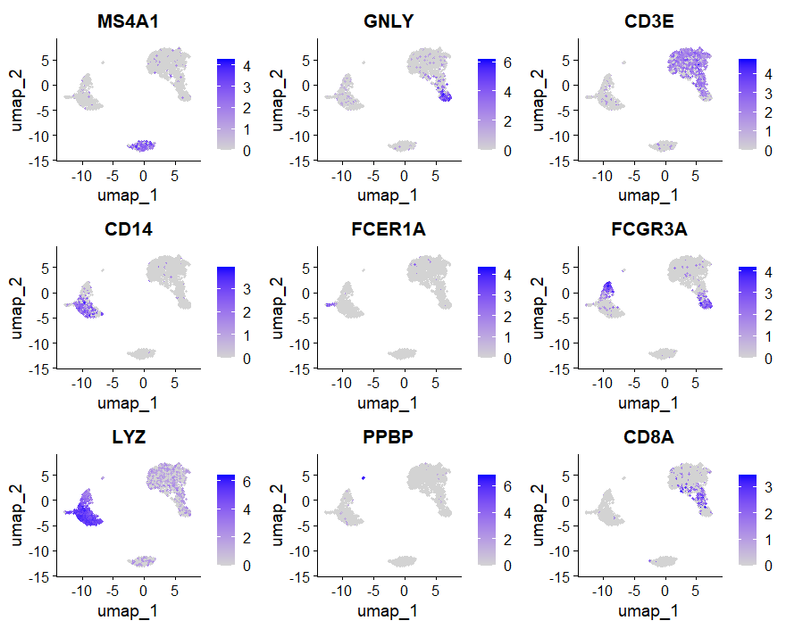
Cell Heatmap of Gene Expression
Exploratory plot after clustering is performed (not just with the conserved marker example earlier).

Slide 13
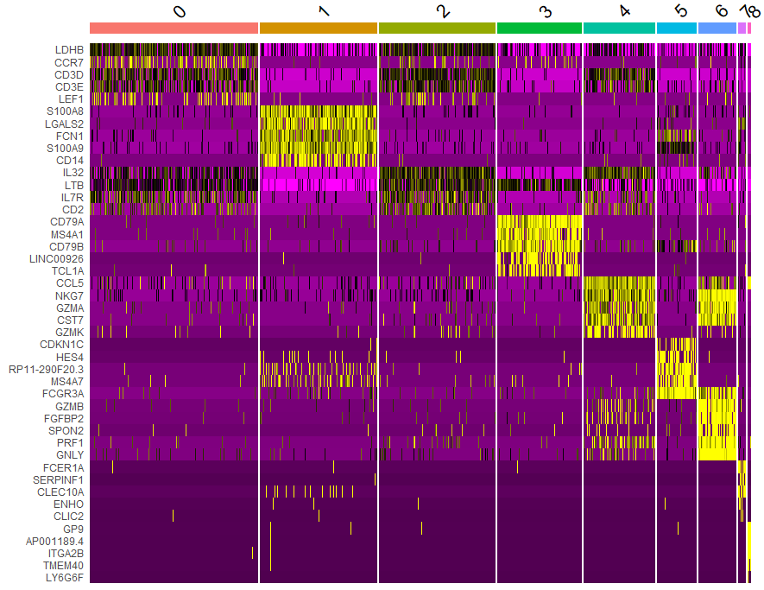
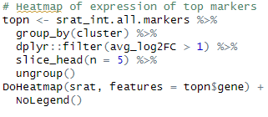
Heatmap of top 20 Genes for Each Cluster

Slide 14




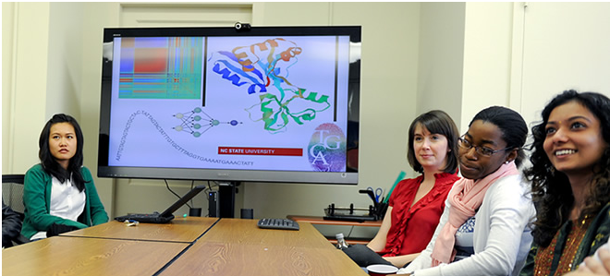
Bridging biological research and data science for the next generation of scientific discoveries.

