Slide 1
Module 3: Processing scRNA-Seq with Seurat
NCSU scRNA Workshop, 2024
Bruce Corliss, PhD and Allison Dickey, PhD

Slide 2
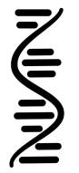
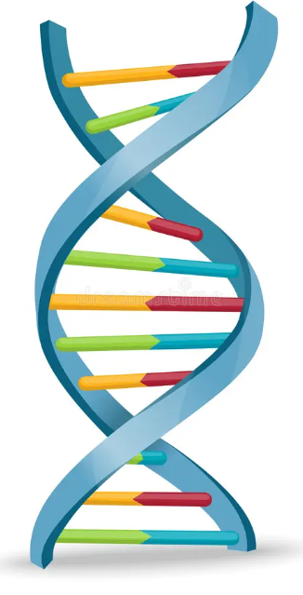
Processing Pipeline Overview
Raw Binary
Sequence
Demultiplexed Reads
Aligned Reads
Filtered feature-
barcode matrices
BCL
FastQ
BAM
SFF
Reference
Genome
VCF
HDF5
GTF
QC
GFF
Seurat
Normalization
and Scaling
Dimensionality
Reduction
Importation
Metadata Curation
Filtering
Marker Identification
Differential Gene
Expression
Biological
Interpretation
Visualization
Clustering
Notes:
https://www.dreamstime.com/stock-illustration-dna-vector-illustration-human-structure-image49975743

Slide 3
Processing Pipeline Overview
Importation
CreateSeuratObject()
Metadata Curation
PercentageFeatureSet()
Filtering
subset()
Normalization
NormalizeData()
FindVariableFeatures()
Scaling
ScaleData()
Dimensionality
Reduction
RunPCA() ElbowPlot()
Clustering
FindClusters() FindNeighbors()
Clustering
RunUMAP(), DimPlot()
Notes:
https://www.dreamstime.com/stock-illustration-dna-vector-illustration-human-structure-image49975743

Slide 4

Count Matrix Importation
Importation
An initial minimal filtering can be used on importation
CreateSeuratObject()
Metadata Curation
PercentageFeatureSet()
Filtering
Cell 1
Cell 2
Cell 3
Cell 4
Cell 5
Cell 6
COUNT
COUNT
COUNT
COUNT
COUNT
COUNT
subset()
Normalization
GENE
GENE
GENE
GENE
GENE
GENE
NormalizeData()
FindVariableFeatures()
Scaling
…
…
…
…
…
…
ScaleData()
Dimensionality
Reduction
Cell 1
Cell 2
Cell 3
Cell 4
RunPCA() ElbowPlot()
COUNT
COUNT
COUNT
COUNT
Clustering
GENE
GENE
GENE
GENE
FindClusters() FindNeighbors()
Clustering
…
…
…
…
RunUMAP(), DimPlot()
Notes:
https://www.dreamstime.com/stock-illustration-dna-vector-illustration-human-structure-image49975743

Slide 5
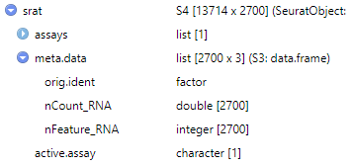
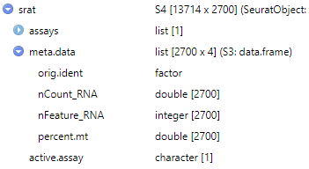
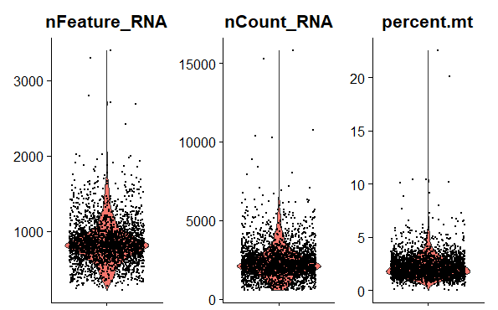
Count Matrix Importation
Importation
Typical QC: calculate for fraction of mitochondrial genes
CreateSeuratObject()
Metadata Curation
PercentageFeatureSet()
Filtering
subset()
Accessors
Normalization
srat@meta.data$percent.mt
srat[["percent.mt"]]
NormalizeData()
FindVariableFeatures()
Some public datasets already perform QC based on MT genes, and all MT genes are removed.
Genes may be labeled at “MT…” or “mt…”, first inspect and confirm what the prefix is.
Scaling
ScaleData()
Dimensionality
Reduction
Visualize QC Metrics
RunPCA() ElbowPlot()
nFeature_RNA: total read count in each cell.
nCount_RNA: total cell count for each gene.
Percent.mt: fraction of mitochondrial gene.
Clustering
FindClusters() FindNeighbors()
Clustering
RunUMAP(), DimPlot()
Notes:
https://www.dreamstime.com/stock-illustration-dna-vector-illustration-human-structure-image49975743

Slide 6
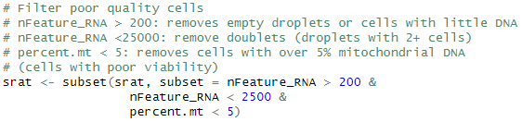
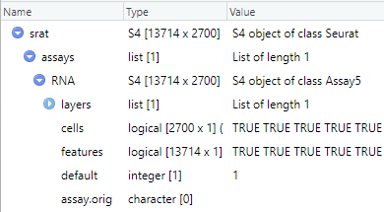
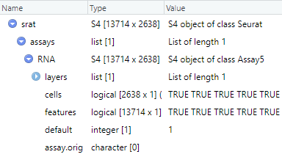
Count Matrix Importation
Importation
CreateSeuratObject()
Remove poor quality cells with the subset() command.
Uses any metadata in Seurat object.
Metadata Curation
PercentageFeatureSet()
Filtering
subset()
Normalization
NormalizeData()
FindVariableFeatures()
Scaling
ScaleData()
Dimensionality
Reduction
RunPCA() ElbowPlot()
Accessors
srat[["RNA"]]@cells
srat@assays$RNA@cells
Clustering
FindClusters() FindNeighbors()
Clustering
RunUMAP(), DimPlot()
Notes:
https://www.dreamstime.com/stock-illustration-dna-vector-illustration-human-structure-image49975743

Slide 7
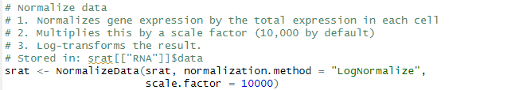
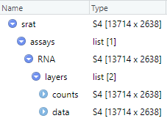
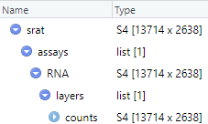

Count Data Normalization
Importation
CreateSeuratObject()
Metadata Curation
An initial minimal filtering can be used on importation
PercentageFeatureSet()
1) Higher raw count values could be from cells with larger library size (total reads from that cell).
2,3) Convention to scale values a useful scale (similar to conventions found in bulk RNA seq).
Filtering
subset()
Normalization
NormalizeData()
FindVariableFeatures()
Scaling
ScaleData()
Dimensionality
Reduction
Accessors
srat[["RNA"]]$data
srat@assays$RNA@data
RunPCA() ElbowPlot()
Clustering
FindClusters() FindNeighbors()
Clustering
RunUMAP(), DimPlot()
Notes:
https://www.dreamstime.com/stock-illustration-dna-vector-illustration-human-structure-image49975743

Slide 8
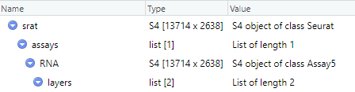
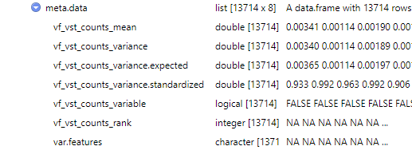
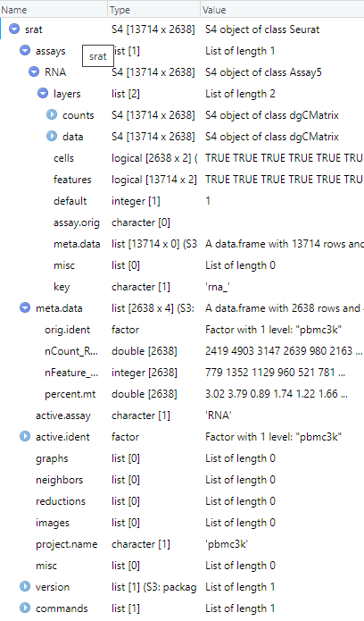

Count Data Normalization: Variable Features
Importation
CreateSeuratObject()
Identify genes with high variation (used for improved clustering)
Metadata Curation
PercentageFeatureSet()
Highly variably expressed genes are used as input points for dimension reduction (statically expressed genes only add noise to the transform).
Filtering
subset()
Normalization
Instead of just calculating gene expression variance across cells (variance is a noisy random variable), normalization and modeling
NormalizeData()
FindVariableFeatures()
Scaling
ScaleData()
Accessors
srat[["RNA"]]@meta.data$var.features
srat@assays$RNA@meta.data$var.features
Dimensionality
Reduction
RunPCA() ElbowPlot()
Clustering
FindClusters() FindNeighbors()
Clustering
RunUMAP(), DimPlot()
Notes:
https://www.dreamstime.com/stock-illustration-dna-vector-illustration-human-structure-image49975743

Slide 9

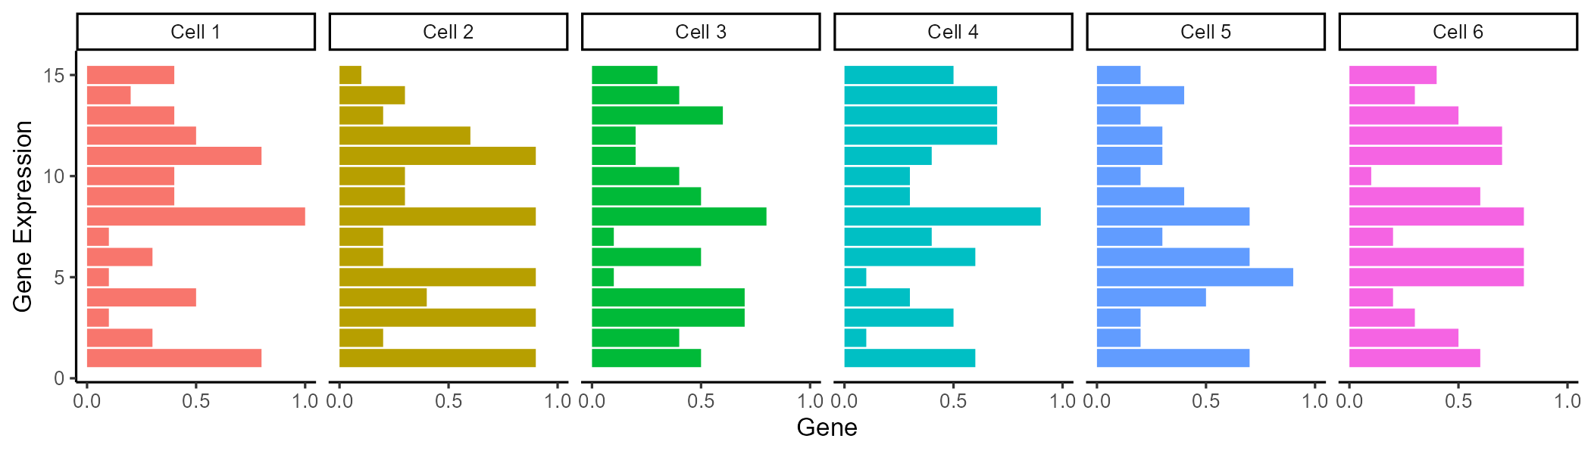
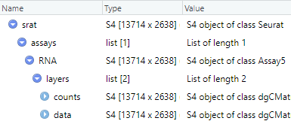
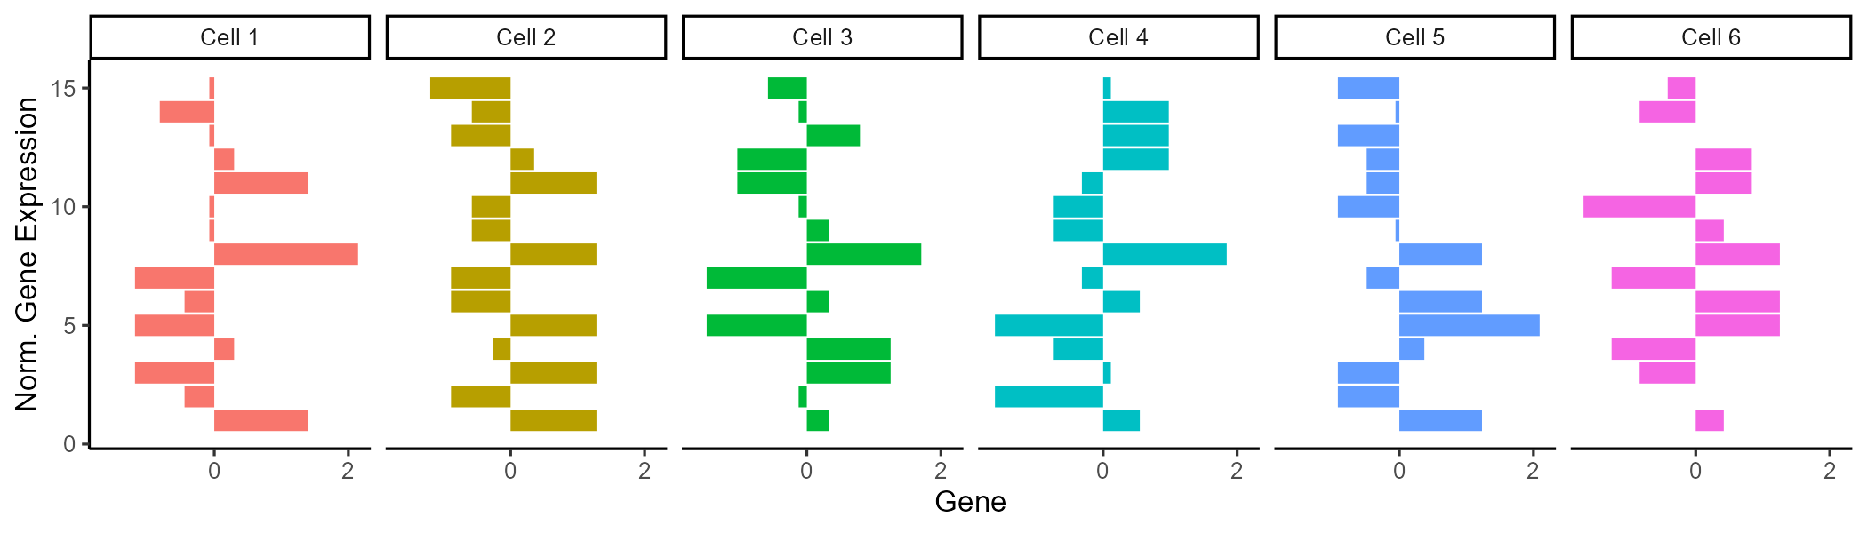
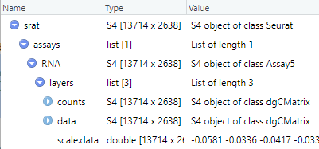
Count Matrix Importation
Importation
Gene expression is scaled (row wise z-scored) to compare across genes
CreateSeuratObject()
Z-score = (x-mean(x))/std(x)
# of SD from mean
Metadata Curation
PercentageFeatureSet()
Centers gene expression by subtracting the average expression for that gene.
Scales expression for each gene by dividing the centered gene expression by their standard deviations.
Filtering
subset()
Normalization
NormalizeData()
FindVariableFeatures()
Scaling
ScaleData()
Dimensionality
Reduction
RunPCA() ElbowPlot()
Clustering
FindClusters() FindNeighbors()
Clustering
RunUMAP(), DimPlot()
Notes:
https://www.dreamstime.com/stock-illustration-dna-vector-illustration-human-structure-image49975743

Slide 10
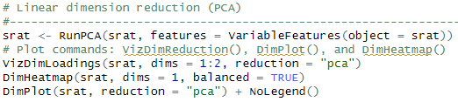
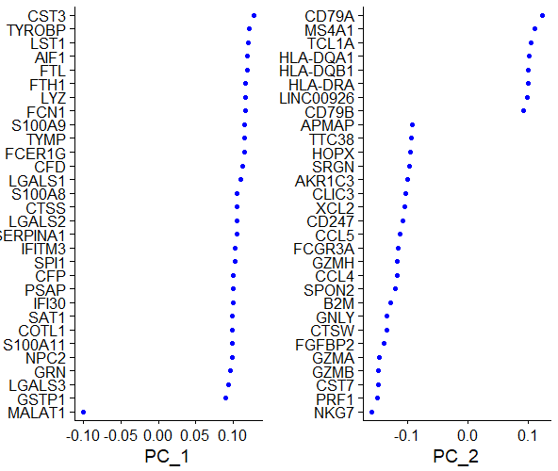
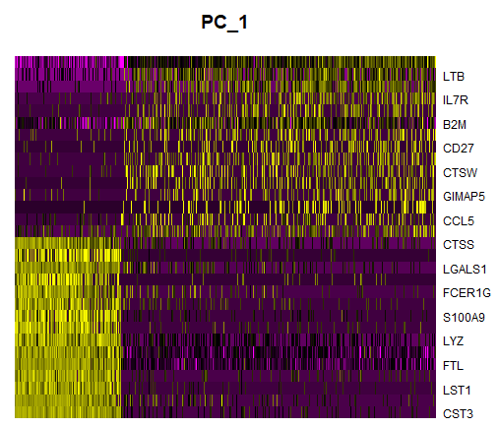
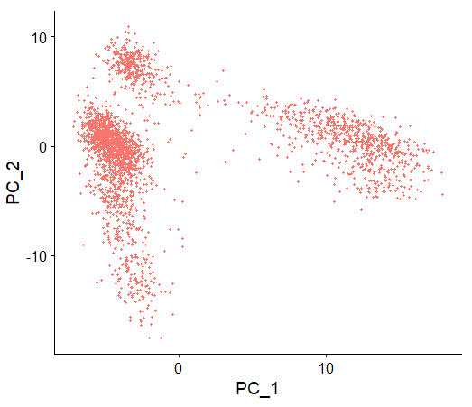

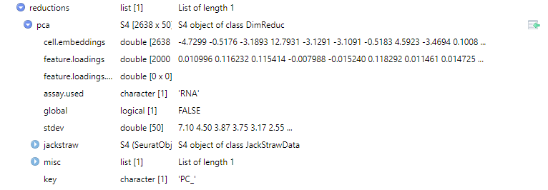
Count Matrix Importation
Importation
CreateSeuratObject()
Metadata Curation
PercentageFeatureSet()
Filtering
subset()
Normalization
NormalizeData()
FindVariableFeatures()
Scaling
ScaleData()
Dimensionality
Reduction
RunPCA() ElbowPlot()
1. PCA linearly transforms data onto a new coordinate system such that the principal components (linear combination features) maximizes the variation in the data.
2. Can be used as “anchor points” for nonlinear dimensionality reduction, examine sources of heterogeneity.
Clustering
FindClusters() FindNeighbors()
Clustering
RunUMAP(), DimPlot()
Notes:
https://www.dreamstime.com/stock-illustration-dna-vector-illustration-human-structure-image49975743

Slide 11

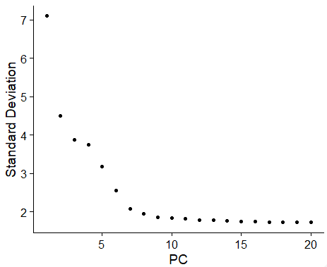
Count Matrix Importation
Importation
An initial minimal filtering can be used on importation
CreateSeuratObject()
Metadata Curation
PercentageFeatureSet()
Filtering
subset()
Normalization
NormalizeData()
FindVariableFeatures()
Plot the variation (standard deviation
Scaling
ScaleData()
Dimensionality
Reduction
RunPCA() ElbowPlot()
Clustering
FindClusters() FindNeighbors()
Clustering
RunUMAP(), DimPlot()
Notes:
https://www.dreamstime.com/stock-illustration-dna-vector-illustration-human-structure-image49975743

Slide 12
Count Matrix Importation
Importation
CreateSeuratObject()
Metadata Curation
PercentageFeatureSet()
Filtering
subset()
Normalization
NormalizeData()
FindVariableFeatures()
Scaling
ScaleData()
Dimensionality
Reduction
RunPCA() ElbowPlot()
Clustering
FindClusters() FindNeighbors()
Clustering
RunUMAP(), DimPlot()
Notes:
https://www.dreamstime.com/stock-illustration-dna-vector-illustration-human-structure-image49975743

Slide 13
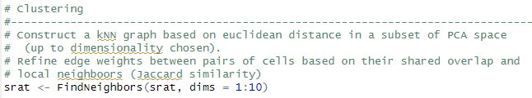
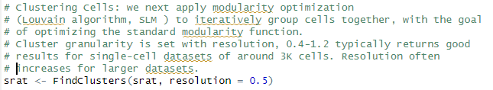
Count Matrix Importation
Importation
An initial minimal filtering can be used on importation
CreateSeuratObject()
Metadata Curation
PercentageFeatureSet()
Filtering
subset()
Normalization
NormalizeData()
FindVariableFeatures()
Scaling
ScaleData()
Dimensionality
Reduction
RunPCA() ElbowPlot()
Clustering
FindClusters() FindNeighbors()
Clustering
RunUMAP(), DimPlot()
Notes:
https://www.dreamstime.com/stock-illustration-dna-vector-illustration-human-structure-image49975743

Slide 14

Count Matrix Importation
Importation
An initial minimal filtering can be used on importation
CreateSeuratObject()
Metadata Curation
PercentageFeatureSet()
Filtering
subset()
Normalization
NormalizeData()
FindVariableFeatures()
Scaling
ScaleData()
Dimensionality
Reduction
RunPCA() ElbowPlot()
Clustering
FindClusters() FindNeighbors()
Clustering
RunUMAP(), DimPlot()
Notes:
https://www.dreamstime.com/stock-illustration-dna-vector-illustration-human-structure-image49975743

Slide 15
Seurat Adjustable Parameters
Find Variable
Genes
Count Matrix
Seurat Import
Normalize Data
Min features
Min cells
Max % mito. genes
Normalization method
Scale factor
Selection method
Loess span width
Number of bins
Binning method
Number of Features
Scale Data
Find Neighbors
Find Clusters
Output
Variables to regress
Scale max
Dimension reduction
K-neighbors
Prunning for SNN
Resolution (UMAP)
______. (t-SNE)
Appropriated from:
Schneider, J Transl Genet Genom 2021;5:37-49.
Notes:
https://www.oaepublish.com/articles/jtgg.2020.48

