Slide 1
Module 4: Cell Type Identification
NC State scRNA Workshop, 2024

Slide 2
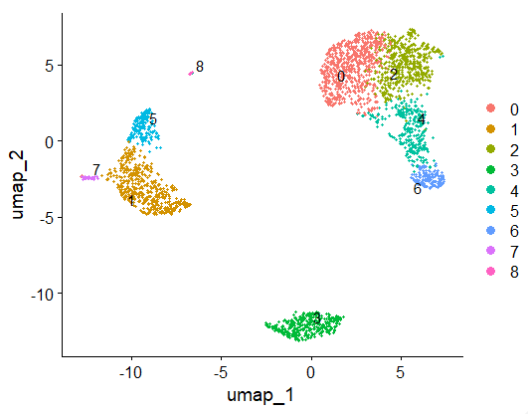
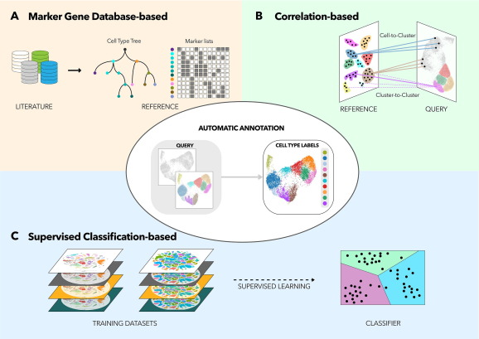
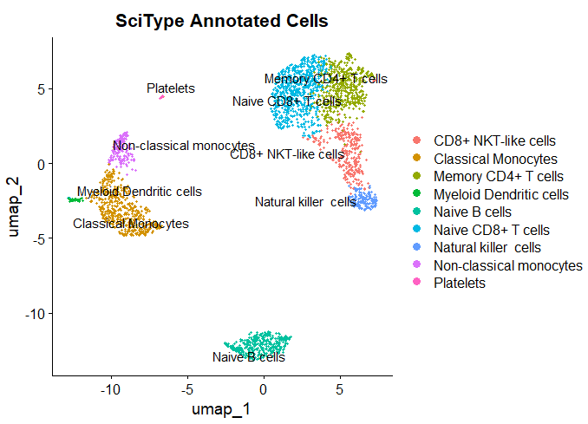
Primary Methods of Cell Type Annotation
UMAP Clustering Results
Pasquini. Comp. and Str. Biotech. J. (2021). 19:961-969.

Slide 3
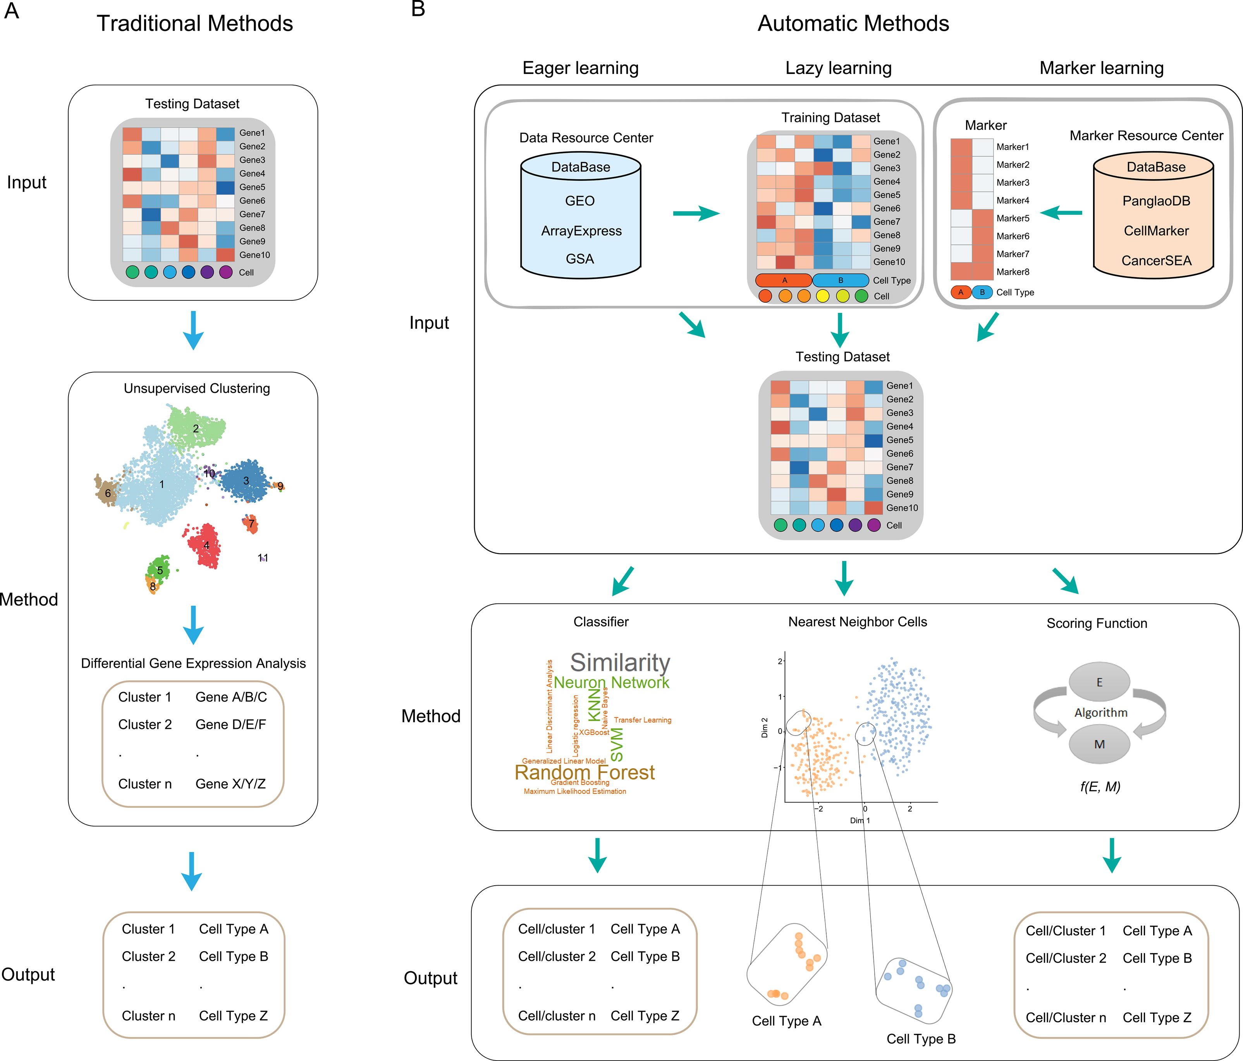
Additional Pipeline Summaries
Xie. Comp. And Str. Biotech J. (2021). 19: 5874-5887
Notes:
https://www.nature.com/articles/s41467-022-28803-w
https://www.dreamstime.com/stock-illustration-dna-vector-illustration-human-structure-image49975743

Slide 4
Multitude of Packages Available for Cell Type Annotation
Marker Gene: highly expressed genes are identified for each cluster, compare against databases of reference cell type hierarchies and marker lists.
Correlation: uses correlation measures to compare gene expression profiles to reference dataset, uses “average cell” (centroid) for each cluster as a reference point.
Supervised Classification: uses machine learning techniques to train a classifier based on reference labeled scRNA-Seq datasets.
Pasquini. Comp. & Str. Biotech. J. (2021). 19:P961-969.

Slide 5
Types of DGE
Identification of all markers for each cluster: this analysis compares each cluster against all others and outputs the genes that are differentially expressed. Useful for identifying unknown clusters and improving confidence in hypothesized cell types.
Identification of conserved markers for each cluster: This analysis looks for genes that are differentially expressed/present within each condition first, and then reports those genes that are conserved in the cluster across all conditions. These genes can help to figure out the identity for the cluster.
Useful with more than one condition to identify cell type markers that are conserved across conditions.
Marker identification between specific clusters: this analysis explores differentially expressed genes between specific clusters.
Useful for determining differences in gene expression between clusters that appear to be representing the same celltype (i.e with markers that are similar) from the above analyses.

Slide 6
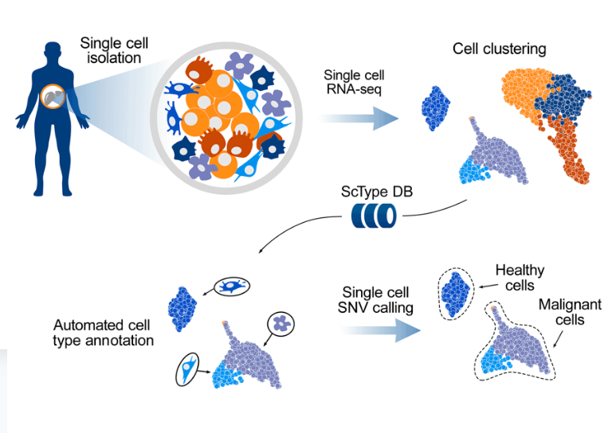
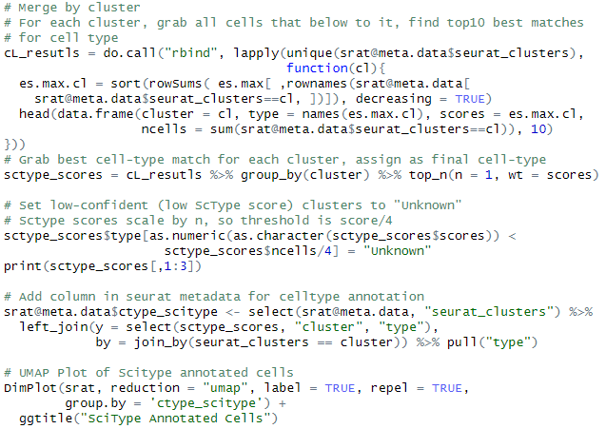

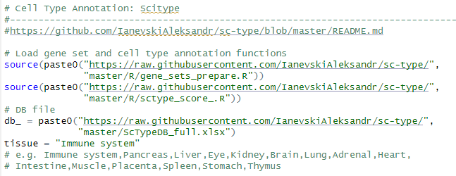
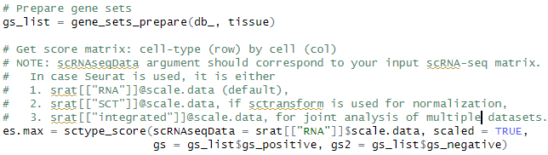
Marker Based: ScType

Slide 7
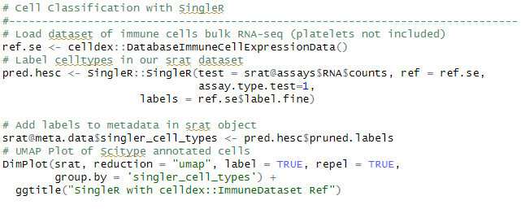
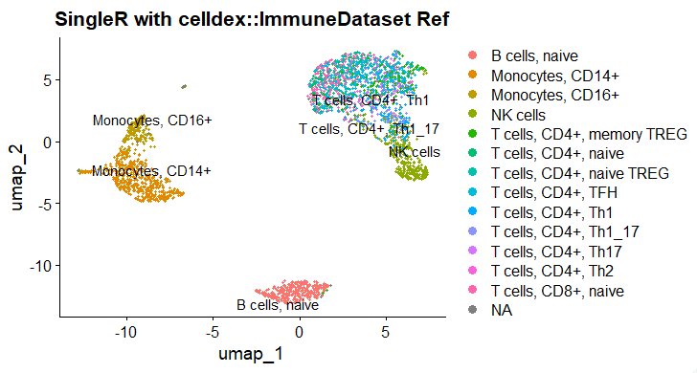
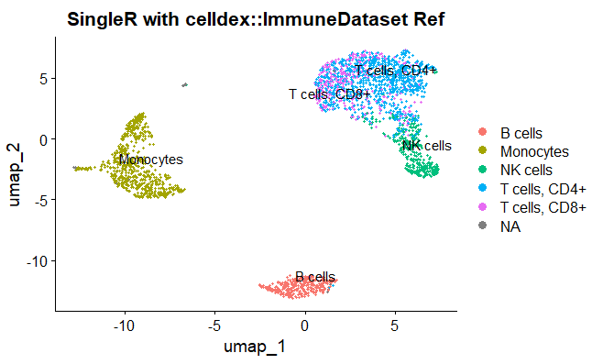
SingleR: Correlation Based Annotation
Fine Labels
Simple Labels

Slide 8
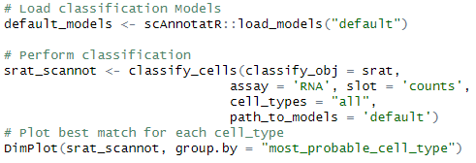
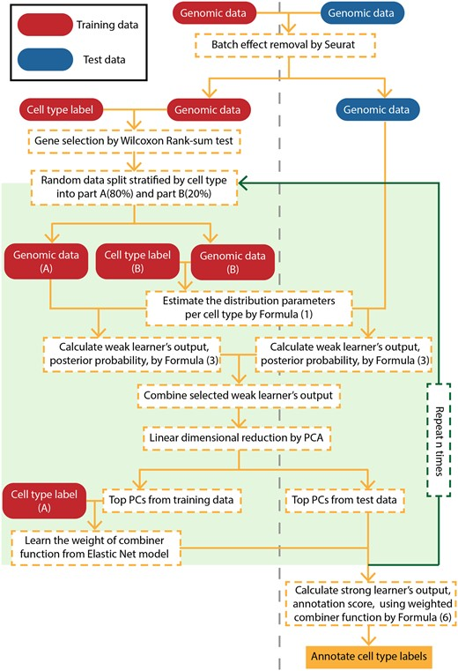
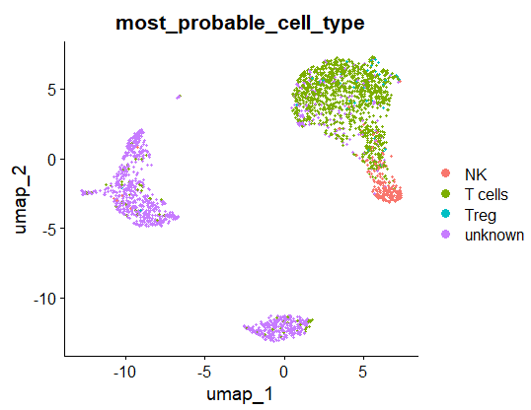
scAnnoteR: Classification Based (default model)

Slide 9
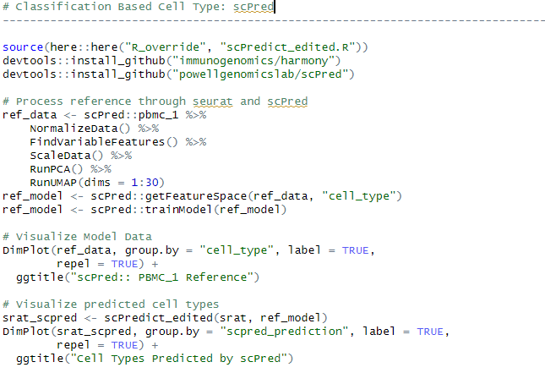
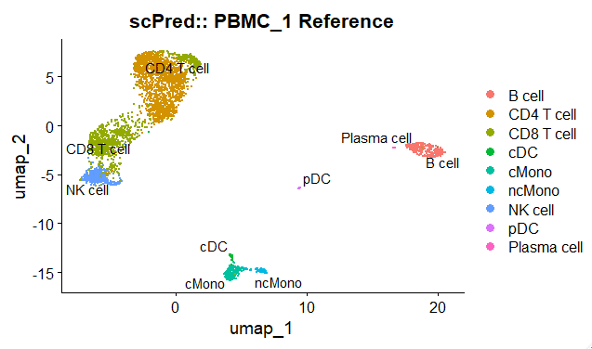
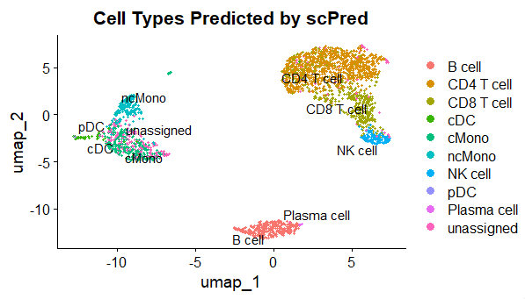
Classification Based: scPred with Trained Reference
Note: updates are required for this package to function with Seurat V5

Slide 10




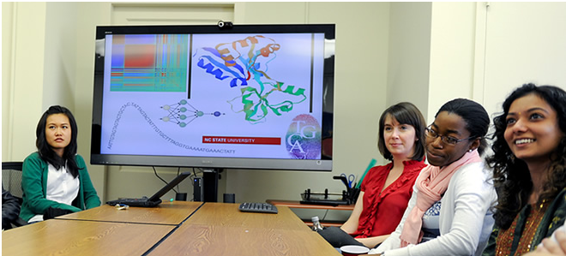
Questions?
Bridging biological research and data science for the next generation of scientific discoveries.

