Slide 1
Module 4: Differential Gene Analysis and Exploratory Analysis with Seurat
NCSU scRNA Workshop, 2024
Bruce Corliss, PhD and Allison Dickey, PhD

Slide 2
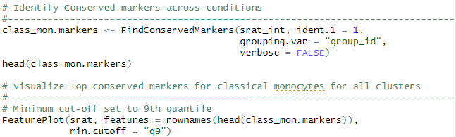
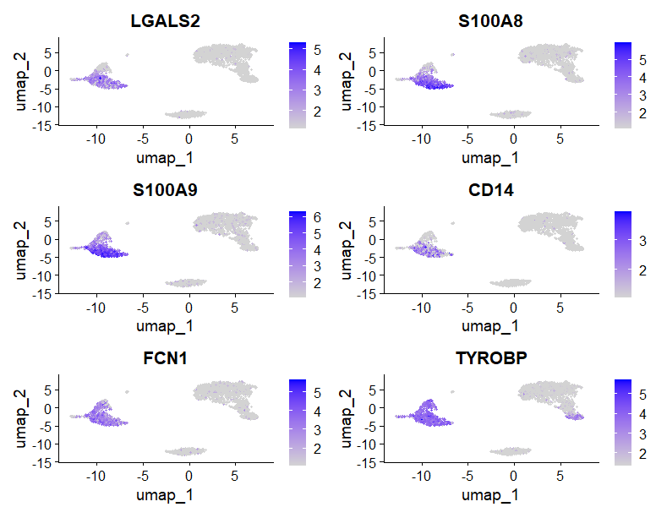
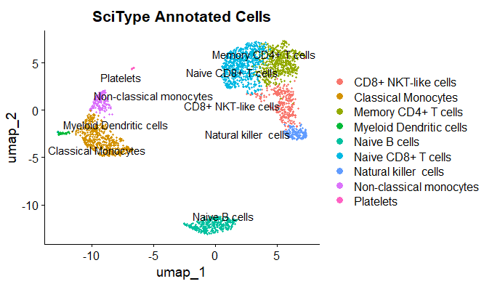
Conserved Marker Analysis
Classical Monocytes
Top Conserved Markers
Notes:
https://www.dreamstime.com/stock-illustration-dna-vector-illustration-human-structure-image49975743

Slide 3

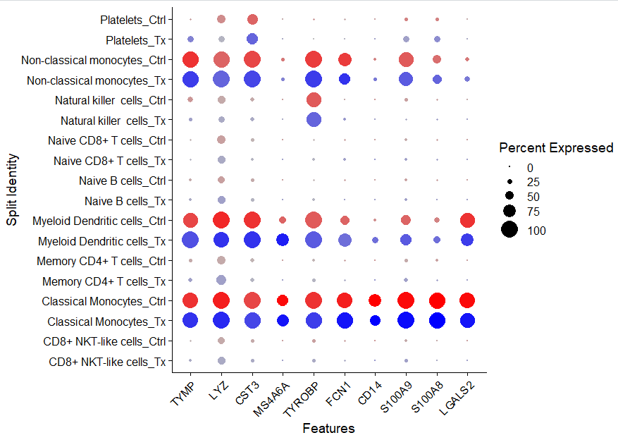
Visualizing Conserved Markers

Slide 4
Differential Gene Expression Analysis
No Statistical method to reveal differentially expressed genes between study groups in Seurat

