Slide 1
Module 1: Introduction to Single Cell RNA-Seq
NCSU scRNA Workshop, 2024
Bruce Corliss, PhD and Allison Dickey, PhD

Slide 2
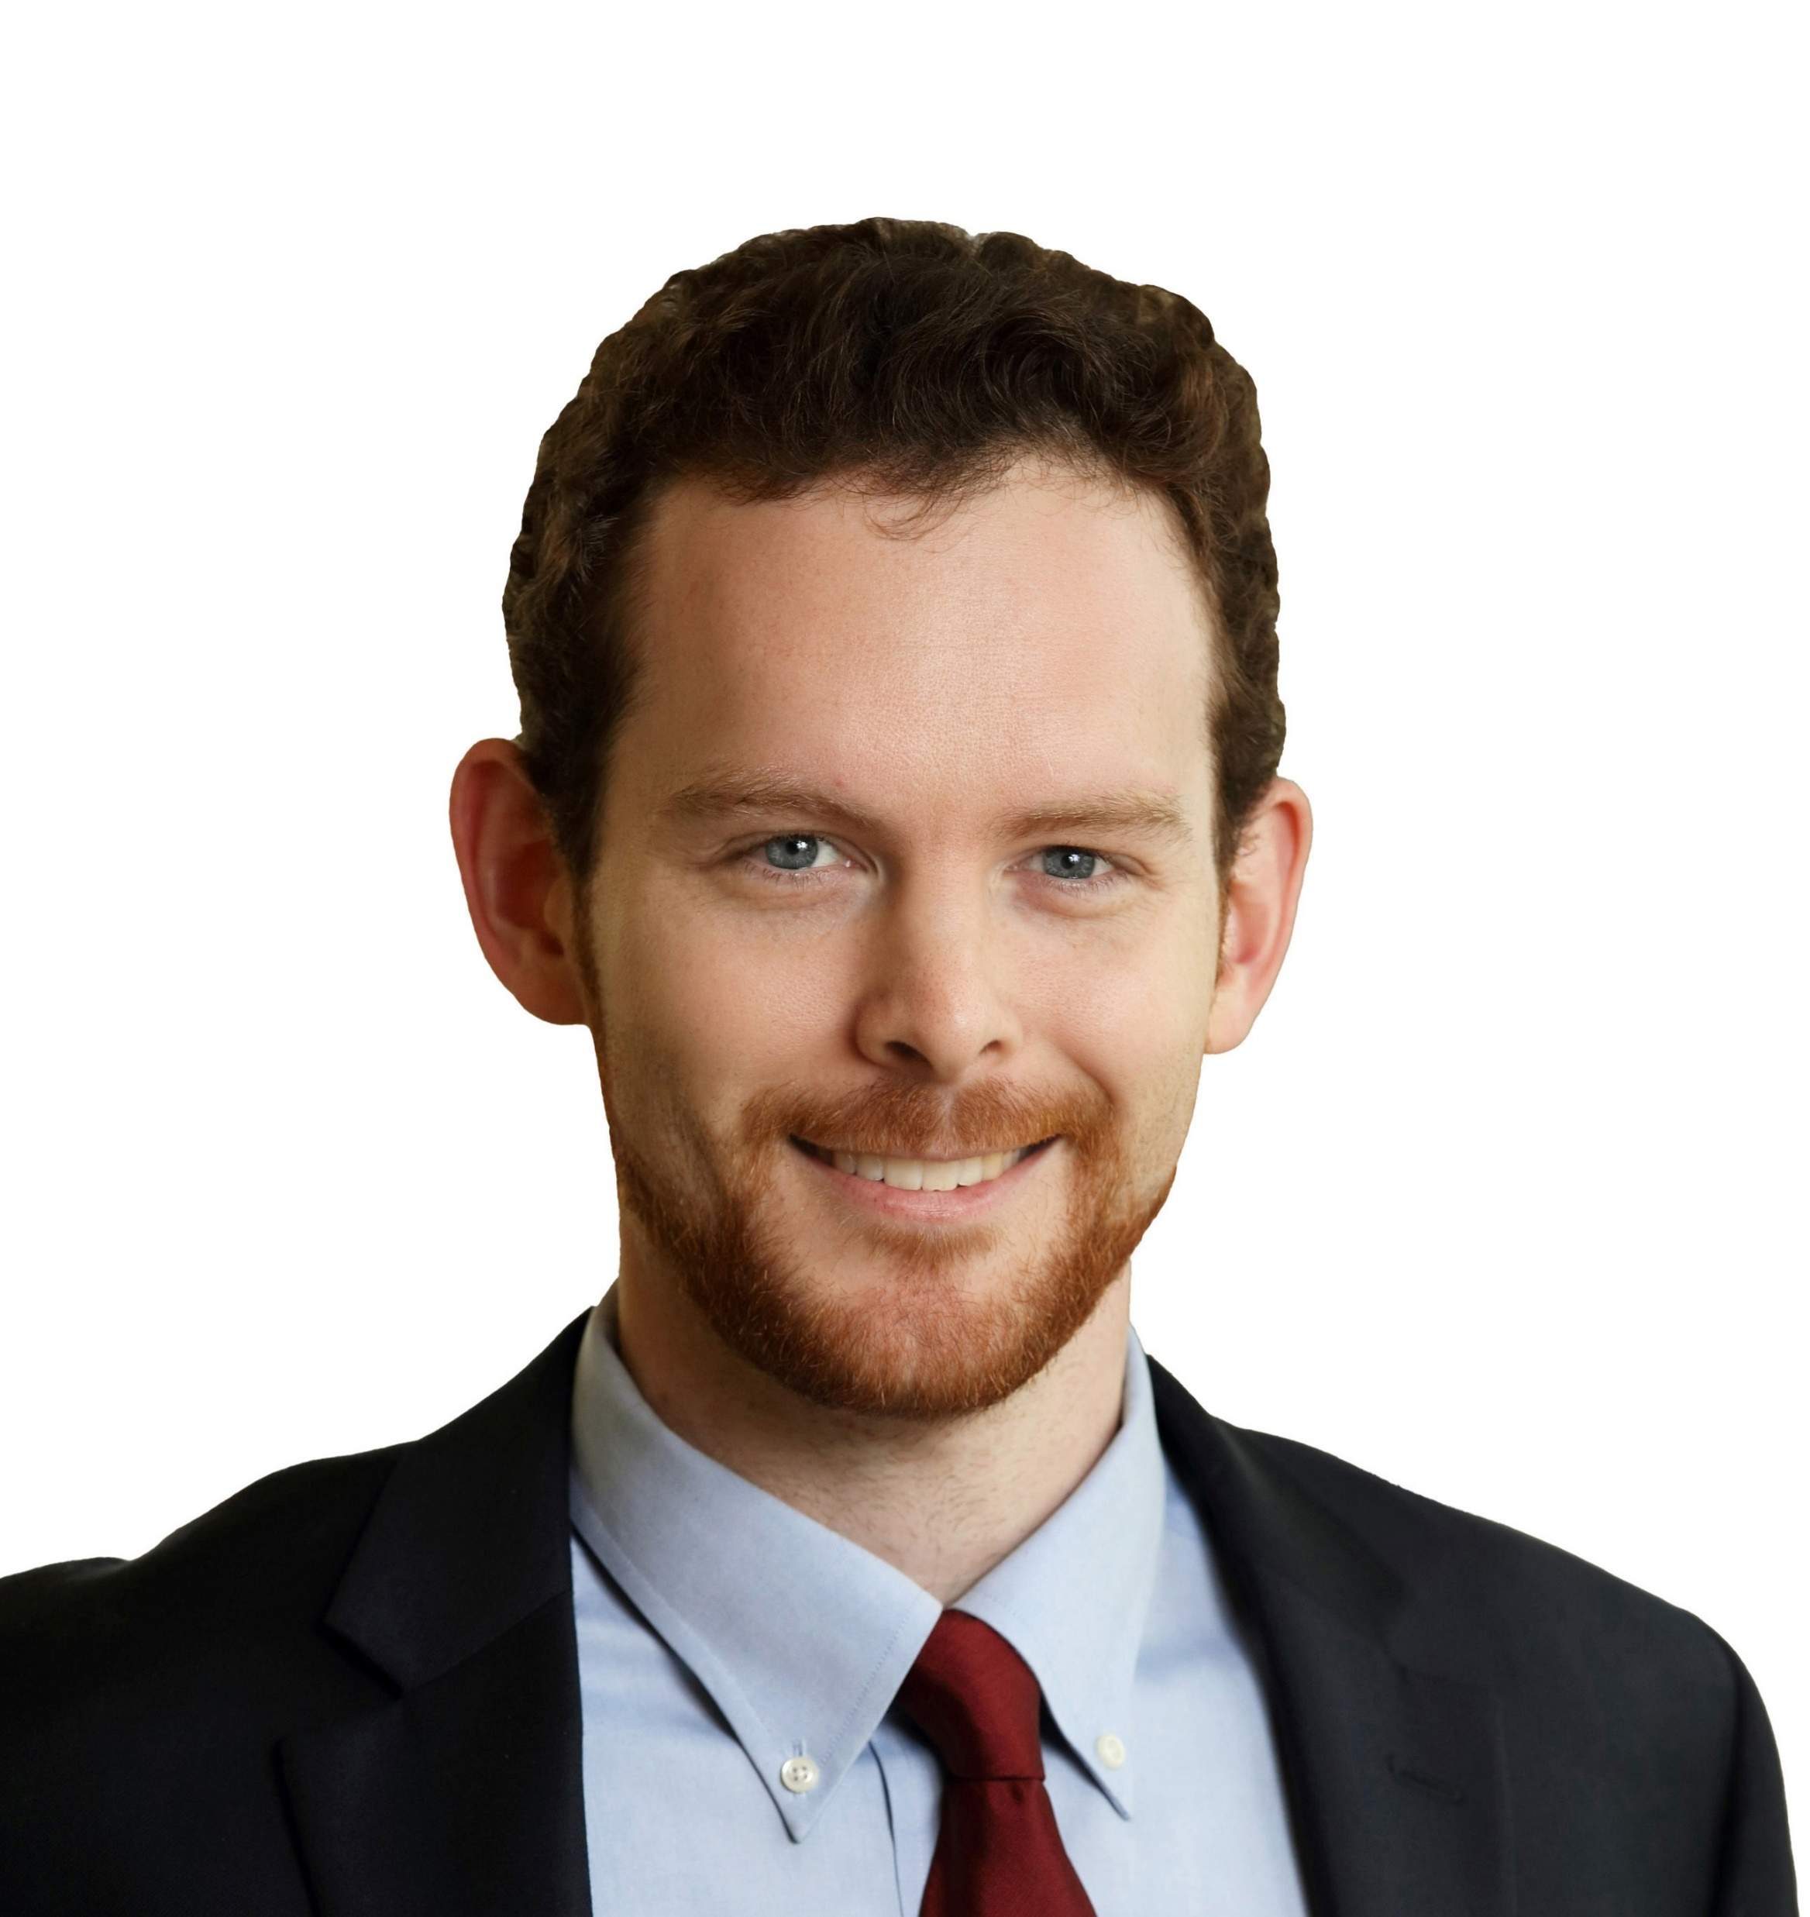
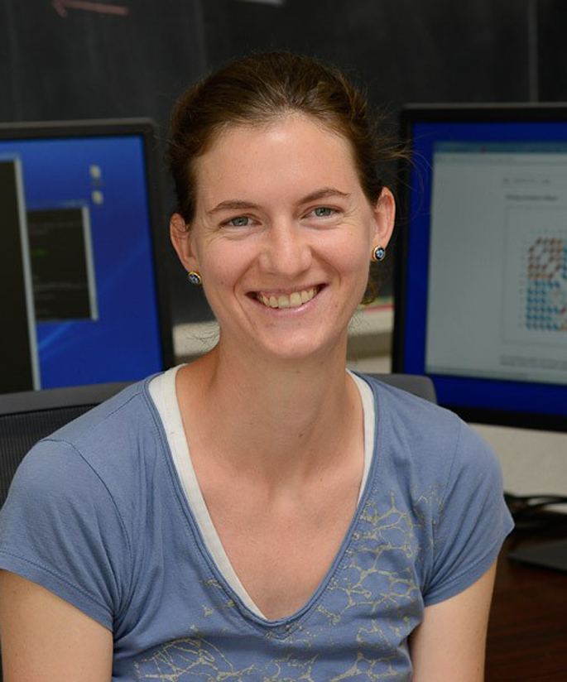
Meet your Instructors
Bruce Corliss, PhD
Allison Dickey, PhD

Slide 3
Learning Objectives

Slide 4
Overview of Course Modules

