Slide 1
Module 6: Pseudotime Analysis with Monocle3
NC State scRNA Workshop, 2024

Slide 2
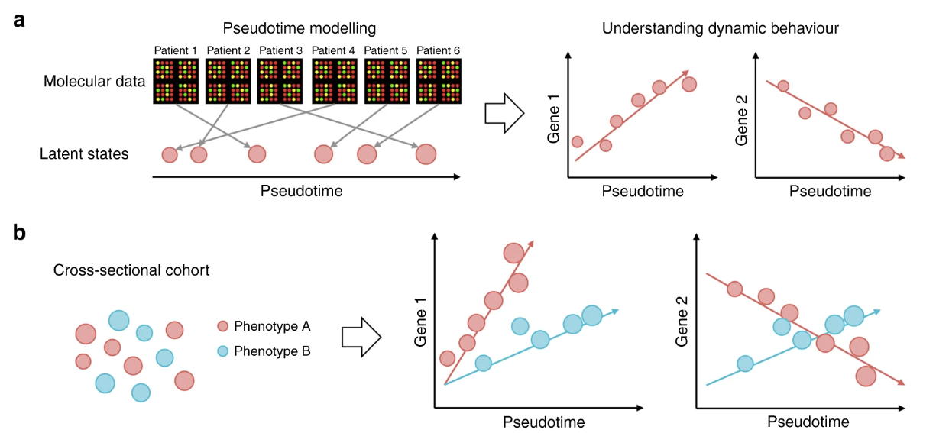
What is Pseudotime Analysis?
Anchor
Pseudotimes measure the relative progression of each of the individuals along the biological process of interest, e.g., disease progression, cellular development, etc., allowing us to understand the (pseudo)-temporal behavior of measured features without explicit time series data.
Determining a cell trajectory can give insight to the biological question when:
1. There is prior knowledge that a trajectory/ cellular differentiation pathway exists.
2. There is sufficient sampling with number of cells and between timepoints.
Anchor
Notes:
https://www.dreamstime.com/stock-illustration-dna-vector-illustration-human-structure-image49975743

Slide 3
Monocle3 Pipeline, Overlap with Seurat
Anchor
Seurat
Monocle3
Metadata Curation
Normalization
PercentageFeatureSet()
preprocess_cds()
Order Cells
Filtering
order_cells()
subset()
Integration
Monocle3 has it’s own scRNA-Seq processing pipeline.
align_cds()
Subset Trajectory
Normalization
NormalizeData()
Nonlinear Dimensional
Reduction
choose_graph_
segments()
FindVariableFeatures()
Scaling
Reprocess Trajectory
Can import data from Seurat to preserve clustering assignments.
ScaleData()
reduce_dimension()
Linear Dimensional
Reduction
Clustering &
Partitioning
Find Altered Genes
RunPCA(), ElbowPlot()
cluster_cells ()
find_gene_modules()
Partition: Cluster of clusters (metaclusters).
Seurat Bridge
Clustering
Aggregate to Gene Modules
FindNeighbors(), FindClusters()
SeuratWrappers::
as.cell_data_set()
Cell Type Annotation
aggregate_gene_
expression()
Nonlinear Dimension Reduction
Trajectory Graph
Visualize Gene Modules
RunUMAP(), DimPlot()
learn_graph()
Anchor
Notes:
https://www.dreamstime.com/stock-illustration-dna-vector-illustration-human-structure-image49975743

Slide 4
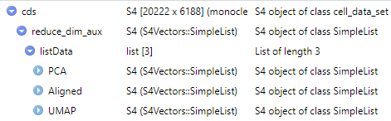
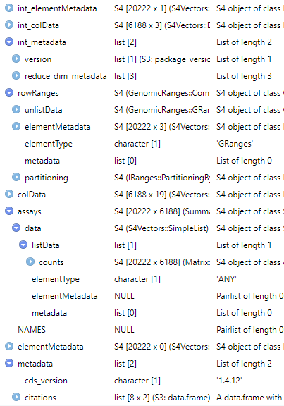
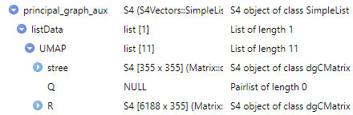
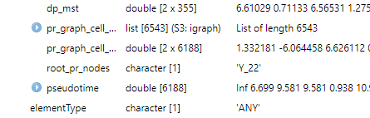

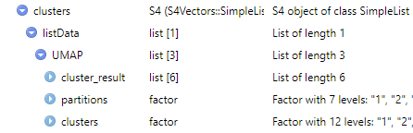
Monocle4 S4 Object
Anchor
cell_data_set (cds): extends the Bioconductor SingleCellExperiment class, includes matrix data and experiment metadata.
1
7
1
2
2
8
3
6
0
Gene name table
3
9
Cell barcodes, metadata
0, 5
4
10
Count data
0
7
11
5
7
6
12
4
Anchor

Slide 5
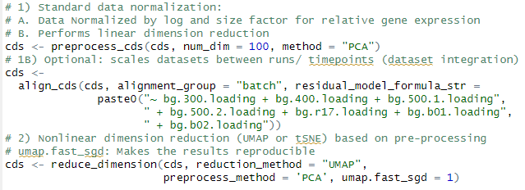
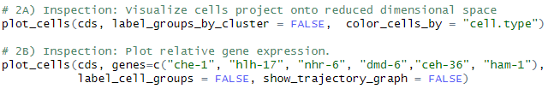
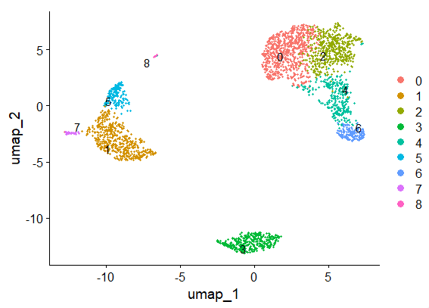
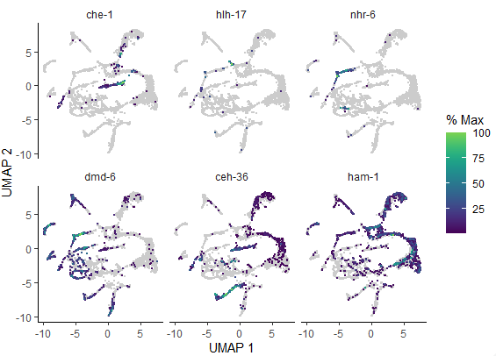
Monocle3
Anchor
Anchor
Experiment groups/batches can be aligned with a factor or continuous variable.
Anchor
Anchor

Slide 6

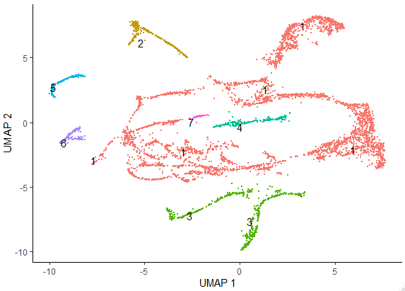
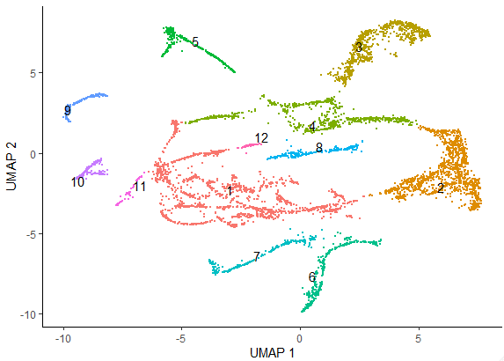
Monocle3
Anchor
Partitions
Clusters
A partition contains one or more clusters (metacluster).
Anchor

Slide 7
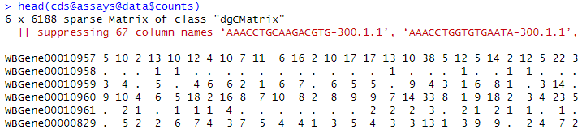
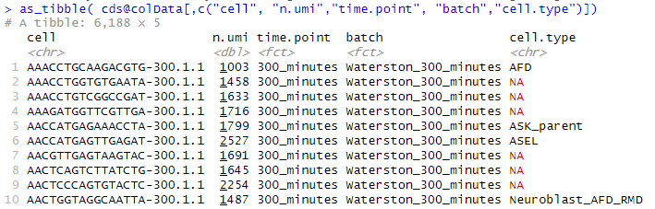
Monocle3
Anchor
Count Matrix: cds@assays@data$counts
Cell Annotation
Package
Metadata: cds@colData
Anchor

Slide 8
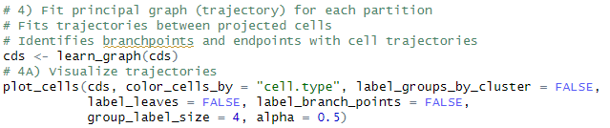
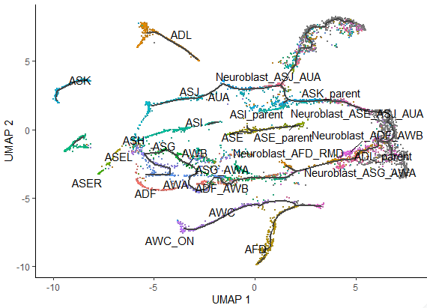
Monocle3
Anchor
Anchor

Slide 9
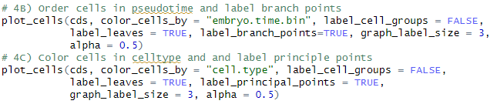
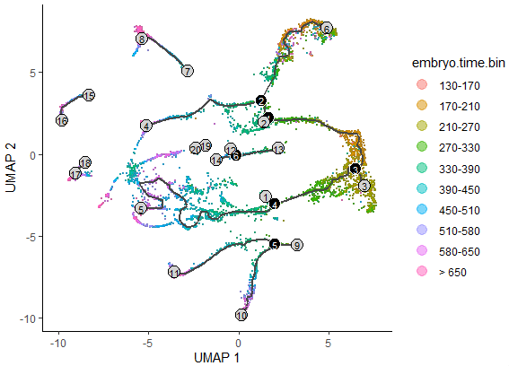
Monocle3
Anchor
Anchor

Slide 10
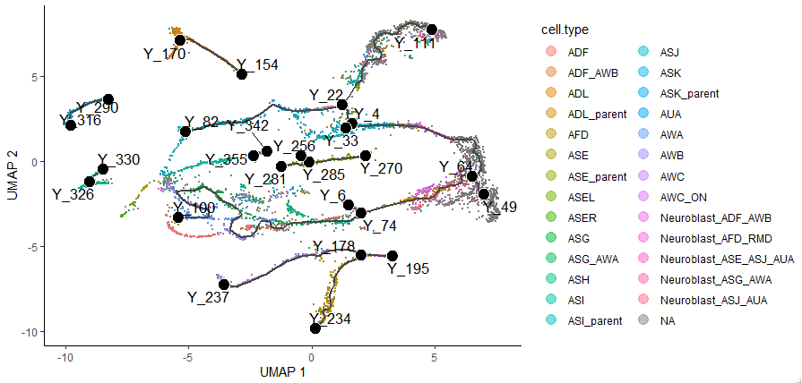
Monocle3
Anchor
Anchor

Slide 11
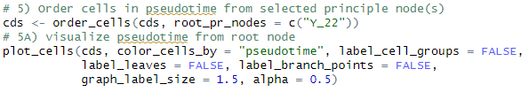
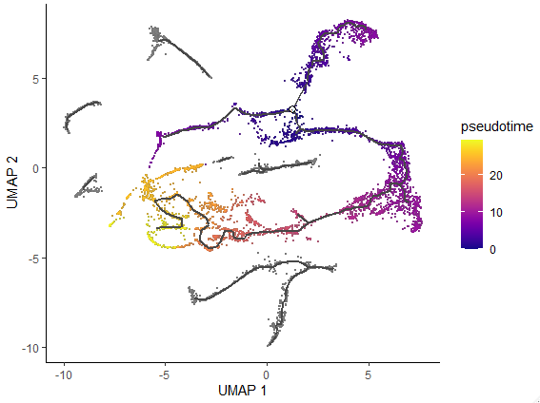
Monocle3
Anchor
Anchor

Slide 12

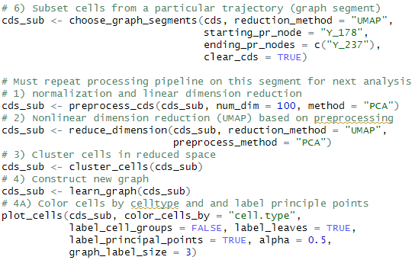
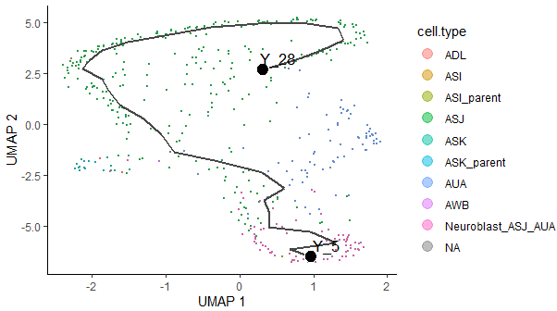
Monocle3
Anchor
Anchor

Slide 13
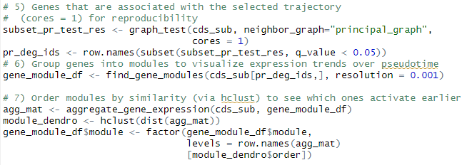
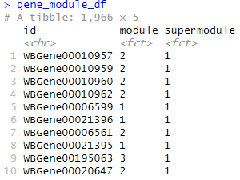

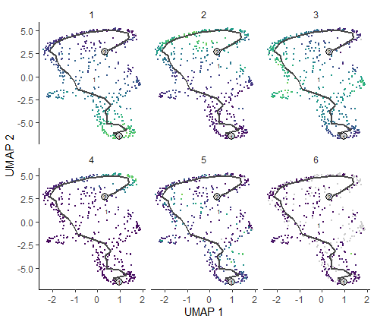
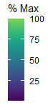
Monocle3
Anchor
Anchor

Slide 14
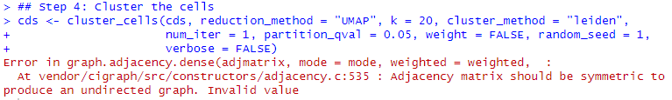
Monocle Troubleshooting
Troubleshooting Strategies
Packages are not up-to-date
Install latest developer versions of Monocle3, SeuratWrappers, and Seurat.
Run utils::update.packages() and BiocManager::valid().
If there are warnings that package updates failed, might be the cause.
Internet search for error message, check for solutions.
Change parameters and algorithms for the step that raises error or previous steps.
Use less PCA dimensions.
Using the PBMC3K Dataset from the previous slides.

Slide 15
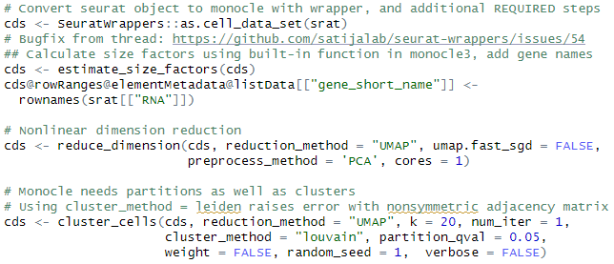
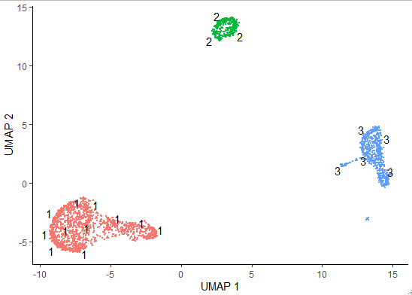
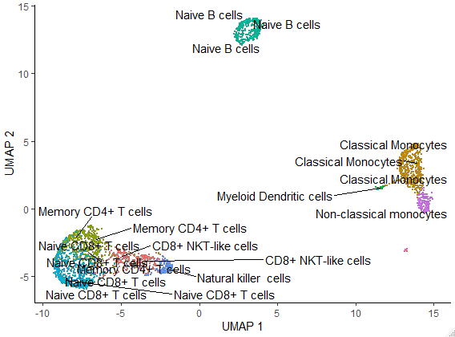
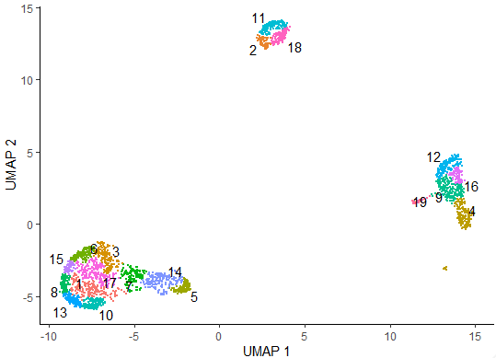
PBMC3K Dataset: Limitations of Pseudotime Analysis
Partitions
Clusters
Cell Types
(scType)

Slide 16
PBMC3K Dataset: Limitations of Pseudotime Analysis
Cell Trajectories where none likely exist:

Slide 17
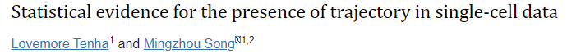
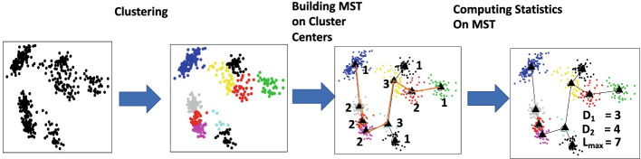

How do we know that trajectory is real?
1) Statistical Analysis (Ongoing research & Development)
2) Inspection and Experimental Validation
Ask the class what they would do to validate.
(Strategies discussed in Module 7)

Slide 18

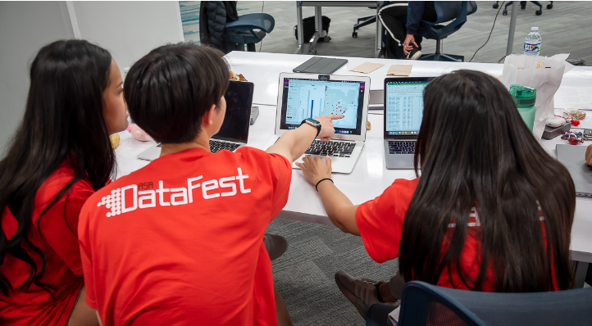


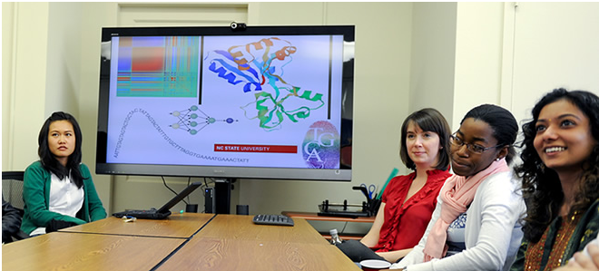
Bridging biological research and data science for the next generation of scientific discoveries.

