Slide 1
Module 2: Aligning Reads with Cell Ranger
NCSU scRNA Workshop, 2024
Bruce Corliss, PhD and Allison Dickey, PhD

Slide 2
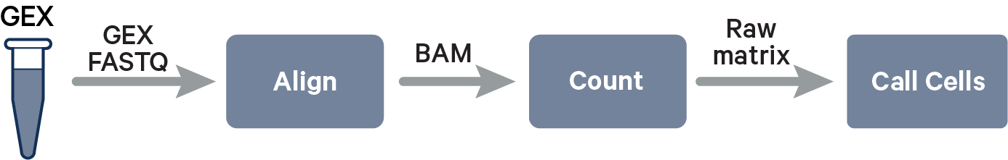
10X Data
https://www.10xgenomics.com/support/software/cell-ranger/algorithms-overview/cr-gex-algorithm

Slide 3
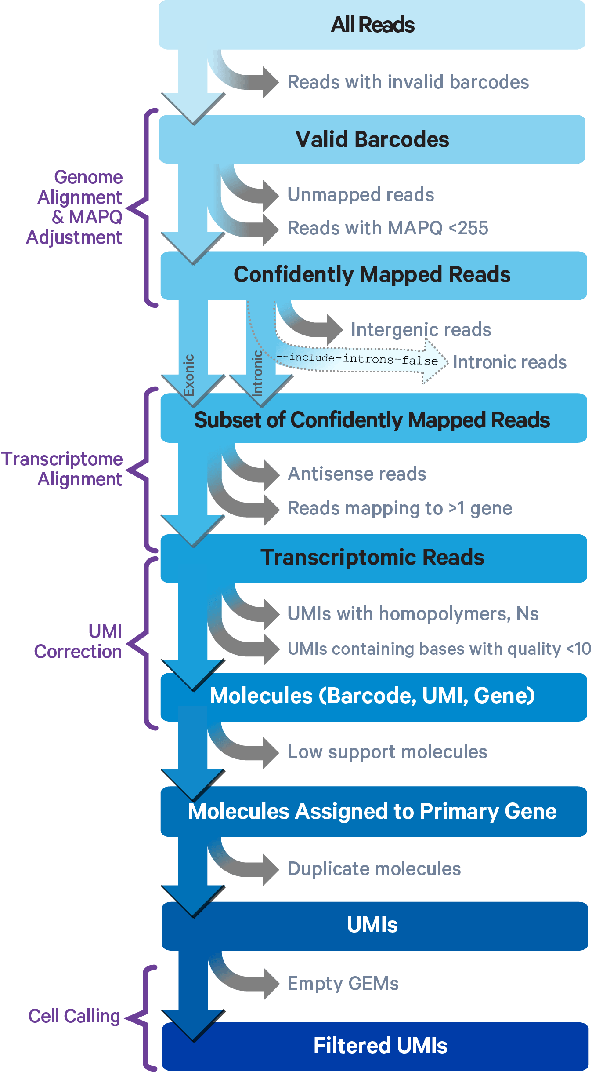
Cell Ranger STAR Alignment
1
2
3
4
5
6
7
8
9
https://www.10xgenomics.com/support/software/cell-ranger/algorithms-overview/cr-gex-algorithm

Slide 4
Cell Ranger STAR Alignment: 1 - 2
1
2
Cell Ranger compares 10x barcodes to the whitelist file of known barcodes for a given assay
Barcodes that do not exactly match any whitelist entries are statistically tested if there is sufficient evidence that they have a sequencing error and are a match.
If so, bar code is corrected to closest matching entry and included, nonmatching barcodes are discarded.
3
4
5
6
7
8
9
https://www.10xgenomics.com/support/software/cell-ranger/algorithms-overview/cr-gex-algorithm

Slide 5
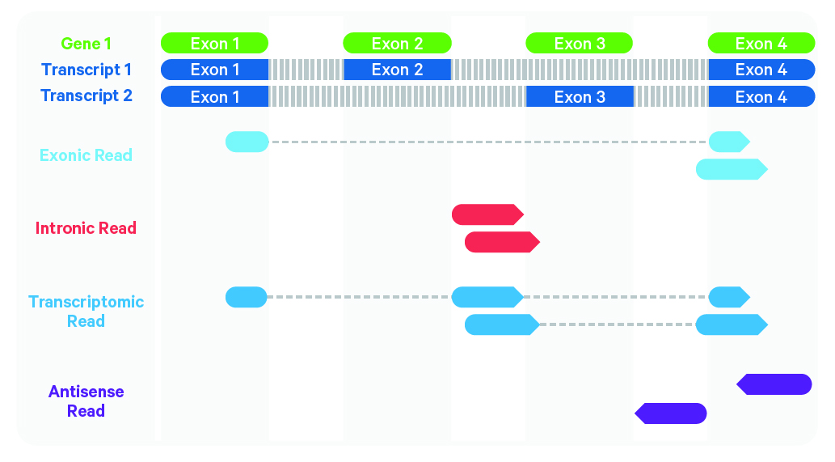
Cell Ranger STAR Alignment: 3 - 4
1
Cell Ranger uses the STAR aligner, which perform splicing-aware alignment of reads to the genome.
2
3
Reference
Genome
4
5
Experiment
Reads
6
7
Antisense reads are discarded because they are not part of the transcriptome.
8
Intronic reads can also be discarded for basic gene expression investigations.
9
https://www.10xgenomics.com/support/software/cell-ranger/algorithms-overview/cr-gex-algorithm

Slide 6
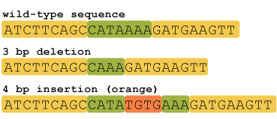
Cell Ranger STAR Alignment: 5 - 6
1
Cell Ranger Criteria for Including Reads:
Must not be a homopolymer, e.g. AAAAAAAAAA
Must not contain N
Must not contain bases with base quality < 10
2
3
Homopolymer reads (2+ repeat bases): known to be sources of error for DNA sequencing because it’s difficult to distinguish number of repeats beyond 2 (leads to alignment errors for the rest of reads.
~1.43 million homopolymer regions in human genome
4
5
6
Reads with N and base quality score <10 are also discarded because of higher error rates.
7
8
9
https://www.10xgenomics.com/support/software/cell-ranger/algorithms-overview/cr-gex-algorithm
https://hackbrightacademy.com/blog/indel-finder-how-the-python-version-of-this-program-works/

Slide 7
Cell Ranger STAR Alignment: 7 - 9
1
2
3
4
5
6
7
8
9
https://www.10xgenomics.com/support/software/cell-ranger/algorithms-overview/cr-gex-algorithm

Slide 8
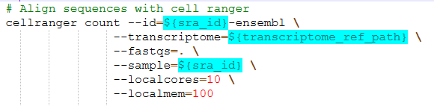

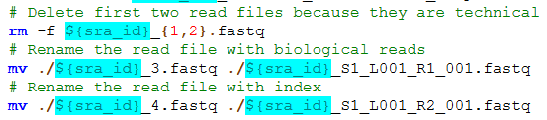
Cell Ranger Setup and Script
Example script found in /M2_CellRanger_Alignment/align_zebrahub_sra.sh
./SRR23691690
./SRR23691690_1.fastq
./SRR23691690_2.fastq
./SRR23691690_3.fastq
./SRR23691690_4.fastq
./SRR23691690_S1_L001_R1_001.fastq
./SRR23691690_S1_L001_R2_001.fastq
https://www.10xgenomics.com/support/software/cell-ranger/algorithms-overview/cr-gex-algorithm

Slide 9
Cell Ranger Outputs
Expression Matrix
 | c1 | c2 | c3 | g4
g1
g2
g3
g4
Gene Metadata
g1
g2
g3
g4
Cell Metadata
c1
c2
c3
c4

Slide 10
Key Cell Ranger Parameters for Alignment
Reference Genome
Can significantly influence number of Reads/Cells
https://www.10xgenomics.com/support/software/cell-ranger/algorithms-overview/cr-gex-algorithm

