Slide 1
Module 4: Initial Cell Type Identification
NC State scRNA Workshop, 2024

Slide 2
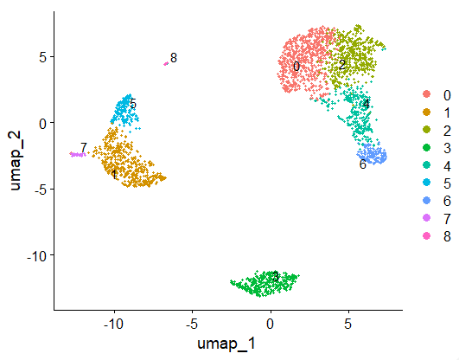
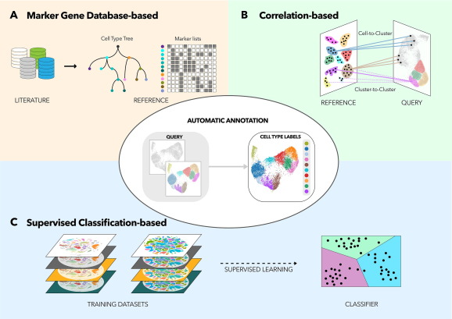
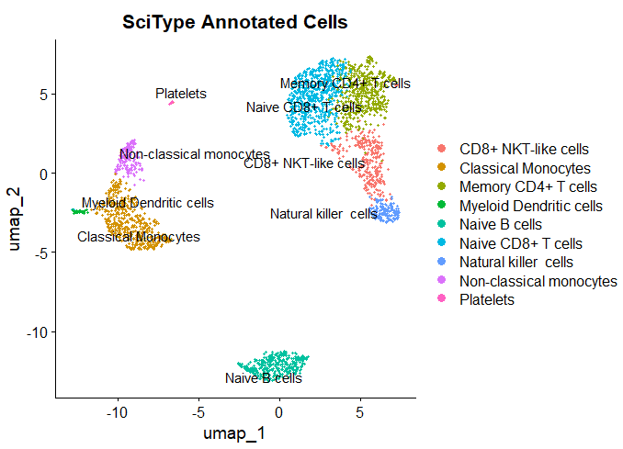
Primary Methods of Cell Type Annotation
UMAP Clustering Results
Pasquini. Comp. and Str. Biotech. J. (2021). 19:961-969.

Slide 3
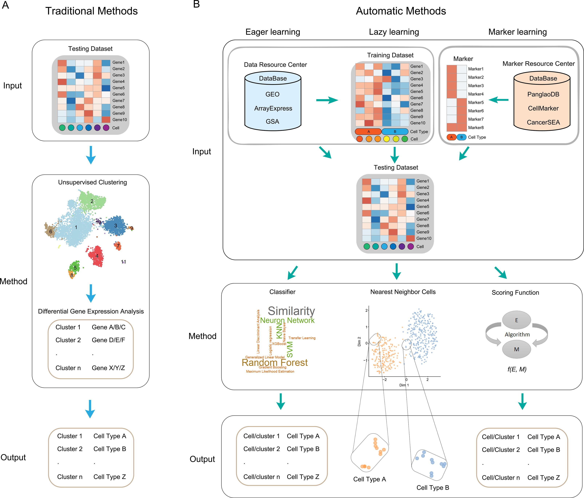
Additional Pipeline Summaries
Xie. Comp. And Str. Biotech J. (2021). 19: 5874-5887
Notes:
https://www.nature.com/articles/s41467-022-28803-w
https://www.dreamstime.com/stock-illustration-dna-vector-illustration-human-structure-image49975743

Slide 4
Multitude of Packages Available for Cell Type Annotation
Marker Gene: highly expressed genes are identified for each cluster, compare against databases of reference cell type hierarchies and marker lists.
Correlation/ Reference: uses correlation measures to compare gene expression profiles to reference dataset, uses “average cell” (centroid) for each cluster as a reference point.
Supervised Classification: uses machine learning techniques to train a classifier based on reference labeled scRNA-Seq datasets.
Pasquini. Comp. & Str. Biotech. J. (2021). 19:P961-969.

Slide 5
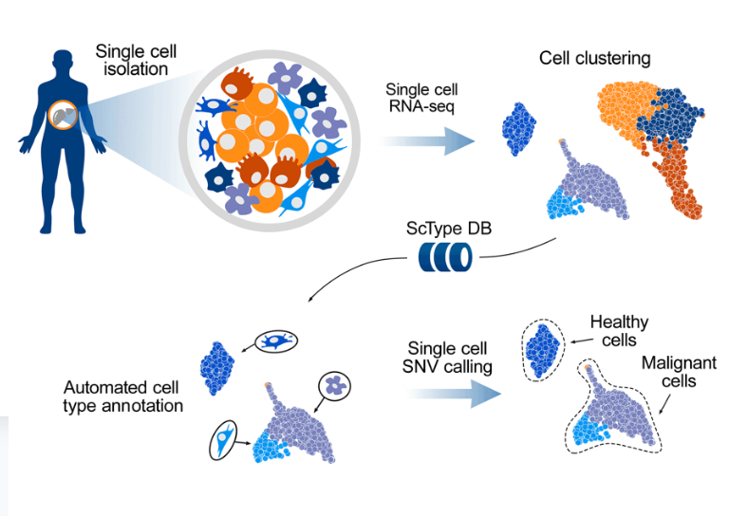
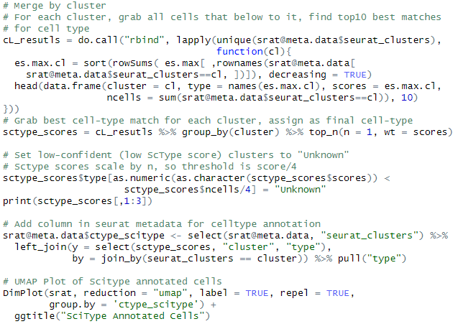

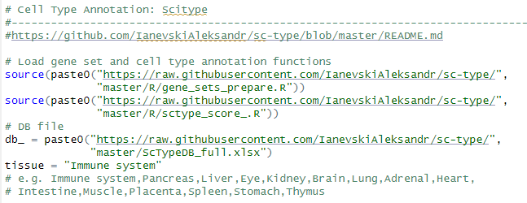
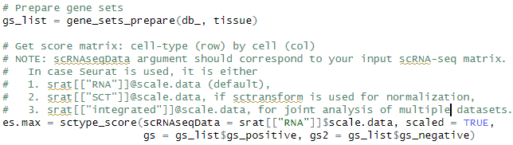
Marker Based: ScType

Slide 6
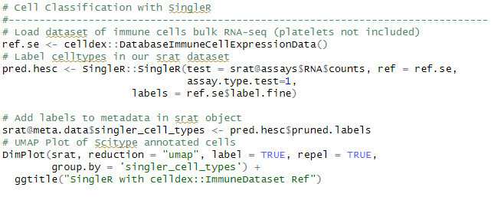
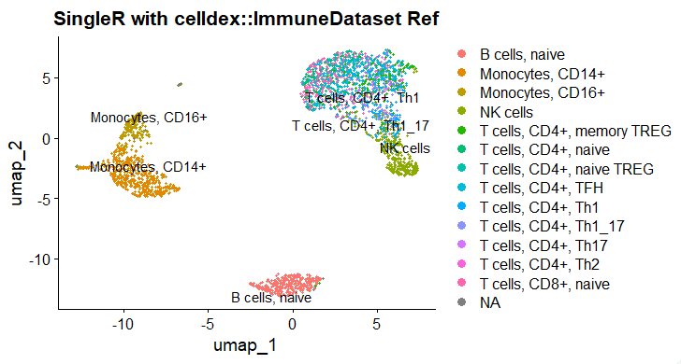
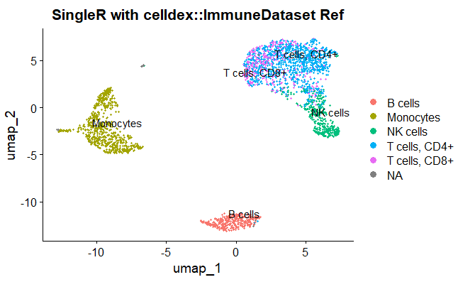
SingleR: Correlation Based Annotation
Fine Labels
Simple Labels

Slide 7
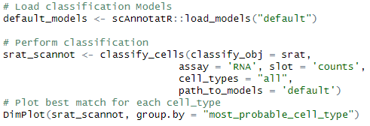
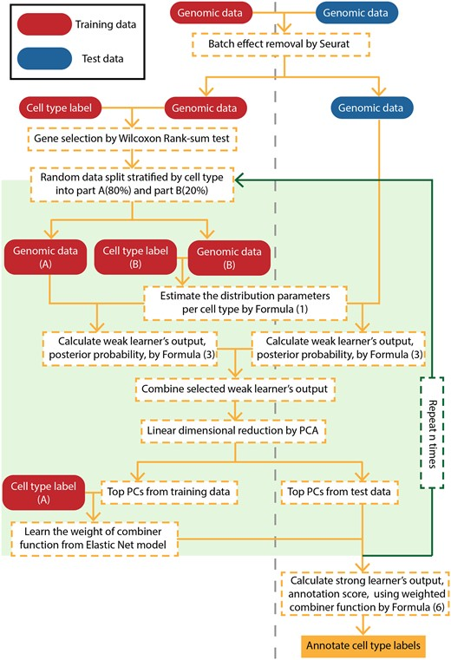
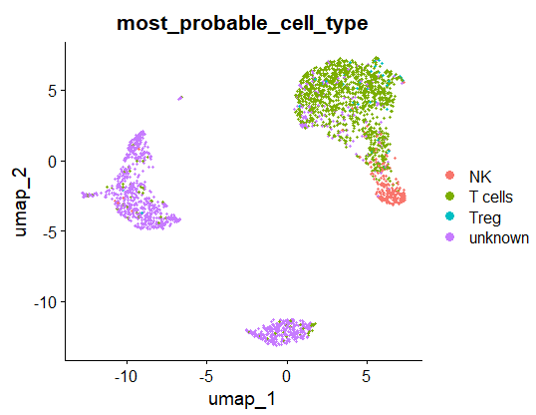
scAnnoteR: Classification Based (default model)

Slide 8
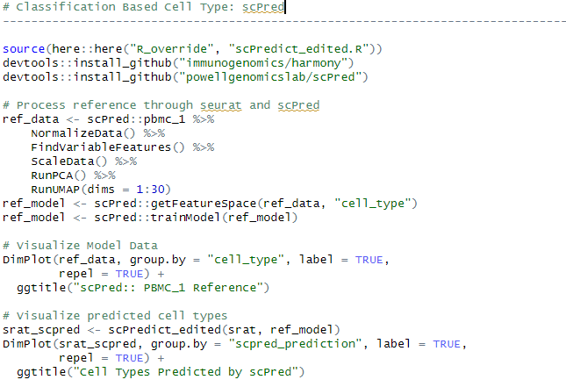
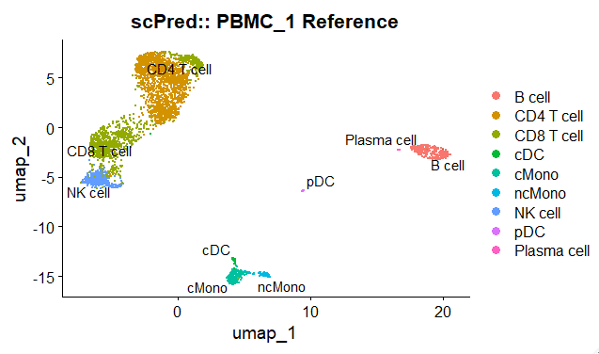
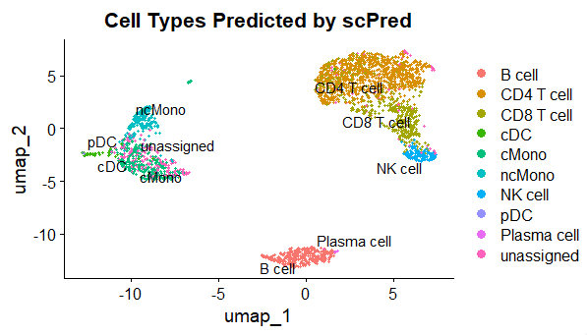
Classification Based: scPred with Trained Reference
Note: updates are required for this package to function with Seurat V5 (source() call on this slide).

Slide 9




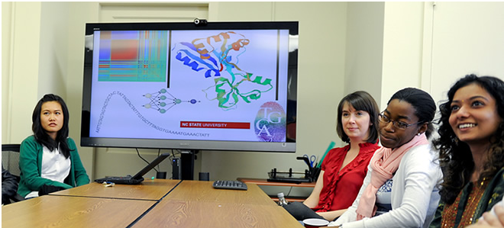
Questions?
Bridging biological research and data science for the next generation of scientific discoveries.

