Slide 1
Module 0: Workshop Introduction
NCSU scRNA Workshop, 2024
Bruce Corliss, PhD and Allison Dickey, PhD

Slide 2
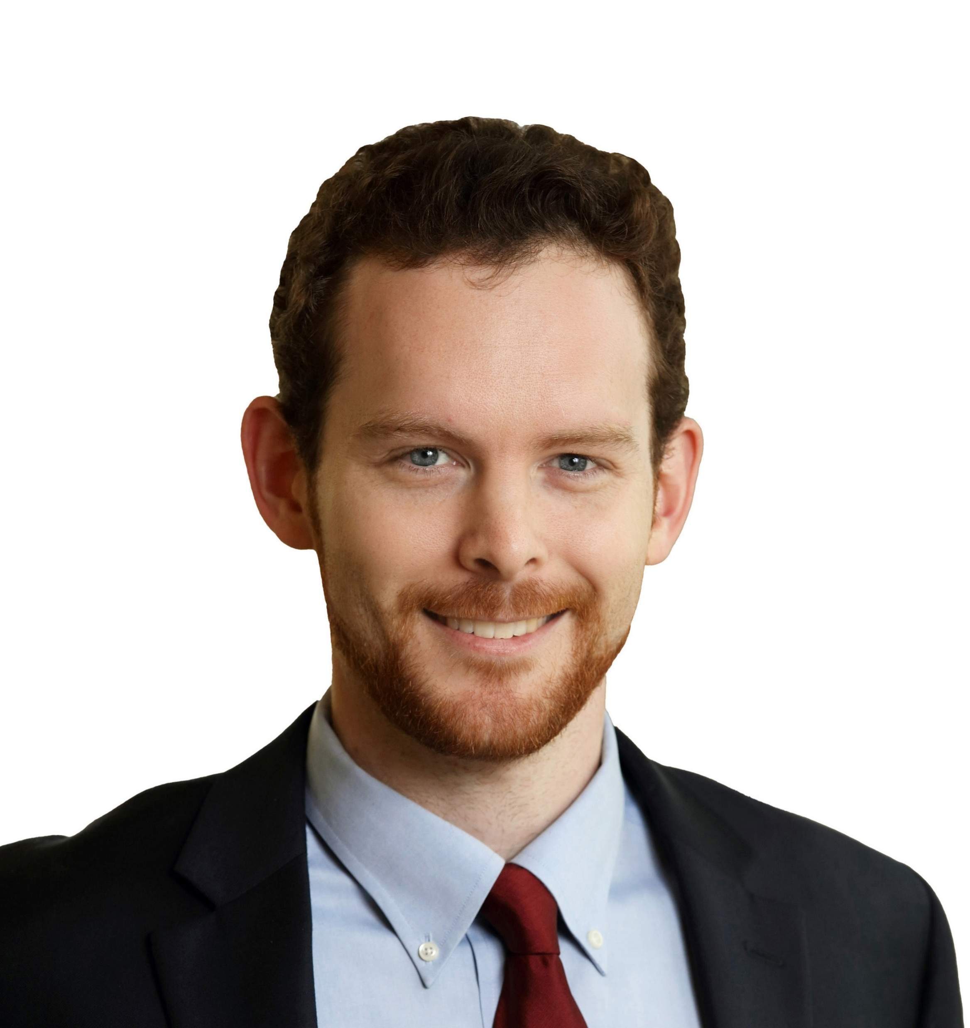
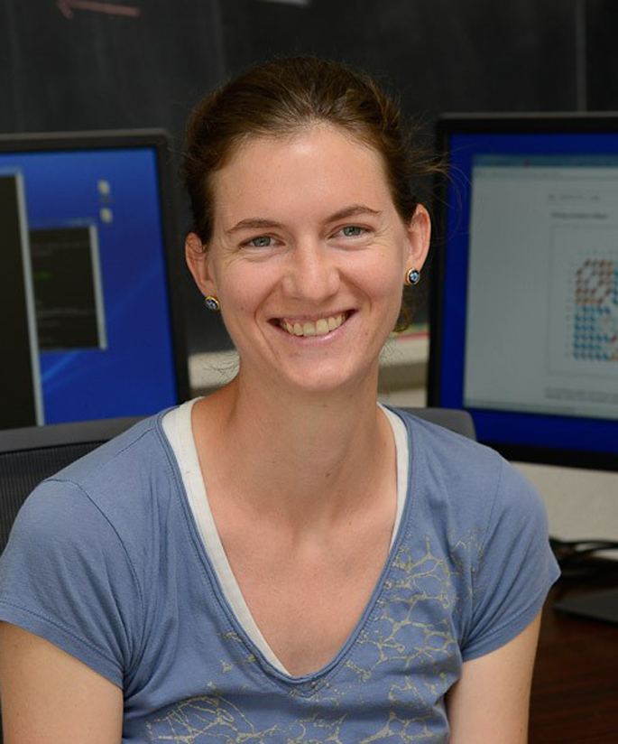
Meet your Instructors
Bruce Corliss, PhD
Allison Dickey, PhD

Slide 3
Learning Objectives
Learn about advantages and disadvantages of scRNA-Seq technologies.
Understand
Use Seurat to process snRNA-Seq data using standard settings.
Understand considerations for when to change from defaults.
Use Monocle to analyze pseudotime data.

Slide 4
Overview of Course Modules

