Slide 1
Module 5: Differential Gene Analysis and Exploratory Analysis with Seurat
NC State scRNA Workshop, 2024

Slide 2
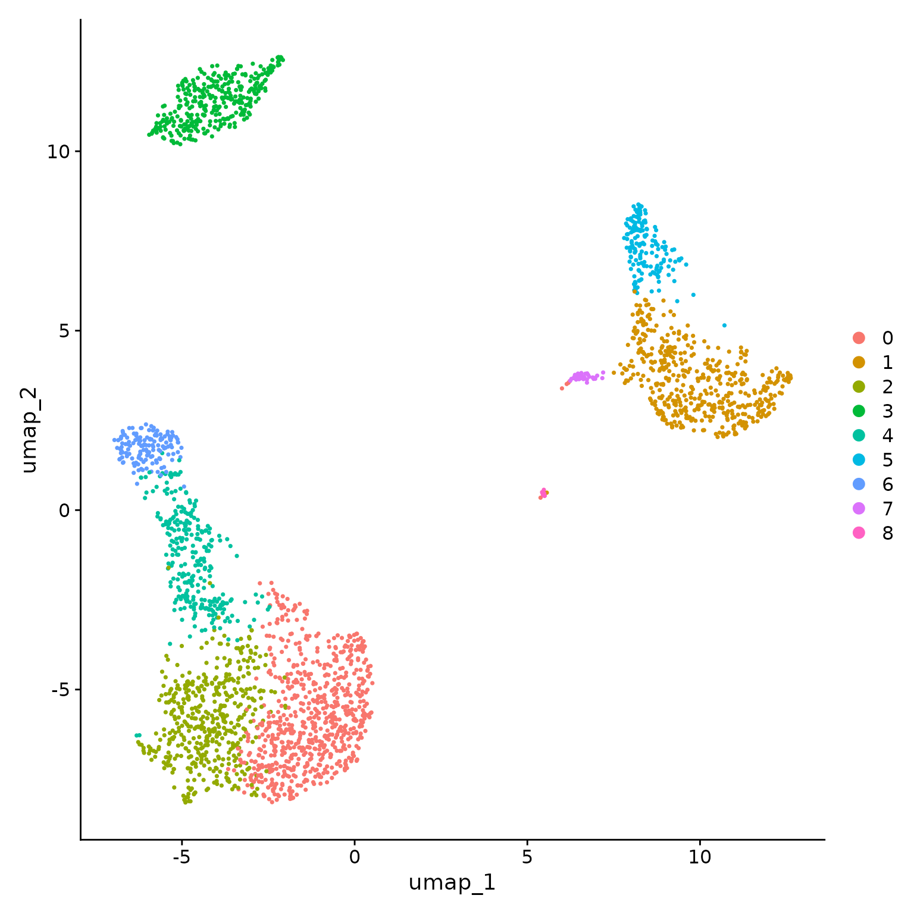
Types of DGE with Single Cell Data
For a single study group, identify differentially expressed genes for each cluster in pairwise fashion (already covered in previous slides).
Ctrl
Tx
For two study groups, find markers that are conserved between a pair of clusters and differentially expressed versus all other clusters.
For two study groups, identify differentially expressed genes for a pair of clusters.
Ctrl
Tx
For a two study groups (with replicates), identify differentially expressed genes for each cluster in paired fashion.
Notes:
https://www.dreamstime.com/stock-illustration-dna-vector-illustration-human-structure-image49975743

Slide 3
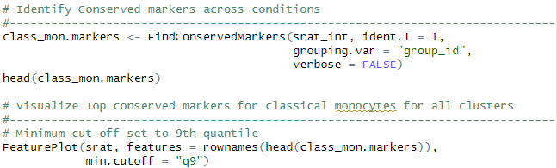
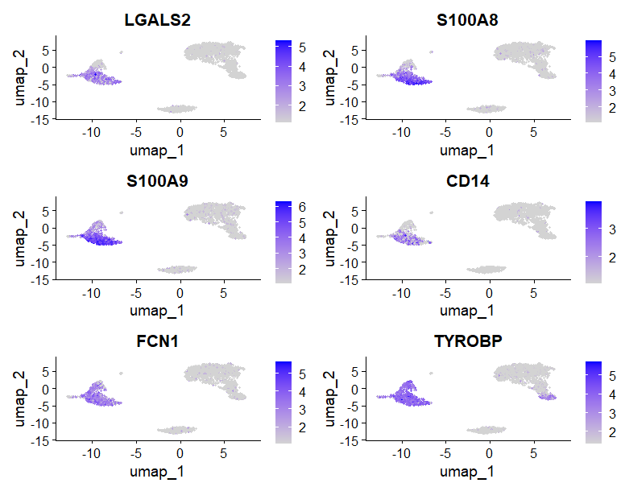
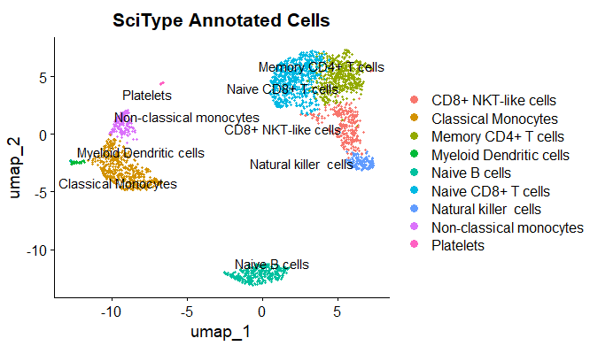
Conserved Marker Analysis
Classical Monocytes
Top Conserved Markers
Notes:
https://www.dreamstime.com/stock-illustration-dna-vector-illustration-human-structure-image49975743

Slide 4

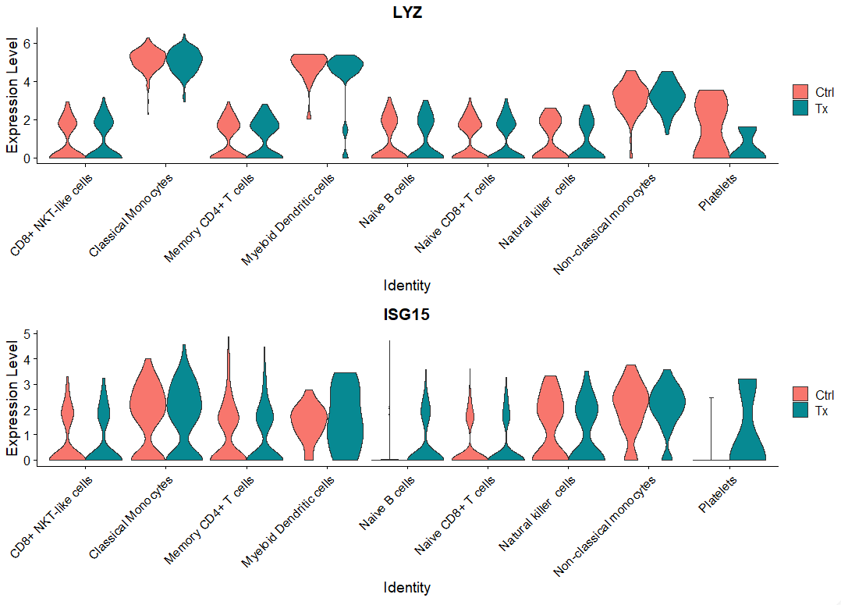
Differential Gene Expression Analysis: Single Study Group

Slide 5

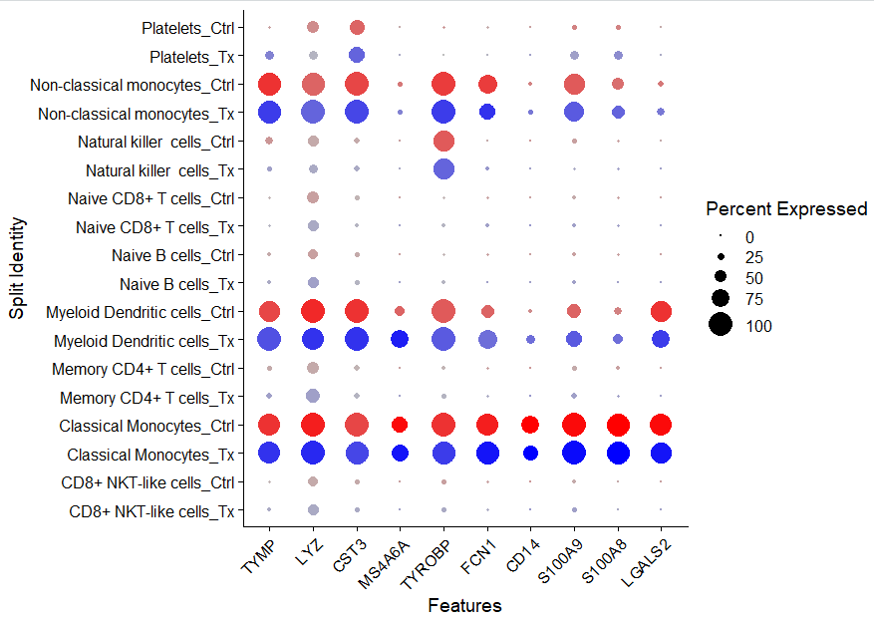
Visualizing Conserved Markers

Slide 6
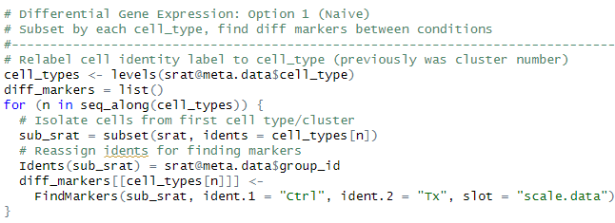
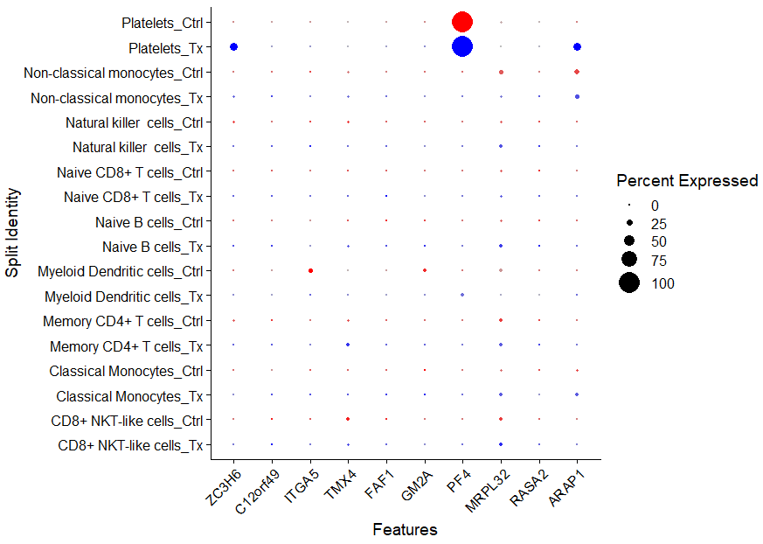
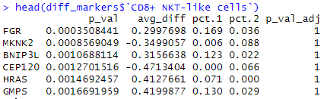
Differential Gene Expression Analysis: Single Study Group
Caution: This test treats each cell as an independent replicate and ignores inherent correlations between cells originating from the same sample (false positives).

Slide 7

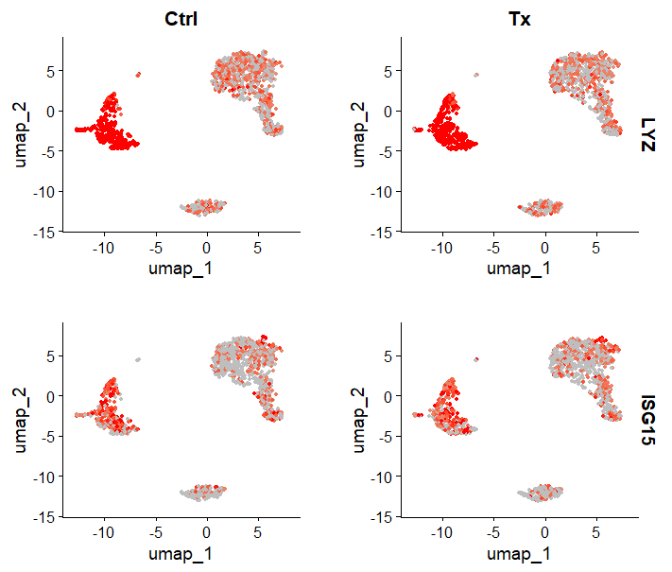
Visualize Specific Gene Expression Across Conditions.

Slide 8
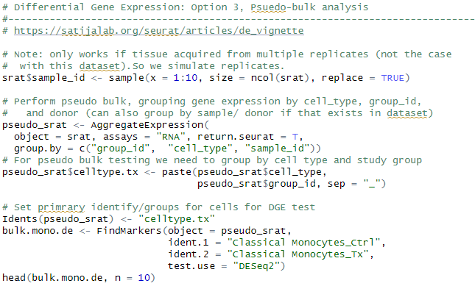
Differential Gene Expression Analysis: Pseudobulk
Pseudobulk: gene expression aggregated per sample and cell type.
independent observations = samples, rather than the individual cells (therefore accounts for within-sample correlation).

Slide 9
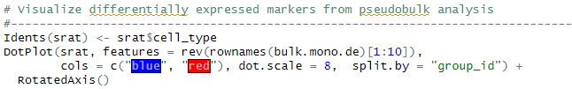
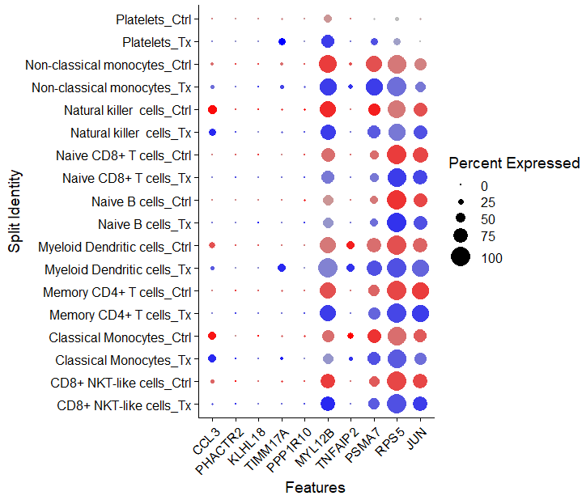
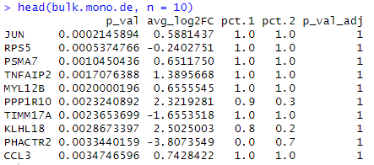
Differential Gene Expression Analysis: Pseudobulk

Slide 10

Seurat Functions for DGE
FindMarkers: will find markers between two different identity groups - you have to specify both identity groups.
FindAllMarkers: will find markers differentially expressed in each identity group by comparing it to all of the others - you don't have to manually define anything. Markers are not forced to be unique to only one group.
FindConservedMarkers: will find markers that are conserved between two groups. It means they are differentially expressed compared to other groups, but have similar expression between the two groups you're actually comparing.
Source
https://www.biostars.org/p/409790/

Slide 11
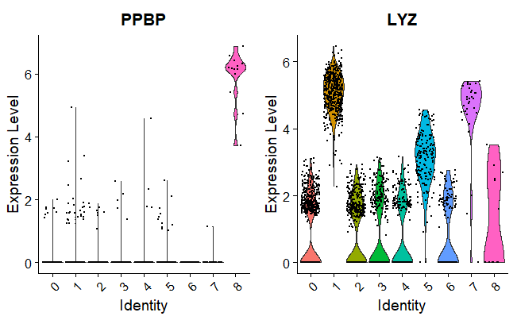
Specific Gene Expression in Each Cluster
Each datapoint is a cell, each plot is a genes, plots are Cluster X Expression.

Slide 12
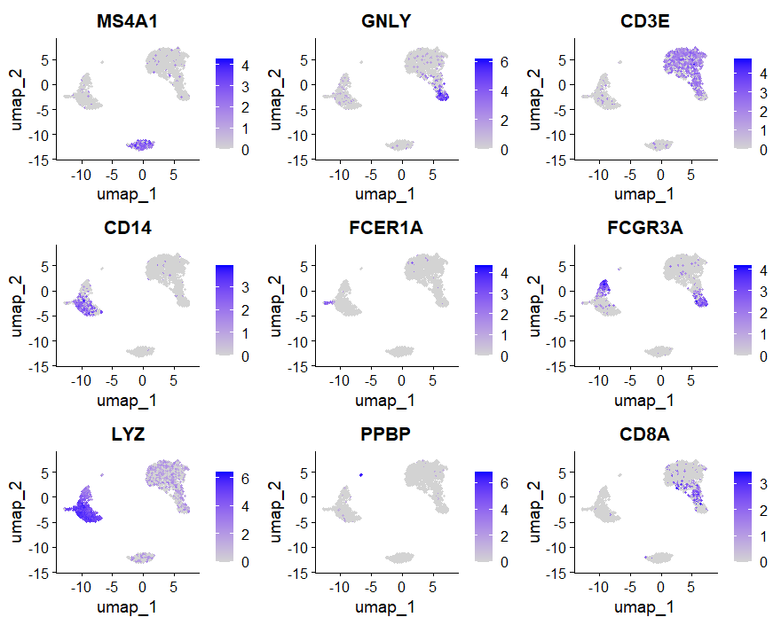
Cell Heatmap of Gene Expression

Slide 13
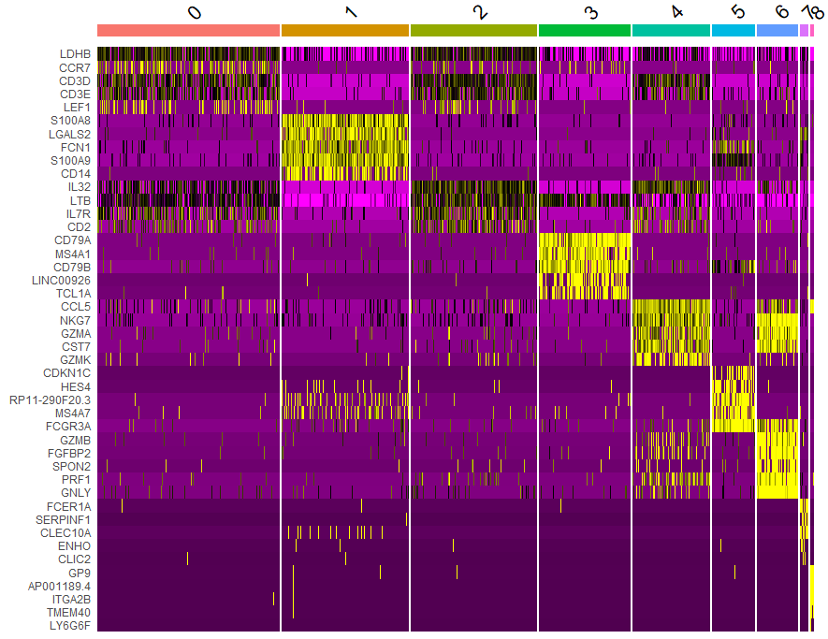
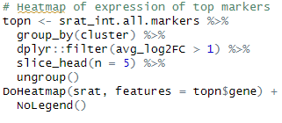
Heatmap of top 20 Genes for Each Cluster

Slide 14




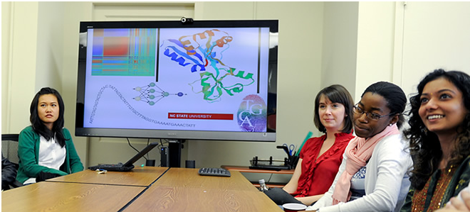
Questions?
Bridging biological research and data science for the next generation of scientific discoveries.

Slide 15
Types of Cell Marker Identification
Identification of differential markers for each cluster: compares each cluster against all others and identifies the genes that are differentially expressed. Useful for initial cell type annotation, identifying unknown clusters, and improving confidence of hypothesized cell types.
Identification of differential markers for each cluster that are conserved across conditions: identifies genes that are differentially expressed/present within each condition first, and then reports those genes that are also conserved in the cluster across all conditions. Useful for identifying constitutive markers across conditions.
Marker identification between specific clusters: this analysis explores differentially expressed genes between specific clusters.
Useful for determining differences in gene expression between clusters that appear to be representing the same celltype (i.e with markers that are similar) from the above analyses.

