Slide 1
Module 1: Introduction to Single Cell RNA-Seq
NCSU scRNA Workshop, 2024
Bruce Corliss, PhD and Allison Dickey, PhD

Slide 2
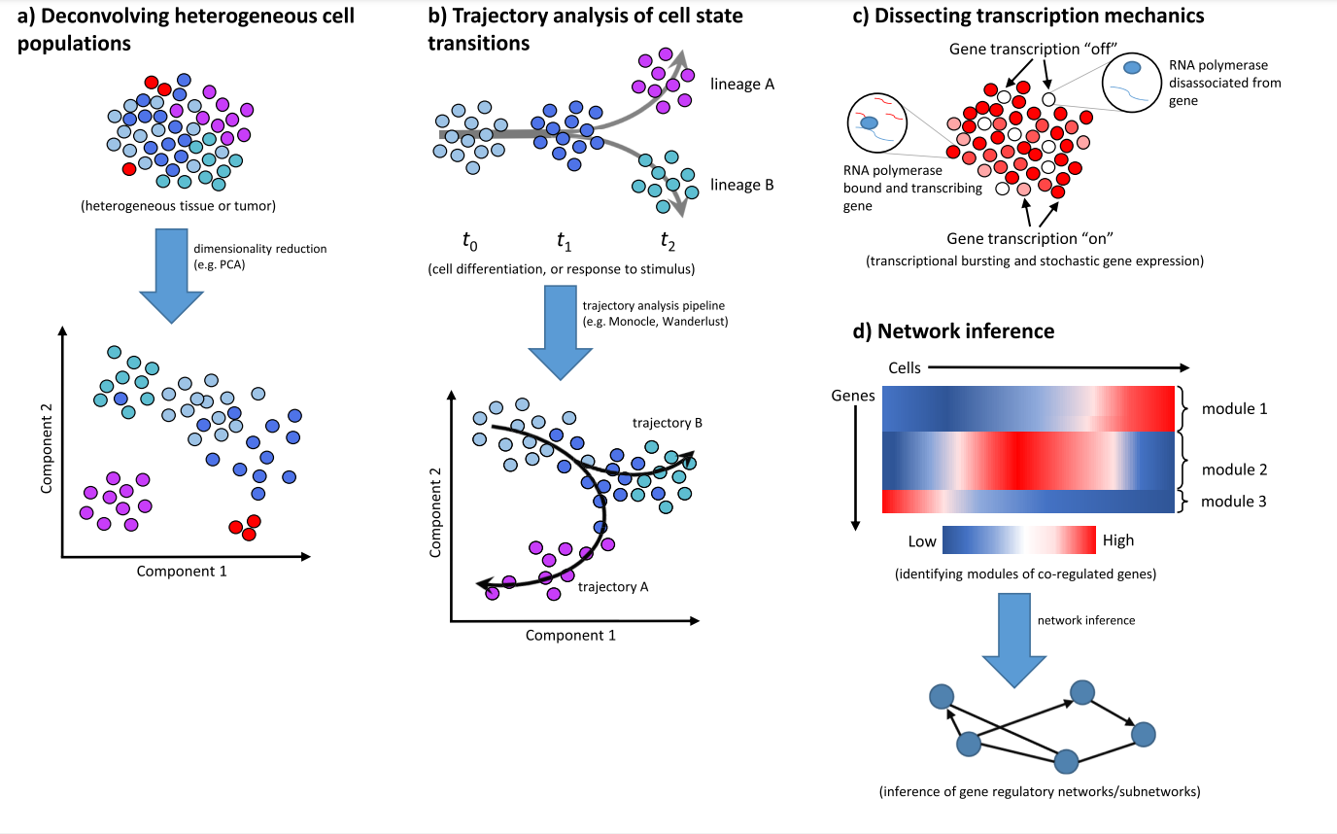
Applications of Single Cell RNA-Seq
Liu, 2016; 5: F1000 Faculty Rev-182.c
Notes:
https://www.ncbi.nlm.nih.gov/pmc/articles/PMC4758375/

Slide 3
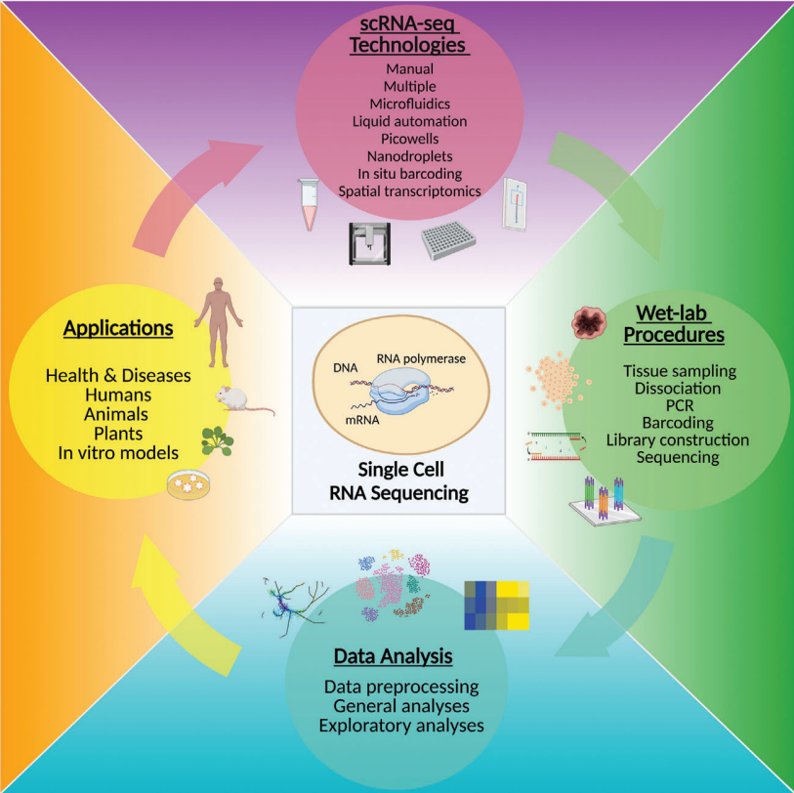
scRNA-Seq Research Lifecycle
Jovic. Clin Transl Med. 2022 Mar; 12(3): e694.
Notes:
https://www.ncbi.nlm.nih.gov/pmc/articles/PMC8964935/

Slide 4
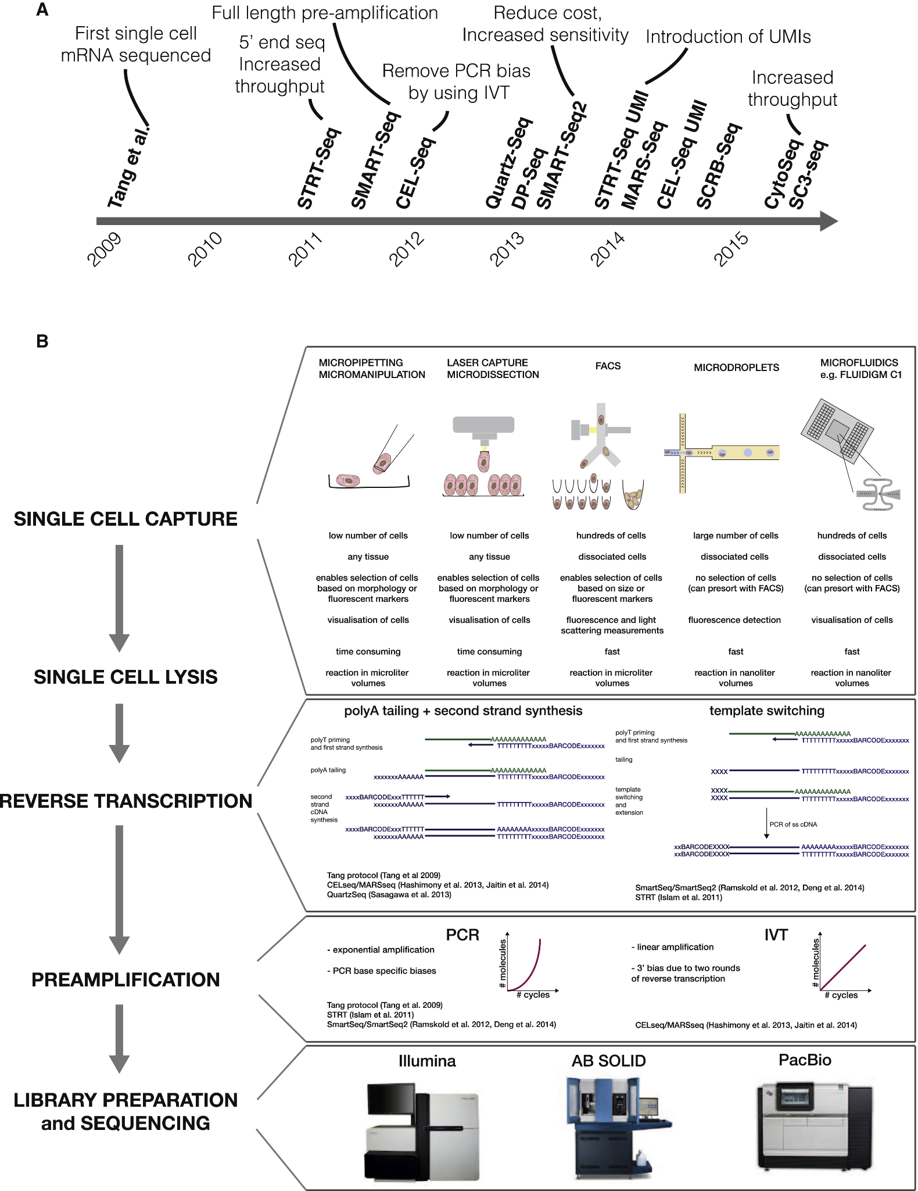
Liu, 2016; 5: F1000 Faculty Rev-182.c
Notes:
https://doi.org/10.1016/j.molcel.2015.04.005

Slide 5
Liu, 2016; 5: F1000 Faculty Rev-182.c
Notes:
https://doi.org/10.1016/j.molcel.2015.04.005

Slide 6
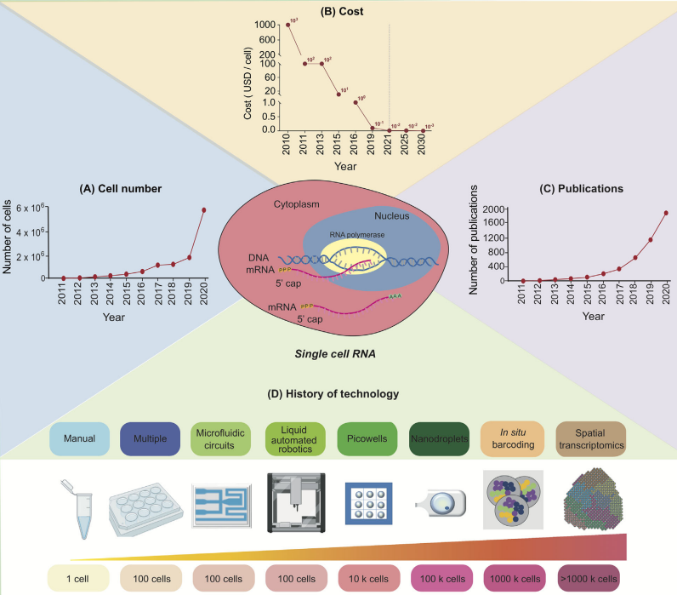
Rapid Development of Single Cell RNA Seq
Rapid rise of scRNA-Seq’s popularity
Jovic. Clin Transl Med. 2022 Mar; 12(3): e694.
Notes:
https://www.ncbi.nlm.nih.gov/pmc/articles/PMC8964935/

Slide 7
Timeline of scRNA-Seq Technologies
Notes:
https://doi.org/10.1016/j.molcel.2015.04.005

Slide 8
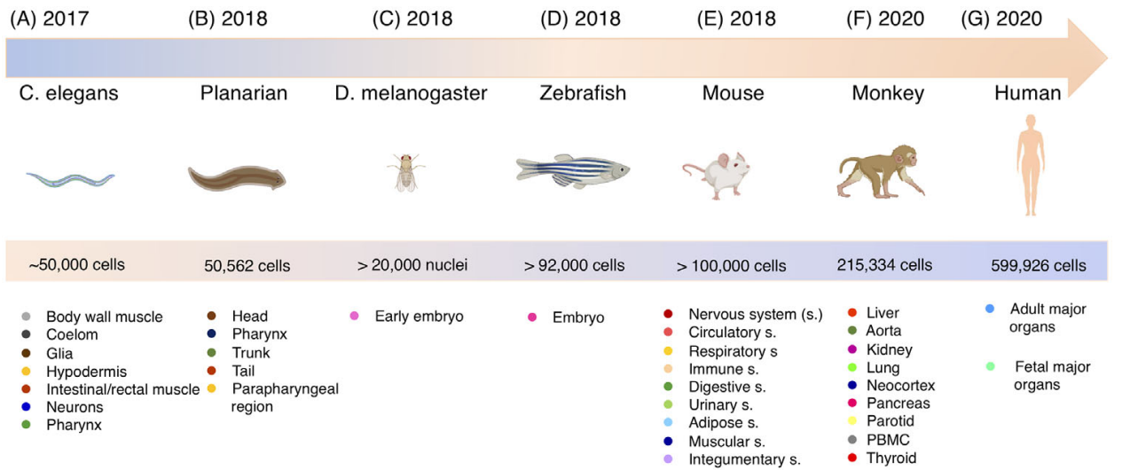
Continuous Development of Larger Atlas Datasets
Liu, 2016; 5: F1000 Faculty Rev-182.
Notes:
https://www.ncbi.nlm.nih.gov/pmc/articles/PMC4758375/

Slide 9
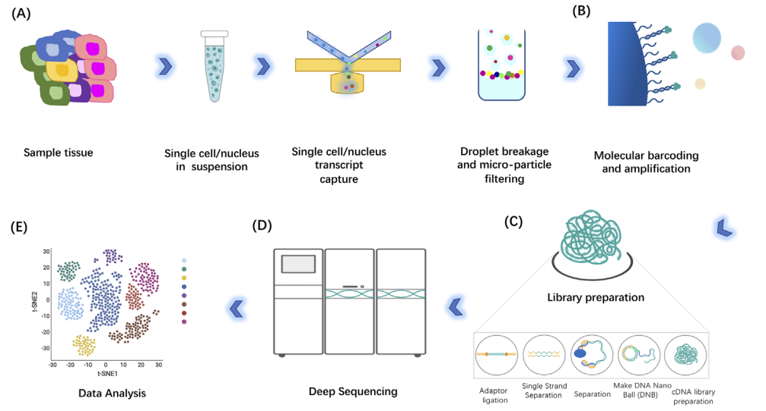
Basic single cell RNA-Seq Workflow
Liu, 2016; 5: F1000 Faculty Rev-182.
Notes:
https://www.ncbi.nlm.nih.gov/pmc/articles/PMC4758375/

Slide 10
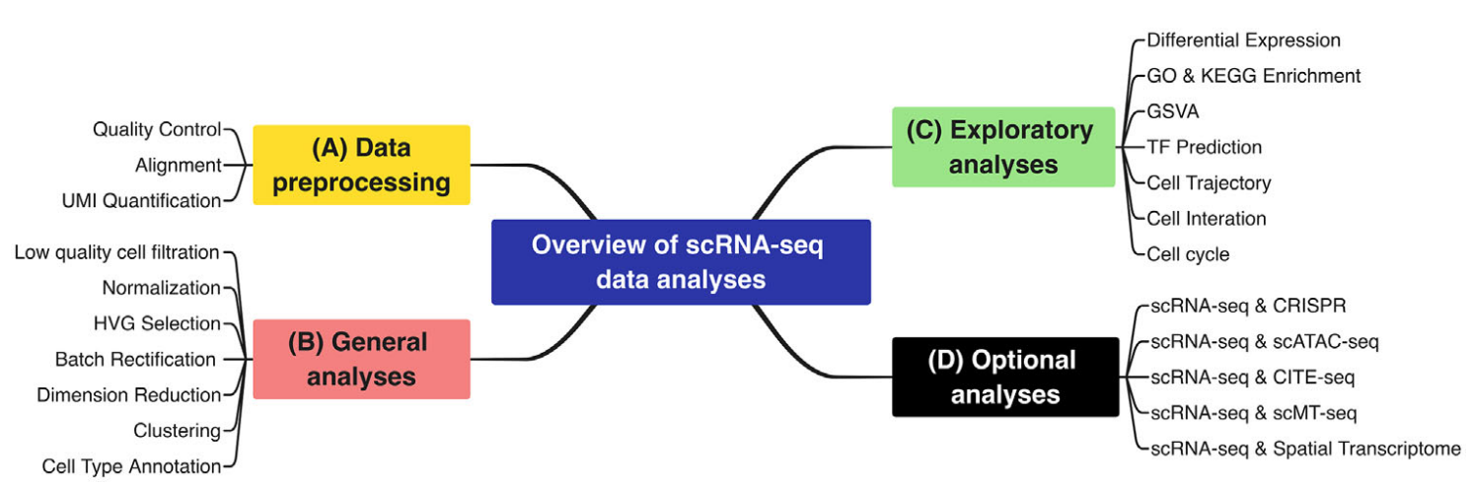
Liu, 2016; 5: F1000 Faculty Rev-182.c
Notes:
https://www.ncbi.nlm.nih.gov/pmc/articles/PMC4758375/

Slide 11
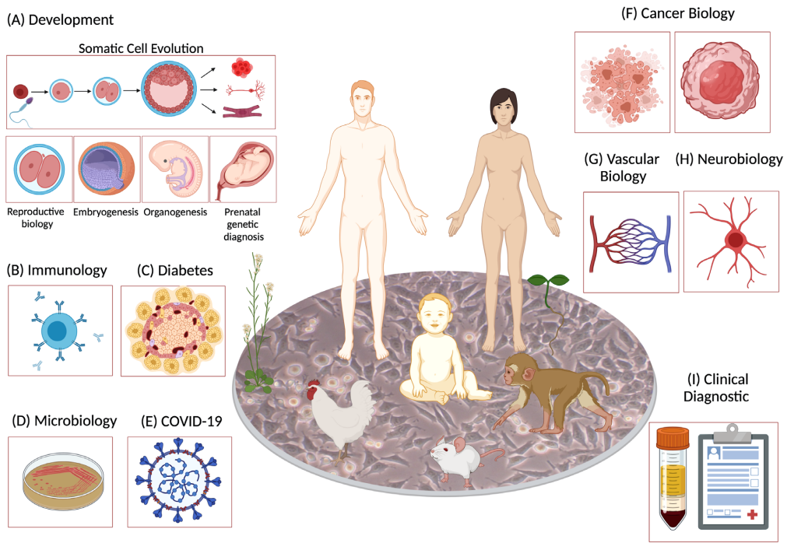
Liu, 2016; 5: F1000 Faculty Rev-182.c
Notes:
https://www.ncbi.nlm.nih.gov/pmc/articles/PMC4758375/

Slide 12
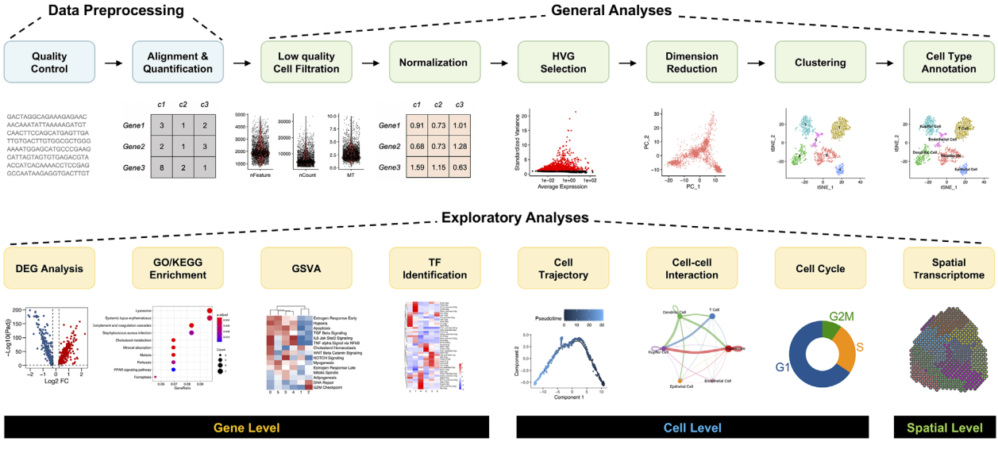
scRNA-Seq Workflow
Liu, 2016; 5: F1000 Faculty Rev-182.c
Notes:
https://www.ncbi.nlm.nih.gov/pmc/articles/PMC4758375/

Slide 13
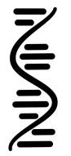

Processing Pipeline Overview
Raw Binary
Sequence
Demultiplexed Reads
Aligned Reads
Filtered feature-
barcode matrices
BCL
FastQ
BAM
SFF
Reference
Genome
VCF
HDF5
GTF
QC
GFF
Seurat
Normalization
and Scaling
Dimensionality
Reduction
Importation
Enrich Metadata
Filtering
Marker Identification
Differential Gene
Expression
Biological
Interpretation
Visualization
Clustering
Notes:
https://www.dreamstime.com/stock-illustration-dna-vector-illustration-human-structure-image49975743

Slide 14
Overview of RNA Seq pipeline

