Slide 1
Module 4: Differential Gene Analysis and Exploratory Analysis with Seurat
NCSU scRNA Workshop, 2024
Bruce Corliss, PhD and Allison Dickey, PhD

Slide 2
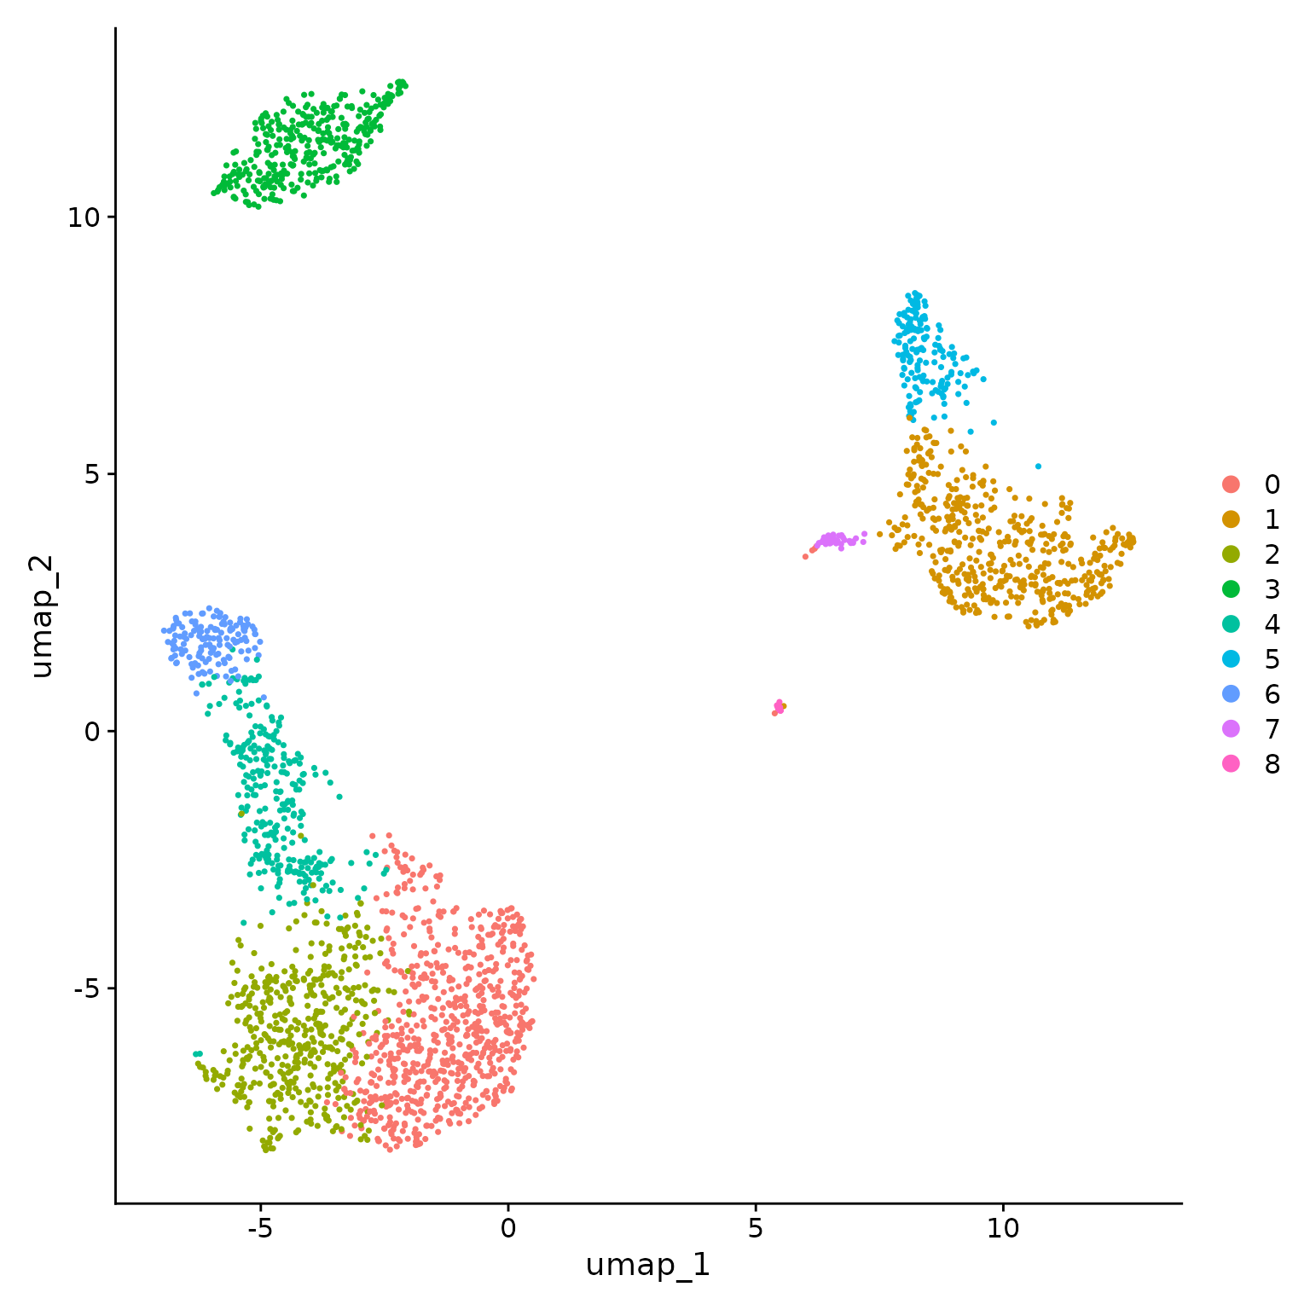
Conserved Marker Analysis
For a single study group, identify differentially expressed genes for each cluster in pairwise fashion (already covered in previous slides).
Ctrl
Tx
For two study groups, find markers that are conserved between a pair of clusters and differentially expressed versus all other clusters.
For two study groups, identify differentially expressed genes for a pair of clusters.
Ctrl
Tx
For a two study groups (with replicates), identify differentially expressed genes for each cluster in pairwise fashion.
Notes:
https://www.dreamstime.com/stock-illustration-dna-vector-illustration-human-structure-image49975743

Slide 3
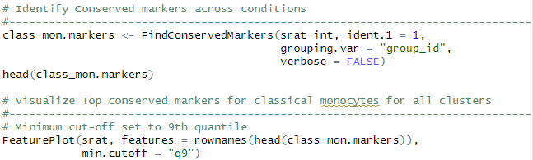
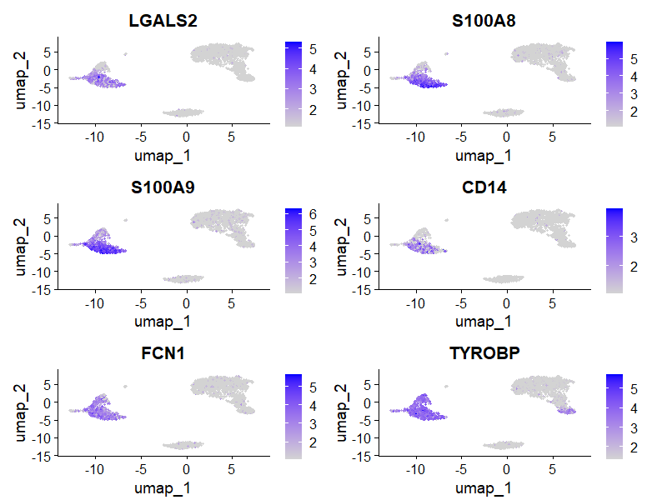
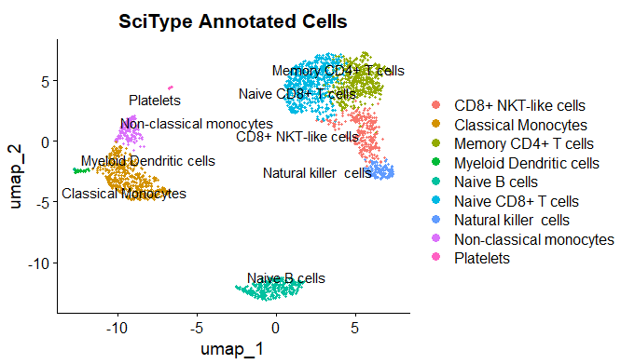
Conserved Marker Analysis
Classical Monocytes
Top Conserved Markers
Notes:
https://www.dreamstime.com/stock-illustration-dna-vector-illustration-human-structure-image49975743

Slide 4

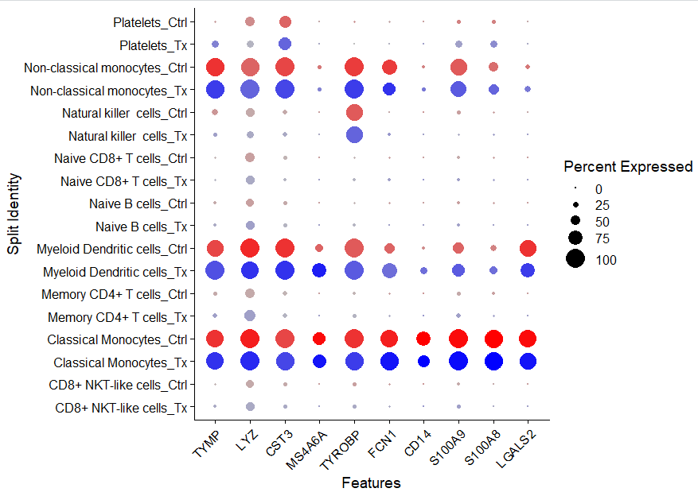
Visualizing Conserved Markers

Slide 5
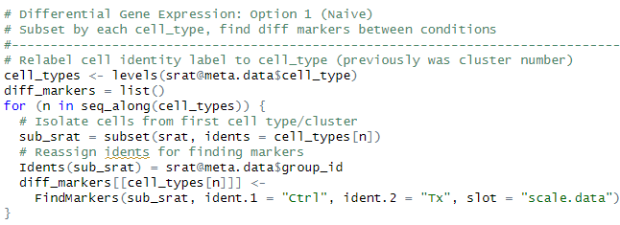
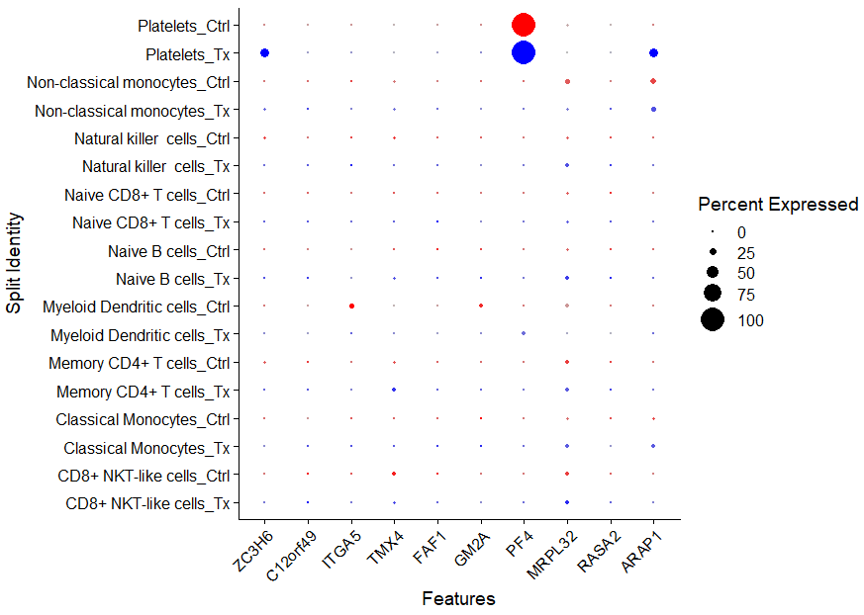
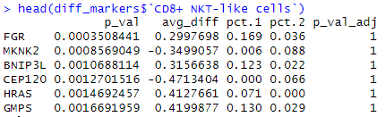
Differential Gene Expression Analysis: Single Study Group
Caution: This test treats each cell as an independent replicate and ignores inherent correlations between cells originating from the same sample (false positives).

Slide 6

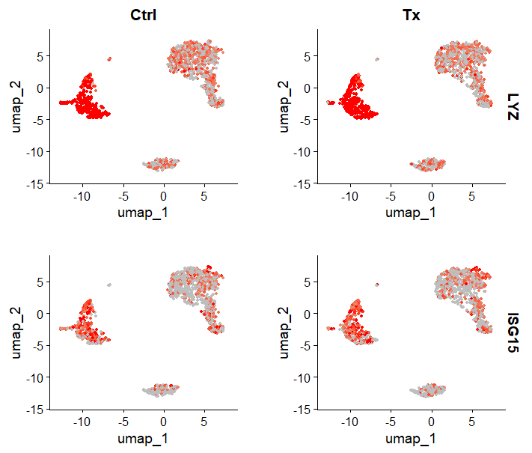

Slide 7

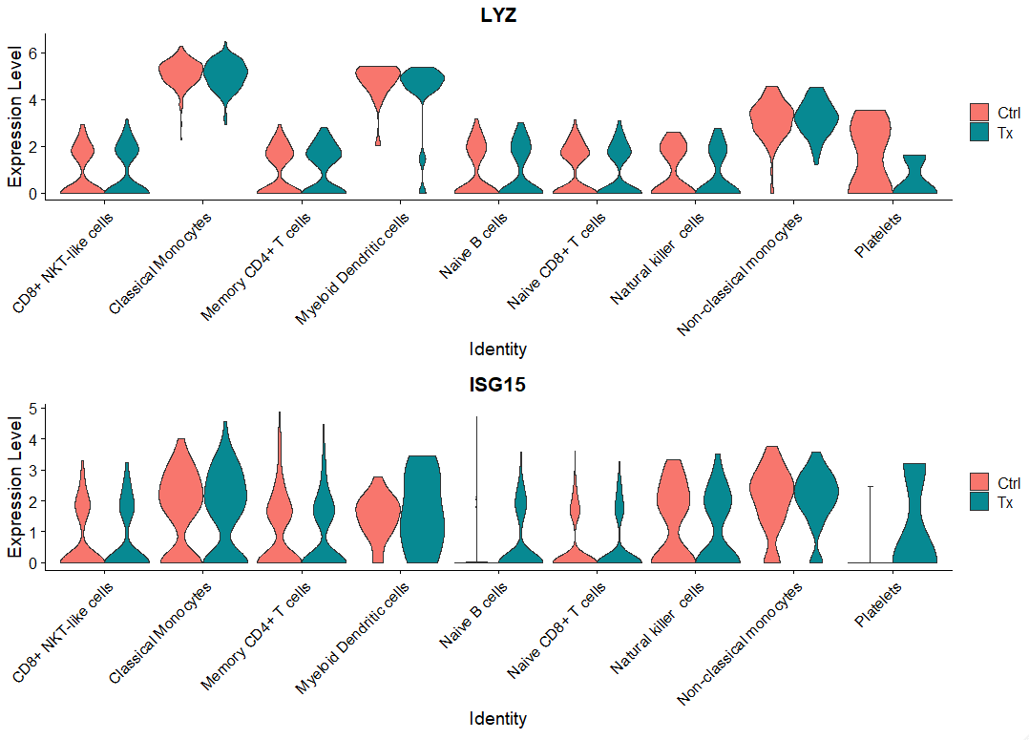
Differential Gene Expression Analysis: Single Study Group

Slide 8
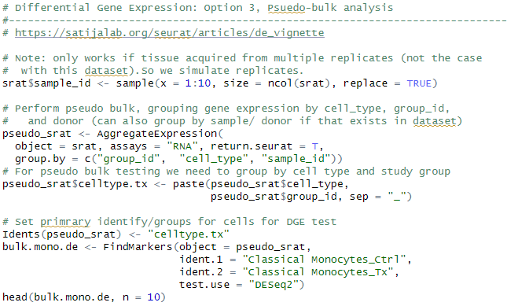
Differential Gene Expression Analysis: Pseudobulk
Pseudobulk: gene expression aggregated per sample and cell type.
independent observations = samples, rather than the individual cells (therefore accounts for within-sample correlation).

Slide 9
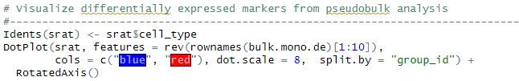
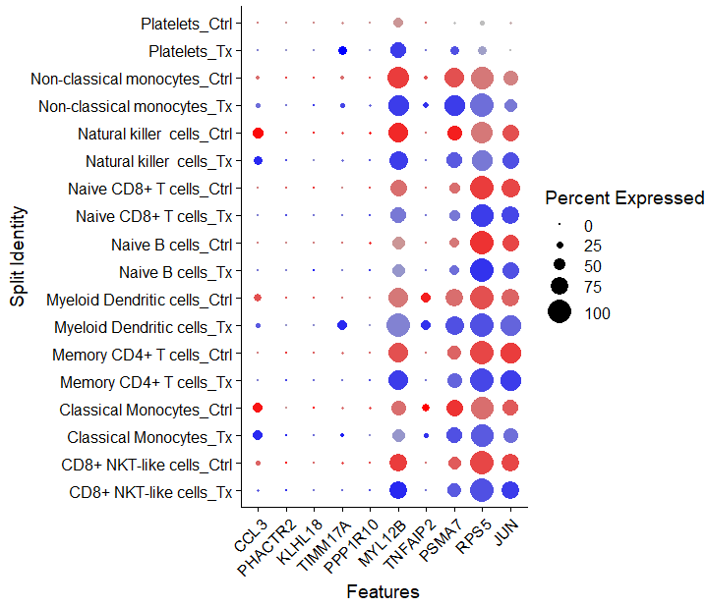
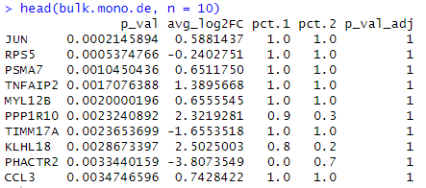
Differential Gene Expression Analysis: Pseudobulk

Slide 10

Seurat Functions for DGE
FindMarkers: will find markers between two different identity groups - you have to specify both identity groups.
FindAllMarkers: will find markers differentially expressed in each identity group by comparing it to all of the others - you don't have to manually define anything. Markers are not forced to be unique to only one group.
FindConservedMarkers: will find markers that are conserved between two groups. It means they are differentially expressed compared to other groups, but have similar expression between the two groups you're actually comparing.
Source
https://www.biostars.org/p/409790/

Slide 11
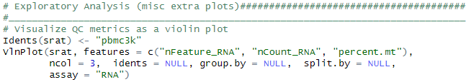
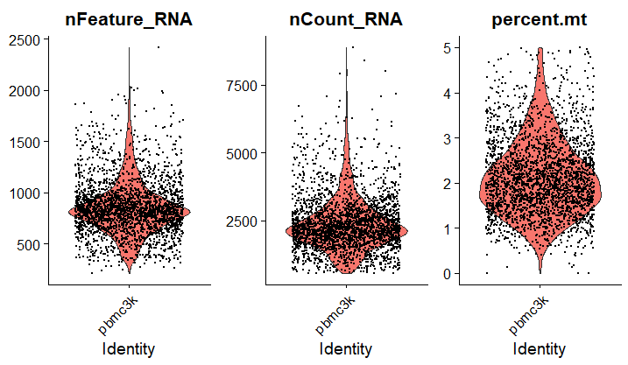
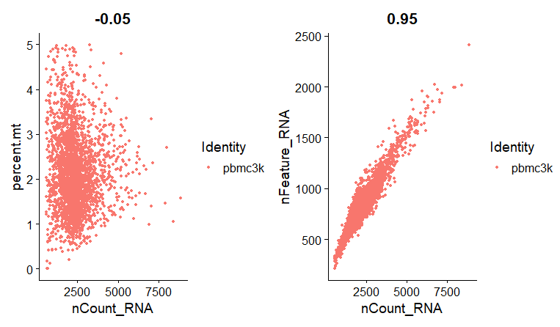
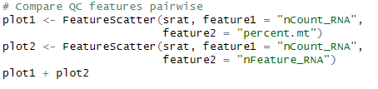
Visualizing Data import thresholds
x

Slide 12
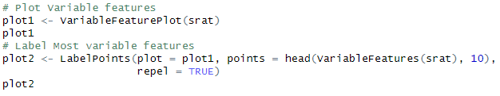
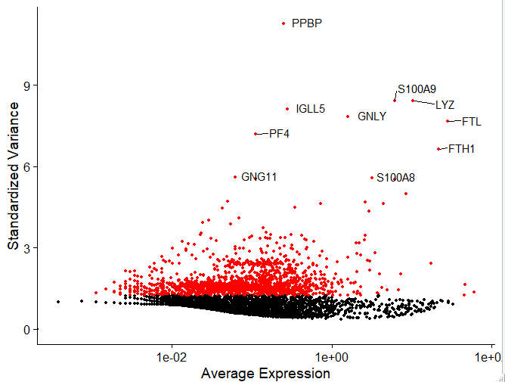
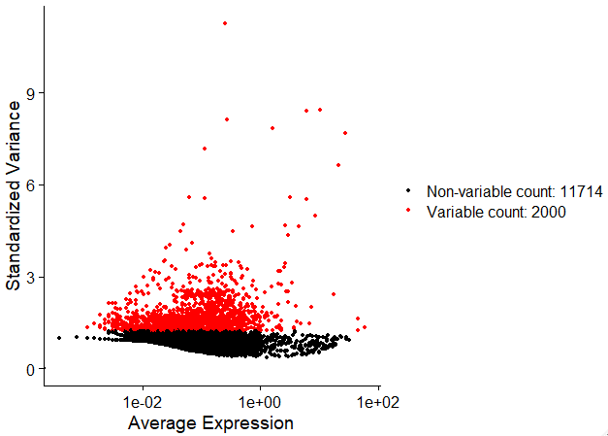
Visualize Highly Variable Features

Slide 13
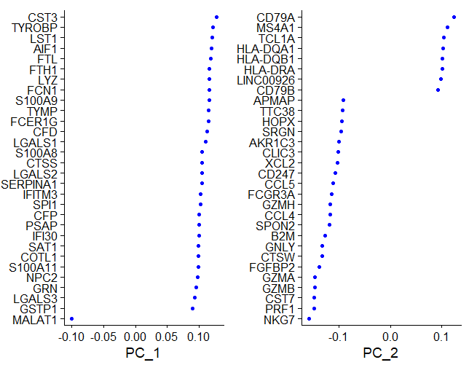
PCA Dim Laodings
Visualize loadings for principal
components in PCA analysis.
Plot: PCA Loading x Gene

Slide 14
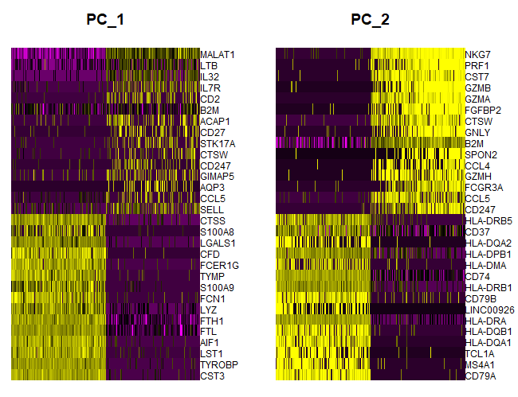
PCA Dim loadings
Plot: Cell X Gene, color is PC loading. Cells and genes sorted by PC score.

Slide 15
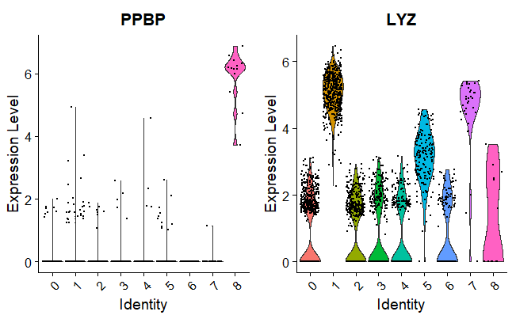
Specific Gene Expression in Each Cluster
Each datapoint is a cell, each plot is a genes, plots are Cluster X Expression.

Slide 16
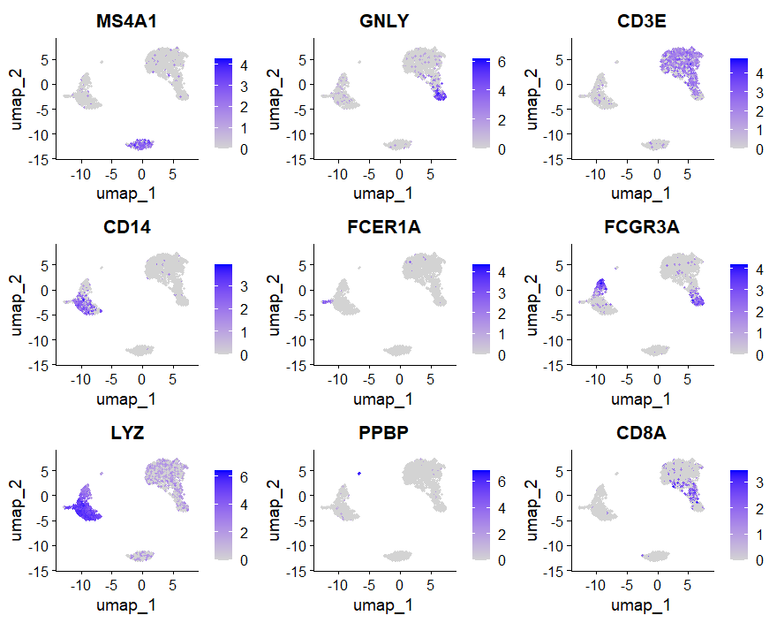
Cell Heatmap of Gene Expression

Slide 17
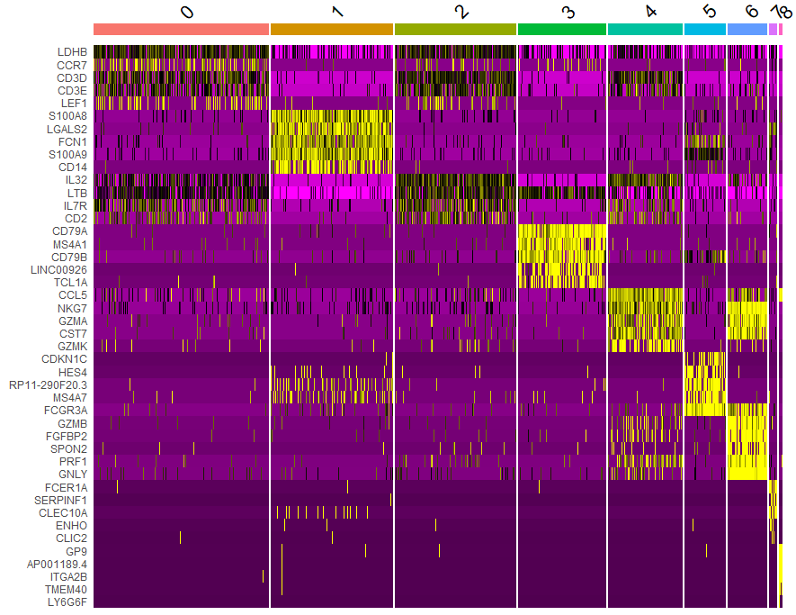
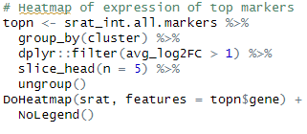
Heatmap of top 20 Genes for Each Cluster

