Slide 1
Module 2: Aligning Reads with Cell Ranger
NCSU scRNA Workshop, 2024
Bruce Corliss, PhD and Allison Dickey, PhD

Slide 2
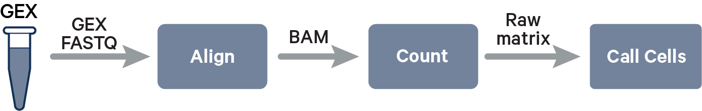
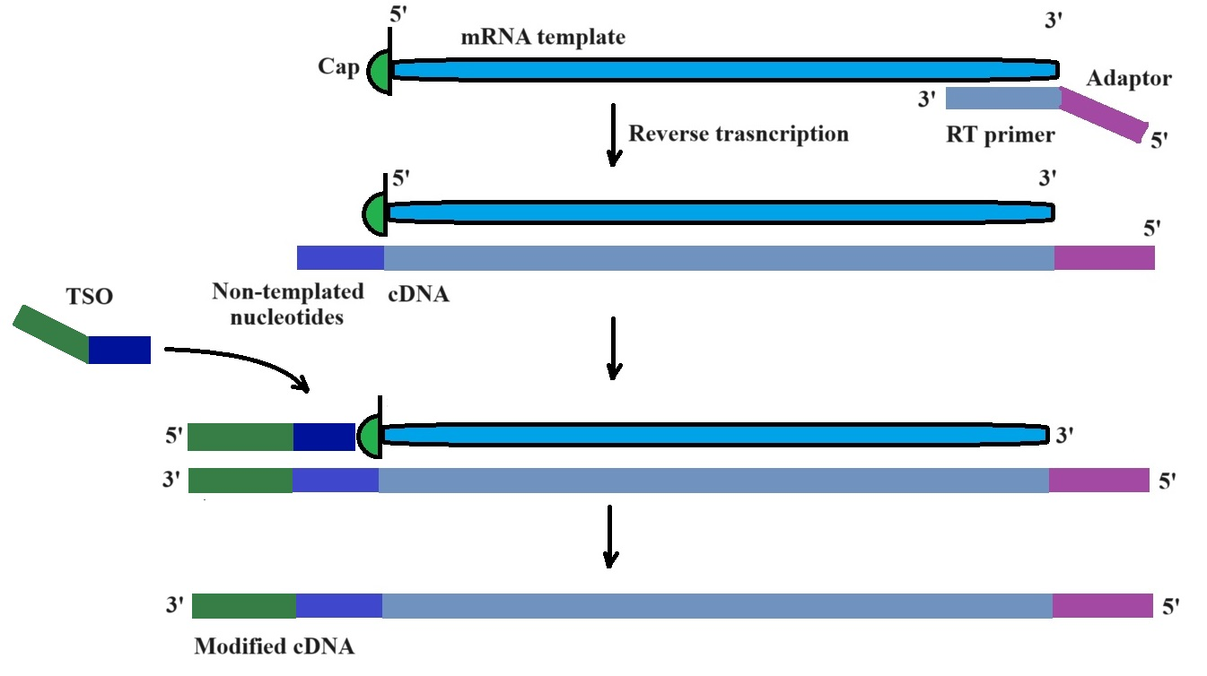
Single Cell Alignment with Cell Ranger
Many sequencing platforms use SMART technology, which uses a TS Oligo tag on the 5’ end.
Reads are a mixture of mRNA templates with some combination of tags on either end.
Cell Ranger takes these input reads and produces counts for gene expression counts.
https://www.biosyn.com/faq/What-Is-A-Template-Switching-Oligonucleotide.aspx
https://www.10xgenomics.com/support/software/cell-ranger/algorithms-overview/cr-gex-algorithm

Slide 3
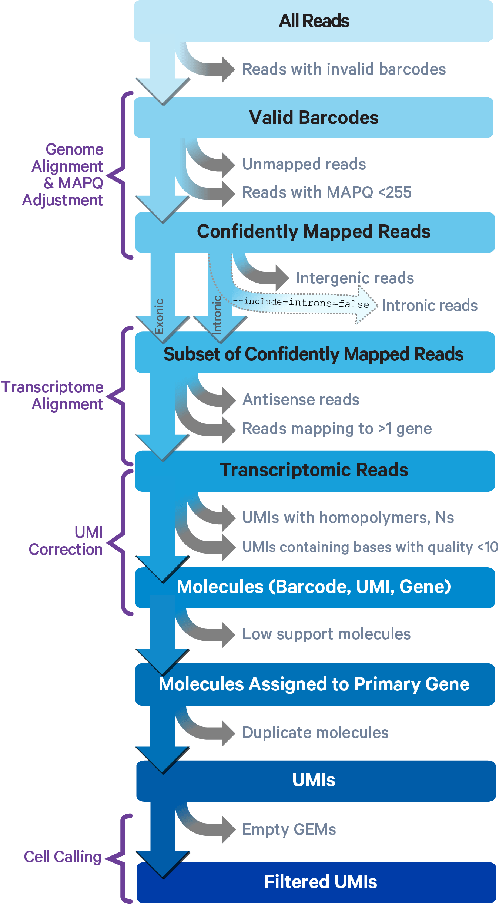


Cell Ranger Alignment: 1 - 2
1
1. Cell Ranger compares 10x barcodes to the whitelist file of known barcodes for a given assay.
2
Whitelist
3
3’
5’
3’
5’
3’
5’
3’
5’
3’
5’
3’
5’
3’
5’
~
3’
5’
4
3’
5’
~
3’
5’
3’
5’
~
3’
5’
3’
5’
~
3’
5’
3’
5’
x
3’
5’
5
3’
5’
x
3’
5’
3’
5’
x
3’
5’
6
Barcodes that don’t match any whitelist entries are statistically tested if there is sufficient evidence that they have a sequencing error and are an actual match.
If so, bar code is corrected to the closest matching entry and included, nonmatching barcodes are discarded.
7
8
9
https://www.10xgenomics.com/support/software/cell-ranger/algorithms-overview/cr-gex-algorithm

Slide 4
Cell Ranger Alignment: 1 - 2
1
2
3
2. Read trimming: the 3’ switch oligo sequence and 5’ poly-A tail are trimmed from reads in cDNA library prior to alignment.
4
Full length cDNA Reads
Trimmed cDNA Reads
5
6
7
8
9
https://www.10xgenomics.com/support/software/cell-ranger/algorithms-overview/cr-gex-algorithm

Slide 5
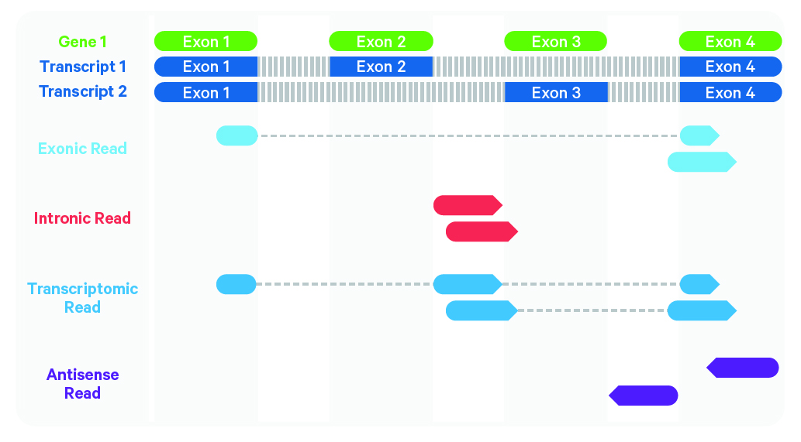
Cell Ranger Alignment: 3 - 4
1
Cell Ranger uses the STAR aligner, which perform splicing-aware alignment of reads to the genome.
2
3
Reference
Genome
4
5
Experiment
Reads
6
7
Antisense reads are discarded because they are not part of the transcriptome.
8
Intronic reads are discarded for basic gene expression investigations.
9
https://www.10xgenomics.com/support/software/cell-ranger/algorithms-overview/cr-gex-algorithm

Slide 6
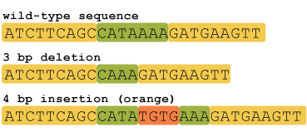
Cell Ranger Alignment: 5 - 6
1
5. Cell Ranger Discards Low Quality Reads
Quality = mapping to a specific genome location with high confidence.
Must not contain bases with base quality < 10
Must not contain N
Must not be a homopolymer, e.g. AAAAAAAAAA
2
3
Homopolymer reads (2+ repeat bases): known to be sources of error for DNA sequencing because it’s difficult to distinguish number of repeats beyond 2 (leads to alignment errors for the rest of reads.
1.43 million homopolymer regions in human genome.
4
5
6
6. Cell Ranger performs Umi counting
Reads are grouped by barcode, UMI, and gene annotation
If there are reads with same barcode and UMI but different gene annotations, discards the annotation with lease supported reads (low support molecules).
7
8
Output counts: unfiltered featured-barcode matrix
9
https://www.10xgenomics.com/support/software/cell-ranger/algorithms-overview/cr-gex-algorithm
https://hackbrightacademy.com/blog/indel-finder-how-the-python-version-of-this-program-works/

Slide 7
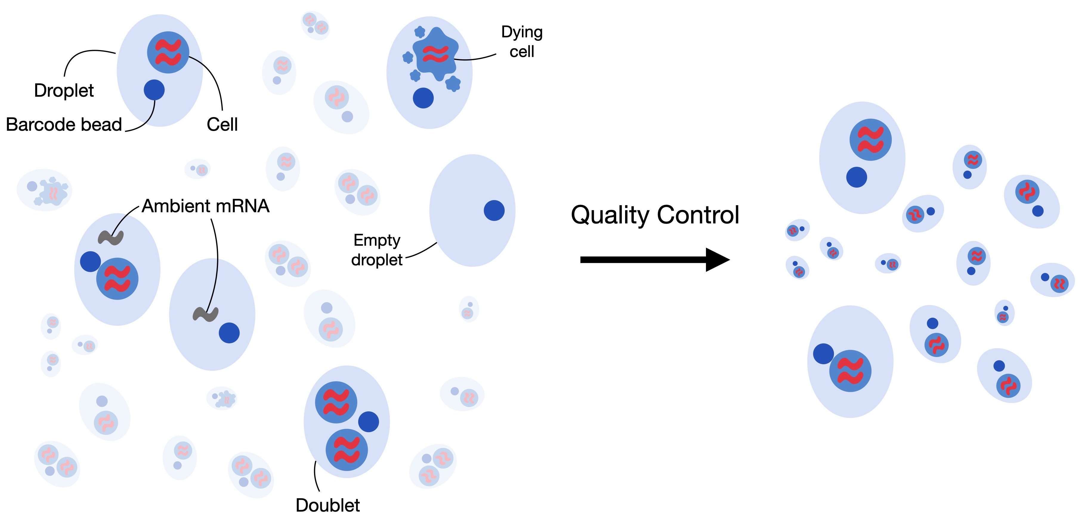
Cell Ranger Alignment: 7 - 9
1
7. Discard duplicate molecules
2
3
????
4
8. Discard Empty GEMs (gel bead in emulsion droplets).
5
6
7
8
>> Output results: filtered featured-barcode matrix
9
https://www.10xgenomics.com/support/software/cell-ranger/algorithms-overview/cr-gex-algorithm

Slide 8
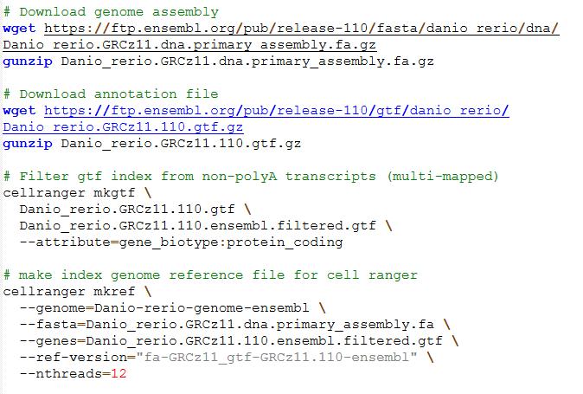
Cell Ranger Indexed Reference Genome Script

Slide 9
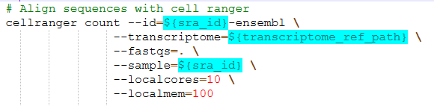

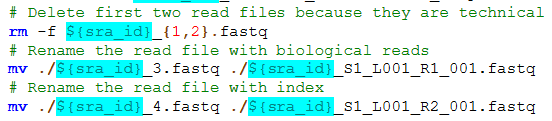
Cell Ranger Alignment Script
Example script found in /M2_CellRanger_Alignment/align_zebrahub_sra.sh
./SRR23691690
./SRR23691690_1.fastq
./SRR23691690_2.fastq
./SRR23691690_3.fastq
./SRR23691690_4.fastq
./SRR23691690_S1_L001_R1_001.fastq
./SRR23691690_S1_L001_R2_001.fastq
https://www.10xgenomics.com/support/software/cell-ranger/algorithms-overview/cr-gex-algorithm

Slide 10
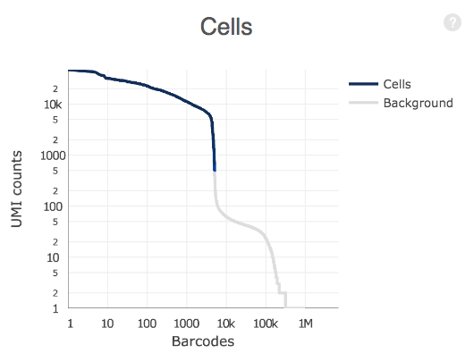
Cell Ranger Outputs
>> matrix.mtx
>> features.tsv
>> barcodes.tsv
Unfiltered featured-barcode matrix: raw gene-barcode matrix includes all valid barcodes from GEMs (Gel Bead-In EMulsions) captured in the data. However, because most GEMs do not actually contain cells, it follows that most barcodes in the data do not correspond to cells, but rather background noise (e.g. GEMs with free-floating mRNA from lysed or dead cells).
Filtered featured-barcode matrix: The filtered gene-barcode matrix excludes barcodes that correspond to this background noise. This can be visualized in the barcode vs UMI count rank plot in the web summary file.
Notes:
In the example plot below, UMI counts are on the y-axis ranging from 0 to 10,000 in log scale. Barcodes are on the x-axis, ranked from 0 to 1,000,000 also in log scale. Cell-associated barcodes as determined by the cell-calling heuristic are in blue while background barcodes are in gray.

Slide 11
Key Cell Ranger Parameters for Alignment
Reference Genome
Can significantly influence number of Reads/Cells
https://www.10xgenomics.com/support/software/cell-ranger/algorithms-overview/cr-gex-algorithm

Slide 12
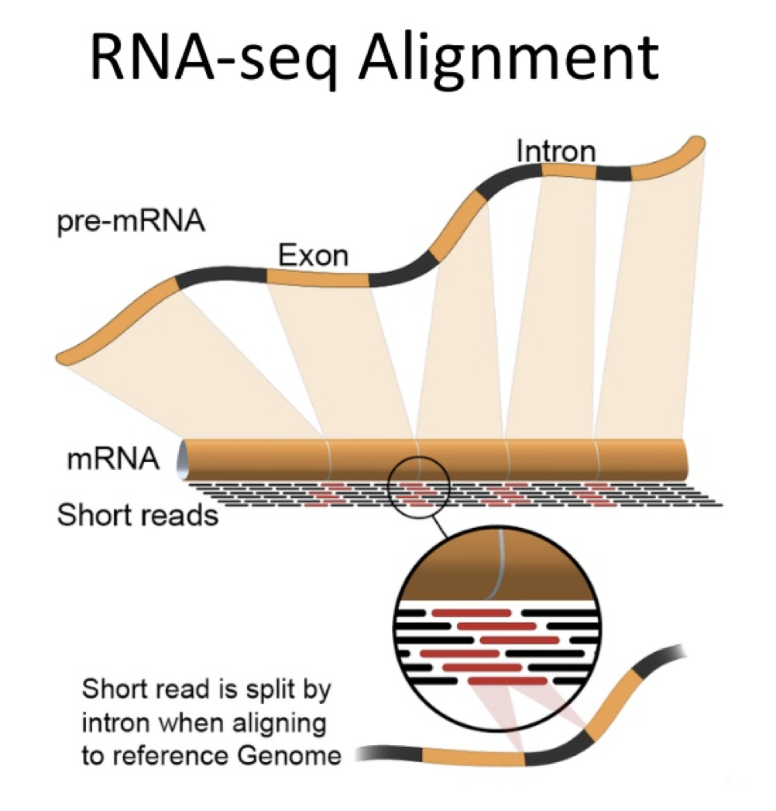
Questions?
1
2
3
4
5
6
7
8
https://bioinformatics.ccr.cancer.gov/docs/b4b/RNASeq_Overview/05.Alignment/
9

