Slide 1
Module 6: Pseudotime Analysis with Monocle3
NCSU scRNA Workshop, 2024
Bruce Corliss, PhD and Allison Dickey, PhD

Slide 2
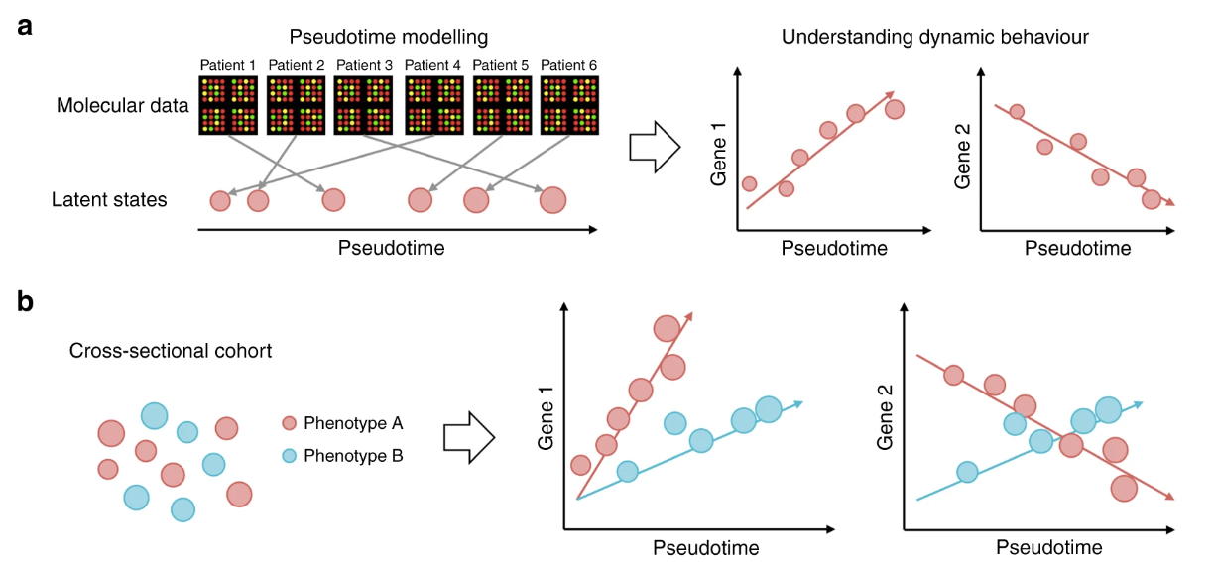
What is Pseudotime Analysis?
pseudotimes measure the relative progression of each of the individuals along the biological process of interest, e.g., disease progression, cellular development, etc., allowing us to understand the (pseudo)temporal behaviour of measured features without explicit time series data
Determining a cell trajectory can give insight to the biological question.
There is prior knowledge that a trajectory/ cellular differentiation pathway exists.
There is sufficient sampling with number of cells and between timepoints.
Notes:
https://www.dreamstime.com/stock-illustration-dna-vector-illustration-human-structure-image49975743

Slide 3
Monocle3 Pipeline, Overlap with Seurat
Seurat
Monocle3
Metadata Curation
Normalization
Subset Trajectory
PercentageFeatureSet()
preprocess_cds()
Filtering
Integration
choose_graph_segments()
subset()
align_cds()
Monocle3 has it’s own scRNA-Seq processing pipeline.
Reprocess Trajectory
Normalization
Linear Dimensional
Reduction
NormalizeData()
FindVariableFeatures()
Scaling
reduce_dimension()
Find Altered Genes
Can import data from Seurat to preserve clustering assignments.
ScaleData()
Nonlinear Dimension Reduction,
Clustering,
Partitioning
find_gene_modules()
Linear Dimensional
Reduction
Aggregate to Gene Modules
RunPCA(), ElbowPlot()
aggregate_gene_expression()
Partition: Cluster of clusters (metaclusters).
Seurat Bridge
cluster_cells ()
Clustering
FindNeighbors(), FindClusters()
Visualize Gene Modules
Trajectory Graph
Nonlinear Dimension Reduction
learn_graph()
Order Cells
RunUMAP(), DimPlot()
order_cells()
Notes:
https://www.dreamstime.com/stock-illustration-dna-vector-illustration-human-structure-image49975743

Slide 4
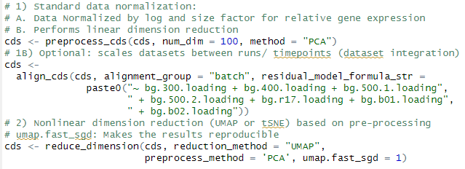
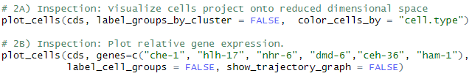
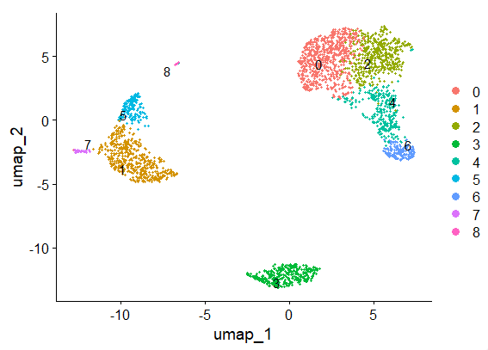
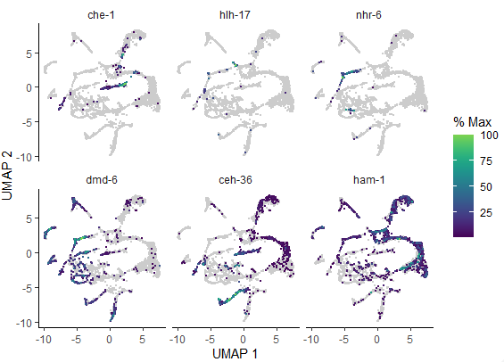
Monocle3
Normalization
Subset Trajectory
preprocess_cds()
Integration
choose_graph_segments()
align_cds()
Reprocess Trajectory
Linear Dimensional
Reduction
reduce_dimension()
Find Altered Genes
Nonlinear Dimension Reduction,
Clustering,
Partitioning
find_gene_modules()
Aggregate to Gene Modules
aggregate_gene_expression()
cluster_cells ()
Visualize Gene Modules
Trajectory Graph
learn_graph()
Order Cells
order_cells()

Slide 5

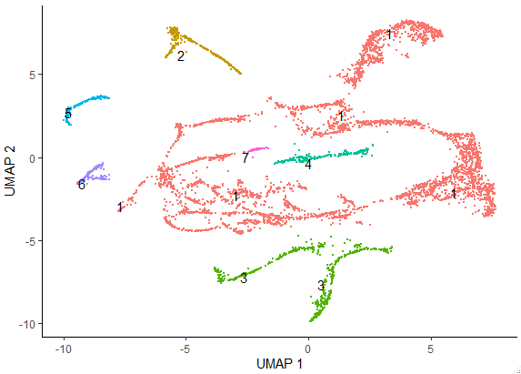
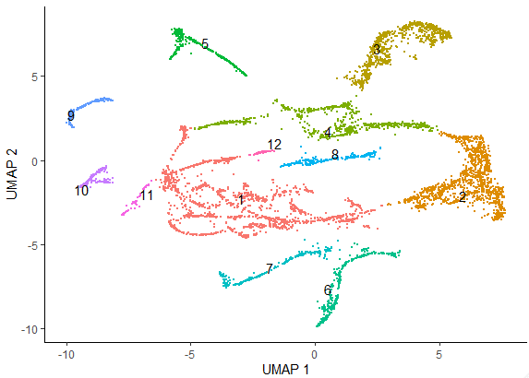
Monocle3
Normalization
Subset Trajectory
preprocess_cds()
Integration
choose_graph_segments()
align_cds()
Reprocess Trajectory
Linear Dimensional
Reduction
Partitions
Clusters
reduce_dimension()
Find Altered Genes
Nonlinear Dimension Reduction,
Clustering,
Partitioning
find_gene_modules()
Aggregate to Gene Modules
aggregate_gene_expression()
cluster_cells ()
Visualize Gene Modules
Trajectory Graph
learn_graph()
Order Cells
A partition contains one or more clusters.
order_cells()

Slide 6
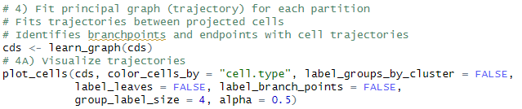
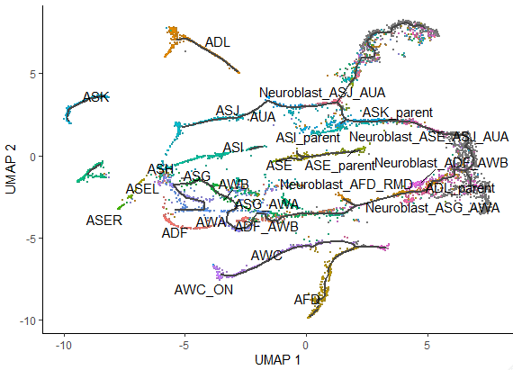
Monocle3
Normalization
Subset Trajectory
preprocess_cds()
Integration
choose_graph_segments()
align_cds()
Reprocess Trajectory
Linear Dimensional
Reduction
reduce_dimension()
Find Altered Genes
Nonlinear Dimension Reduction,
Clustering,
Partitioning
find_gene_modules()
Aggregate to Gene Modules
aggregate_gene_expression()
cluster_cells ()
Visualize Gene Modules
Trajectory Graph
learn_graph()
Order Cells
order_cells()

Slide 7
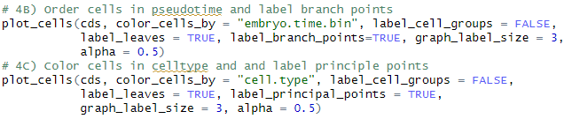
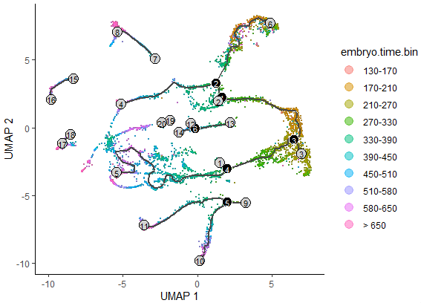
Monocle3
Normalization
Subset Trajectory
preprocess_cds()
Integration
choose_graph_segments()
align_cds()
Reprocess Trajectory
Linear Dimensional
Reduction
reduce_dimension()
Find Altered Genes
Nonlinear Dimension Reduction,
Clustering,
Partitioning
find_gene_modules()
Aggregate to Gene Modules
aggregate_gene_expression()
cluster_cells ()
Visualize Gene Modules
Trajectory Graph
learn_graph()
Order Cells
order_cells()

Slide 8
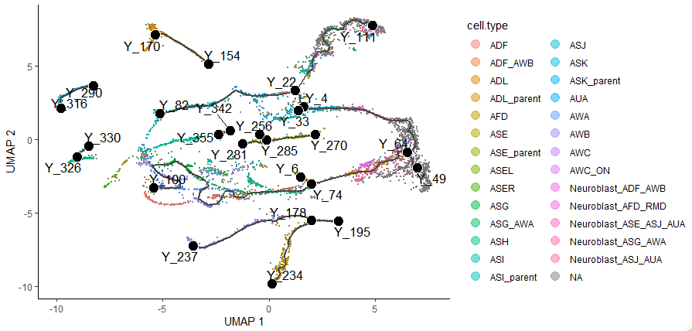
Monocle3
Normalization
Subset Trajectory
preprocess_cds()
Integration
choose_graph_segments()
align_cds()
Reprocess Trajectory
Linear Dimensional
Reduction
reduce_dimension()
Find Altered Genes
Nonlinear Dimension Reduction,
Clustering,
Partitioning
find_gene_modules()
Aggregate to Gene Modules
aggregate_gene_expression()
cluster_cells ()
Visualize Gene Modules
Trajectory Graph
learn_graph()
Order Cells
order_cells()

Slide 9
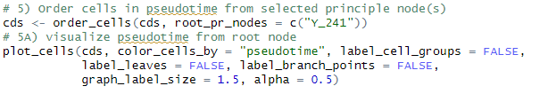
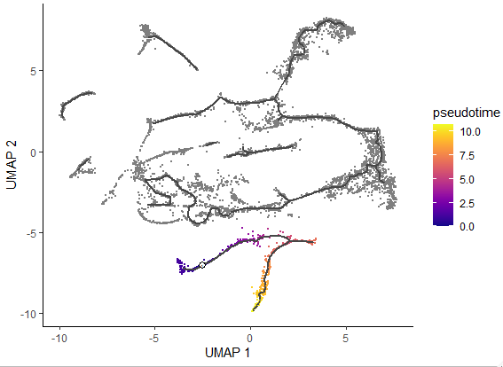
Monocle3
Normalization
Subset Trajectory
preprocess_cds()
Integration
choose_graph_segments()
align_cds()
Reprocess Trajectory
Linear Dimensional
Reduction
reduce_dimension()
Find Altered Genes
Nonlinear Dimension Reduction,
Clustering,
Partitioning
find_gene_modules()
Aggregate to Gene Modules
aggregate_gene_expression()
cluster_cells ()
Visualize Gene Modules
Trajectory Graph
learn_graph()
Order Cells
order_cells()

Slide 10
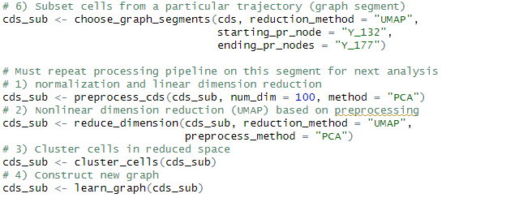

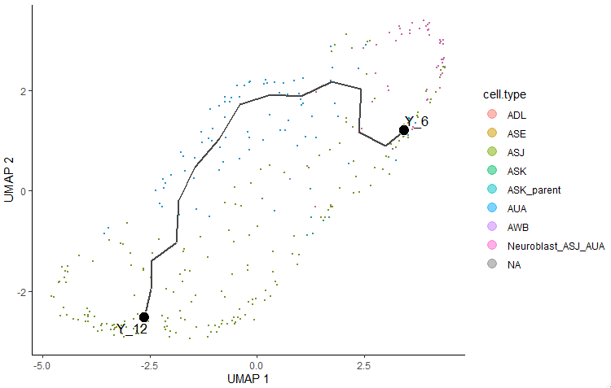
Monocle3
Normalization
Subset Trajectory
preprocess_cds()
Integration
choose_graph_segments()
align_cds()
Reprocess Trajectory
Linear Dimensional
Reduction
reduce_dimension()
Find Altered Genes
Nonlinear Dimension Reduction,
Clustering,
Partitioning
find_gene_modules()
Aggregate to Gene Modules
aggregate_gene_expression()
cluster_cells ()
Visualize Gene Modules
Trajectory Graph
learn_graph()
Order Cells
order_cells()

Slide 11
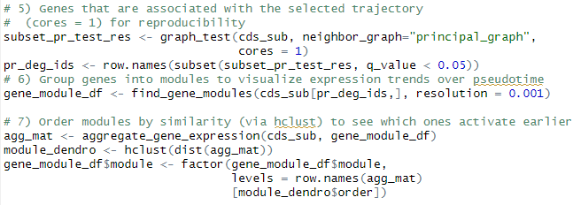

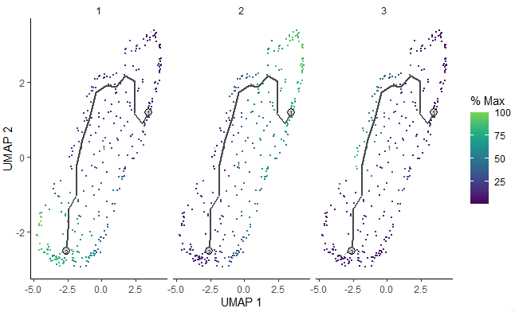
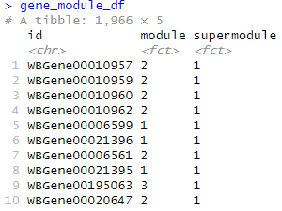
Monocle3
Normalization
Subset Trajectory
preprocess_cds()
Integration
choose_graph_segments()
align_cds()
Reprocess Trajectory
Linear Dimensional
Reduction
reduce_dimension()
Find Altered Genes
Nonlinear Dimension Reduction,
Clustering,
Partitioning
find_gene_modules()
Aggregate to Gene Modules
aggregate_gene_expression()
cluster_cells ()
Visualize Gene Modules
Trajectory Graph
learn_graph()
Order Cells
order_cells()

