Slide 1
Module 0: Workshop Introduction
NCSU scRNA Workshop, 2024
Bruce Corliss, PhD and Allison Dickey, PhD

Slide 2

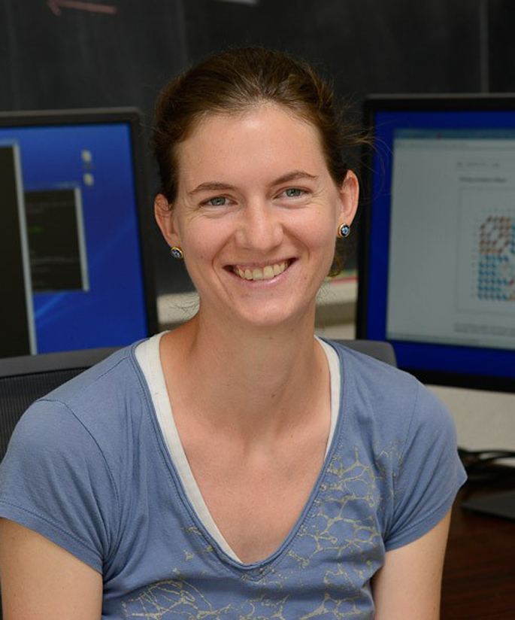
Meet your Instructors
Bruce Corliss, PhD
Research Bioinformatician at NC State
Allison Dickey, PhD

Slide 3
Learning Objectives
Overarching Purpose: to help participants beat the steep learning curve
Learn about advantages and disadvantages of scRNA-Seq technologies.
Understand
Use Seurat to process snRNA-Seq data using standard settings.
Understand considerations for when to change from defaults.
Use Monocle to analyze pseudotime data.

Slide 4
Overview of Course Modules

Slide 5

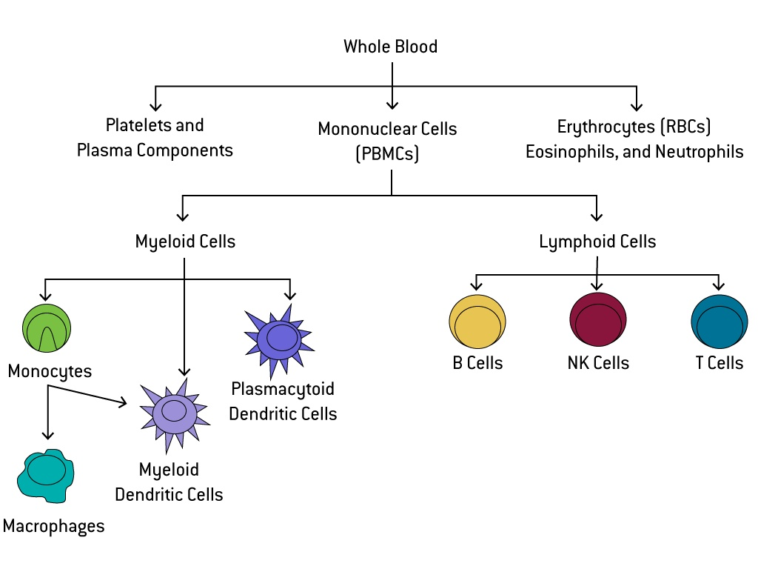
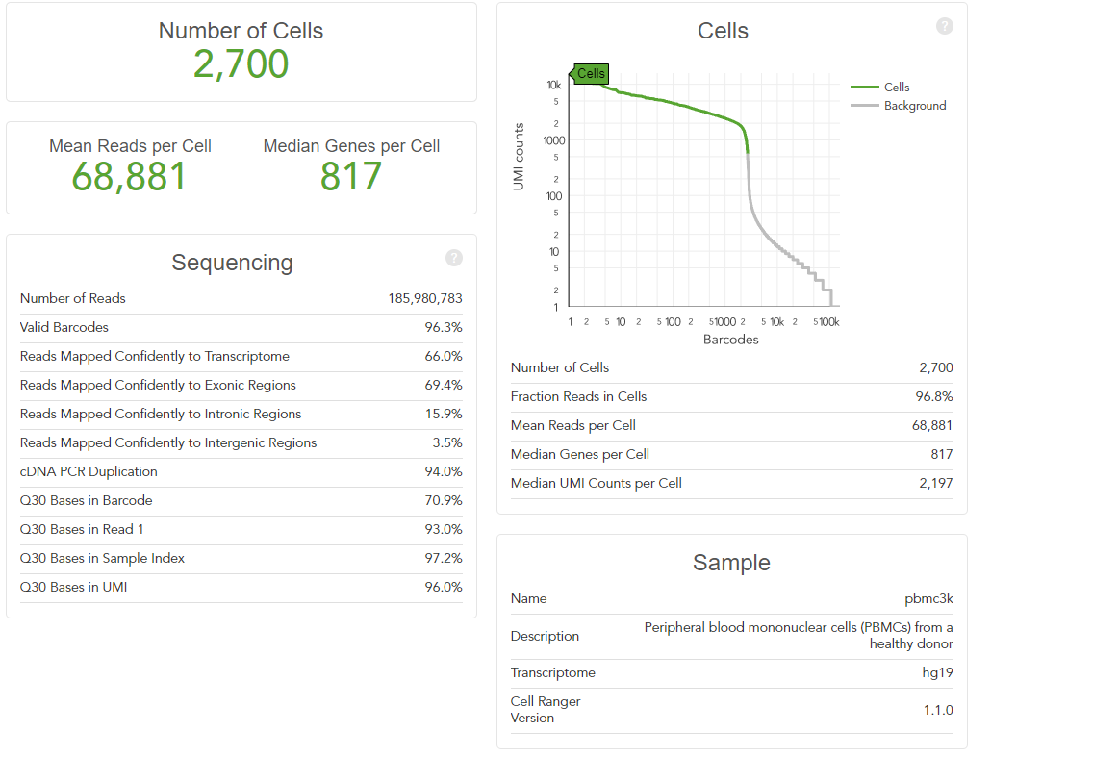
The Teaching Dataset
Peripheral blood mononuclear cells (PBMCs) from a healthy donor
Used for all powerpoints and the test_pipeline.R script.
Artificially altered for Dataset Integration, Differential Gene Expression, and Cell Trajectory/ Pseudotime Analysis to illustrate the null case.

Slide 6
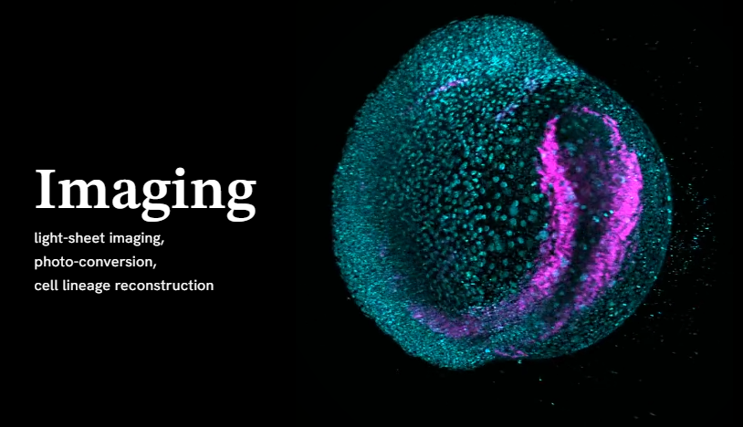
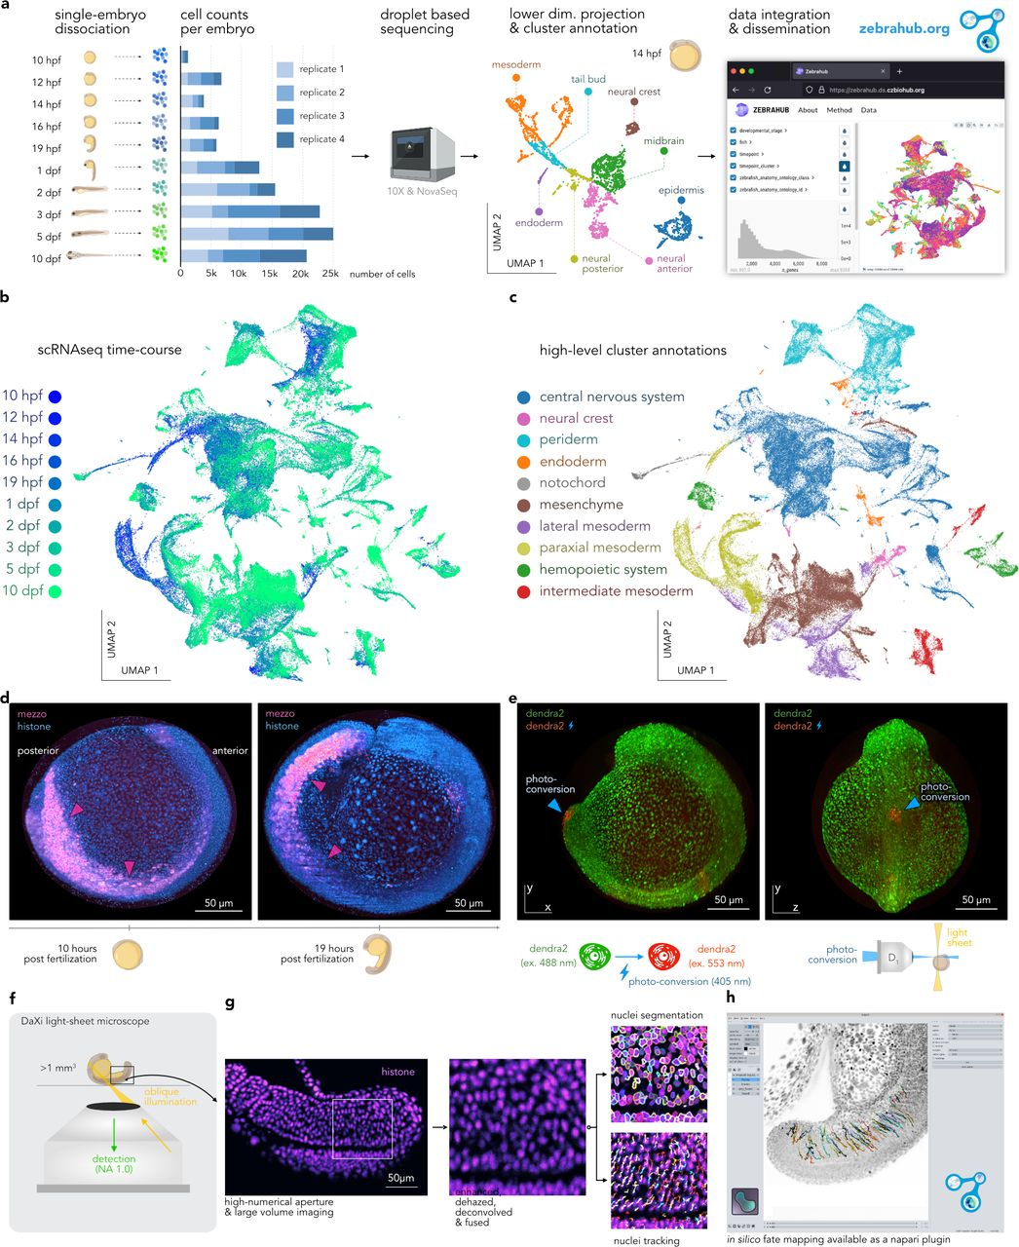
The Interactive Dataset
Zebrahub is a comprehensive atlas of zebrafish embryonic development.
Technologies: single-cell RNA sequencing and live light-sheet imaging.
Provides a complete cartography of cellular lineages in space, time, and molecular domains, an essential step toward understanding how organisms develop.
Zebrahub - Multimodal Zebrafish Developmental Atlas Reveals the State Transition Dynamics of Late Vertebrate Pluripotent Axial Progenitors. Lange et al. BioRxiv 2023.

Slide 7

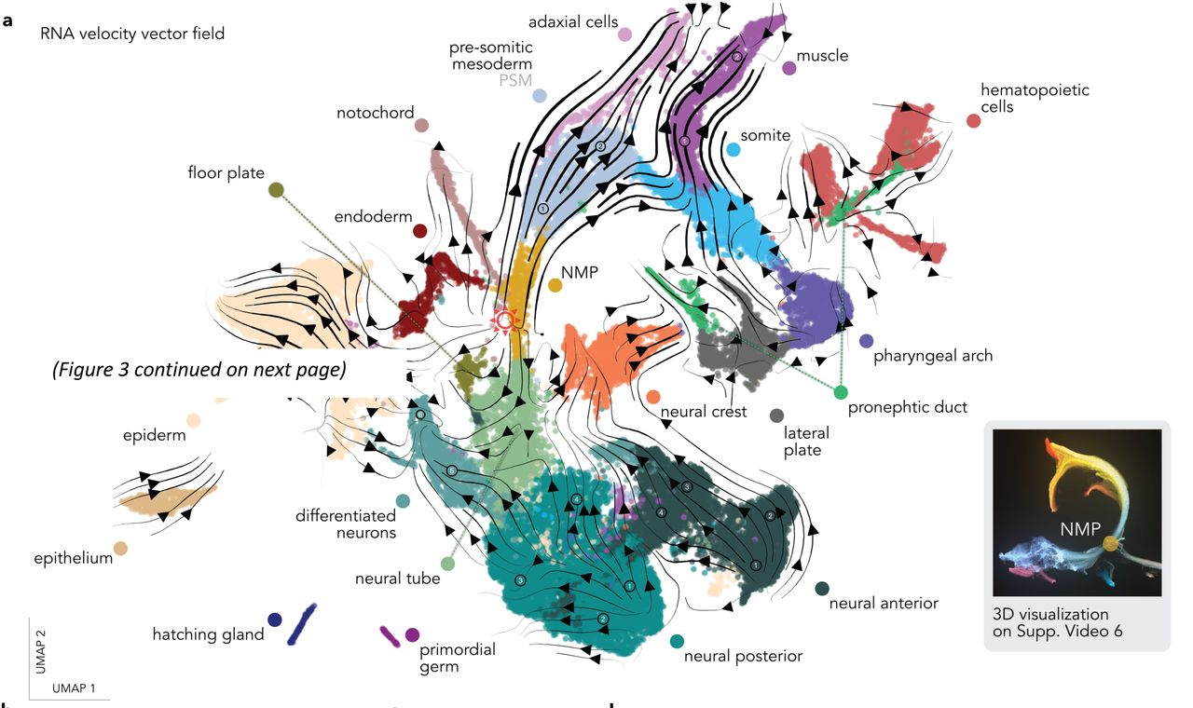
The Interactive Dataset
Cell type annotated and embryonic tissue annotated.
Zebrahub - Multimodal Zebrafish Developmental Atlas Reveals the State Transition Dynamics of Late Vertebrate Pluripotent Axial Progenitors. Lange et al. BioRxiv 2023.

