Slide 1
Module 4: Differential Gene Analysis and Exploratory Analysis with Seurat
NCSU scRNA Workshop, 2024
Bruce Corliss, PhD and Allison Dickey, PhD

Slide 2
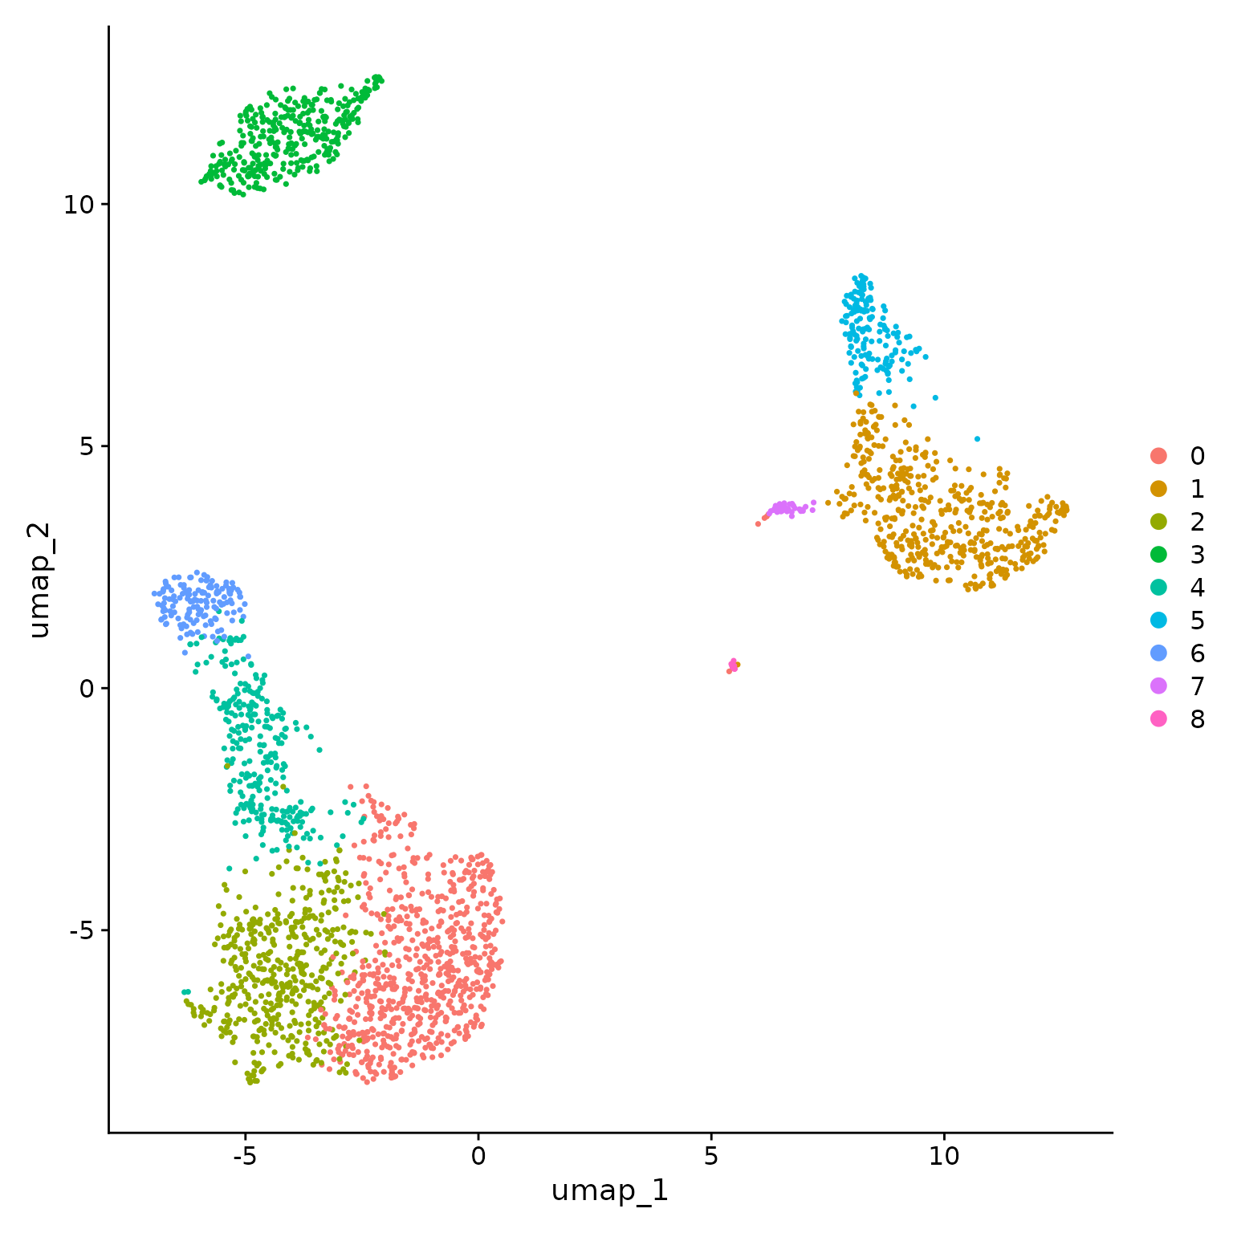
Conserved Marker Analysis
For a single study group, identify differentially expressed genes for each cluster in pairwise fashion (already covered in previous slides).
Ctrl
Tx
For two study groups, find markers that are conserved between two given clusters and differentially expressed versus all other clusters.
Ctrl
Tx
For two study groups, identify differentially expressed genes for a pair of clusters.
For a two study groups with replicates, identify differentially expressed genes for each cluster in pairwise fashion.
Notes:
https://www.dreamstime.com/stock-illustration-dna-vector-illustration-human-structure-image49975743

Slide 3
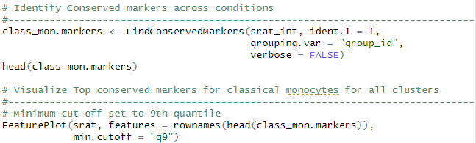
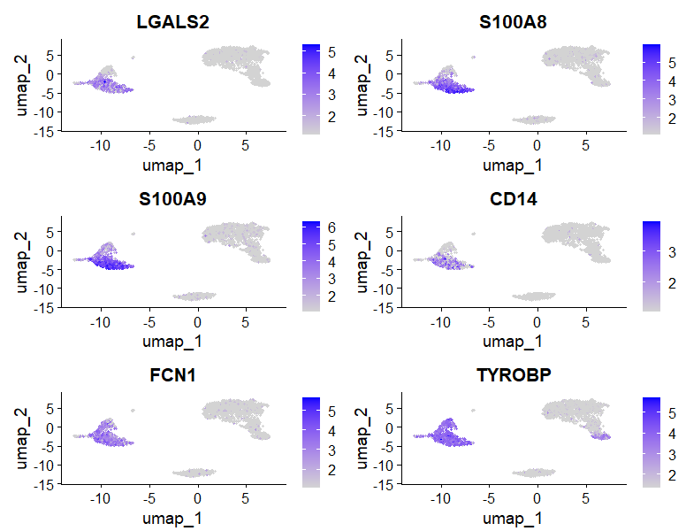
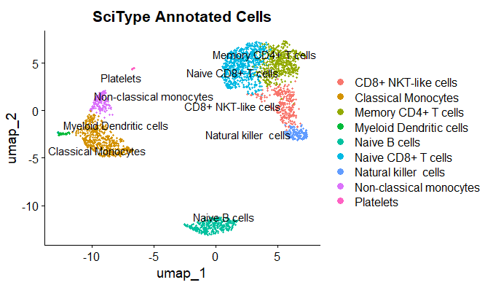
Conserved Marker Analysis
Classical Monocytes
Top Conserved Markers
Notes:
https://www.dreamstime.com/stock-illustration-dna-vector-illustration-human-structure-image49975743

Slide 4

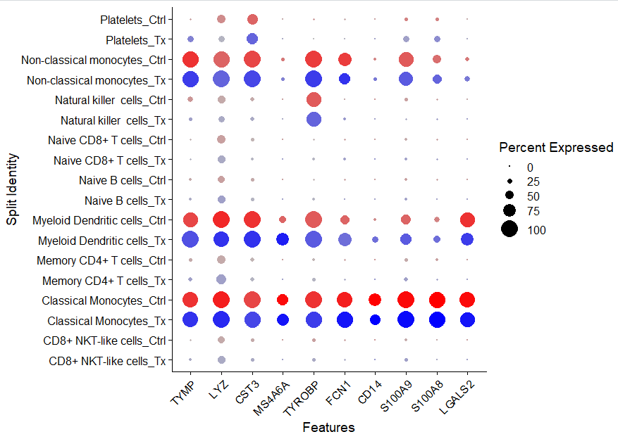
Visualizing Conserved Markers

Slide 5
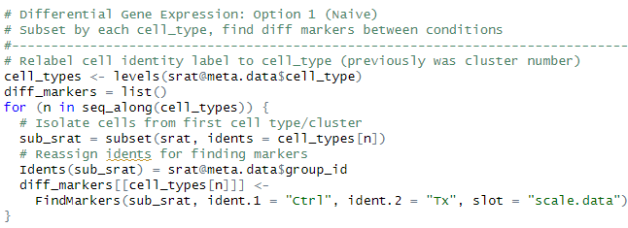
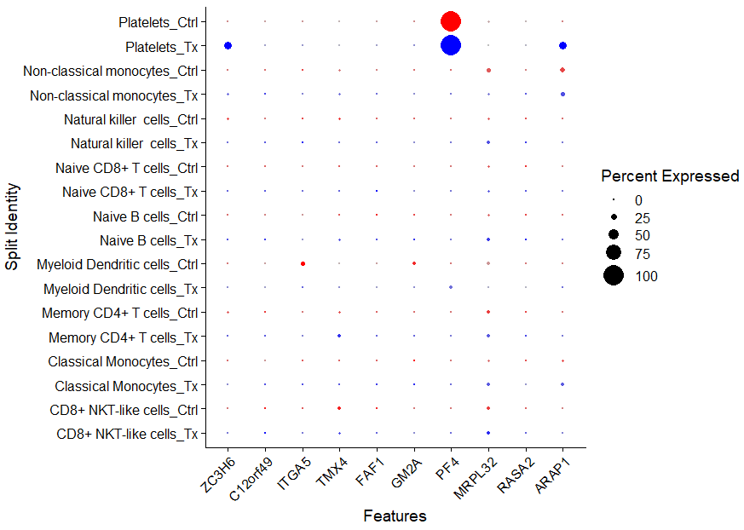
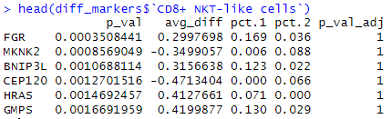
Differential Gene Expression Analysis: Single Study Group
Caution: This test treats each cell as an independent replicate and ignores inherent correlations between cells originating from the same sample (false positives).

Slide 6

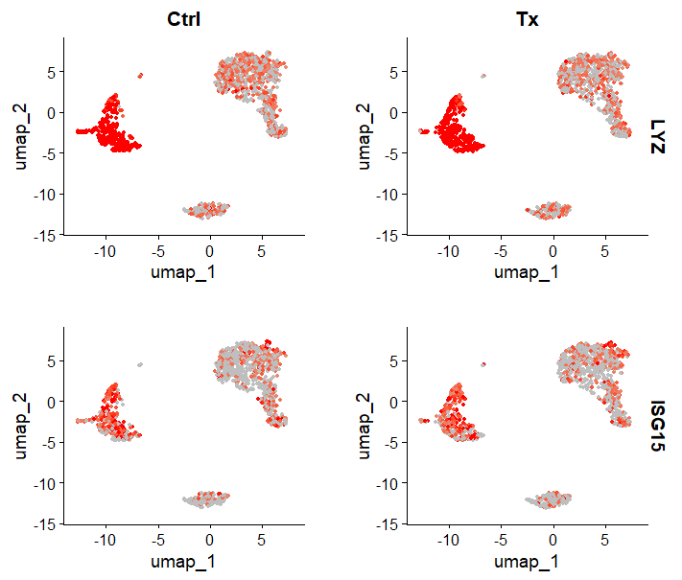

Slide 7

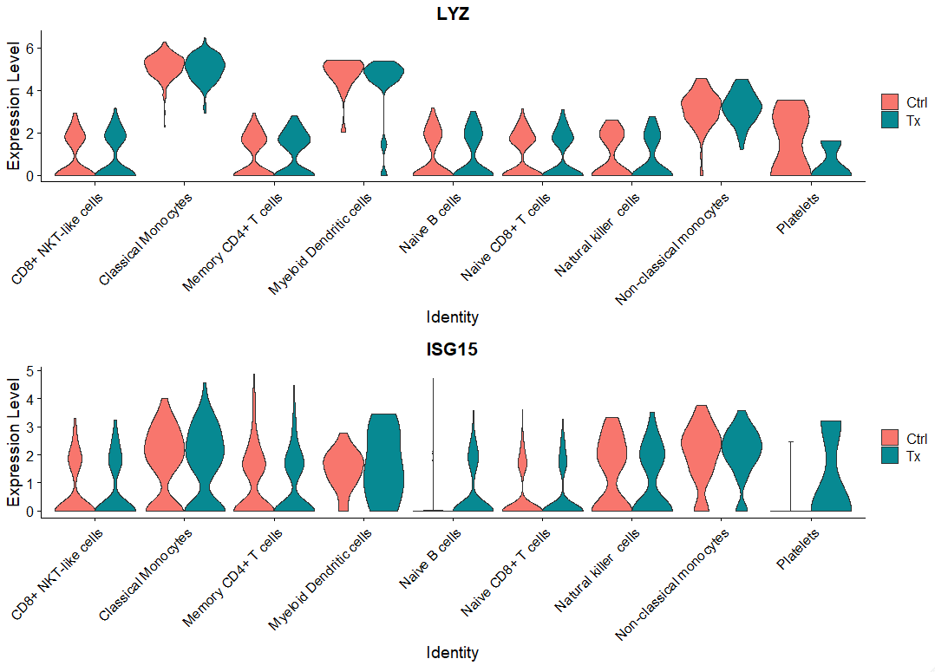
Differential Gene Expression Analysis: Single Study Group

Slide 8
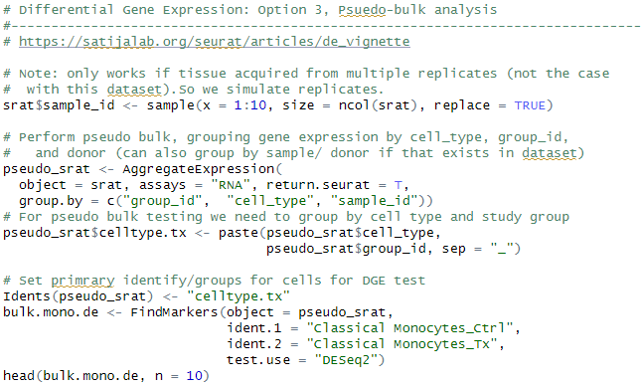
Differential Gene Expression Analysis: Pseudobulk
Pseudobulk: gene expression aggregated per sample and cell type.
independent observations = samples, rather than the individual cells (therefore accounts for within-sample correlation).

Slide 9
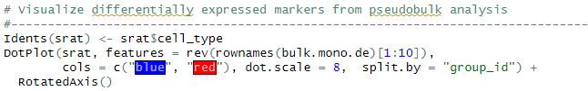
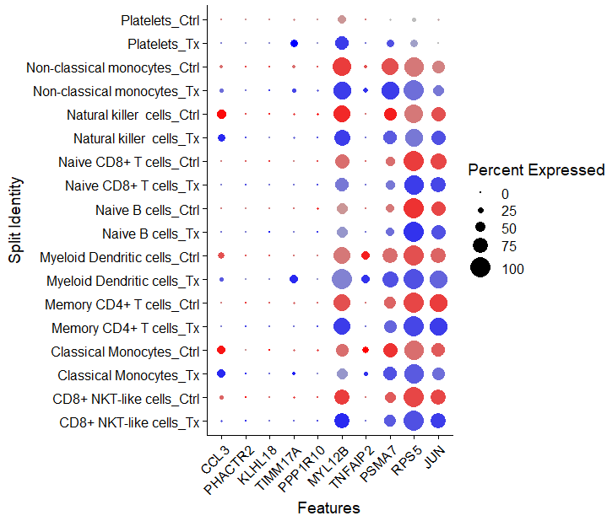
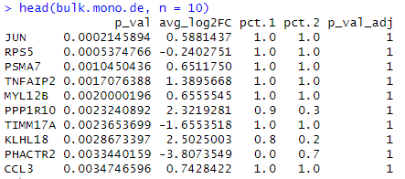
Differential Gene Expression Analysis: Pseudobulk

Slide 10

FindMarkers: will find markers between two different identity groups - you have to specify both identity groups.
FindAllMarkers: will find markers differentially expressed in each identity group by comparing it to all of the others - you don't have to manually define anything. Markers are not forced to be unique to only one group.
FindConservedMarkers: will find markers that are conserved between two groups. It means they are differentially expressed compared to other groups, but have similar expression between the two groups you're actually comparing.
Source
https://www.biostars.org/p/409790/

Slide 11
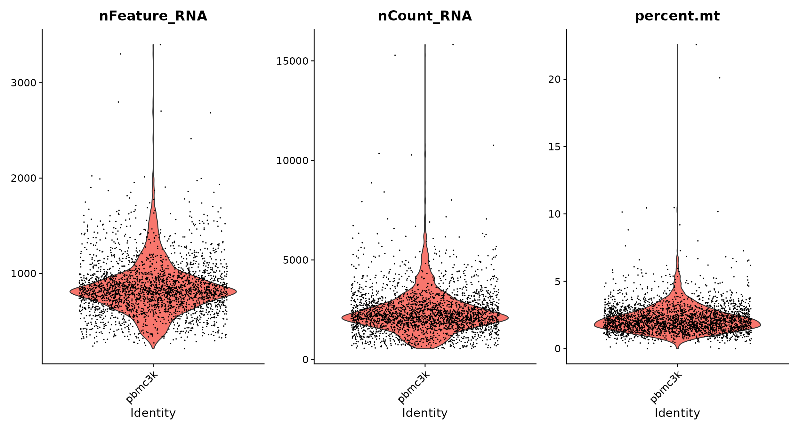
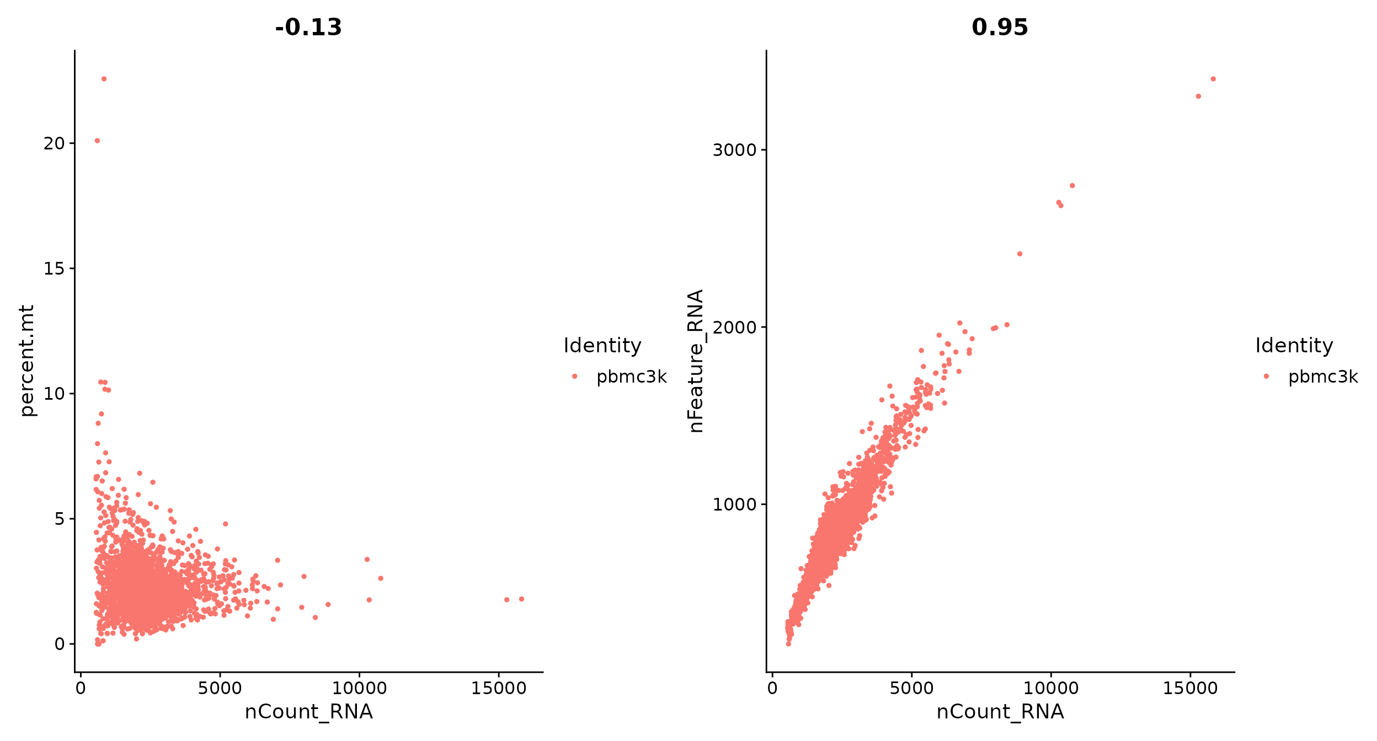
Visualizing Data import thresholds
x
# Visualize QC metrics as a violin plot
VlnPlot(pbmc, features = c("nFeature_RNA", "nCount_RNA", "percent.mt"), ncol = 3)
# FeatureScatter is typically used to visualize feature-feature relationships, but can be used
# for anything calculated by the object, i.e. columns in object metadata, PC scores etc.
plot1 <- FeatureScatter(pbmc, feature1 = "nCount_RNA", feature2 = "percent.mt")
plot2 <- FeatureScatter(pbmc, feature1 = "nCount_RNA", feature2 = "nFeature_RNA")
plot1 + plot2

Slide 12
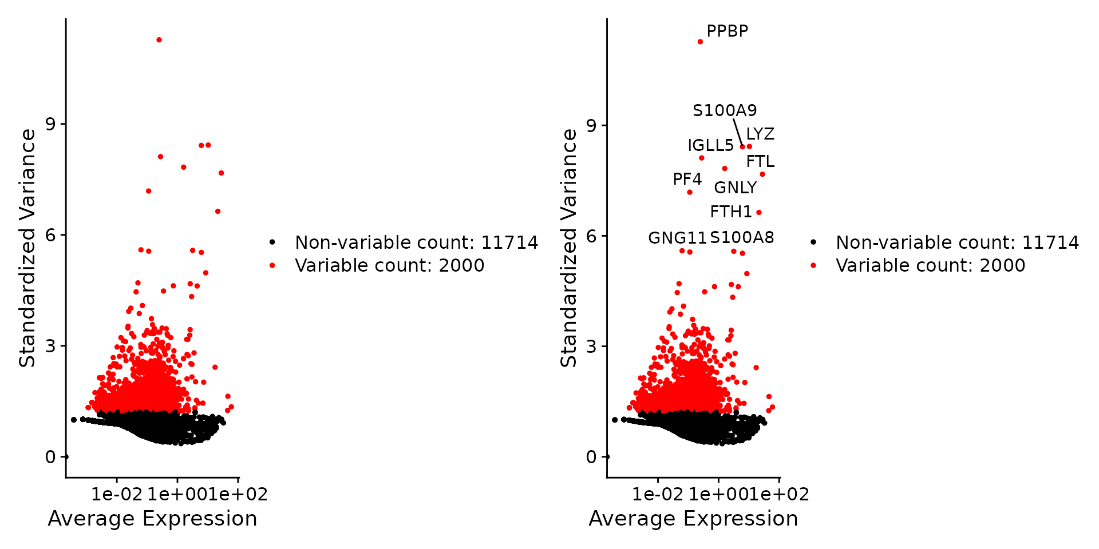
Visualize Highly Variable Features
pbmc <- FindVariableFeatures(pbmc, selection.method = "vst", nfeatures = 2000)
# Identify the 10 most highly variable genes
top10 <- head(VariableFeatures(pbmc), 10)
# plot variable features with and without labels
plot1 <- VariableFeaturePlot(pbmc)
plot2 <- LabelPoints(plot = plot1, points = top10, repel = TRUE)
plot1 + plot2

Slide 13
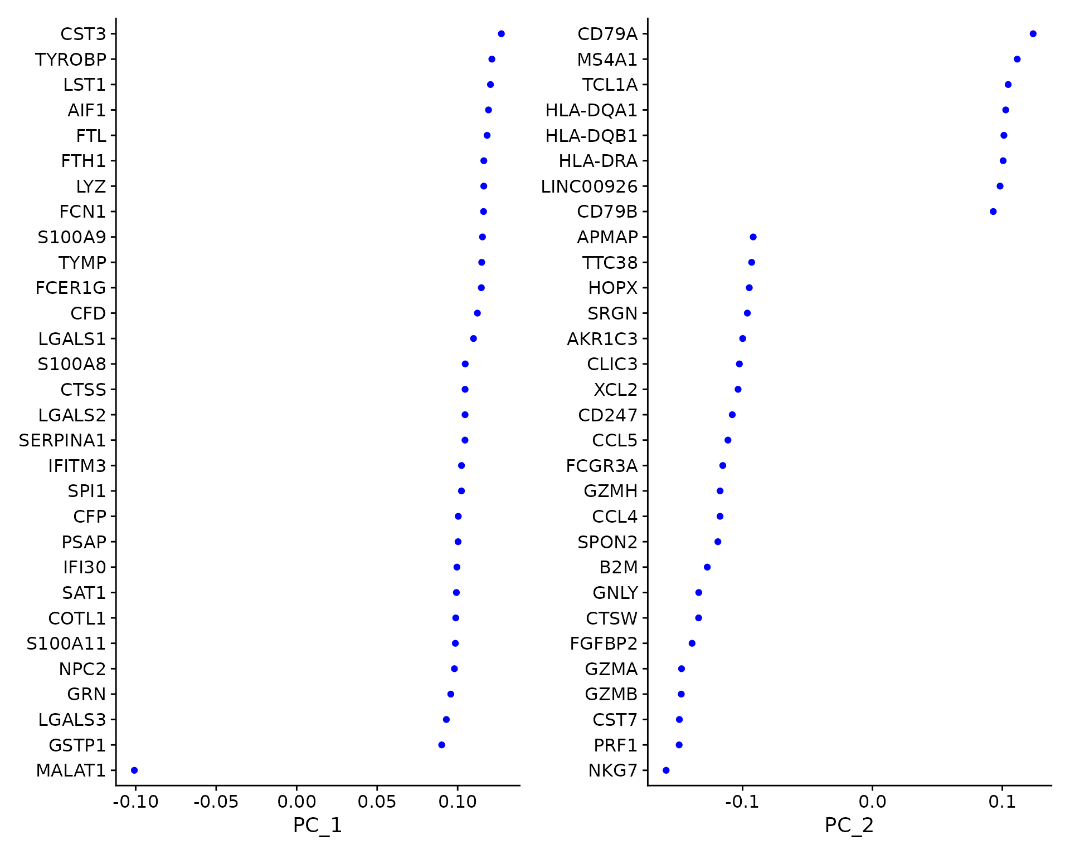
PCA Dim Laodings
VizDimLoadings(pbmc, dims = 1:2, reduction = "pca")

Slide 14
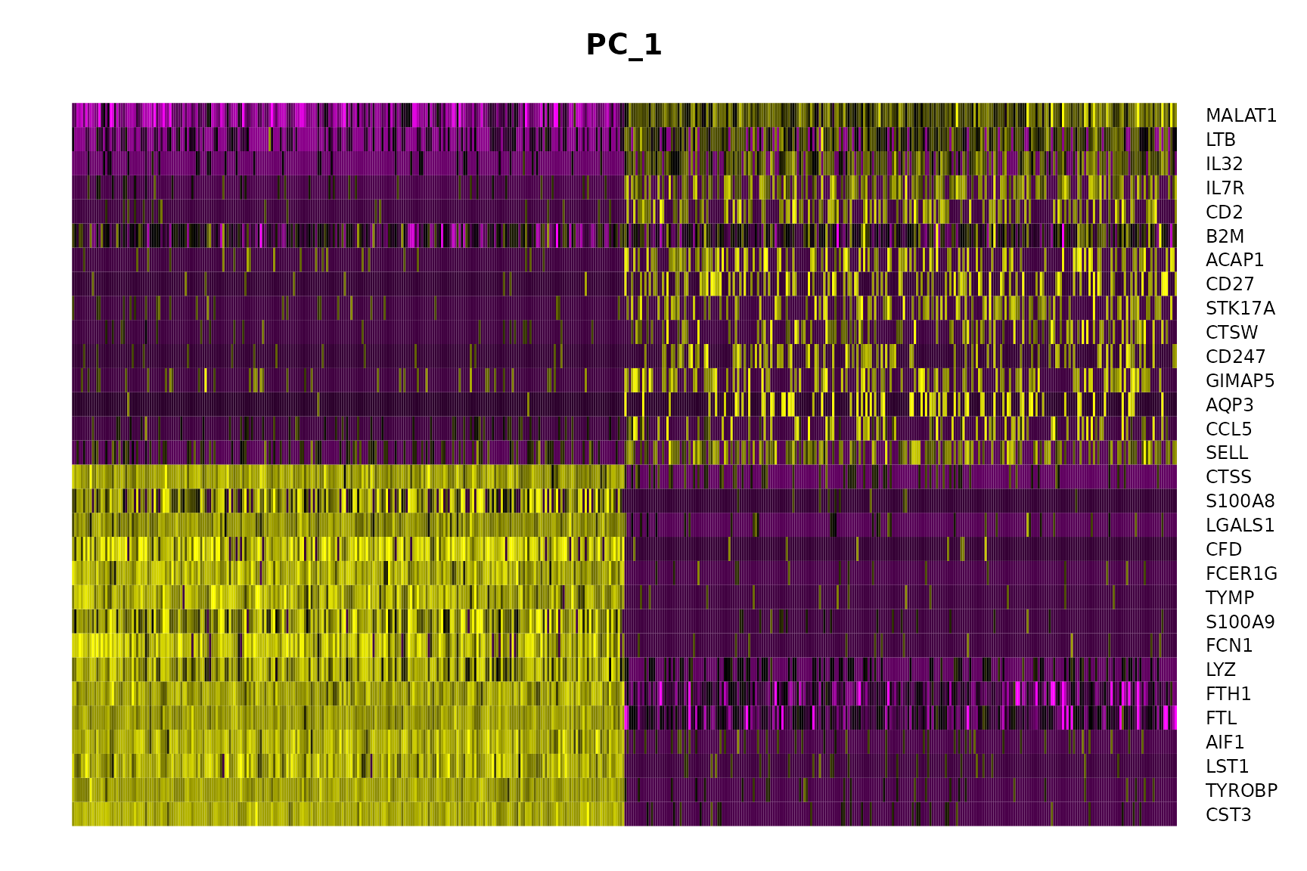
PCA Dim loadings
DimHeatmap(pbmc, dims = 1:15, cells = 500, balanced = TRUE)

Slide 15
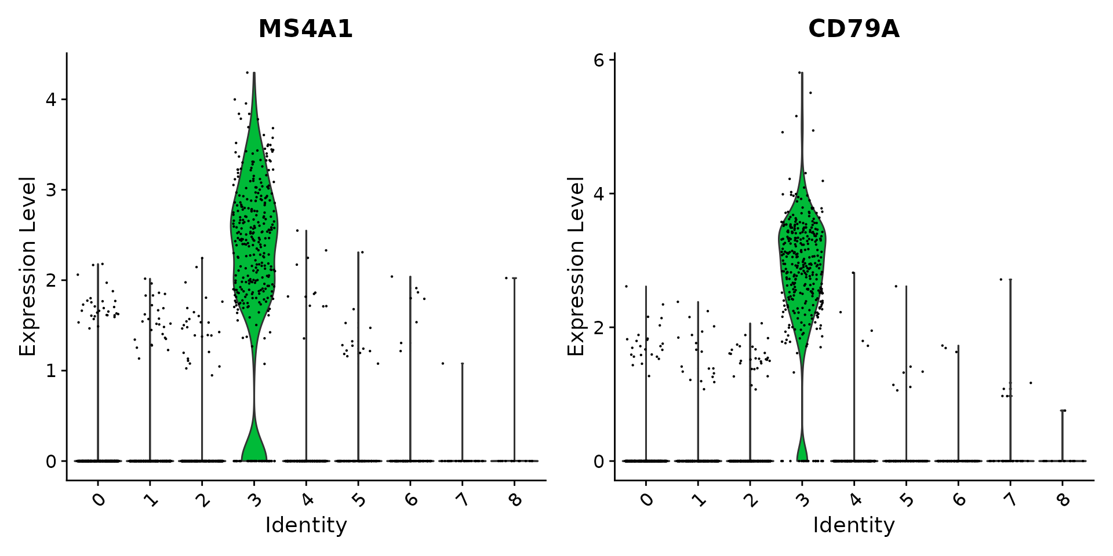
Specific Gene Expression in Each Cluster
VlnPlot(pbmc, features = c("MS4A1", "CD79A"))

Slide 16
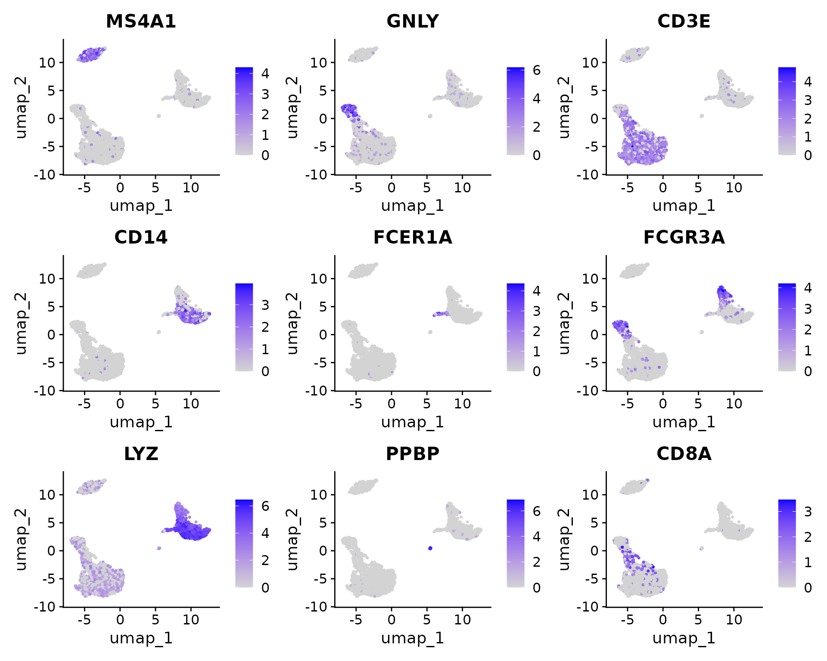
Cell Heatmap of Gene Expression
FeaturePlot(pbmc, features = c("MS4A1", "GNLY", "CD3E", "CD14", "FCER1A", "FCGR3A", "LYZ", "PPBP",
"CD8A"))

Slide 17
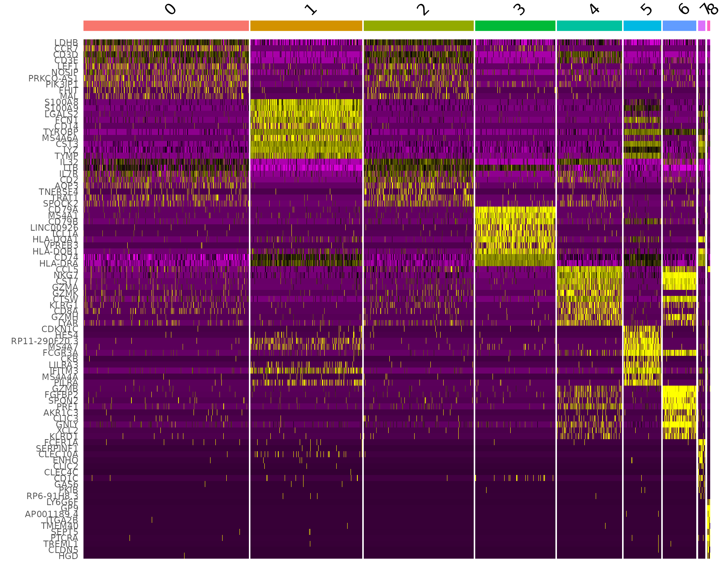
Heatmap of top 20 Genes for Each Cluster
pbmc.markers %>%
group_by(cluster) %>%
dplyr::filter(avg_log2FC > 1) %>%
slice_head(n = 10) %>%
ungroup() -> top10
DoHeatmap(pbmc, features = top10$gene) + NoLegend()

