Slide 1
Module 2: Aligning Reads with Cell Ranger
NCSU scRNA Workshop, 2024
Bruce Corliss, PhD and Allison Dickey, PhD

Slide 2
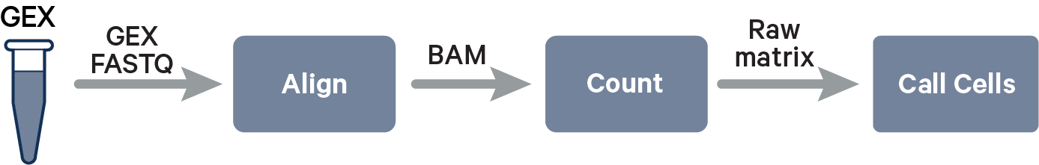
Convert Raw Single Cell RNA-Seq to Gene Expression
https://www.10xgenomics.com/support/software/cell-ranger/algorithms-overview/cr-gex-algorithm

Slide 3
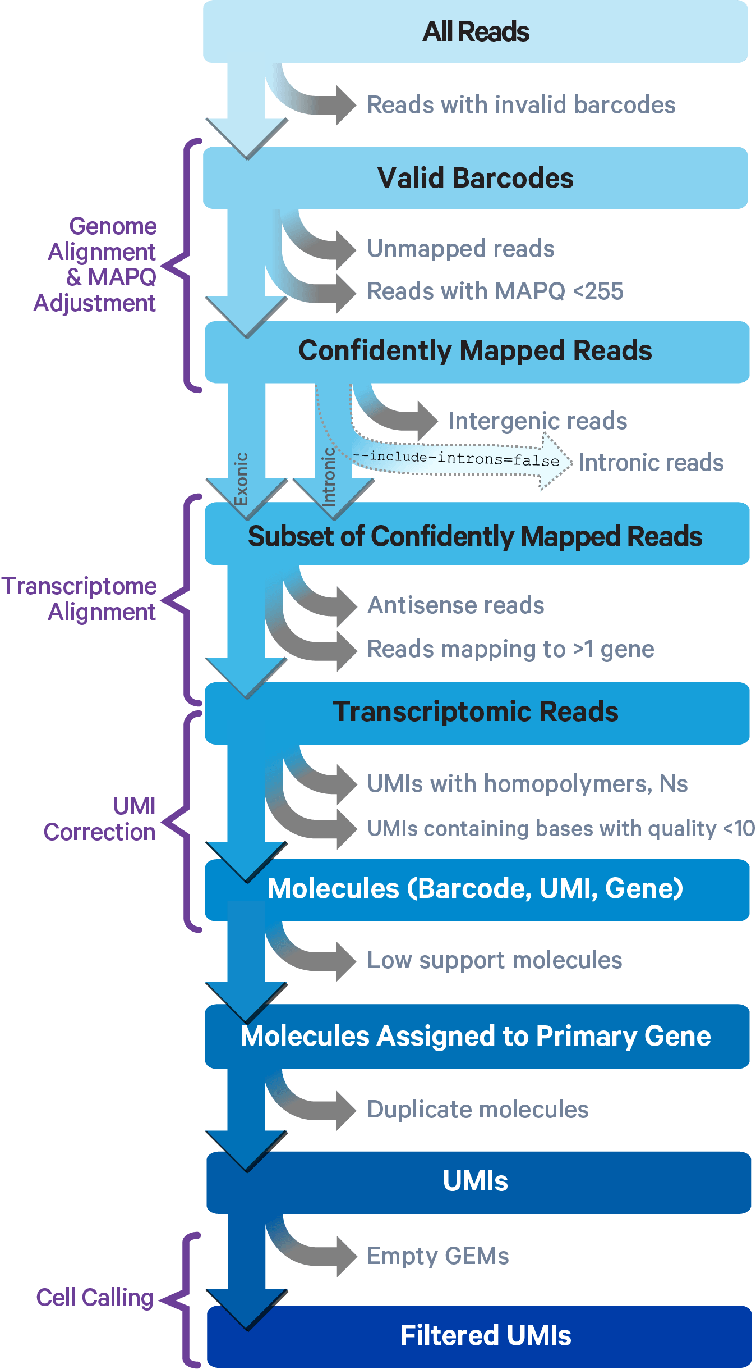
Cell Ranger STAR Alignment
1
2
3
4
5
6
7
8
9
https://www.10xgenomics.com/support/software/cell-ranger/algorithms-overview/cr-gex-algorithm

Slide 4
Cell Ranger STAR Alignment: 1 - 2
1
2
3
4
5
6
7
8
9
https://www.10xgenomics.com/support/software/cell-ranger/algorithms-overview/cr-gex-algorithm

Slide 5
Cell Ranger STAR Alignment: 3 - 4
1
2
3
4
5
6
7
8
9
https://www.10xgenomics.com/support/software/cell-ranger/algorithms-overview/cr-gex-algorithm

Slide 6
Cell Ranger STAR Alignment: 5 - 6
1
2
3
4
5
6
7
8
9
https://www.10xgenomics.com/support/software/cell-ranger/algorithms-overview/cr-gex-algorithm

Slide 7
Cell Ranger STAR Alignment: 7 - 9
1
2
3
4
5
6
7
8
9
https://www.10xgenomics.com/support/software/cell-ranger/algorithms-overview/cr-gex-algorithm

Slide 8
Cell Ranger Outputs
Expression Matrix
 | c1 | c2 | c3 | g4
g1
g2
g3
g4
Gene Metadata
g1
g2
g3
g4
Cell Metadata
c1
c2
c3
c4

Slide 9
Cell Ranger Setup and Script
https://www.10xgenomics.com/support/software/cell-ranger/algorithms-overview/cr-gex-algorithm

Slide 10
Key Cell Ranger Parameters for Alignment
Reference Genome
Can significantly influence number of Reads/Cells
https://www.10xgenomics.com/support/software/cell-ranger/algorithms-overview/cr-gex-algorithm

