Slide 1
Module 4: Differential Gene Analysis and Exploratory Analysis with Seurat
NCSU scRNA Workshop, 2024
Bruce Corliss, PhD and Allison Dickey, PhD

Slide 2
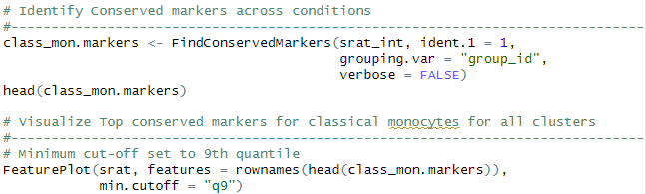
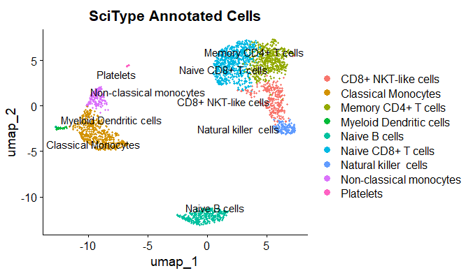
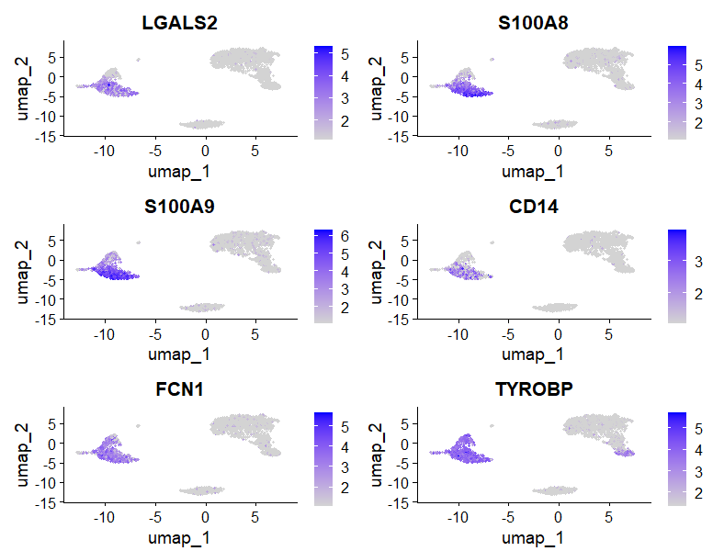
Conserved Marker Analysis
Classical Monocytes
Top Conserved Markers
Notes:
https://www.dreamstime.com/stock-illustration-dna-vector-illustration-human-structure-image49975743

Slide 3

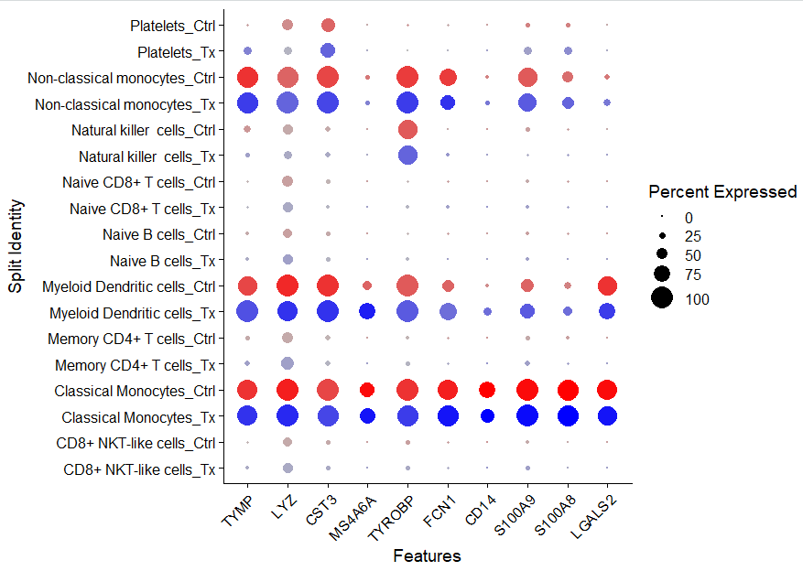
Visualizing Conserved Markers

Slide 4
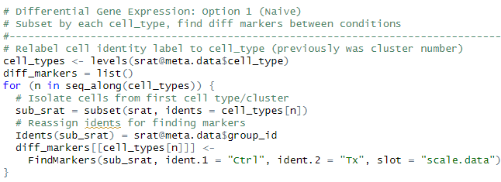
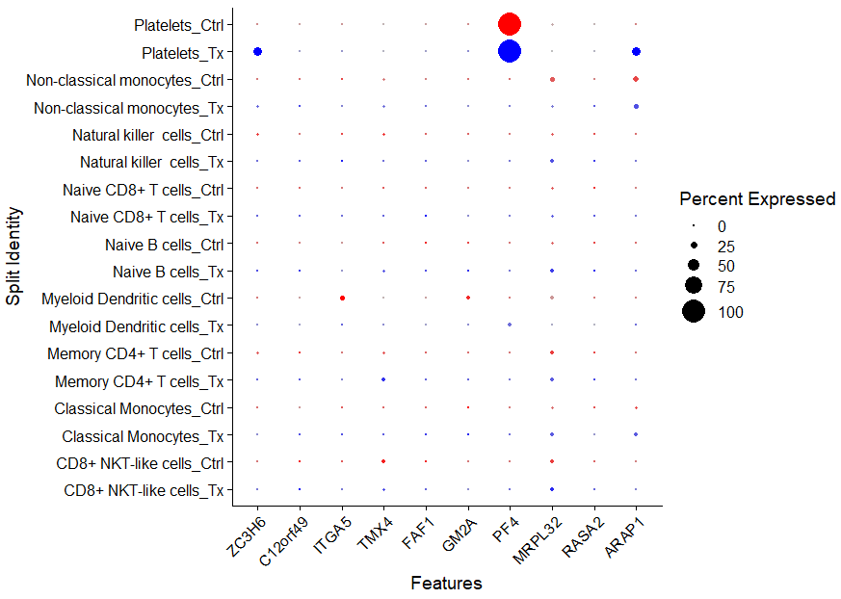
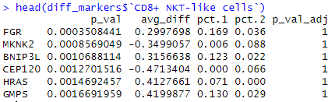
Differential Gene Expression Analysis: Naïve 1
Caution: This test treats each cell as an independent replicate and ignores inherent correlations between cells originating from the same sample (false positives).

Slide 5
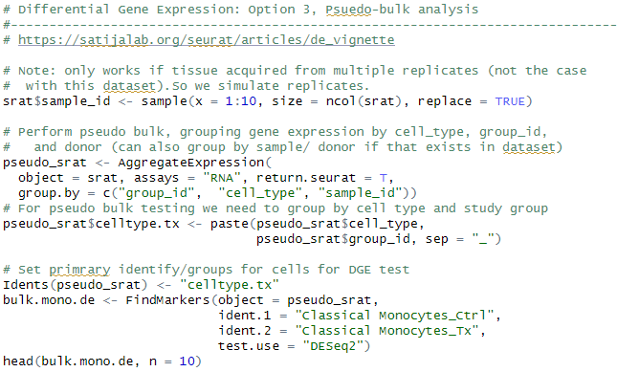
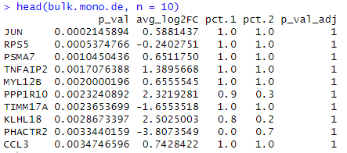
Differential Gene Expression Analysis: Pseudobulk
Pseudobulk: gene expression aggregated per sample and cell type.
independent observations = samples, rather than the individual cells (therefore accounts for within-sample correlation).

