Slide 1
Module 0: Workshop Introduction
NCSU scRNA Workshop, 2024
Bruce Corliss, PhD and Allison Dickey, PhD

Slide 2

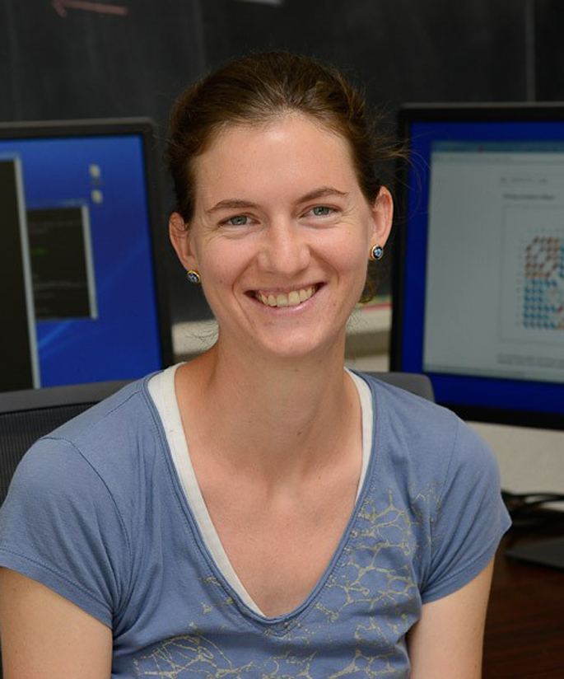
Meet your Instructors
Bruce Corliss, PhD
Research Bioinformatician at NC State
PhD in Biomedical Engineering
Support for Dr. Fred Wright (BRC),
Dr. Cathrine Hoyo (Biological Sciences), and the
Center for Human Health and the Environment
Allison Dickey, PhD

Slide 3
Learning Objectives
Overarching Purpose: to help participants beat the steep learning curve with processing scRNA-Seq Data
Understand the
Use Seurat to process snRNA-Seq data using standard settings.
Understand considerations for when to change from defaults.
Use Monocle to analyze pseudotime data.

Slide 4
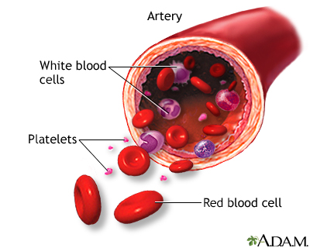

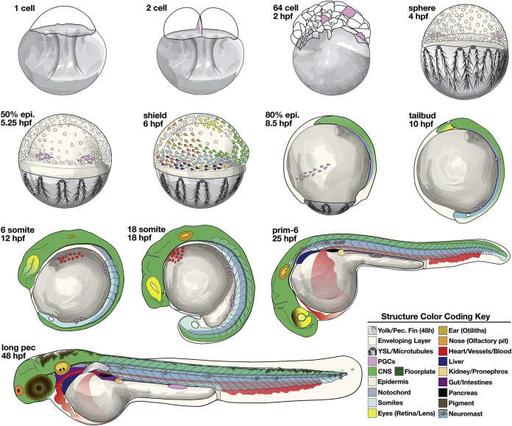

Overview of Course Modules
Intro scRNA-Seq
Cell Ranger Read Alignment
Seurat Processing Pipeline
Cell Type Identification
Teaching Dataset
Blood Sample,
Healthy Donor
Interactive Dataset
5) Suerat Exploratory
6) Monocle Pseudotime
7) Best Practices and Summary

Slide 5
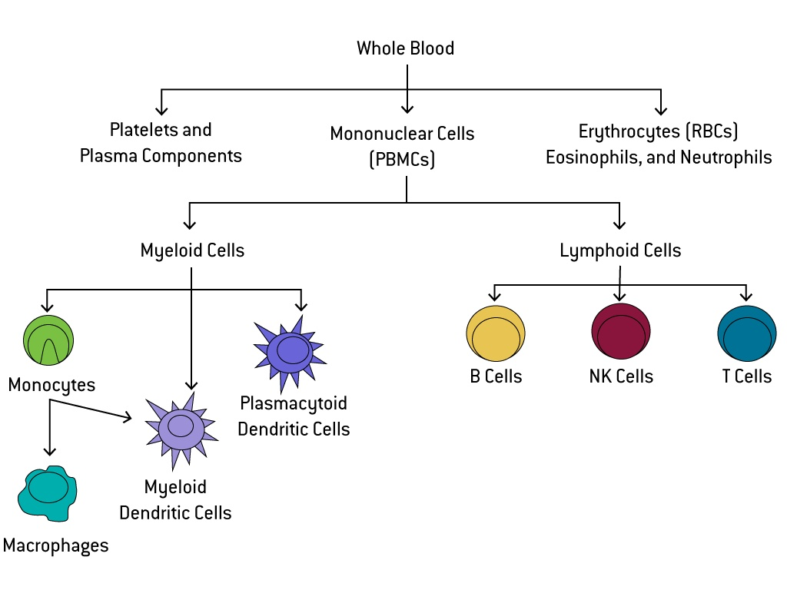
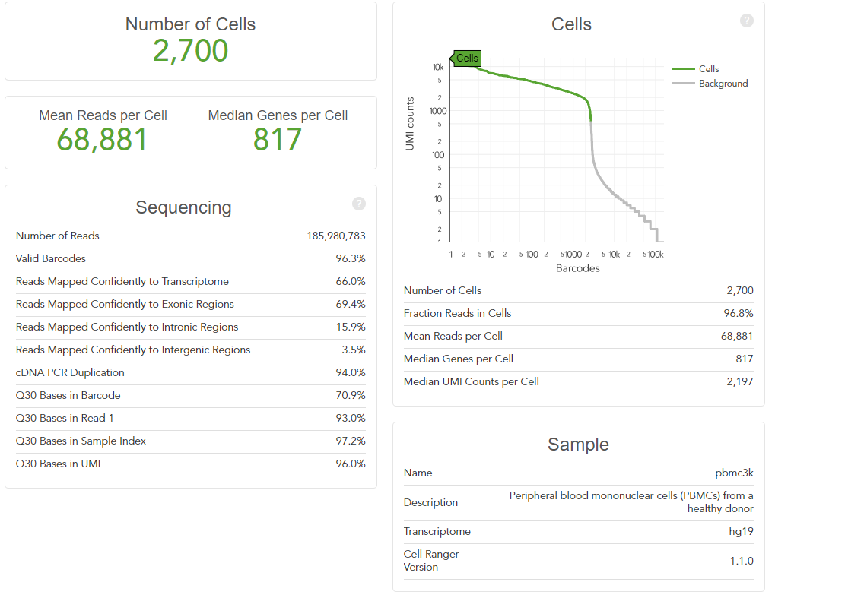
The Teaching Dataset
Peripheral blood mononuclear cells (PBMCs) from a healthy donor
Used for all powerpoints and the test_pipeline.R script.
Artificially altered for Dataset Integration, Differential Gene Expression, and Cell Trajectory/ Pseudotime Analysis to illustrate the null case.

Slide 6
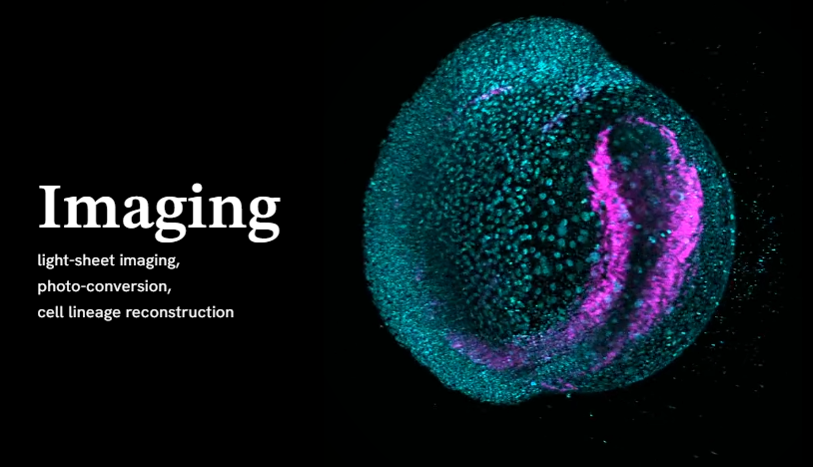
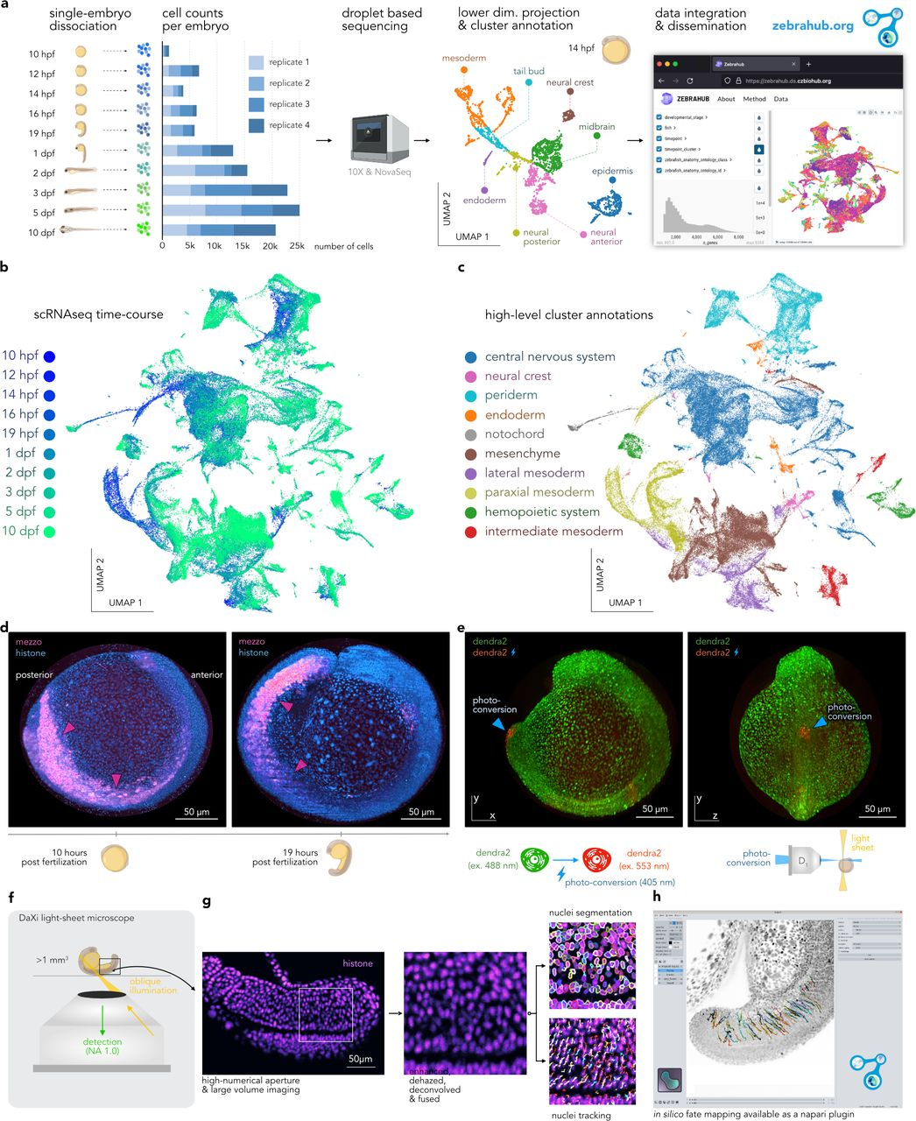
The Interactive Dataset
Zebrahub is a comprehensive atlas of zebrafish embryonic development.
Technologies: single-cell RNA sequencing and live light-sheet imaging.
Provides a complete cartography of cellular lineages in space, time, and molecular domains, an essential step toward understanding how organisms develop.
Zebrahub - Multimodal Zebrafish Developmental Atlas Reveals the State Transition Dynamics of Late Vertebrate Pluripotent Axial Progenitors. Lange et al. BioRxiv 2023.

Slide 7
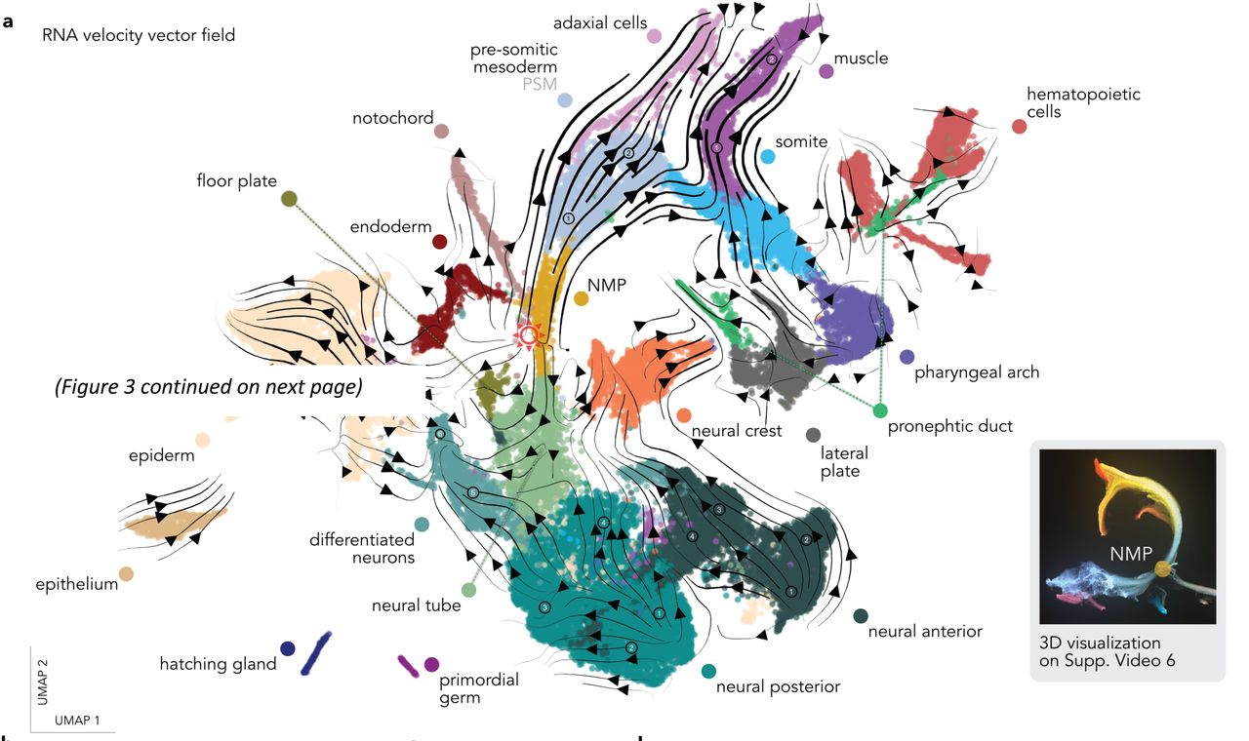
The Interactive Dataset
Cell type annotated and embryonic tissue annotated.
Zebrahub - Multimodal Zebrafish Developmental Atlas Reveals the State Transition Dynamics of Late Vertebrate Pluripotent Axial Progenitors. Lange et al. BioRxiv 2023.

Slide 8
Format for Course
Slides with example code/ output used to analyze data.
All code for analyzing PBMC dataset is found in
/M0_Intro_Workshop/test_packages.R
All code for analyzing zerbahub dataset are found in
/M3_Seurat_Processing/Module_part1.Rmd
/M3_Seurat_Processing/Module_part2.Rmd

