Slide 1
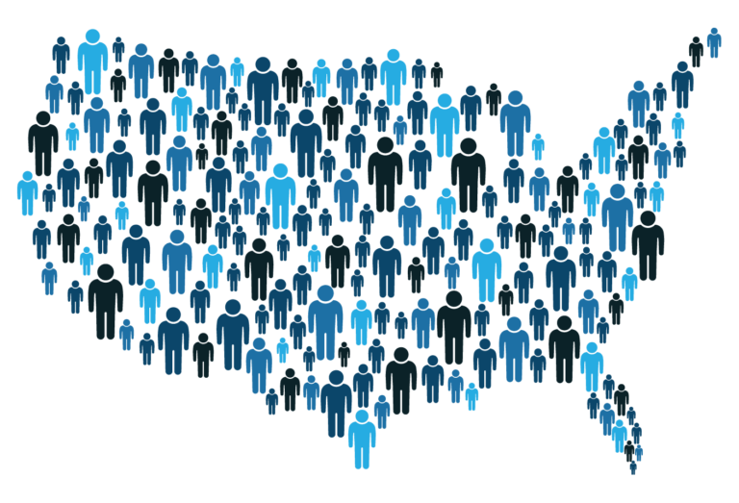
R Shiny: US Population Analysis by County and Year
Bryan Cover

Slide 2
Why Study Population?
Population is a measurement of needed resources, jobs, house prices, and trends in movement
Every 10 years the US conducts its census to get a more accurate measurement of its population
The data set is maintained by the US Census Bureau
Many of the existing sites to analyze population data either don’t go the county granularity or don’t allow the user to select which years they’d like to compare

Slide 3
Shiny App
Using a slider and drop down, users can select which state they are interested in and what time period from 1970-2019. The resulting graphs and charts will show population trends by their self, compared to the US average, and raw data. If a state has too many counties, users can use the tools provided by plotly to adjust the default display to make it more readable.

Slide 4
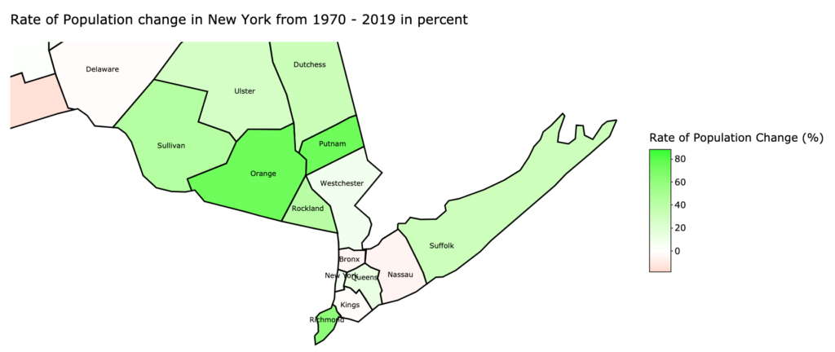
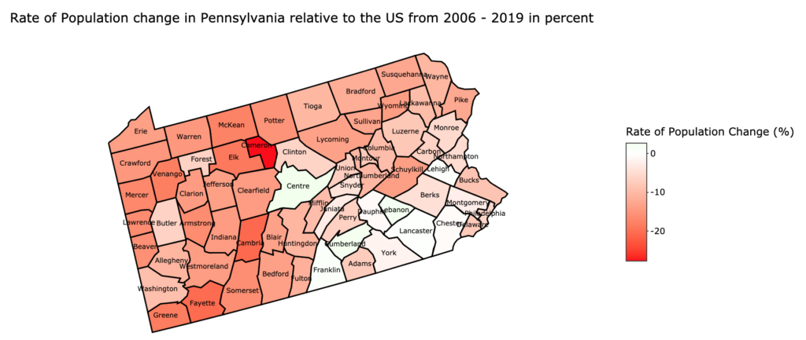

Slide 5
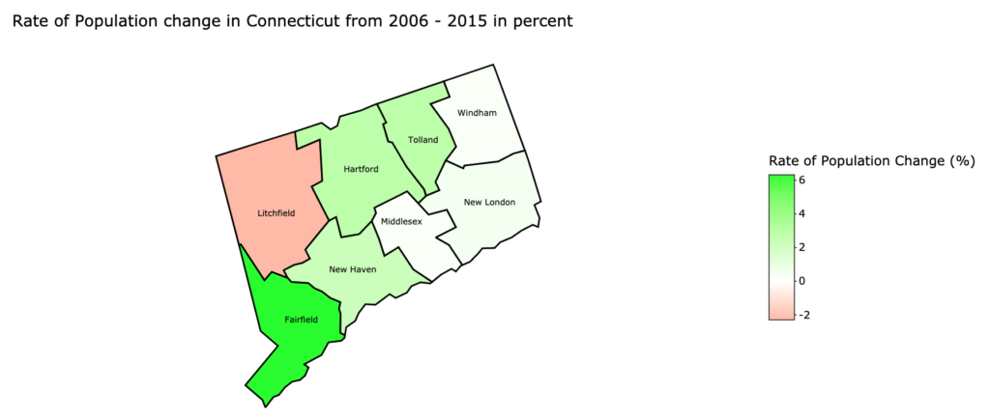
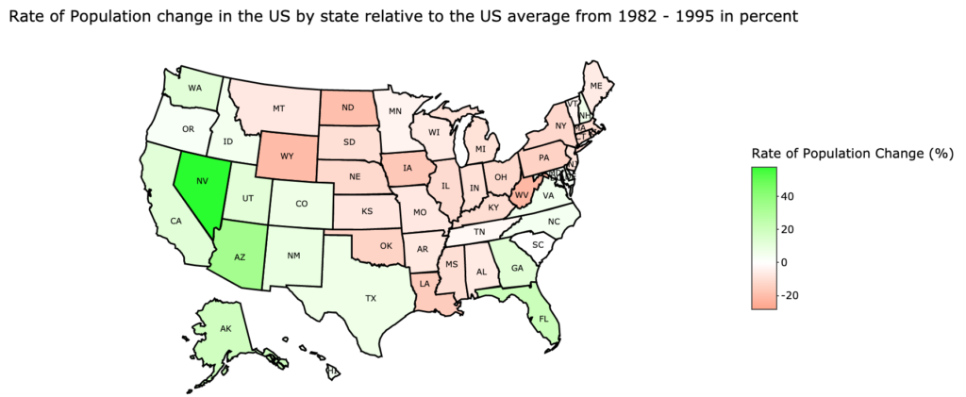
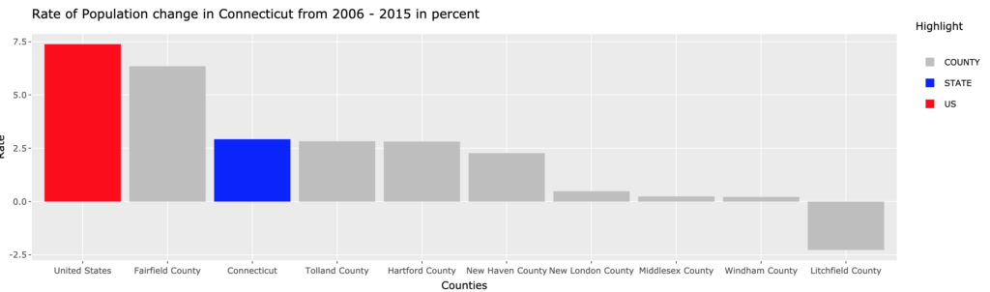

Slide 6
Improvements/Future Work
Increase Performance
Work on UI improvements on data displayed
Analyze which years had the fastest rate of change for each county
Optionally, try and do a web search to determine cause

