Slide 1
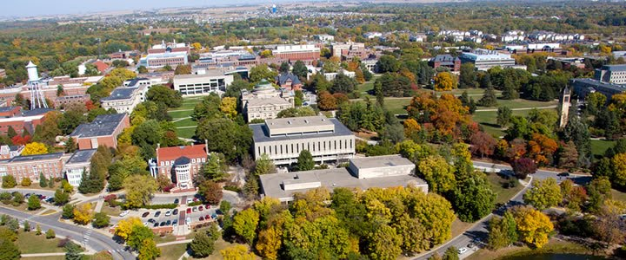
Kaggle Competition: Predicting House Prices in Ames, Iowa
Bryan Cover

Slide 2
Why Predict Housing Prices?
This Kaggle competition not only presents us with an opportunity to practice ML, but also gives us a real world data set.
The data can provide home owners the importance to which features of their house should be upgraded to provide the biggest impact to their home’s value.
This type of analysis is important to a variety of today’s companies and industries, including Zillow, Better.com, large banking institutions, and local real estate teams.

Slide 3
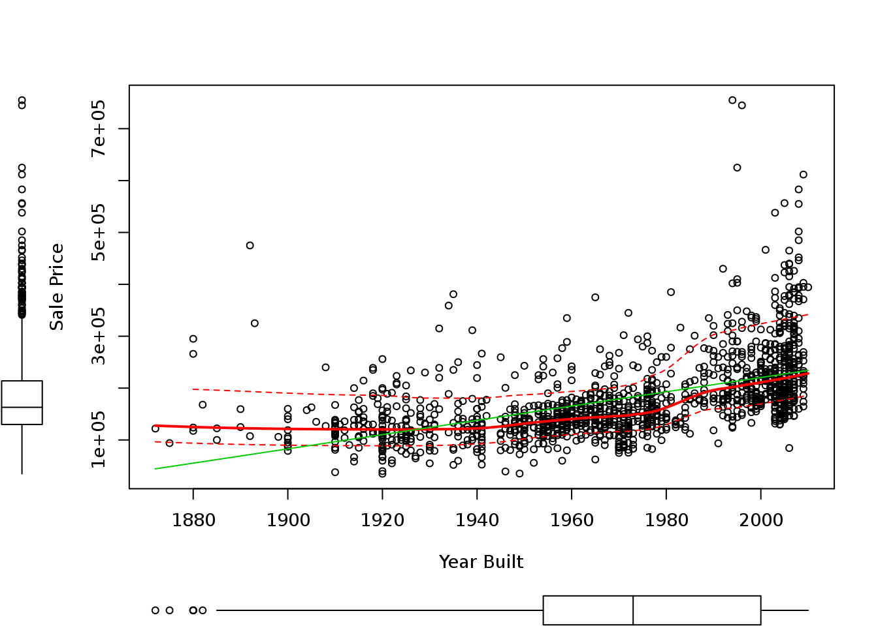
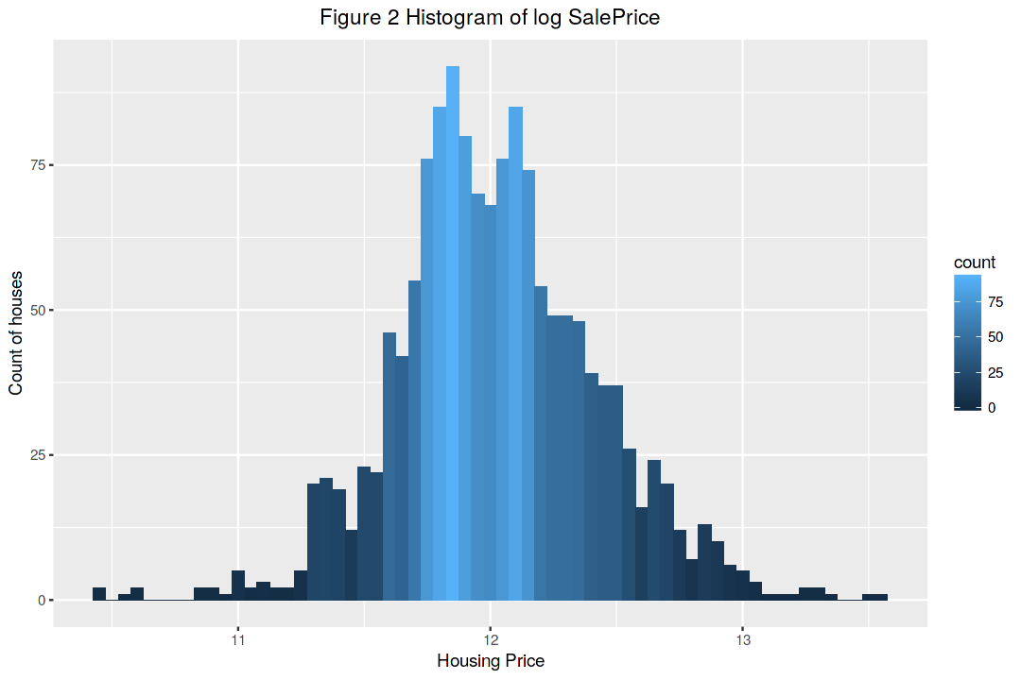
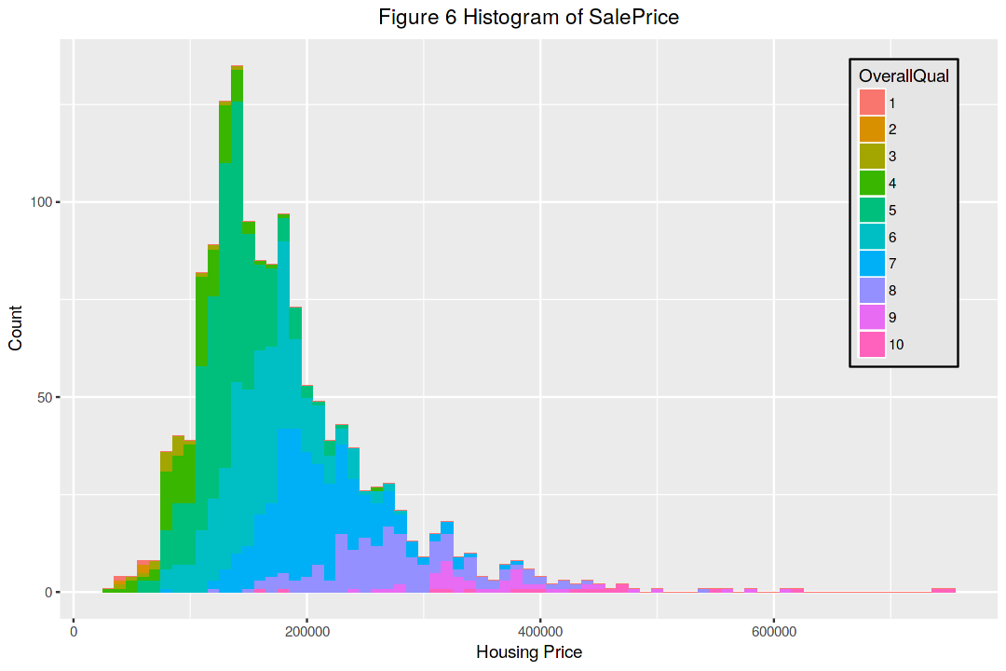
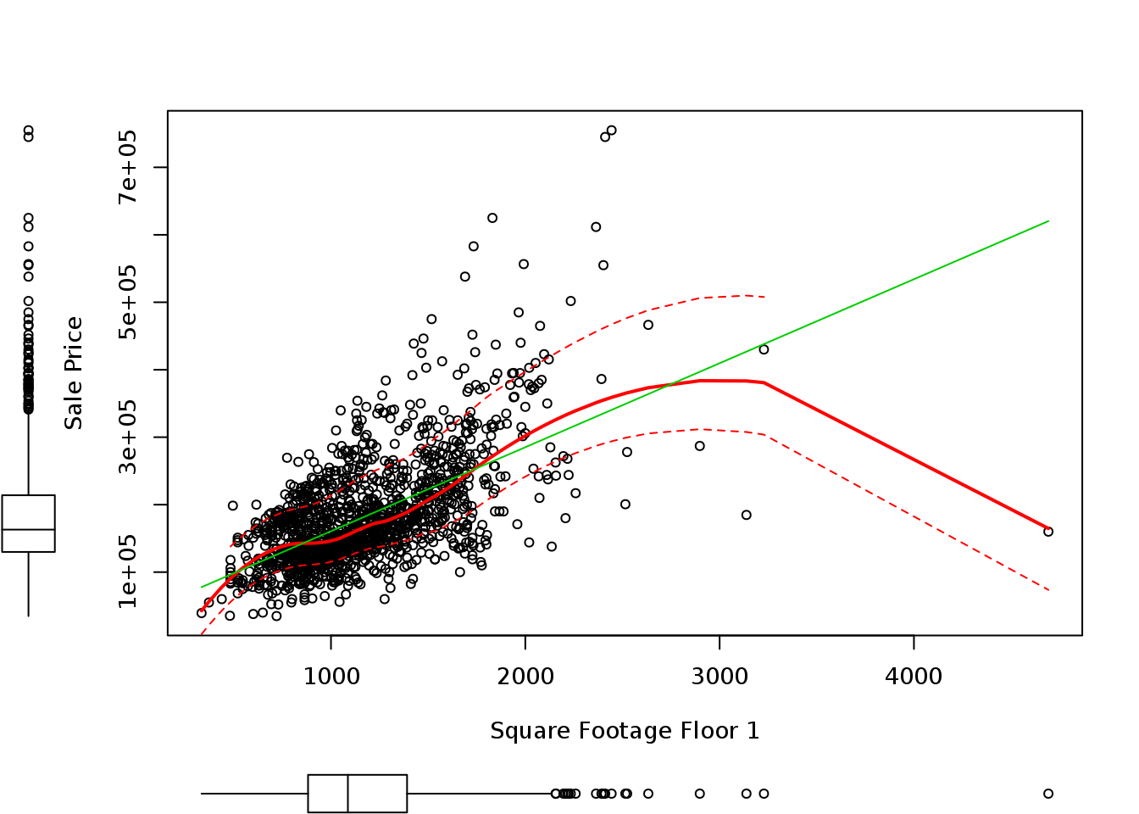
Data Analysis
The data set itself contains 1400+ entries with over 80 different attributes
Newer houses, generally sell for more. Larger homes generally sell for more. Better quality homes sell for more.

Slide 4
Data Cleaning and Feature Engineering
Numerate a lot of column data so that the model can extrapolate better:
Street type will be 1 for “Pave”, 0 for “Grvl”
Lot Type is now 1 for “reg” and 0 for all other
Land Contour is now 1 for “Lvl” and 0 for all other
Quality entries were numerated such that 5 = Excellent and 1 = Poor
This was done for 43 types of attributes
Create new columns to generalize Neighborhood quality and price level. This was done using neighborhood features in the data set
Null values were replaced with 0 for features that made sense

Slide 5
Training and Model Selection
Work was first performed on a partition of the data. Then on the whole training data to avoid overfitting.
First a Linear Model was generated using the entire feature set. The feature set was then trimmed to those that had a significant code of 0.001 or better. The model was regenerated.
RSME: 0.169

Slide 6
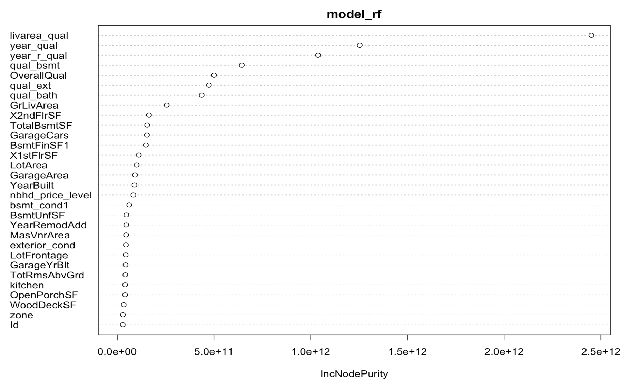
Random Forest
The data was now trained using a Random Forest and then tested for RSME.
RSME: 0.150

Slide 7
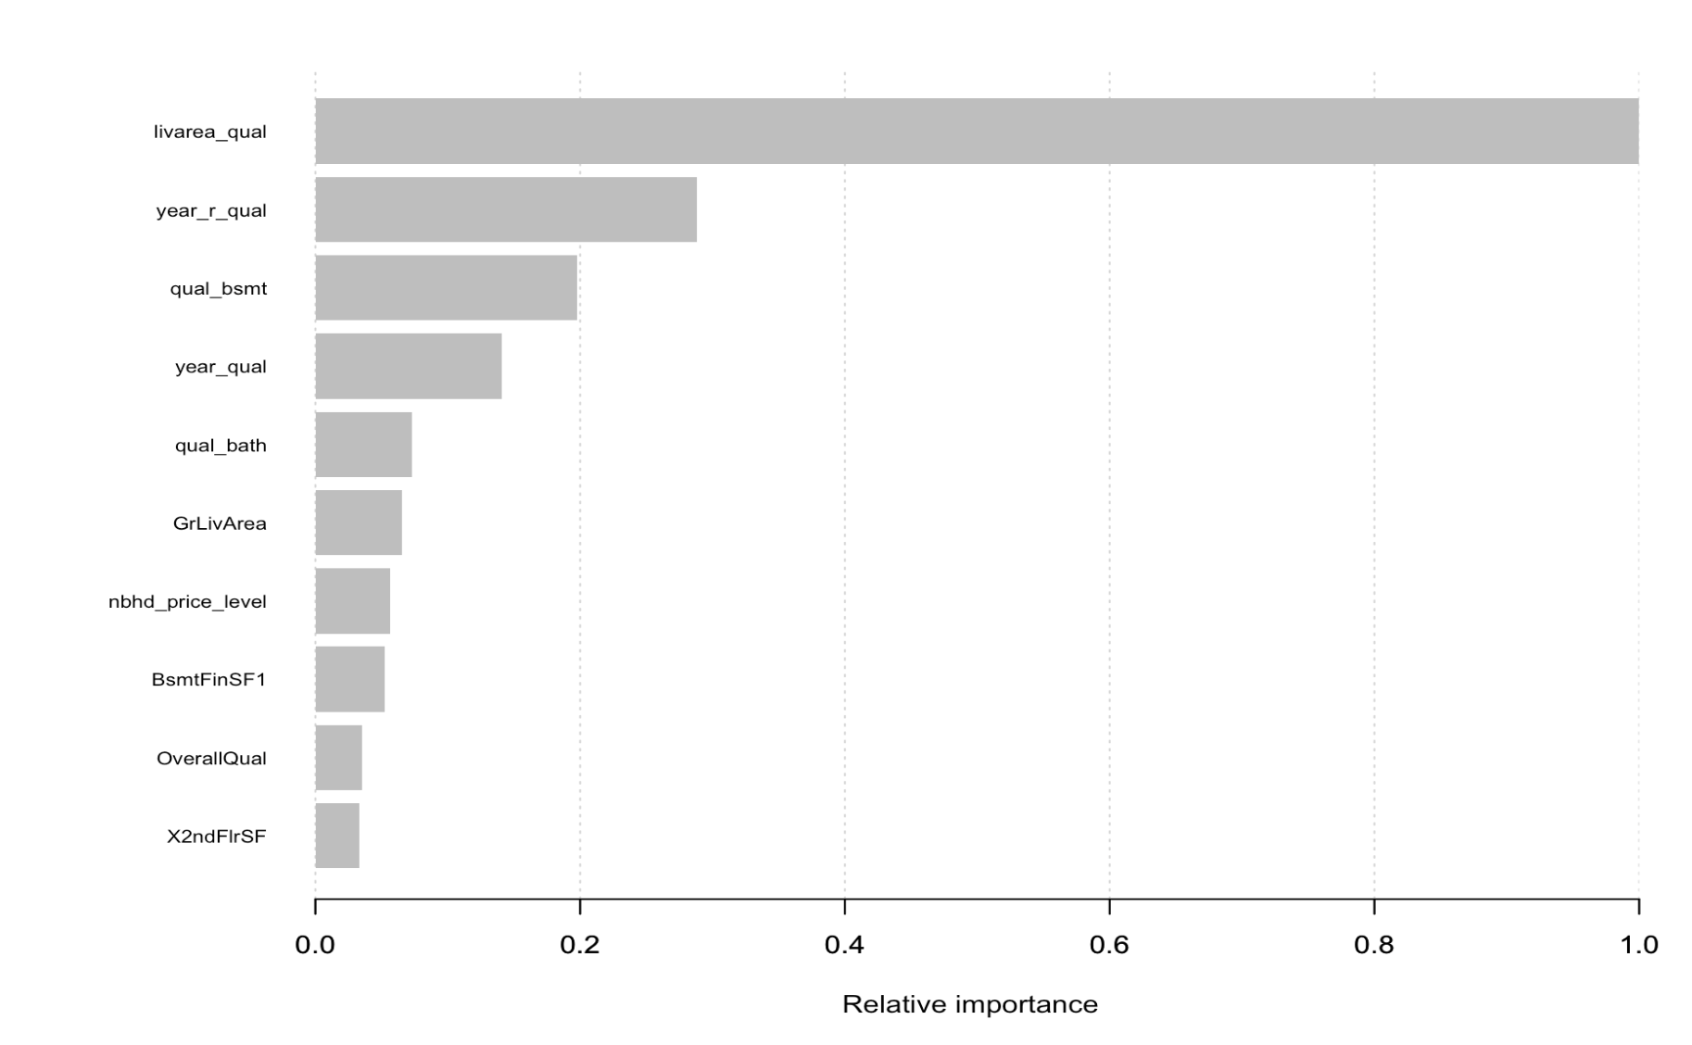
XGBoost
The Training data was now run using XGBoost and converting the data set to a sparse matrix
RSME: 0.139

Slide 8
Results and Future Work
The XGBoost model was used in the submission to Kaggle. The test data was formatted using the same formatting that was used on the training data.
The best score achieved was 0.12396
Future work with more time would be to try and continue improving the score by looking what additional feature engineering could be done.

