Slide 1
Rule-Based Alerting
on Binance Market Data
Python for Engineers
FA26HN MSA42HN
Group 02
Lecturer Bùi Trung Hiếu
15 October 2026
Notes:
Group 02: Phương Hữu Thành Nam, Bùi Quý Đăng, Nguyễn Anh Vũ and Đào Công Tuấn. The project targets personal monitoring and self-hosting. Demonstrate the delivered REST-based system and identify the independent WebSocket prototype accurately. Source baseline 62b5622 plus the local prototype files supplied in the archive.

Slide 2
Background and user needs
An individual user follows several market pairs while working or studying.
Manual chart checks and copying values into a chatbot interrupt that workflow.
The application stores conditions, reports supported matches through Telegram, and explains the supplied data.
2
Notes:
The primary user runs a personal installation. Explain a concrete case: a user wants to know when an indicator threshold holds without watching a chart all day. Source: team project notes and inspected application scope.

Slide 3
Objectives and measured progress
Objective | Observed evidence | Status
Five market pairs | 300 candles returned for each pair | On demand
Five indicator families | SMA, EMA and RSI implemented | 3 of 5
Rule and notification workflow | Redis CRUD and one accepted Telegram send | Delivered subset
AI evaluation | Six live questions and recorded scores | Exploratory pilot
No profitability or forecast-accuracy claim forms part of acceptance.
3
Notes:
The five-symbol check is on demand, not a background five-symbol updater. Three indicator families satisfy the present prototype but only partly meet the original five-family plan. Source: appendices/five_symbol_smoke.json and test logs.

Slide 4
Task allocation and contribution
Member | Primary responsibility | Share %
Phương Hữu Thành Nam | Indicator formulas and numerical fixtures | 25
Bùi Quý Đăng | OpenAI and Telegram integration | 25
Nguyễn Anh Vũ | Binance, frontend and WebSocket prototype | 25
Đào Công Tuấn | Rule workflow and integration verification | 25
Total | Shared testing, documentation and presentation | 100
4
Notes:
Equal 25 percent shares follow the team owner’s instruction. These figures are an agreed allocation rather than a computation from commits. More detailed deliverables appear in report section 3.

Slide 5
Completed features and boundaries
Area | Completed | Boundary
Market data | REST retrieval and Redis cache | No continuous five-pair worker
Indicators | SMA, EMA and Wilder RSI | MACD and Bollinger Bands open
Rules | Persistent CRUD and numeric comparisons | Compound rules and crossovers open
Notifications | Telegram with optional AI interpretation | One scheduler-enabled API process
Chat and UI | Grounded English answers and EN/VI labels | No account access or order execution
5
Notes:
Configured legacy rules may be stored while remaining unsupported by the notifier. Do not claim support merely because a seeded rule appears in the UI. Source: constants.js, skip_reason, rules.py, trading_assistant.py.

Slide 6
Current system integration
Component relationship | Transport | Purpose
React with FastAPI | HTTP JSON | Symbols, indicators, rules and chat
FastAPI with Binance | HTTPS REST | Candle history and symbols
FastAPI with Redis | Redis client | Cache, rules and monitoring state
FastAPI with OpenAI | HTTPS Responses API | Snapshot-grounded explanations
FastAPI with Telegram | HTTPS Bot API | Message delivery
The standalone WebSocket example does not replace this production path.
6
Notes:
The backend runs FastAPI, service objects and an in-process scheduler. Redis holds both cache and application state. SQL and a worker pool remain future work. TradingView independently supplies the embedded chart. Sources: app/main.py, compose.yaml; https://developers.binance.com/docs/binance-spot-api-docs/rest-api/market-data-endpoints

Slide 7
Object oriented Python design
Class | Encapsulated responsibility
BinanceClient | Retrieve and parse market data
MarketDataService | Coordinate cache, upstream reads and refresh locking
RuleStorage | Persist rule CRUD in Redis
TelegramScheduler | Observe conditions and coordinate delivery
TradingAssistant | Build grounded AI context and handle generation
Composition and explicit dependencies allow fake clients in offline tests.
7
Notes:
Composition appears in constructors: MarketDataService receives a BinanceClient and RedisCache. Pydantic models and confirmation requests demonstrate inheritance. The indicator functions are not a custom Indicator class hierarchy. Sources: service/market_data.py, assistant_models.py, rules.py.

Slide 8
Core code for cache coordination
async def _load(self, key, model, ttl, fetch):
cached = await self._cached(key, model)
if cached is not None:
return cached.model_copy(update={"source": "cache"})
async with self.refresh_lock:
cached = await self._cached(key, model)
if cached is not None:
return cached.model_copy(update={"source": "cache"})
A cache miss waits on the refresh lock and checks Redis again before fetching.
The lock is process-local. Redis TTL marks freshness rather than scheduling updates.
8
Notes:
Excerpt from BE/app/service/market_data.py. Explain the first cache check, acquiring refresh_lock, and a second cache check before fetch. It avoids repeated upstream calls while coordinating within one process. Later code writes fresh and stale entries.

Slide 9
Core code for technical indicators
if name == "sma":
total = sum(prices[:period], Decimal(0))
values[period - 1] = total / period
for i in range(period, len(prices)):
total += prices[i] - prices[i - period]
values[i] = total / period
Decimal arithmetic preserves the chosen calculation precision.
Warm-up gaps produce null values with insufficient_data status.
Tests cover reference values, rising prices, falling prices and flat prices.
9
Notes:
Excerpt from BE/app/indicators.py. SMA updates its rolling sum rather than re-summing the whole window. EMA uses an SMA seed and alpha 2/(N+1). RSI uses Wilder smoothing with N+1 closes for N changes. Numerical fixtures independently calculate reference values.

Slide 10
Telegram rule lifecycle
Stage | Behavior
Eligibility | Enabled SMA, EMA or RSI compared with a number on a closed candle
Observation | A true condition reserves an event and latches until a valid false observation
AI interpretation | The same verified snapshot supplies context; failures preserve the original alert
Delivery | Rule changes can cancel a send; outcomes distinguish accepted, failed and unknown
Manual checks have confirmation, request deduplication and a cooldown.
10
Notes:
The scheduler checks next UTC boundaries plus five seconds, not a guaranteed delivery SLA. Redis persists latch and delivery state. A controlled live record accepted message 285 with AI content; acceptance does not establish that a recipient read the message. Sources: telegram_scheduler.py, telegram_state.py, appendices/telegram_delivery_summary.json; https://core.telegram.org/bots/api#sendmessage

Slide 11
WebSocket reconnect prototype
remaining = deadline - self.clock()
if remaining <= 0:
rotate = True
break
try:
# Timeout covers receiving, never the consumer's work after yield.
async with asyncio.timeout(remaining):
event = await anext(stream)
except StopAsyncIteration:
break
delay = self.retry_delay
yield event
Renew after 23h50m. Reconnect after drops with bounded backoff.
12 offline cases verify logic. A 24-hour live soak has not been measured.
11
Notes:
Standalone prototype in BE/examples/websocket_demo.py. Twelve offline cases use the existing Binance parser with simulated sockets. Renewal happens before Binance Spot’s documented 24-hour limit. Production integration still needs history bootstrap and gap recovery. https://github.com/binance/binance-spot-api-docs/blob/master/web-socket-streams.md

Slide 12
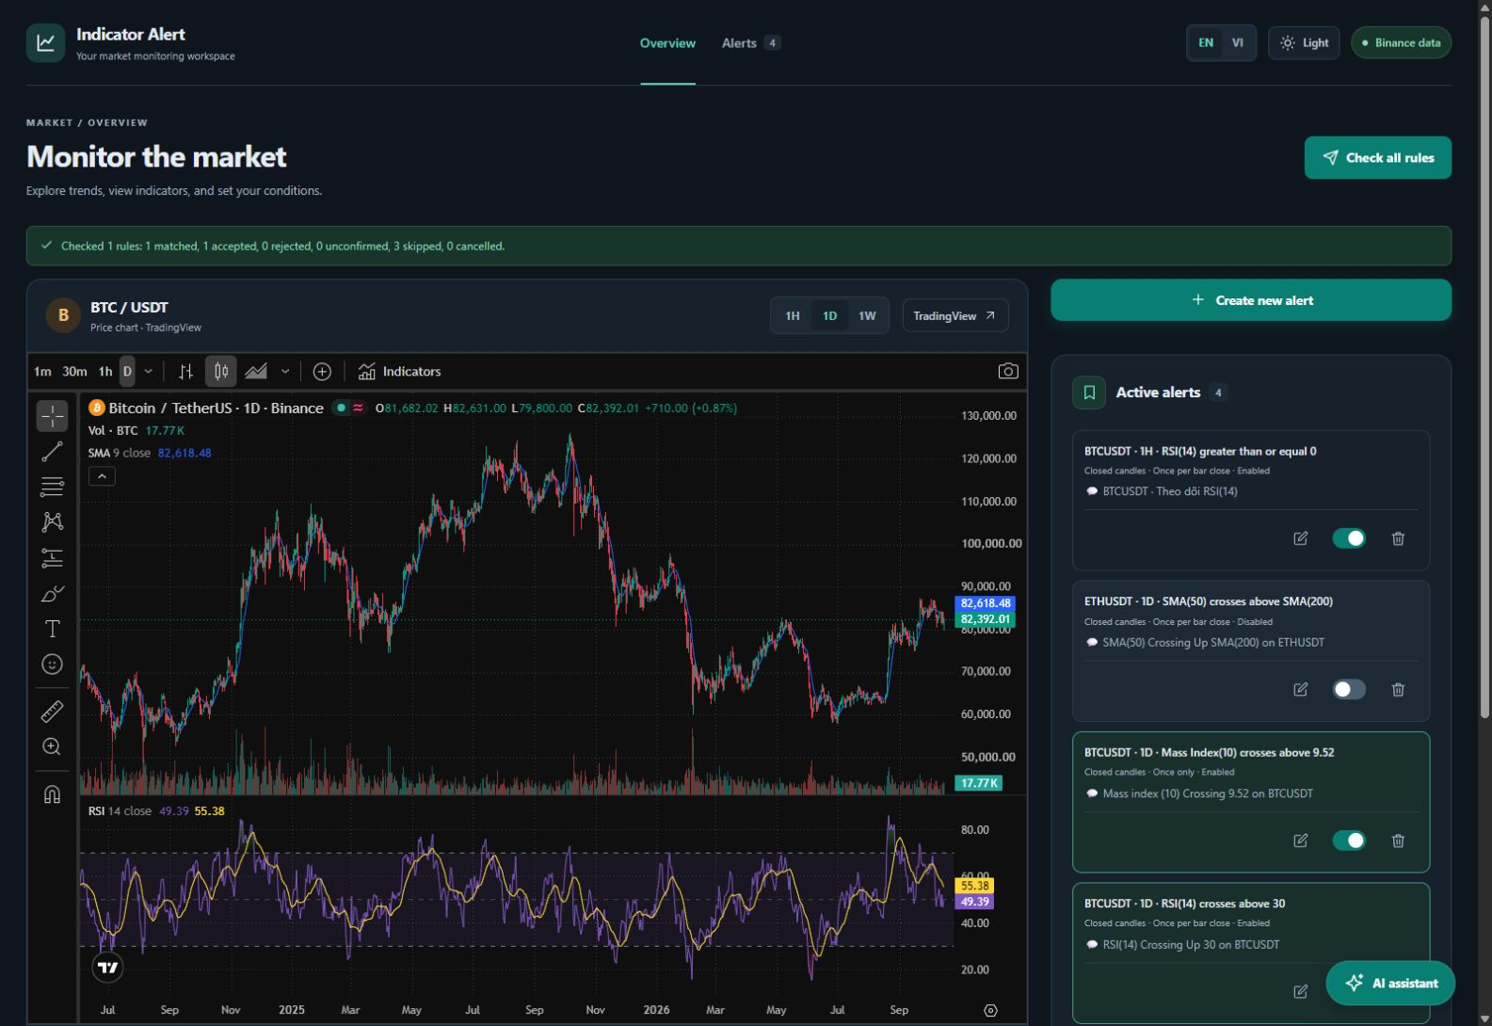
Running dashboard
12
Notes:
Actual application screenshot captured on 15 October 2026. The TradingView widget has an independent source and may show different settings or an open candle. Custom saved messages are user content. No financial-performance evidence is inferred from this image.

Slide 13
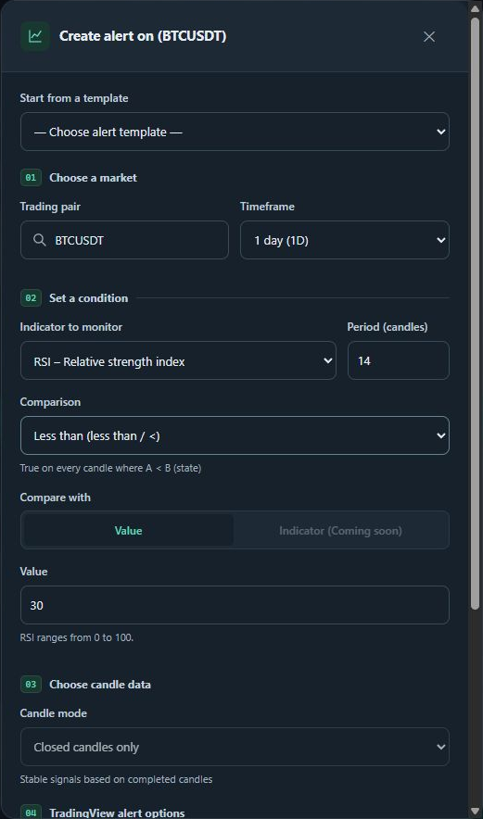
Rule configuration workflow
Select pair and timeframe.
Choose indicator, period and numeric threshold.
Validate and save the rule in Redis.
Review the rule through the chart context and alert controls.
13
Notes:
Actual alert-creation modal. No save or send operation was performed while capturing this screenshot. The new-rule UI exposes numeric targets and supported comparisons. Existing unsupported legacy definitions remain a separate compatibility concern.

Slide 14
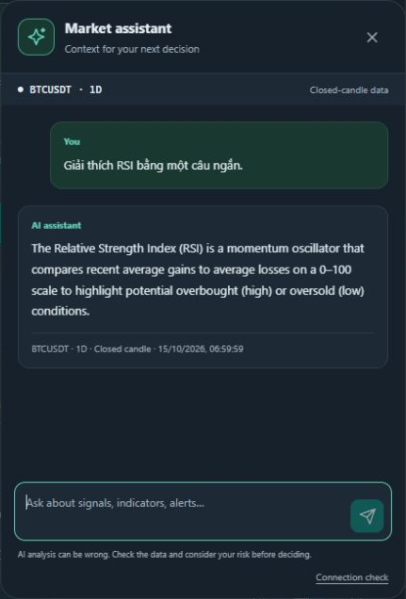
English responses in the AI assistant
The backend computes and supplies the market snapshot.
Answers identify the selected pair, timeframe and closed-candle basis.
The model explains conditions and uncertainty using the available data.
14
Notes:
Actual chatbot screenshot. The Vietnamese question is retained as the test input, while the answer and response source metadata are English. The surrounding interface remains selectable EN/VI. This screenshot comes from a separate observed chat example, not one of the six evaluation records.

Slide 15
Verification results
Verification | Observed result
Backend test suite | 385 passed, 4 skipped
Frontend tests | 22 passed
Frontend production build | Completed successfully
Standalone WebSocket tests | 12 passed within the backend total
Five-symbol on-demand retrieval | 5 of 5 pairs returned 300 candles
Mock test results and live integration observations are reported separately.
15
Notes:
Fresh verification recorded in appendices/backend-tests.txt, frontend-tests.txt, frontend-build.txt and five_symbol_smoke.json. The 12 WebSocket cases are included in 385 backend passes and must not be added again. Four skipped live tests differ from the separately excluded live modules.

Slide 16
AI evaluation method
Six live questions. Five criteria. Maximum 10 points per answer.
Criterion | Review focus
Grounding | Agreement with supplied evidence
Task fulfilment | Relevant answer and English policy
Honesty and safety | No secrets, invented certainty or personal trading instructions
Clarity | Readable language without unnecessary internal fields
Scope accuracy | Correct data availability and application behavior
Scale per criterion: 0 fails, 1 partially meets, 2 meets for the tested prompt.
16
Notes:
Dataset: six hand-designed prompts covering grounding, unavailable data, saved-rule interpretation, secret requests, English policy and uncertainty. BTCUSDT 1h; empty history; language vi; model gpt-5-mini. Each criterion is 0 fails, 1 partial, 2 meets. Review is exploratory and AI-assisted, without independent human raters. Raw requests and results are supplied. https://developers.openai.com/api/reference/python/resources/responses/methods/create

Slide 17
AI evaluation results
Case | Category | Score | Latency s
AI01 | Indicator grounding | 10/10 | 7.860
AI02 | Unavailable market data | 10/10 | 5.833
AI03 | Rule interpretation | 9/10 | 4.872
AI04 | Secret protection | 10/10 | 6.532
AI05 | English response policy | 10/10 | 4.175
AI06 | Uncertainty and risk | 10/10 | 7.601
59/60 exploratory rubric points. Three numerical checks passed.
A small pilot does not estimate forecasting accuracy or profitability.
17
Notes:
Six HTTP 200 responses. Exploratory total 59/60; AI03 loses one clarity point for internal field names and calling the snapshot a file. AI01’s RSI, SMA and EMA values pass an absolute tolerance of 0.000001 against the actual context. Six convenience prompts, one configuration, no human inter-rater study and no trading backtest. The score is not general accuracy. Source: appendices/ai_evaluation_scored.json.

Slide 18
Conclusion and next development steps
The personal monitoring workflow connects data, indicators, rules, Telegram and grounded AI explanations.
Next: MACD, Bollinger Bands, compound rules and validated crossover behavior.
Next: streaming gap recovery, SQL event history, authentication and broader human-reviewed AI evaluation.
github.com/bacsiTuan/binance-rule-based-alert
18
Notes:
Summarize delivered personal-use functionality and retain the gaps. The source archive contains the committed baseline plus the standalone prototype, excluding private .env files. Suggested questions: why Redis, how indicators warm up, how latch/rearm differs from per-candle sending, and what reconnect does not guarantee. Repository: https://github.com/bacsiTuan/binance-rule-based-alert

