Slide 1
Accountability Taxonomy for AI Software Bill of Materials
Arthit Suriyawongkul, ADAPT Centre, Trinity College Dublin
@bact
16 April 2024

Slide 2
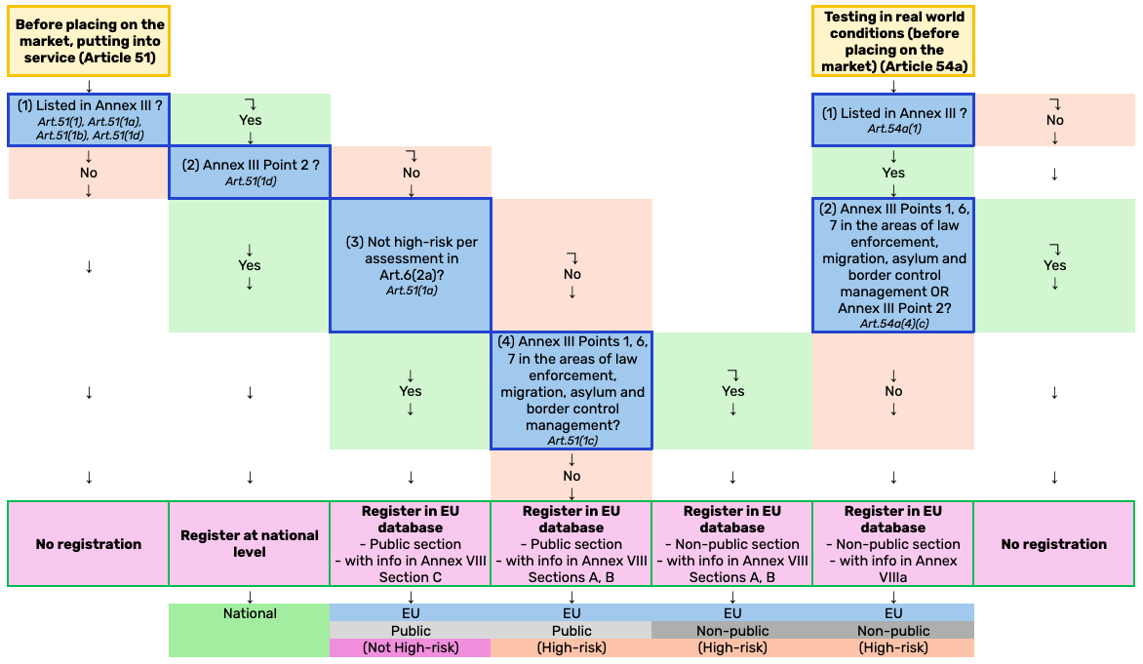

Slide 3
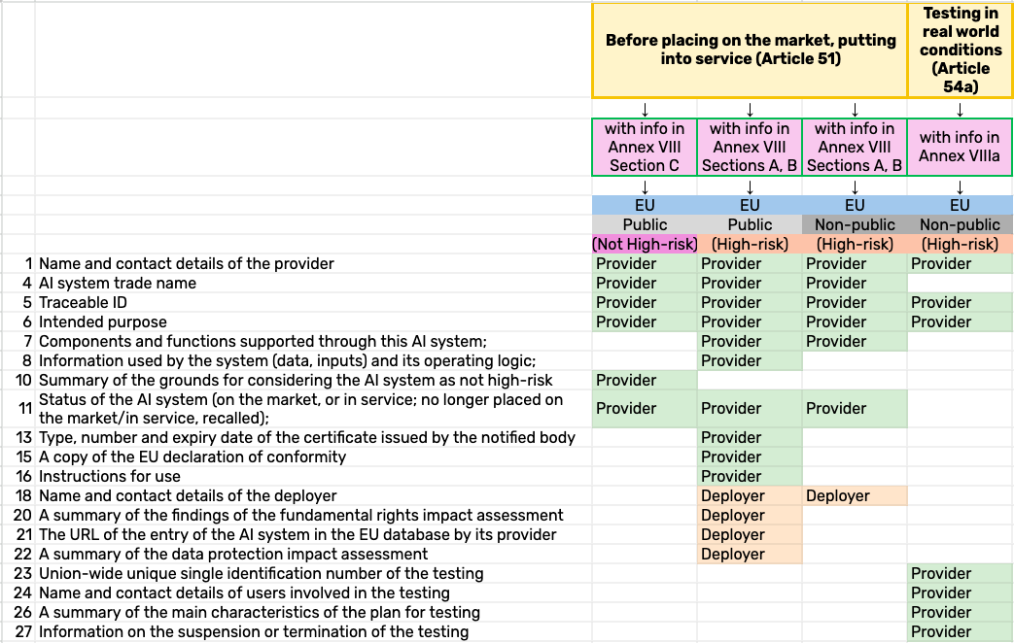

Slide 4
Accountability?

Slide 5
Actor
Carry out
Conduct

Slide 6
Actor
Account able to
Forum
Carry out
Conduct

Slide 7
Actor
Account able to
Forum
Carry out
Make judgement
Conduct

Slide 8
Actor
Account able to
Forum
Carry out
Make judgement
With Obligation, Actor feels compelled to account
Conduct
The Forum uses Standards to judge Conduct
Obligation
Standards
8
Supervisory team

Slide 9
Who is accountable to whom, for what, by which standards, and why?
Who
Account able to
To whom
Actor
Forum
Carry out
Make judgement
With Obligation, Actor feels compelled to account
For what
The Forum uses Standards to judge Conduct
Conduct
Why
By which
Obligation
Standards
9
Supervisory team

Slide 10
Who is accountable to whom, for what, by which standards, and why?
Voters, Parliament (political accountability)
Management board, Minister (managerial)
Regulators, Ombudsmen (administrative)
Courts (legal)
Professional bodies
Affected 3rd parties, stakeholders (social)
Who
Account able to
To whom
Actor
Forum
Carry out
Make judgement
With Obligation, Actor feels compelled to account
For what
The Forum uses Standards to judge Conduct
Conduct
Why
By which
Obligation
Standards
Mandatory accountability
Voluntary accountability
Quasi-voluntary accountability
Due process (legal accountability)
Professional norms and standards
Political demands
10
Supervisory team

Slide 11
Who is accountable to whom, for what, by which standards, and why?
Voters, Parliament (political accountability)
Management board, Minister (managerial)
Regulators, Ombudsmen (administrative)
Courts (legal)
Professional bodies
Affected 3rd parties, stakeholders (social)
Who
Account able to
To whom
Actor
Forum
Carry out
Make judgement
With Obligation, Actor feels compelled to account
For what
The Forum uses Standards to judge Conduct
Conduct
Why
By which
Obligation
Standards
Mandatory accountability
Voluntary accountability
Quasi-voluntary accountability
Due process (legal accountability)
Professional norms and standards
Political demands
11
Supervisory team

Slide 12
A working definition of accountability.

Slide 13
“Accountability” definition
“A set of mechanisms, practices and attributes that sum to a governance structure which involves committing to legal and ethical obligations, policies, procedures and mechanism, explaining and demonstrating ethical implementation to internal and external stakeholders and remedying any failure to act properly”.
Derived from Felici et al. 2013. Used in IEEE Global Initiative on Ethics of Autonomous and Intelligent Systems and in “A governance framework for algorithmic accountability and transparency” study report by European Parliamentary Research Service.

Slide 14
Purposes of Public Accountability (adapted from Bovens et al. 2010)
Democratic perspective
Popular control
Explainability (legitimacy) + Human oversight (lawful + ethical)
Constitutional perspective
Prevention of corruption and abuse of power
Bias and drift detection (technically robust + ethical)
Learning perspective
Maximising public value
Information that allow the improvement of the system (technically robust, organizational learning)

Slide 15
Accountability as a virtue and as a mechanism
Accountability as a virtue | Accountability as a mechanism
Focus on Behaviour | Focus on governance of behaviour
Focus on actual performance of agencies | Focus on institutional relation or arrangement in which an agent can be held to account by another agent or institution
Accountability is dependent variable; accountability has effect on behaviour | Accountability is independent variable; accountability may or may not have effect on behaviour
Virtue is more domain-specific | Mechanism is less domain-specific
In AI context: How the AI system performs (accuracy, drift, etc.) | In AI context: How the AI system get built and served
AI regulations: Post-market monitoring | AI regulations: Quality management system, Technical documentation
Adapted from Bovens, M., Schillemans, T., Goodin, R.E., 2014. Public Accountability, in: The Oxford Handbook of Public Accountability. Oxford University Press, Oxford, New York, pp. 1–20. https://doi.org/10.1093/oxfordhb/9780199641253.013.0012

Slide 16
“Non-algorithmic” accountability
“Technical issues in algorithmic accountability are largely a question if the system behaves according to specifications.
Accountability issues such as redress are beyond the technical challenges of the algorithm; these are more a question about the actions implied by the specifications.”
European Parliament. Directorate General for Parliamentary Research Services. "A Governance Framework for Algorithmic Accountability and Transparency."

Slide 17
Information obligations

Slide 18
Information obligations in EU AI Act that can support accountability (partial)
For high-risk AI systems
Provider name, registered trade name
Intended purpose
Instruction for use
Design choices
Standards applicable
Data origin, Collection original purpose
Possible biases, Measures to detect
For general purpose AI models
Intended tasks, Limitations
Instruction for use
Model design specification
Training process, Testing process
Information on the data used
Copyright protection policy
Acceptable use policies applicable

Slide 19



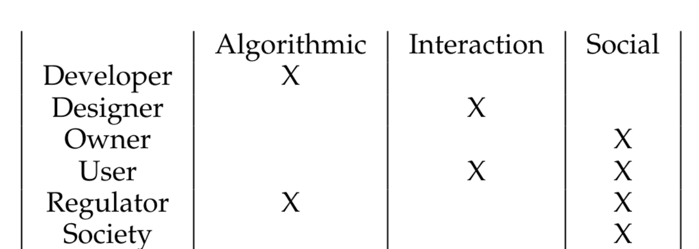

Ensuring Transparency in AI Life-Cycle
New version
ST
Technical documentation, including provenance #A11, #A18. Software Bill of Materials may facilitate the description of elements of AI systems Annex IV (2)
AI Developer
Experience Designer
Technical Writer
Provider
Create AI model
Prioritise explanations by considering domain, use case, impact
Record explainability method limits
Design UX
User can interpret #A13(1)
Interface, mental model
Write documents
Clear language for target (e.g. deployer)
e.g. accuray #A15(2), instructions of use Annex IV (1) (g)
Documenting
AT: Algorithmic transparency
AI System Product Cycle
IT: Interactive transparency
AT
ST
IT
IT
ST: Social transparency
IT
ST
AT
ST
Provider
Deployer
Deployer
Record-keeping #A12 and monitoring #A29(4) (planned in #A61). Report serious incidents to MSA #A62, preferably with a standardized risks and harms taxonomy – for example, AIAAIC.
Monitoring
AT
An example stakeholder transparency matrix purposed. Will differ by the AI system, domain, and context.
IT
ST
User
Place onto the market
Regulators
ST
+ Society
Notes:
Based on the three layers of transparency - we can see that different actors contribute differently to transparency over the course of AI life cycle.
*Note that on the slides, “Regulators” can be more than one kind of authority and thus can be at different stages of the cycle. For a simplified illustration, only one is placed in the diagram.

Slide 20
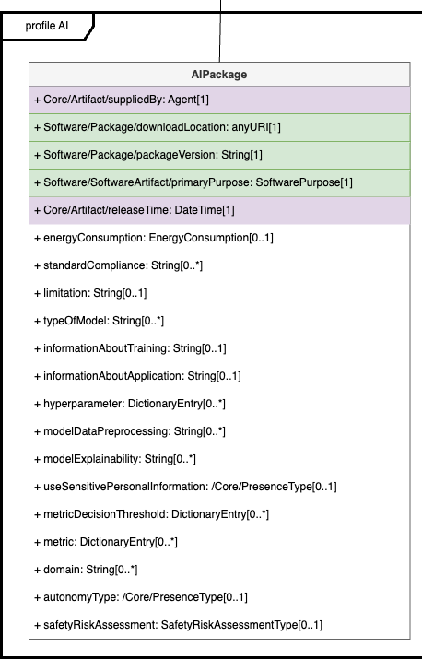
Software Bill of Materials
“formal record containing the details and supply chain relationships of various components used in building software” – Executive Order on Improving the Nation’s Cybersecurity (EO 14028)
“analogous to a list of ingredients” “can help organisations or persons avoid consumption of software that could harm them.” – Wikipedia
“communicating a release: name, version, components, licenses, copyrights, and useful security references.” – SPDX
ISO/IEC 5962:2021 Software Package Data Exchange (SPDX) Specification V2.2.1

Slide 21
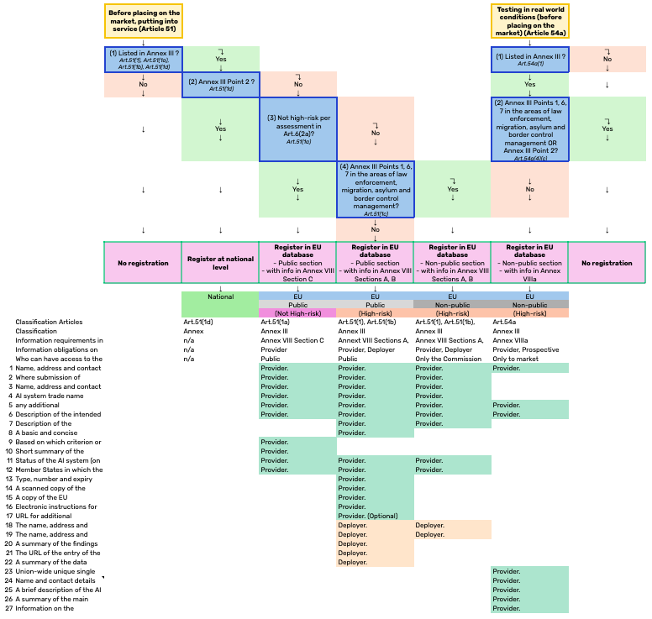
Use cases
For AI providers/deployers
To register in national/supranational database
To get permission for testing in real-world conditions
To get the declaration of conformity
To report serious incident post-market
To estimate remaining information obligations to fulfil to enter a new market
For regulators
To estimate resource for regulatory compliance

Slide 23
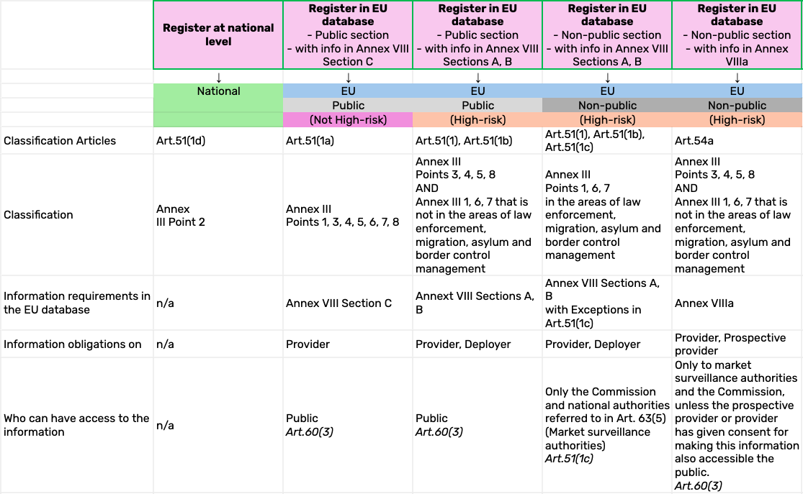

Slide 25
Demo

Slide 26
regtech.adaptcentre.ie

Slide 27





Thank you
Arthit Suriyawongkul suriyawa@tcd.ie

