Slide 1
Nextflow Intro

Slide 2
Outline
Getting Started with Nextflow
Workflow parameterization
Channels
Processes
Workflows

Slide 3
Getting Started with Nextflow
Objectives:
Understand what a workflow management system is.
Understand the benefits of using a workflow management system.
Explain the benefits of using Nextflow as part of your bioinformatics workflow.
Explain the components of a Nextflow script.
Run a Nextflow script.

Slide 4
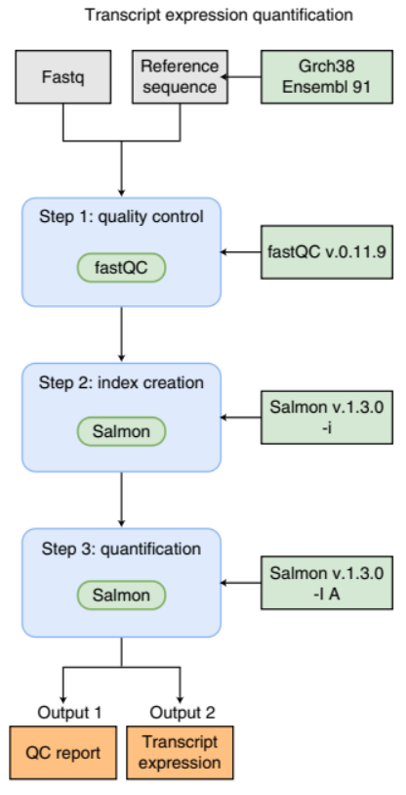
Workflows
run a sequence of tasks
often multiple software packages
as workflows become larger and more complex, the management of the programming logic and software becomes difficult
  need a workflow language that handles this better than Bash or Python

Slide 5
Workflow management systems
Workflow Management Systems (WfMS) such as Snakemake, Galaxy, and Nextflow have been developed specifically to manage computational data-analysis workflows in fields such as bioinformatics, imaging, physics, and chemistry.
These systems contain multiple features that simplify the development, monitoring, execution and sharing of pipelines, such as:
  Run time management
  Software management
  Portability & Interoperability
  Reproducibility
  Re-entrancy

Slide 6
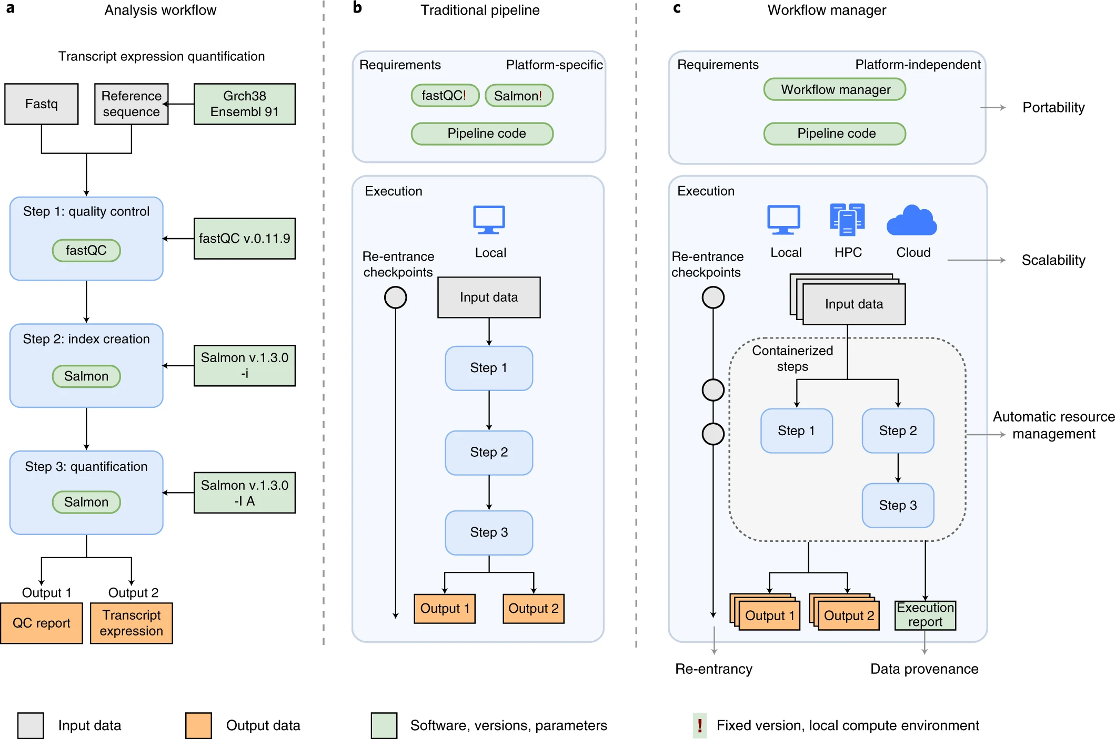
Workflow management systems
Wratten, L., Wilm, A. & Göke, J. Reproducible, scalable, and shareable analysis pipelines with bioinformatics workflow managers. Nat Methods 18, 1161–1168 (2021). https://doi.org/10.1038/s41592-021-01254-9

Slide 7
Processes, channels, and workflows
Nextflow workflows have 3 main parts: processes, channels, and workflows.
  Processes describe a task to be run. A process script can be written in any scripting language that can be executed by the Linux platform (Bash, Perl, Ruby, Python, R, etc.). Processes spawn a task for each complete input set. Each task is executed independently and cannot interact with other tasks. The only way data can be passed between process tasks is via asynchronous queues, called channels.
  Processes define inputs and outputs for a task. Channels are then used to manipulate the flow of data from one process to the next.
  The interaction between processes, and ultimately the pipeline execution flow itself, is then explicitly defined in a workflow section.

Slide 8
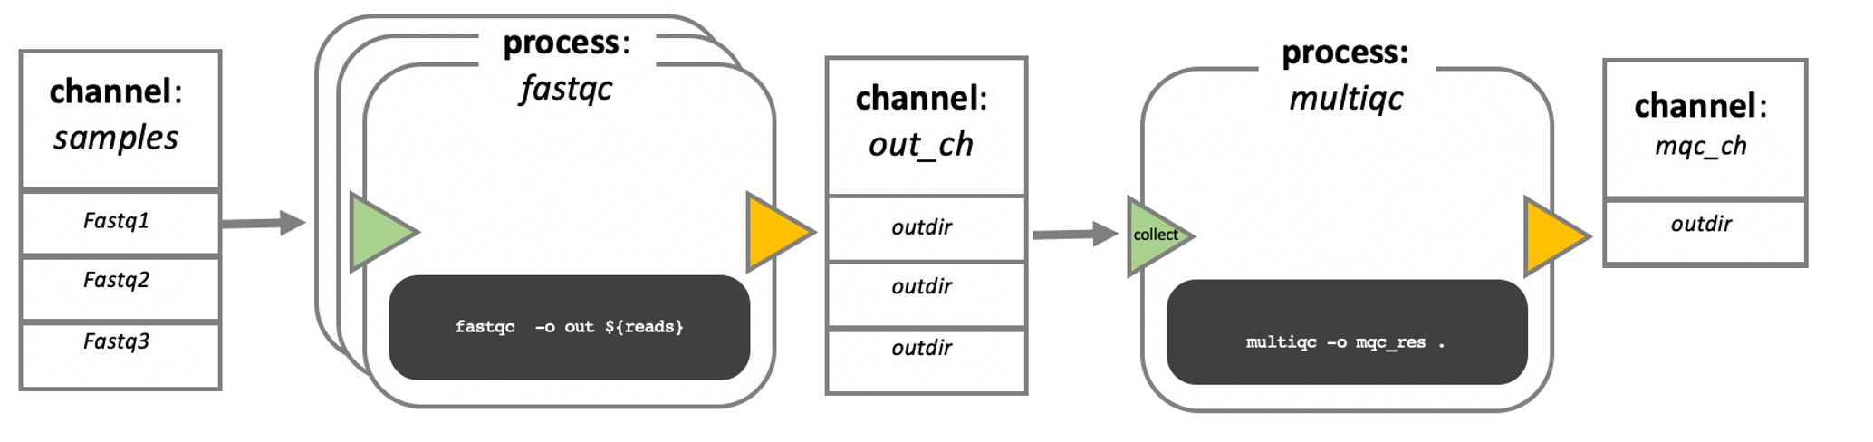
Processes, channels, and workflows

Slide 9
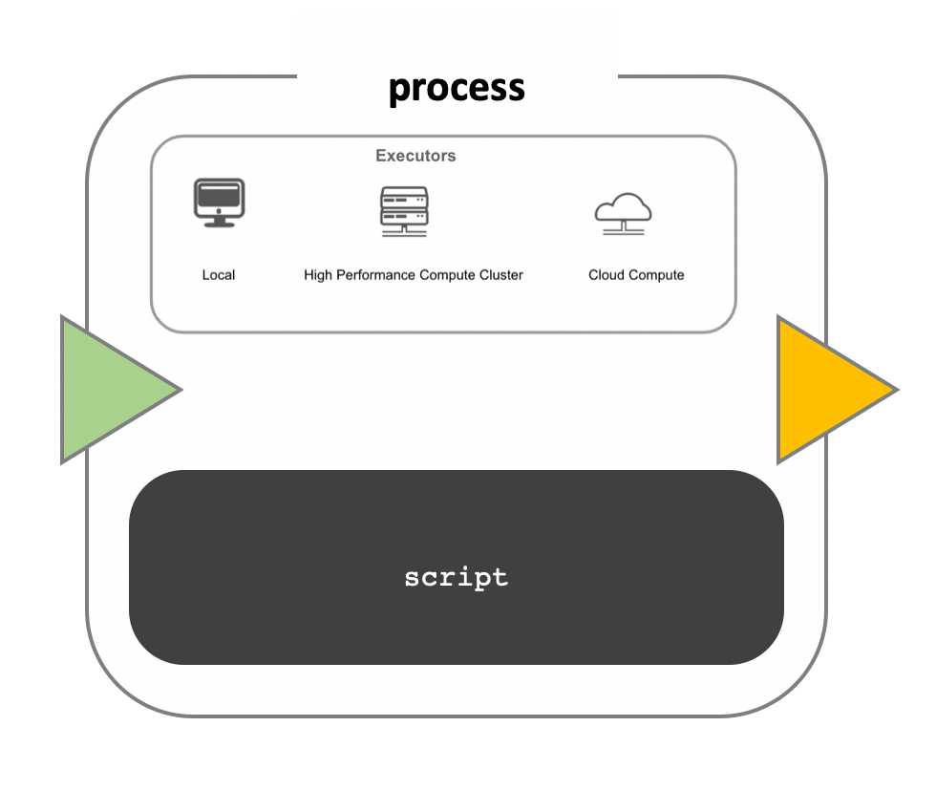
Workflow execution
While a process defines what command or script must be executed, the executor determines how that script is run in the target system.
If not otherwise specified, processes are executed on the local computer. The local executor is very useful for pipeline development, testing, and small-scale workflows, but for large-scale computational pipelines, a High Performance Cluster (HPC) or Cloud platform is often required.
Nextflow provides a separation between the pipeline’s functional logic and the underlying execution platform. This makes it possible to write a pipeline once, and then run it on your computer, compute cluster, or the cloud, without modifying the workflow, by defining the target execution platform in a configuration file.
Nextflow provides out-of-the-box support for major batch schedulers and cloud platforms such as Sun Grid Engine, SLURM job scheduler, AWS Batch service and Kubernetes.
  A full list can be found here.

Slide 10
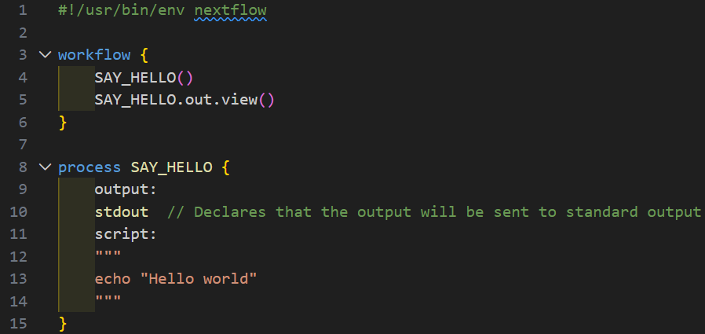
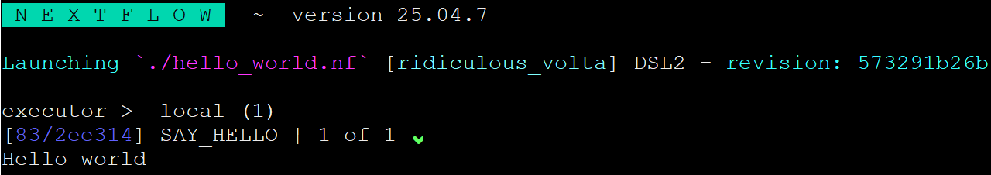
Your first script

Slide 11
Workflow parameterization
Objectives
Use pipeline parameters to change the input to a workflow.
Add a pipeline parameters to a Nextflow script.
Understand how to create and use a parameter file.

Slide 12
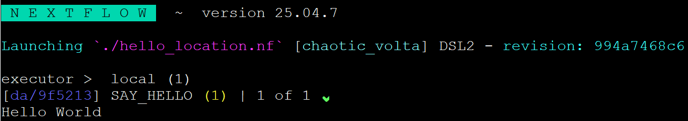
Workflow parameterization
#!/usr/bin/env nextflow
params.location = null
workflow {
location_ch = Channel.of(params.location)
SAY_HELLO(location_ch)
SAY_HELLO.out.view()
}
process SAY_HELLO {
input:
val location
output:
stdout // Declares that the output will be sent to standard output
script:
"""
echo "Hello ${location ?: 'World'}"
"""
}

Slide 13
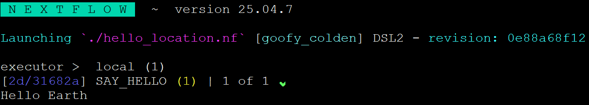
Adding a parameter to a script
#!/usr/bin/env nextflow
params.location = null
workflow {
location_ch = Channel.of(params.location)
SAY_HELLO(location_ch)
SAY_HELLO.out.view()
}
process SAY_HELLO {
input:
val location
output:
stdout // Declares that the output will be sent to standard output
script:
"""
echo "Hello ${location ?: 'World'}"
"""
}

Slide 14
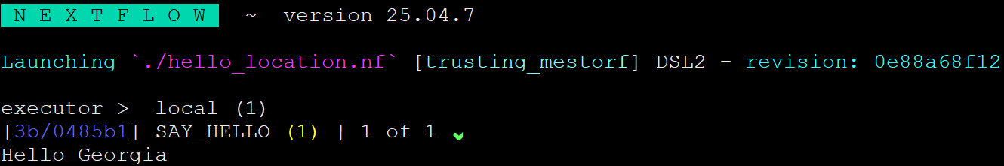
Create & use a parameter file (JSON)
{
"location": "Georgia"
}
location-params.json

Slide 15
Channels
Objectives
Understand how Nextflow manages data using channels.
Understand the different types of Nextflow channels.
Create a value and queue channel using channel factory methods.
Select files as input based on a glob pattern.
Edit channel factory arguments to alter how data is read in.

Slide 16
Channels
Channels are the way in which Nextflow sends data around a workflow.
Channels connect processes via their inputs and outputs.
Channels can store multiple items, such as files (e.g., fastq files) or values.
When the process runs using one item from the input channel, we will call that run a task.

Slide 17
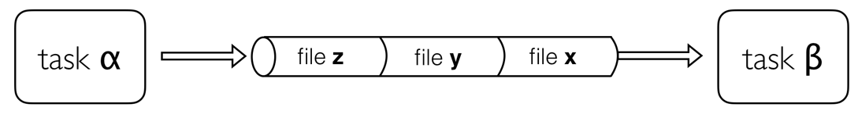
Channels
allows complex tasks to be split up, run in parallel
asynchronous
the first element into a channel queue is the first out of the queue (First in - First out).
Channels only send data in one direction

Slide 18
Channel types
2 kinds of channels: queue channels and value channels
Queue channels are a type of channel in which data is consumed (used up) to make input for a process/operator. Queue channels can be created in two ways:
  As the outputs of a process.
  Explicitly using channel factory methods such as Channel.of or Channel.fromPath.
A value channel is bound to a single value. A value channel can be used an unlimited number times since its content is not consumed.

Slide 19
Creating Channels using Channel factories
Channel factories are used to explicitly create channels.
  In programming, factory methods (functions) are a programming design pattern used to create different types of objects (in this case, different types of channels).
Channel factories are called using the Channel.<method> syntax, and return a specific instance of a Channel.

Slide 20
Queue channel factory
Queue (consumable) channels can be created using the following channel factory methods.
  Channel.of
  Channel.fromList
  Channel.fromPath
  Channel.fromFilePairs
  Channel.fromSRA

Slide 21
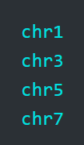
The of Channel factory
When you want to create a channel containing multiple values you can use the channel factory Channel.of.
Channel.of allows the creation of a queue channel with the values specified as arguments, separated by a ,.

Slide 22
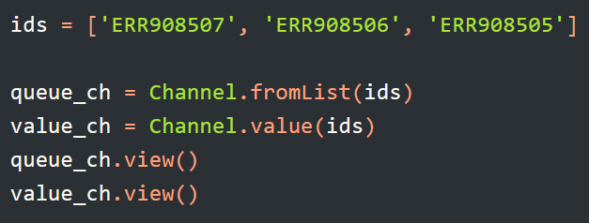
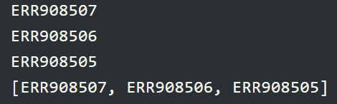
The fromList Channel factory
You can use the Channel.fromList method to create a queue channel from a list object.

Slide 23

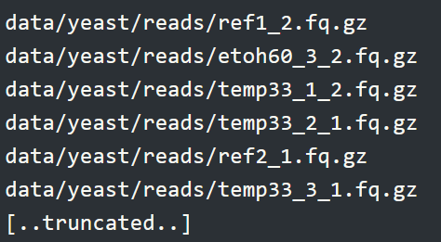
The fromPath Channel factory
The fromPath factory method creates a queue channel containing one or more files matching a file path.
You can also use glob syntax to specify pattern-matching behavior for files.

Slide 24
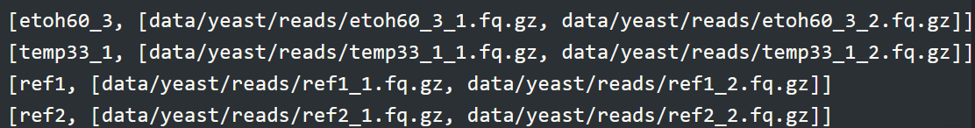
The fromFilePairs Channel factory
creates a queue channel containing a tuple for every set of files matching a specific glob pattern (e.g., /path/to/*_{1,2}.fq.gz)

Slide 25
Processes
Objectives
Understand how Nextflow uses processes to execute tasks.
Create a Nextflow process.
Define inputs and outputs to a process.
Understand how to handle grouped input and output using the tuple qualifier.
Understand how to use conditionals to control process execution.
Use process directives to control execution of a process.
Use the publishDir directive to save result files to a directory.

Slide 26
Processes
We now know how to create and use Channels to send data around a workflow. We will now see how to run tasks within a workflow using processes.
A process is the way Nextflow executes commands you would run on the command line or custom scripts.
a particular step in a workflow
independent of each other

Slide 27
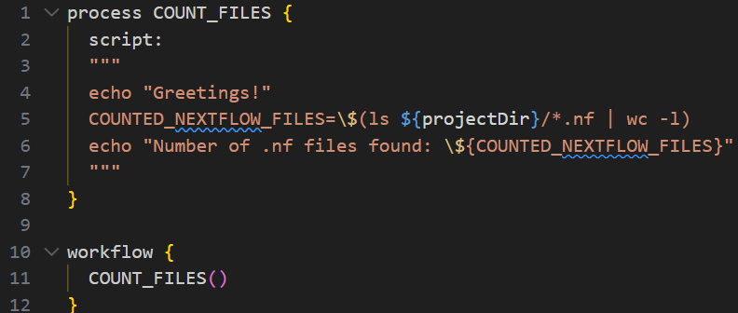
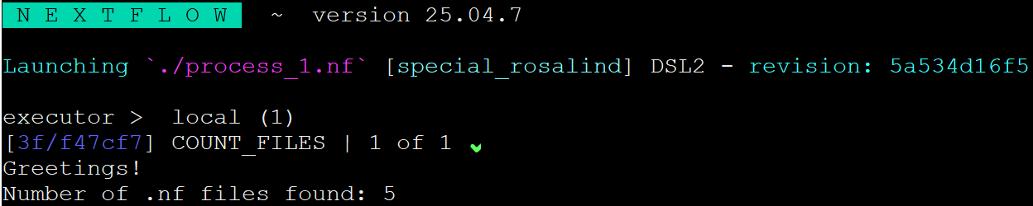
Processes

Slide 28
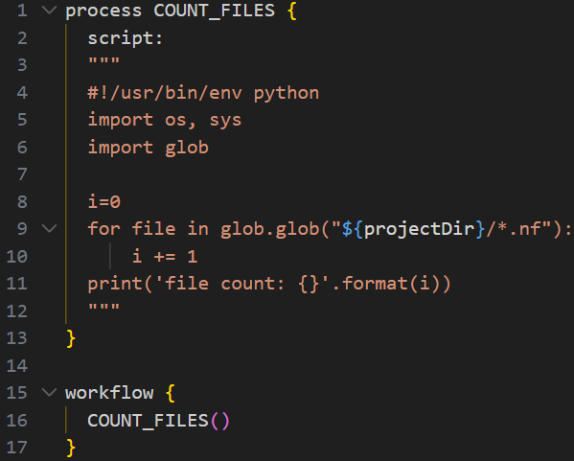
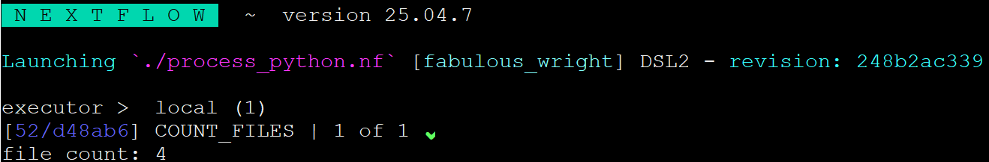
Processes

Slide 29
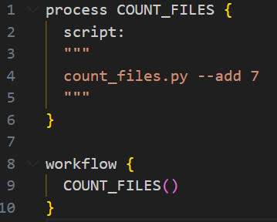
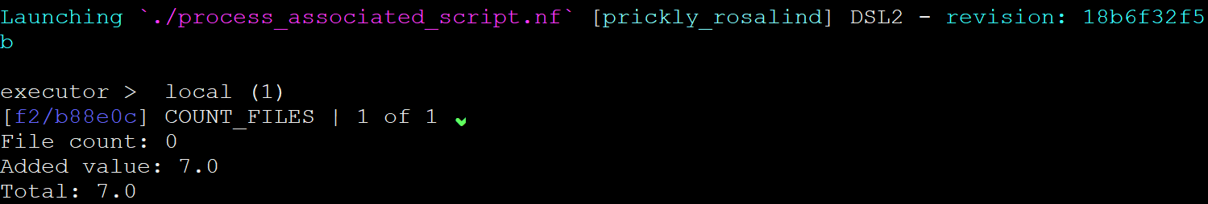
Processes

Slide 30
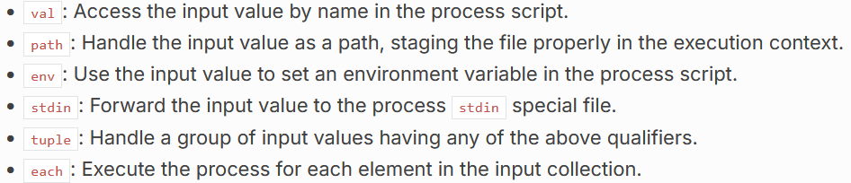
Processes: Inputs
The input block defines which channels the process is expecting to receive input from.
The number of elements in input channels determines the process dependencies and the number of times a process executes.
https://www.nextflow.io/docs/latest/process.html#inputs

Slide 31
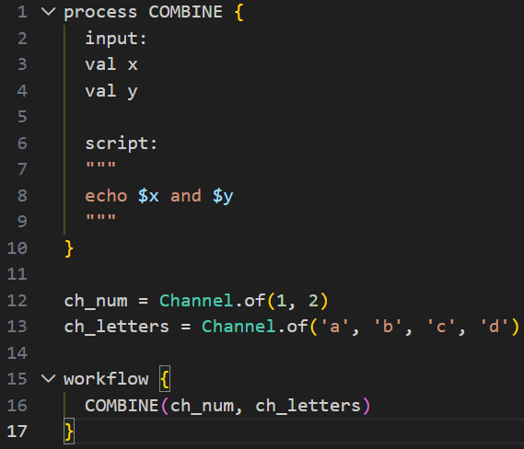
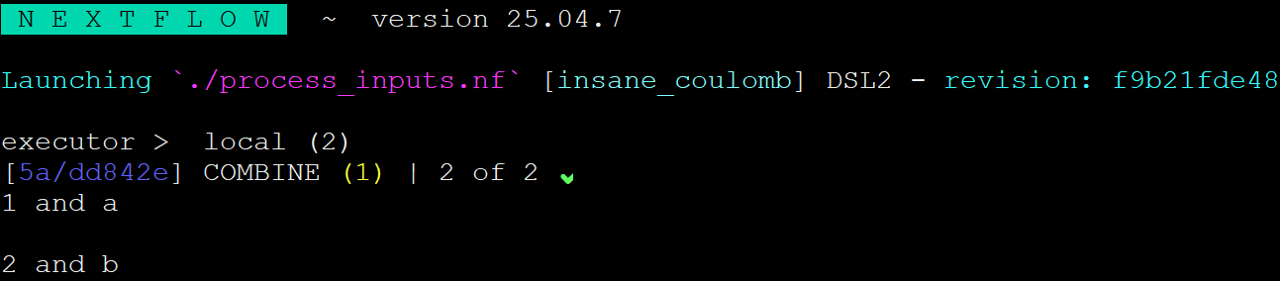
Processes: Inputs
The process is executed only twice, because when a queue channel has no more data to be processed it stops the process execution.

Slide 32
Processes: Outputs
Like the input, the type of output data is defined using type qualifiers.
When an output file name contains a * or ?, it is interpreted as a pattern match.
  Input files are not included in the list of possible matches.
  Glob pattern matches against both files and directories path.
  When a two stars pattern ** is used to recurse through subdirectories, only file paths are matched i.e. directories are not included in the result list.

Slide 33
Processes: Directives
Directive declarations allow the definition of optional settings, like the number of cpus and amount of memory, that affect the execution of the current process without affecting the task itself.
Directives are commonly used to define the amount of computing resources to be used or extra information for configuration (e.g., container) or logging purpose such as (e.g., tag).
Note: You do not use = when assigning a value to a directive.

Slide 34
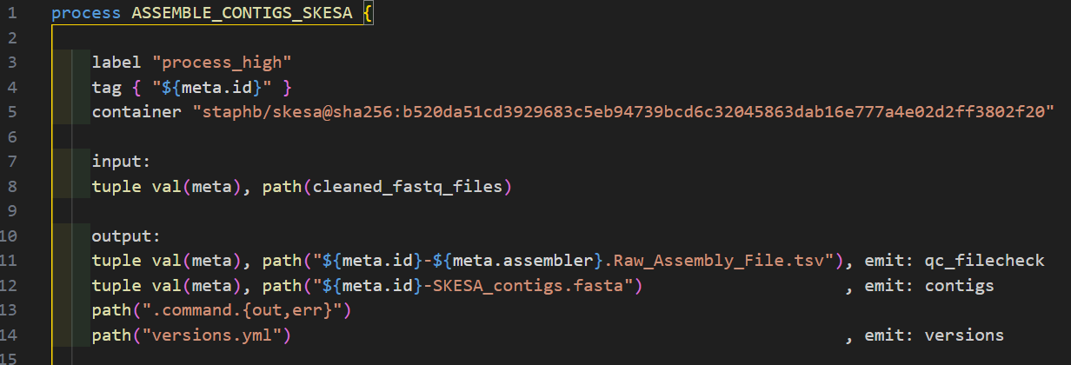
Processes: Directives

Slide 35
Processes: Output Organizing
Nextflow manages intermediate results from the pipeline’s expected outputs independently.
Files created by a process are stored in a task specific working directory which is considered as temporary. Normally this is under the work directory, which can be deleted upon completion.
The files you want the workflow to return as results need to be defined in the process output block and then the output directory specified using the directive publishDir. More information here.

Slide 36
Processes: Output Organizing
Nextflow manages intermediate results from the pipeline’s expected outputs independently.
Files created by a process are stored in a task specific working directory which is considered as temporary. Normally this is under the work directory, which can be deleted upon completion.
The files you want the workflow to return as results need to be defined in the process output block and then the output directory specified using the directive publishDir. More information here.

Slide 37
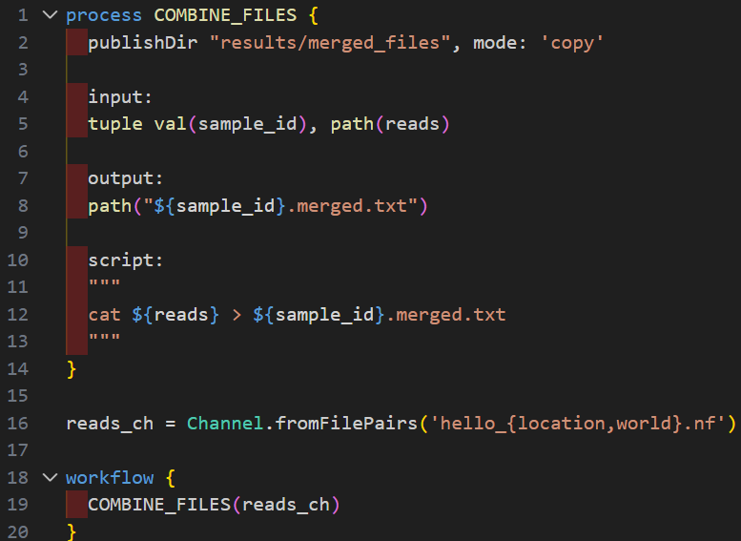
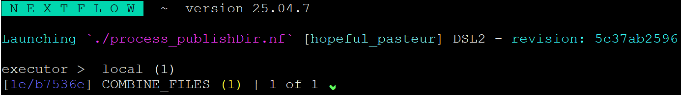
Processes: Output Organizing

Slide 38
Workflows
Objectives
Create a Nextflow workflow joining multiple processes.
Understand how to connect processes via their inputs and outputs within a workflow.

Slide 39
Workflows
Objectives
Create a Nextflow workflow joining multiple processes.
Understand how to to connect processes via their inputs and outputs within a workflow.

Slide 40
Workflows
We can connect processes to create our pipeline inside a workflow scope.
In contrast to processes, the workflow definition in Nextflow does not require a name.
  A named workflow is a subworkflow that can be invoked from other workflows. More information can be found in the official documentation here.
A process is invoked as a function in the workflow scope, passing the expected input channels as arguments.

Slide 41
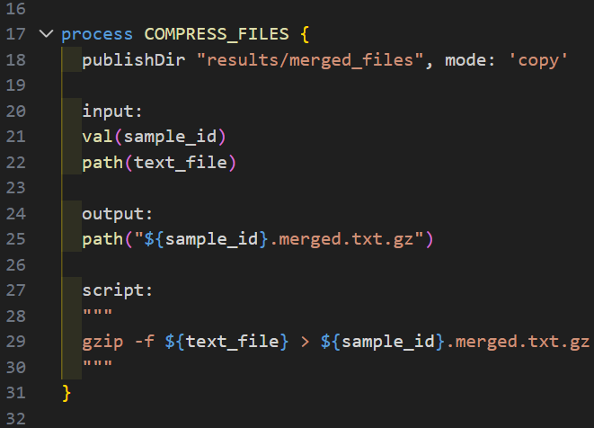
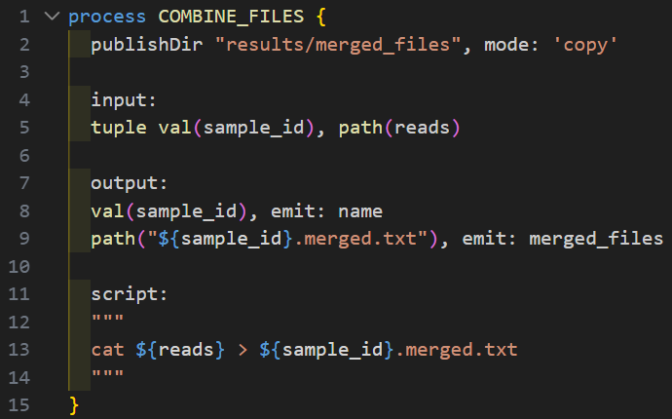
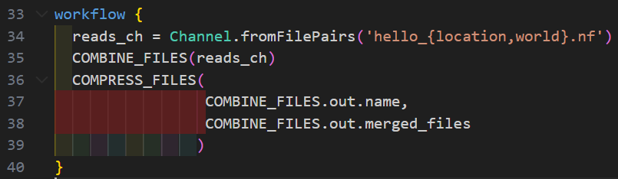
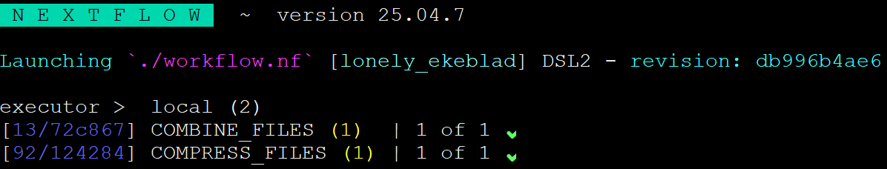
Workflows

Slide 42
More Learning Resources
https://training.nextflow.io/latest/
https://nf-co.re/docs/
https://carpentries-incubator.github.io/workflows-nextflow/
https://github.com/bacterial-genomics/nextflow-intro

