Slide 1

Deep Learning-based Resource Utilization Prediction
in Cloud Computing Environments.
Vitumbiko Mafeni – 1102249014
Tran Huy Thang – 1102360007
Phuong-Bac Ta – 1002360003

Slide 2
Content
Introduction
Related Work
Problem Formulation
Proposed Method
Performance Evaluation
Conclusion and Future Work.

Slide 3
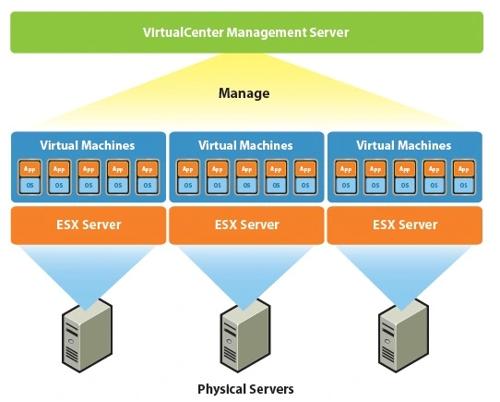
Introduction
Cloud computing has grown in popularity due to its services and the power of virtualization technology [1] which offer infrastructure as a service (IaaS) with numerous virtual machine instance on a physical server, optimal resource management and services management.
However, it is difficult to maintain such as high level of service while allocating as few resources as possible due to strict constraint of cloud infrastructure [2].
➔ Efficient resource allocation while maintaining service agreements has become increasingly important.

Slide 4
Introduction
Resource allocation (auto-scale)
Reactive[A1, A2]
Proactive[B4-C11]
Monitor resources usage and make resources allocation or deallocation decision on-the-fly based on certain load thresholds,
Proactive methods, on the other hand, are able to make decisions before overloading or underloading situations happen by predicting future resources usage
? Requires a method to predict the system's resource consumption accurately and handle it quickly so that it can support reasonable resource adjustments to optimize usage strategies as well as energy consumption.
➔ Propose resource usage prediction method using deep learning model with time-series data from cloud system (virtual machine-based infrastructure).

Slide 5
Related Works (1)
Reactive approaches [A1, A2, A3] rely on a pre-defined set threshold for determining resource utilization change, consider short-term information [A1], policies-based management [A2] and rule-based management [A3]

Slide 6
[A1] A Hybrid Method for Short-Term Host Utilization Prediction in Cloud Computing
Related Works (1)
Problem Statement
Dynamic resource scheduling in cloud computing for Quality of Service (QoS) is critical.
The challenge is predicting future host utilization in real-time due to rapid and unstable changes.
Machine learning methods are accurate but time-consuming for resource allocation and scheduling.

Slide 7

[A1] A Hybrid Method for Short-Term Host Utilization Prediction in Cloud Computing
Related Works (1)
Solution
Proposed hybrid method, EEMD-RT-ARIMA, for short-term host utilization prediction.
Utilizes ensemble empirical mode decomposition (EEMD), runs test (RT), and autoregressive integrated moving average (ARIMA).
Decomposes nonstationary host utilization into more stable intrinsic mode function (IMF) components and a residual component.
Selects and reconstructs efficient IMF components to reduce prediction time and error accumulation.
Combines prediction results from three new components, each predicted by the ARIMA method.
Experiment conducted on real host utilization data, comparing the proposed method with ARIMA and EEMD-ARIMA in terms of error, effectiveness, and time-cost analysis.
Results indicate that the proposed method is cost-effective and suitable for short-term host utilization prediction in cloud computing.

Slide 8
[A2] Experimental Evaluation of Rule-Based Autonomic Computing Management Framework for Cloud-Native Applications
Related Works (1)
Problem Statement
Policy-based management in a flexible manner is needed to govern system behavior.
For Cloud-native applications, compliance with CI/CD objectives should be simplified.
The system should adapt to changes in requirements at runtime without affecting the implementation.

Slide 9
[A2] Experimental Evaluation of Rule-Based Autonomic Computing Management Framework for Cloud-Native Applications
Related Works (1)
Solution
Implement a rule-based approach to represent policies in the context of Cloud-native applications.
Extend the management characteristics available in current orchestrators for deploying applications in orchestrated environments.
Develop a general methodology for experimental evaluation of complex Cloud-native environments.
Propose two categories of experiments to evaluate the rule-based approach: one for dynamic resource adjustment and one for assessing the influence of the rule engine on autonomic management.
Evaluate the proposed solution from the perspective of the execution environment's resources, demonstrating its usability and capabilities in the AMoCNA (Autonomic Management of Cloud-native Applications) system.

Slide 10
[A3] Workload Prediction Using ARIMA Model and Its Impact on Cloud Applications’ QoS
Related Works (1)
Problem Statement
Cloud-based companies face intense competition as they shift to cloud-based software as a service (SaaS) applications on public clouds.
Providing good quality of service (QoS) is crucial to retain users and remain competitive.
Maintaining QoS while optimizing resource allocation is challenging due to varying workloads.

Slide 11
[A3] Workload Prediction Using ARIMA Model and Its Impact on Cloud Applications’ QoS
Related Works (1)
Solution
Employ proactive dynamic provisioning of resources to estimate and allocate resources based on future application needs, releasing them when not required.
Develop a cloud workload prediction module for SaaS providers using the autoregressive integrated moving average (ARIMA) model.
Evaluate the accuracy of future workload prediction using real web server request traces.
Assess the impact of prediction accuracy on resource utilization efficiency and QoS.
Simulation results demonstrate that the model achieves up to 91 percent accuracy, leading to efficient resource utilization with minimal impact on QoS, helping SaaS providers thrive in the competitive market.

Slide 12
Related Works (2)
[B4] Host utilization prediction using hybrid kernel based support vector regression in cloud data centers
IDEA:
The article presents a method for predicting server resource usage and managing virtual machine (VM) migration in a cloud computing environment. It introduces the algorithms, performance evaluation parameters, experimental settings, and results of existing prediction methods and the author's proposed method. Specifically, the article presents a prediction method using SVM (Support Vector Machine).

Slide 13
Related Works (2)
[B4] Host utilization prediction using hybrid kernel based support vector regression in cloud data centers
Step 1: Enter input to the model. This involves providing the necessary data related to CPU utilization, memory utilization, and bandwidth utilization history as input to the model.
Step 2: Apply a hybrid kernel function to map non-linear data to a higher-dimensional space. This step is crucial for handling non-linear data and involves using the hybrid kernel function to transform the data into a higher-dimensional space.
Step 3: Load the training data set (input) and train the model to decide the boundary line that classifies data. The training data set is utilized to train the SVM or SVR model to determine the boundary line that helps classify the data based on historical utilization information.
Step 4: For new data (CPU, Memory, Bandwidth), predict the utilization (Pi). After training the model, new data regarding CPU, memory, and bandwidth is utilized to predict resource utilization using the trained SVM or SVR model.
Step 5: If Pi crosses the decision boundary, treat the host as overloaded. This step involves analyzing the predicted utilization value to determine whether the host is overloaded or not based on a predefined decision boundary.
Step 6: Perform VM migration algorithm if the host is overloaded. In the event of an overloaded host, a VM migration algorithm is executed to handle the resource requirements and ensure smooth operations within the cloud environment.

Slide 14
Related Works (2)
[B5] Workload prediction in cloud using artificial neural network and adaptive differential evolution
In the paper, the authors focus on researching ways to improve the prediction of workload in cloud data centers. Instead of relying solely on traditional methods like backpropagation, they applied a technique called Differential Evolution, a commonly used evolutionary algorithm in the field of optimization. Importantly, this method allows the model to explore the solution space comprehensively, avoiding the issues commonly encountered with being stuck in local maxima, which traditional methods often face.

Slide 15
Related Works (2)
[B5] Workload prediction in cloud using artificial neural network and adaptive differential evolution
The "Differential Evolution" method is an optimization algorithm inspired by the process of natural evolution. Specifically, it simulates the evolutionary process in nature, where favorable individuals are selected and continue to exist through generations to create new generations with better performance.
The algorithm begins with a set of initial solutions called the population. Through each generation, individuals in the population undergo operations such as mutation, crossover, and selection to create new individuals, combining the best features from the previous generation. This process continues iteratively through multiple generations until an optimal solution is reached or other stopping conditions are met.
The "Differential Evolution" method helps the algorithm explore the search space comprehensively, avoiding the issue of being trapped in local optima. This makes it a powerful tool for optimizing complex problems, such as function optimization, or in this case, improving the prediction of workload in cloud data centers.

Slide 16
Related Works (2)
[B5] Workload prediction in cloud using artificial neural network and adaptive differential evolution
Result:
The application of the "Differential Evolution" method has achieved better performance in predicting workload in cloud data centers compared to traditional methods such as backpropagation. This method has significantly improved the accuracy of predictions and provided a more effective approach to resource management and workload forecasting in the cloud environment. This opens up prospects for the practical application of this method to optimize performance and reduce operational costs in modern cloud systems.

Slide 17
Related Works (2)
[B6] A hybrid heuristic-based tuned support vector regression model for cloud load prediction
The scientific paper presents the application of the CGA-PSO optimization algorithm in predicting CPU and memory loads in a cloud environment. The paper focuses on implementing the TSVR (Tuned Support Vector Regression) model to forecast workload
The paper introduces the application of the CGA-PSO optimization algorithm for workload prediction in a cloud environment. The proposed approach involves the implementation of the TSVR (Tuned Support Vector Regression) model, which is optimized using a hybrid GA-PSO algorithm. The workflow includes the use of heuristic methods for parameter tuning in the SVR model.
Result:
The results of the study demonstrate that the TSVR (Tuned Support Vector Regression) model outperforms other algorithms in predicting CPU and memory workloads in a cloud environment.

Slide 18
Related Works (3)
Deep Learning approaches [C7, C8, C9, C10, C11] have been used in various time series prediction methods in cloud computing.
[C7] author offered a prediction approach based on LSTM model for predicting actual resource and mean resource with ability to learn long-term relationships from data.
[C9, C10] employing bidirectional LSTM (BiLSTM) for deep learning prediction model to enhance performance of LSTM for large-scale resource consumption prediction in the cloud computing environment
[C11] proposed a hybrid approach by combining RNN and Bi-LSTM to forecast CPU workload of VMs in cloud system which can improve the performance of using single technique separately
[C8] the author proposed the combination between CNN and LSTM model for predicting workload variables (CPU). CNN is used for extract the complex features of each VM usage component after LSTM network for modeling temporal information of periodic trends.

Slide 19
Related Works (3)
Deep Learning approaches [C7, C8, C9, C10, C11] have been used in various time series prediction methods in cloud computing.
Only consider univariate metrics (CPU) to make prediction that insufficient accuracy
LSTM, CNN –based is sequential processing that make time series data must processed sample by sample and also past information retained through past hidden states that make model complexity is higher then will be more delay when deploy in a real environment

Slide 20
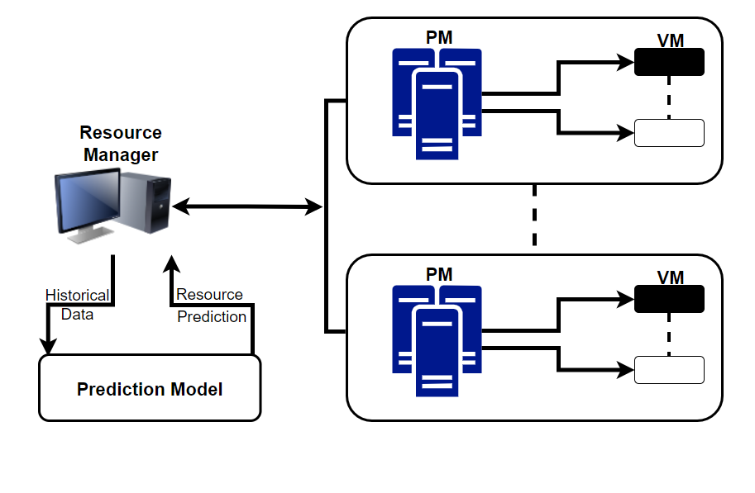

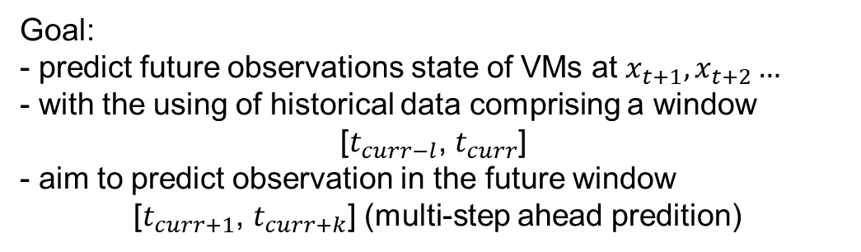
Problem Formulation
$x_{t}$ $={\{x}_{1}$, $x_{2}$ … $x_{d}\}$
Indicates the multivariate time series data of VMs (CPU, memory, network) in the current state
Goal:
- predict future observations state of VMs at $x_{t+1},x_{t+2}…$
- with the using of historical data comprising a window
[$t_{curr−l}$, $t_{curr}$]
- aim to predict observation in the future window
[$t_{curr+1}$, $t_{curr+k}$] (multi-step ahead predition)

Slide 21
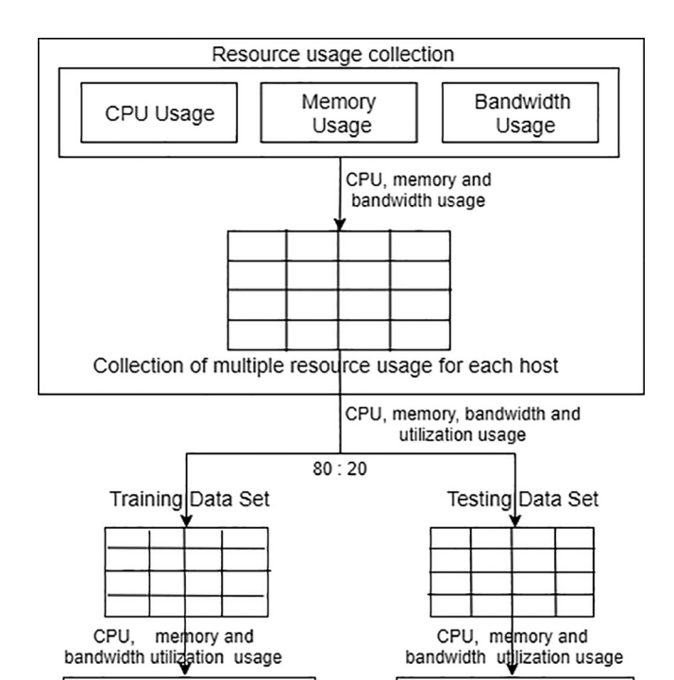
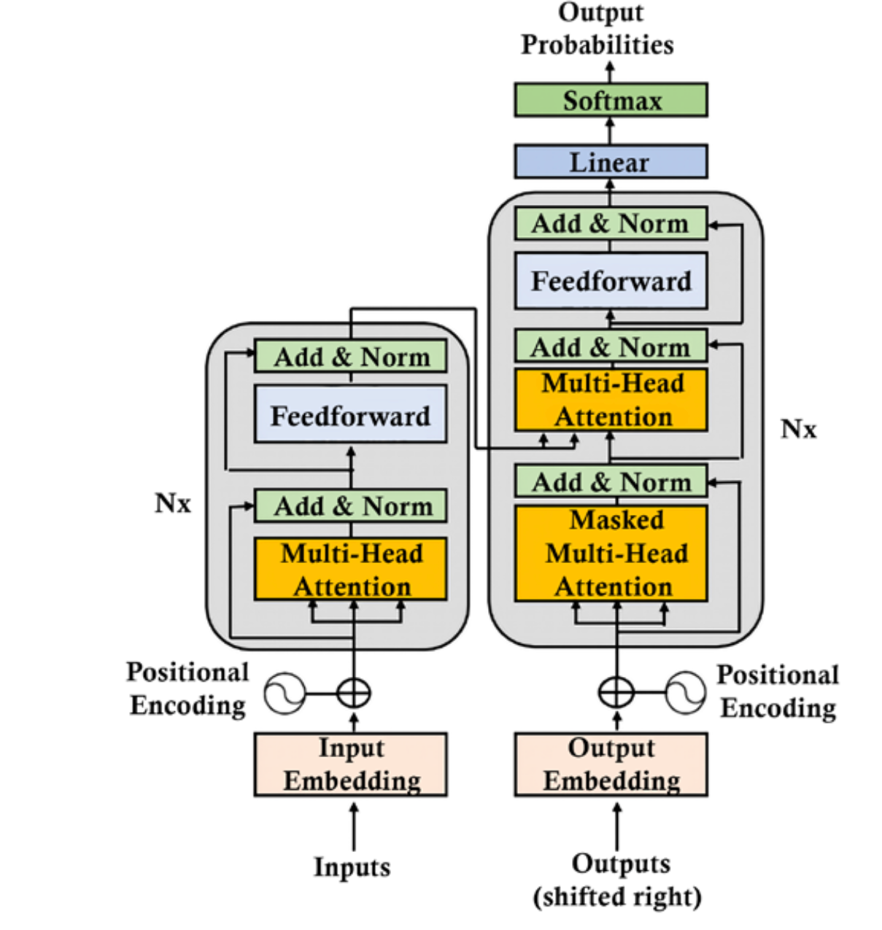
Proposed Method
Transformer-based
Model Training
Transformer-based
Model Trained
Predict Utilization for future resource usage

Slide 22
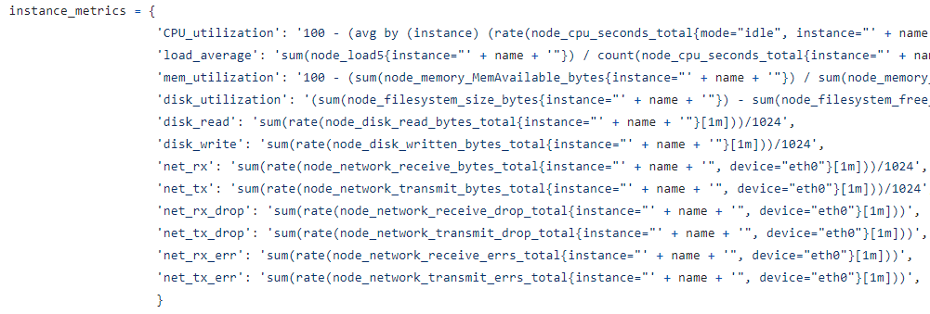

Approach to Data Collection and Annotation
Collected Dataset
Parsing logic
Public Dataset - Google Workload Traces 2022

Slide 23
Performance Evaluation

Slide 24
Conclusion and Future works

Slide 25
Thank you!

Slide 26
References
[1] Bhardwaj, A., & Krishna, C. R. (2021). Virtualization in cloud computing: Moving from hypervisor to containerization—a survey. Arabian Journal for Science and Engineering, 46(9), 8585-8601.
[2] Khallouli, W., & Huang, J. (2022). Cluster resource scheduling in cloud computing: literature review and research challenges. The Journal of supercomputing, 1-46.

