Slide 1



EVALution 1.0
An Evolving Semantic Dataset for Training and Evaluation of Distributional Semantic Models
Enrico Santus, Frances Yung,
Alessandro Lenci & Chu-Ren Huang

Slide 2
Distributional Semantic Models
Distributional Semantic Models represent lexical meaning in vector spaces by encoding corpora derived word co-occurrences in vectors (Sahlgren, 2006).
Distributional Hypothesis (Harris, 1954)
“You shall know a word by the company it keeps” (Firth, J. R. 1957:11).

Slide 3
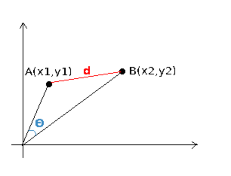
Similarity
DSMs are known to be particularly strong in identifying semantic similarity between lexical items, thanks to their geometric representation (Zesch and Gurevych, 2006).
Vector cosine: distance as index of similarity

Slide 4
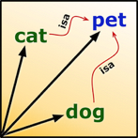
Many kinds of Similarity
Lexical items are similar to each other in many ways:
cat is similar to lion → COORDINATES (under feline)
cat is similar to animal → HYPONYM
cat is similar to dog → ANTONYMS (or: PARANYMS)
How to actually discriminate the different types of similarity?

Slide 5
Discriminate Semantic Relations
Several distributional approaches:
Pattern based approaches (Hearst, 1992):
word-pairs = seeds → collocations → patterns (training & evaluation)
Unsupervised distributional measures (Santus et al., 2014; Lenci and Benotto, 2012)
weighting the features (evaluation)
Both the approaches rely on datasets containing semantic relations, for training and/or evaluation

Slide 6
Datasets
Test Of English as a Foreign Language (TOEFL) → 80 multiple-choice questions about SYN (Landauer and Dumais, 1997)
Extended Graduate Record Examination (GRE) → Multiple-choice questions about ANT (Mohammed et al., 2008)
WordNet → Computational lexicon, developed by lexicographers, containing several relations (HYPER, COORD, SYN, etc.) (Fellbaum, 1998)
ConceptNet → Semantic network including WordNet and many other resources, plus additional relations (UsedFor, Desires, etc.) (Liu and Singh, 2004)
WordSim 353 → Human ratings; “similarity” is left undefined and it contains several kinds of paradigmatic relations (SIMIL) (Finkelstein et al., 2002)
BLESS → Balanced resource, developed for evaluating DSMs. It contains several relations (HYPER, COORD, MERO, EVENT, RANDOM, etc.) (Baroni and Lenci, 2011)
Lenci/Benotto → Balanced resource based on human judgments (HYPER, SYN, ANT) (Santus et al., 2014)

Slide 7
Why a new One?
Benchmarks developed for purposes other than DSMs training and evaluation.
Most of the adopted benchmarks include:
Task-specific resources (TOEFL, GRE)
semantic relations defined according to the scope
General-purpose resources (WordNet, ConceptNet)
need to be inclusive and comprehensive, so inhomogeneous
Relata and relations are given without additional information (e.g. relation domain, word semantic field, frequency, POS, etc.).

Slide 8
Example
Consider the following pairs:
key is a space
relief is a damage
silly is a child
apple is a best

Slide 9
Example
Consider the following pairs:
key is a space → WordNet 4.0 (basketball)
relief is a damage → WordNet 4.0 (law)
silly is a child → WordNet 4.0 (hypernymy?)
apple is a best → ConceptNet 5.0 (judgment)
In a certain sense, these pairs are right. But how representative are them?

Slide 10
Design
PROTOTIPICAL PAIRS: Human judgments ensure that only prototypical and reliable pairs are selected.
HOMOGENEITY and DISCRIMINATIVE ANALYSIS: Relata in the pairs should appear in more relations, in order to:
increase homogeneity of data (e.g. not comparing dogs and apples)
allow discriminative training and evaluation (analysis)
BALANCING CRITERIA: Additional information allows filtering the data according to the needs (e.g. semantic criteria, statistical ones), both in training and evaluation
We want to provide a balanced corpus NO!
We want the user to be able to balance it according to his/her criteria YES!

Slide 11
EVALution 1.0
Freely downloadable dataset designed for the training and the evaluation of DSMs
7.5K pairs
1.8K relata (63 of which: MWE)
9 semantic relations
10 types of additional information for PAIRS
7 types of additional information for RELATA

Slide 12
Methodology
Tuples were:
extracted from ConceptNet 5.0 + WordNet 4.0 (8.8M pairs)
filtered through automatic methods to exclude (13K pairs):
useless pairs (i.e. !relevant relations, mirrors, !alpha char, etc.)
pairs in other resources (i.e. BLESS and Lenci/Benotto).
pairs which relata do not occur at least in 3 relations
paraphrased: “W1 is a kind of W2”, “W1 is the opposite of W2”…
judged through Crowdflower (7.5K pairs)
5 subjects → 1 (strongly disagree) to 5 (strongly agree)
Threshold: 3 positive judgments (>3)
annotated
5 subjects → PAIRS → semantic tags
2 subjects → RELATA → semantic tags
Corpus-based info (frequency, POS, forms, etc.)

Slide 13
Relations, Pairs and Relata
Relation | Pairs | Relata | Template Sentence
IsA | 1880 | 1296 | X is a kind of Y
Ant | 1600 | 1144 | X can be used as the opposite of Y
Syn | 1086 | 1019 | X can be used with the same meaning of Y
Mero PartOf MemberOf MadeOf | 1003 654 32 317 | 978 599 52 327 | X is… …part of Y …member of Y …made of Y
Entailment | 82 | 132 | If X is true, then also Y is true
HasA (possession) | 544 | 460 | X can have or can contain Y
HasProperty (attribute) | 1297 | 770 | Y is to specify X

Slide 14
Additional Information
Relata: Crowdflower (2 annotators) + Corpus (ukWac + Wackypedia)
Semantic tags (basic, superordinate, event, time, object, etc.)
Frequency
Dominant POS / Distribution of POS
Distribution of inflected/capitalized forms
Pairs: Crowdflower (5 annotators) + ConceptNet 5.0
Semantic tags (event, time, space, object, etc.)
Paraphrases
Judgments
Source
Score in the source, if available

Slide 15
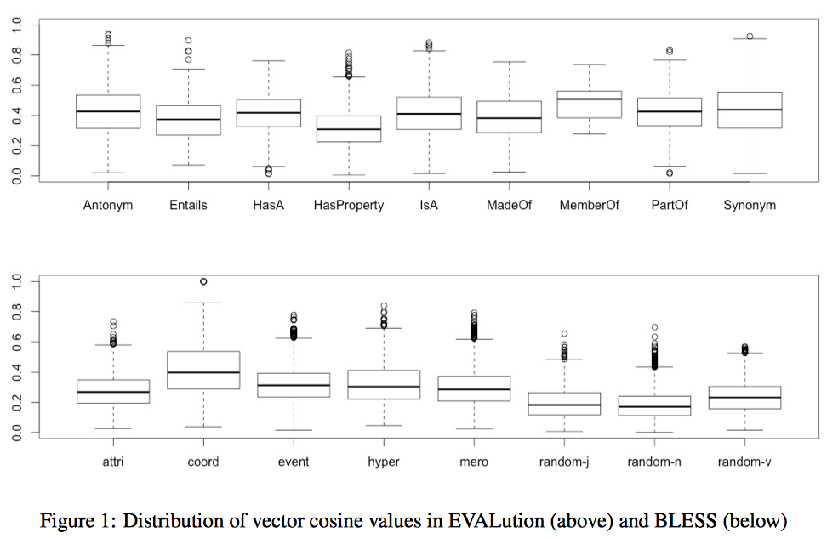
Dataset Evaluation

Slide 16
Conclusions
We have introduced EVALution 1.0, an evolving semantic dataset designed for training and evaluation of DSMs.
EVALution 1.0 vs. previous resources:
prototypical pairs (i.e. human judgments);
internal consistency (i.e. proportion term/SemRel);
additional information (i.e. data filtering and analysis).
Extensions include:
Use of RDF (LEMON)
Scripts for Data Analysis & Filtering
Inclusion and Analysis of Rejected Pairs
Extension of the
# of pairs
# and types of annotations

Slide 17

EVALution 1.0
The resource is available at:
https://github.com/esantus

