Slide 1
TRAFFIC SIGN RECOGNIZATION
SUBMITTED BY: SHIVAM(18BCS3054), 18IS9/C
ADITYA(18BCS6656), 18IS9/C
KANISHKA(18BCS6634), 18IS9/C

Slide 2
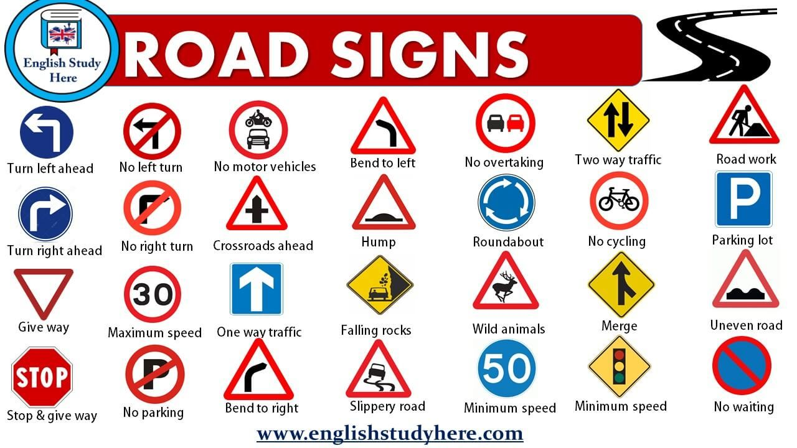
CONTENTS
INTRODUCTION
OBJECTIVES
TRAFFIC SIGN CLASS
DECTECTION METHOD
COLOR BASED DETECTION
SHAPE BASED DETECTION
APPROACH
BLOCK DIAGRAM
FLOW CHART
ALGORITHM AND CODE
CONCLUSION

Slide 3
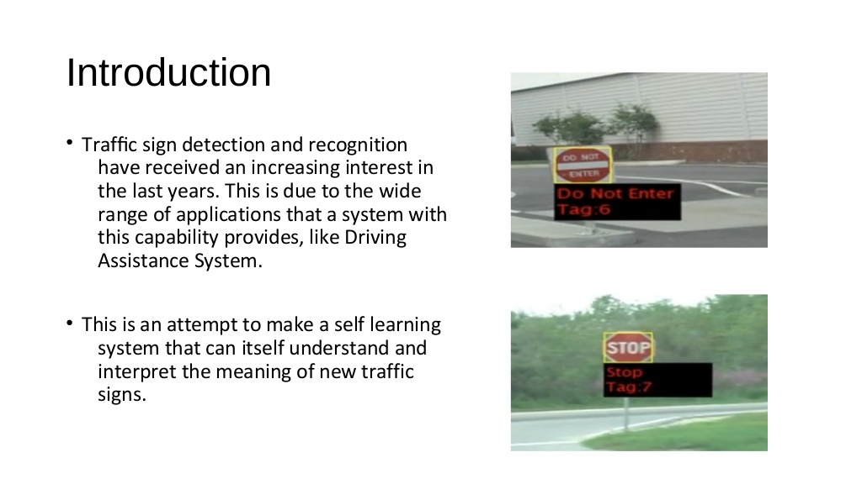

Slide 4
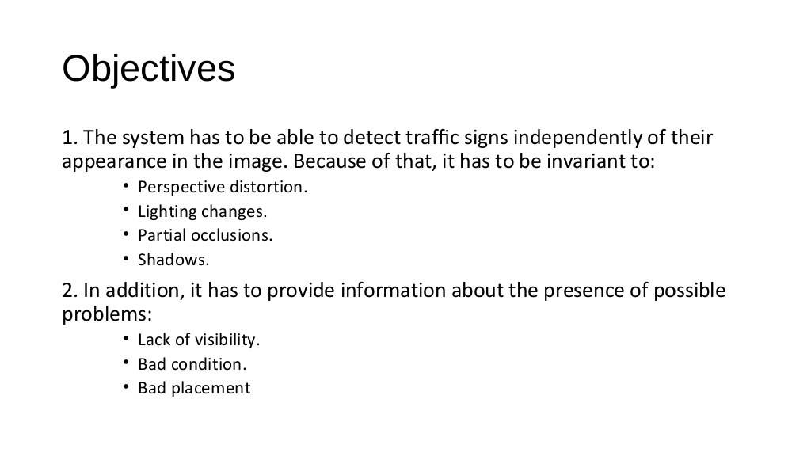

Slide 5
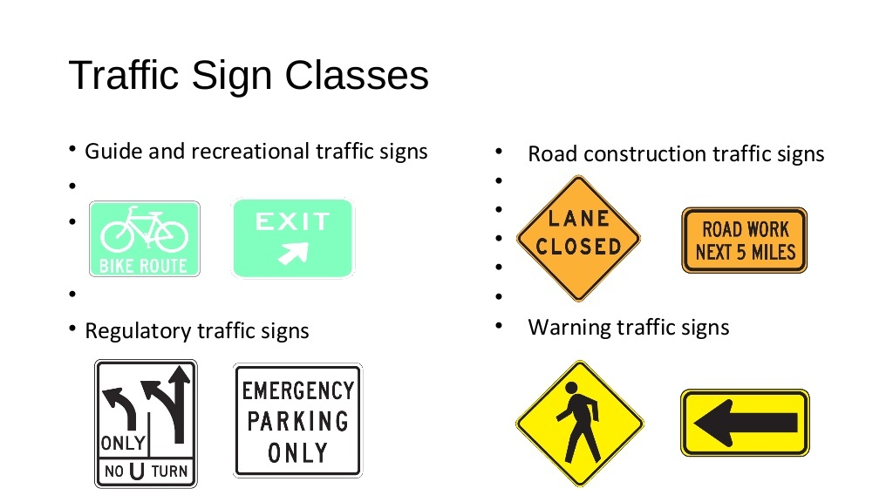

Slide 6
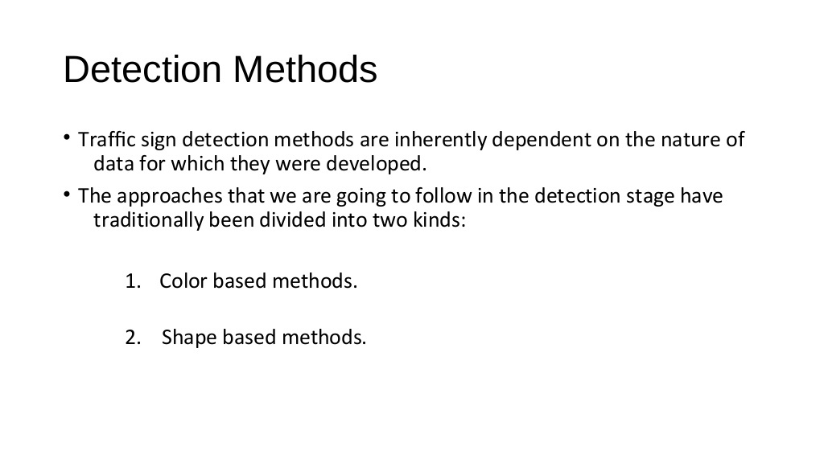

Slide 7
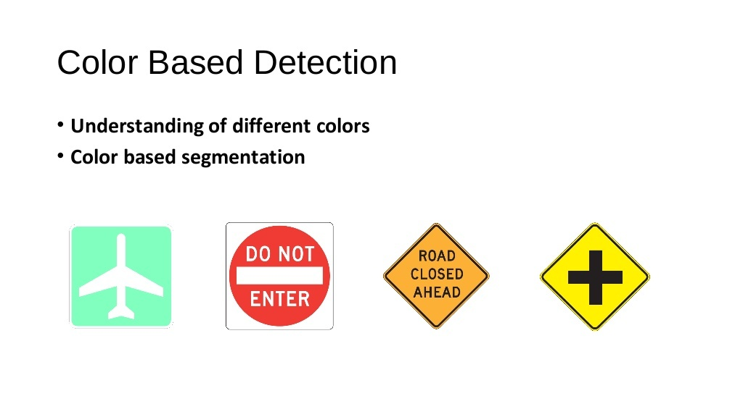

Slide 8
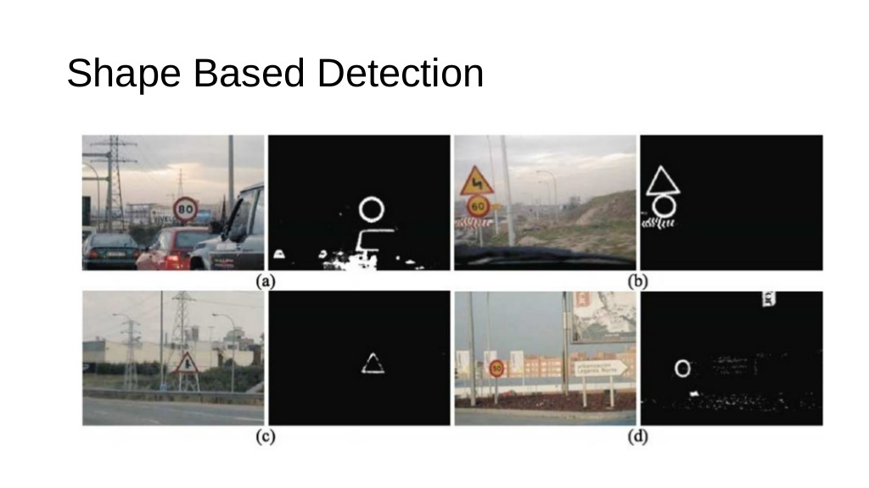

Slide 9
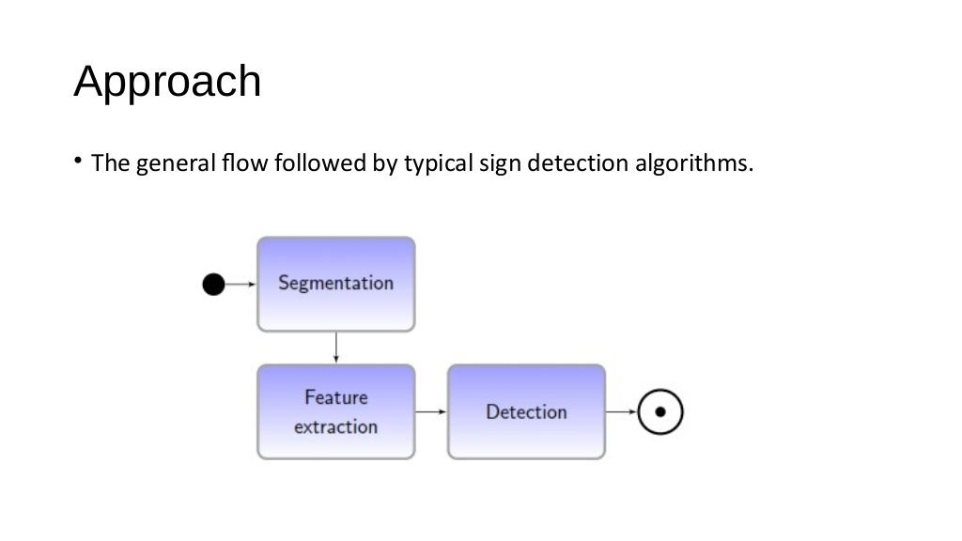

Slide 10
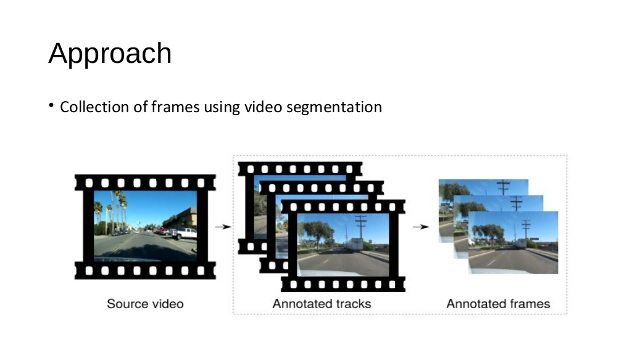

Slide 11
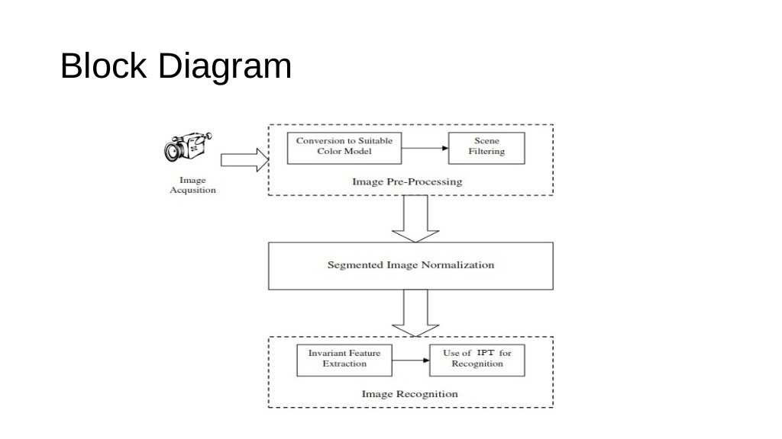

Slide 12
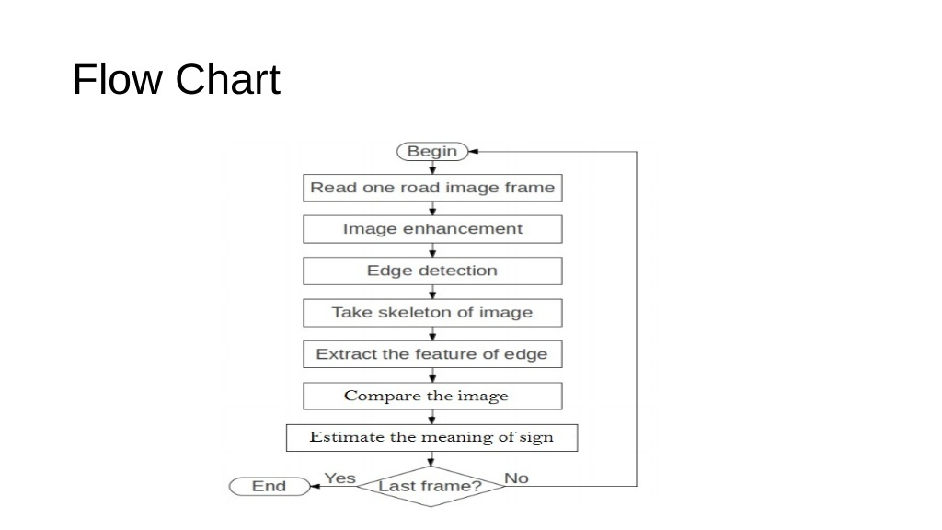

Slide 13
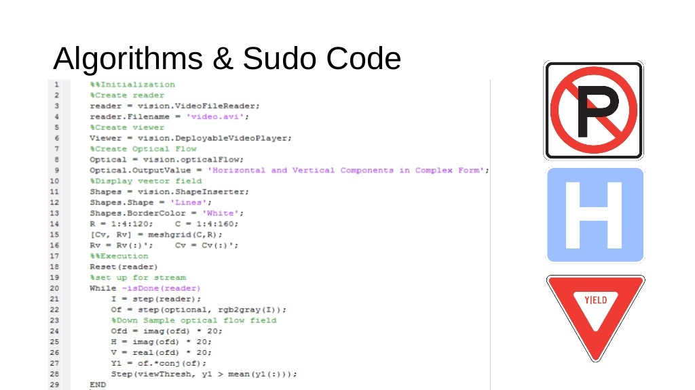

Slide 14
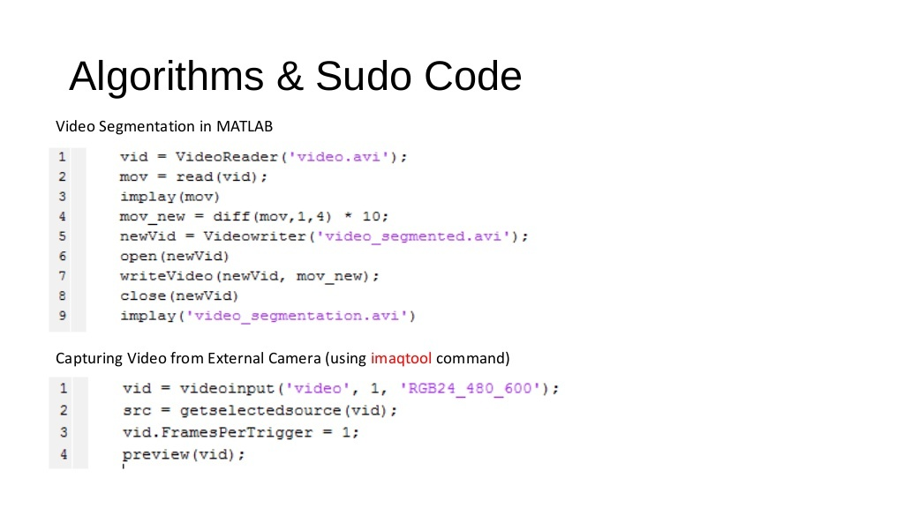

Slide 15
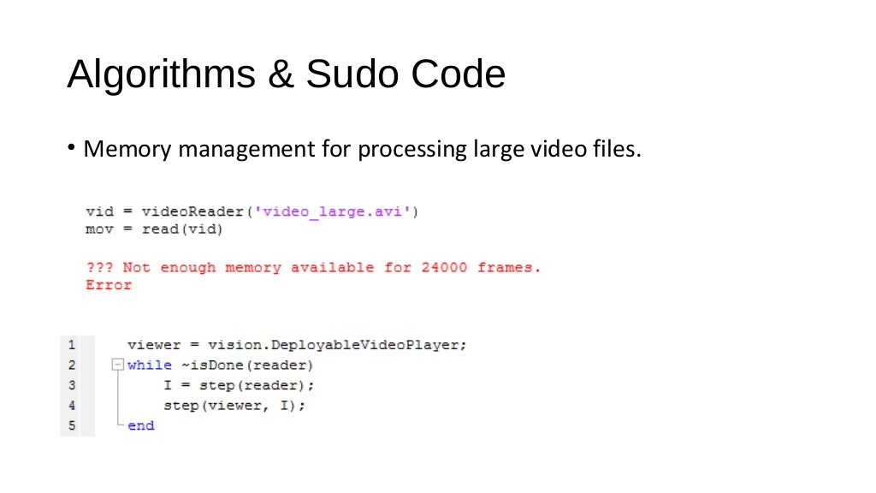

Slide 16
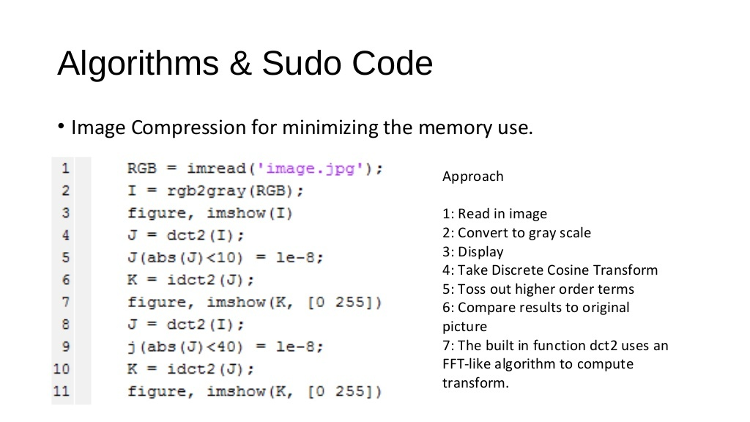

Slide 17
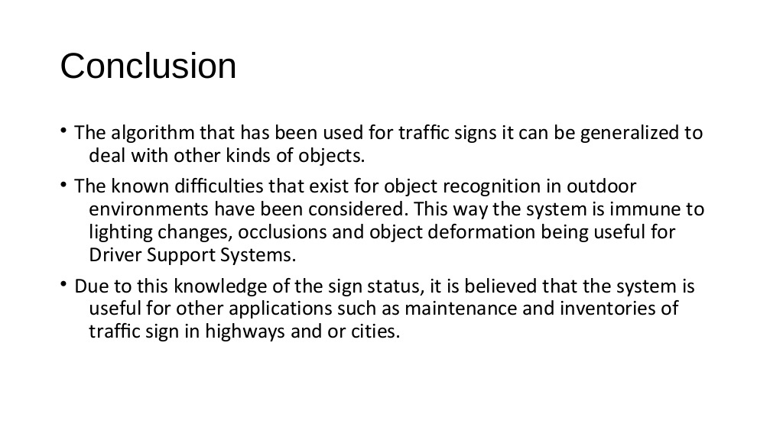

Slide 18


