Slide 1
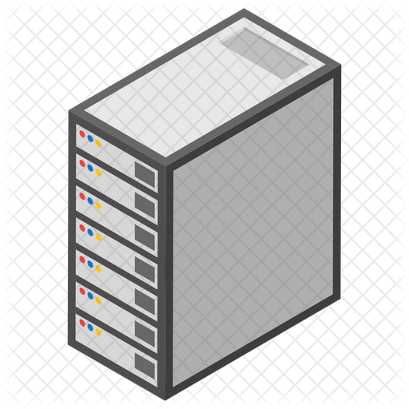


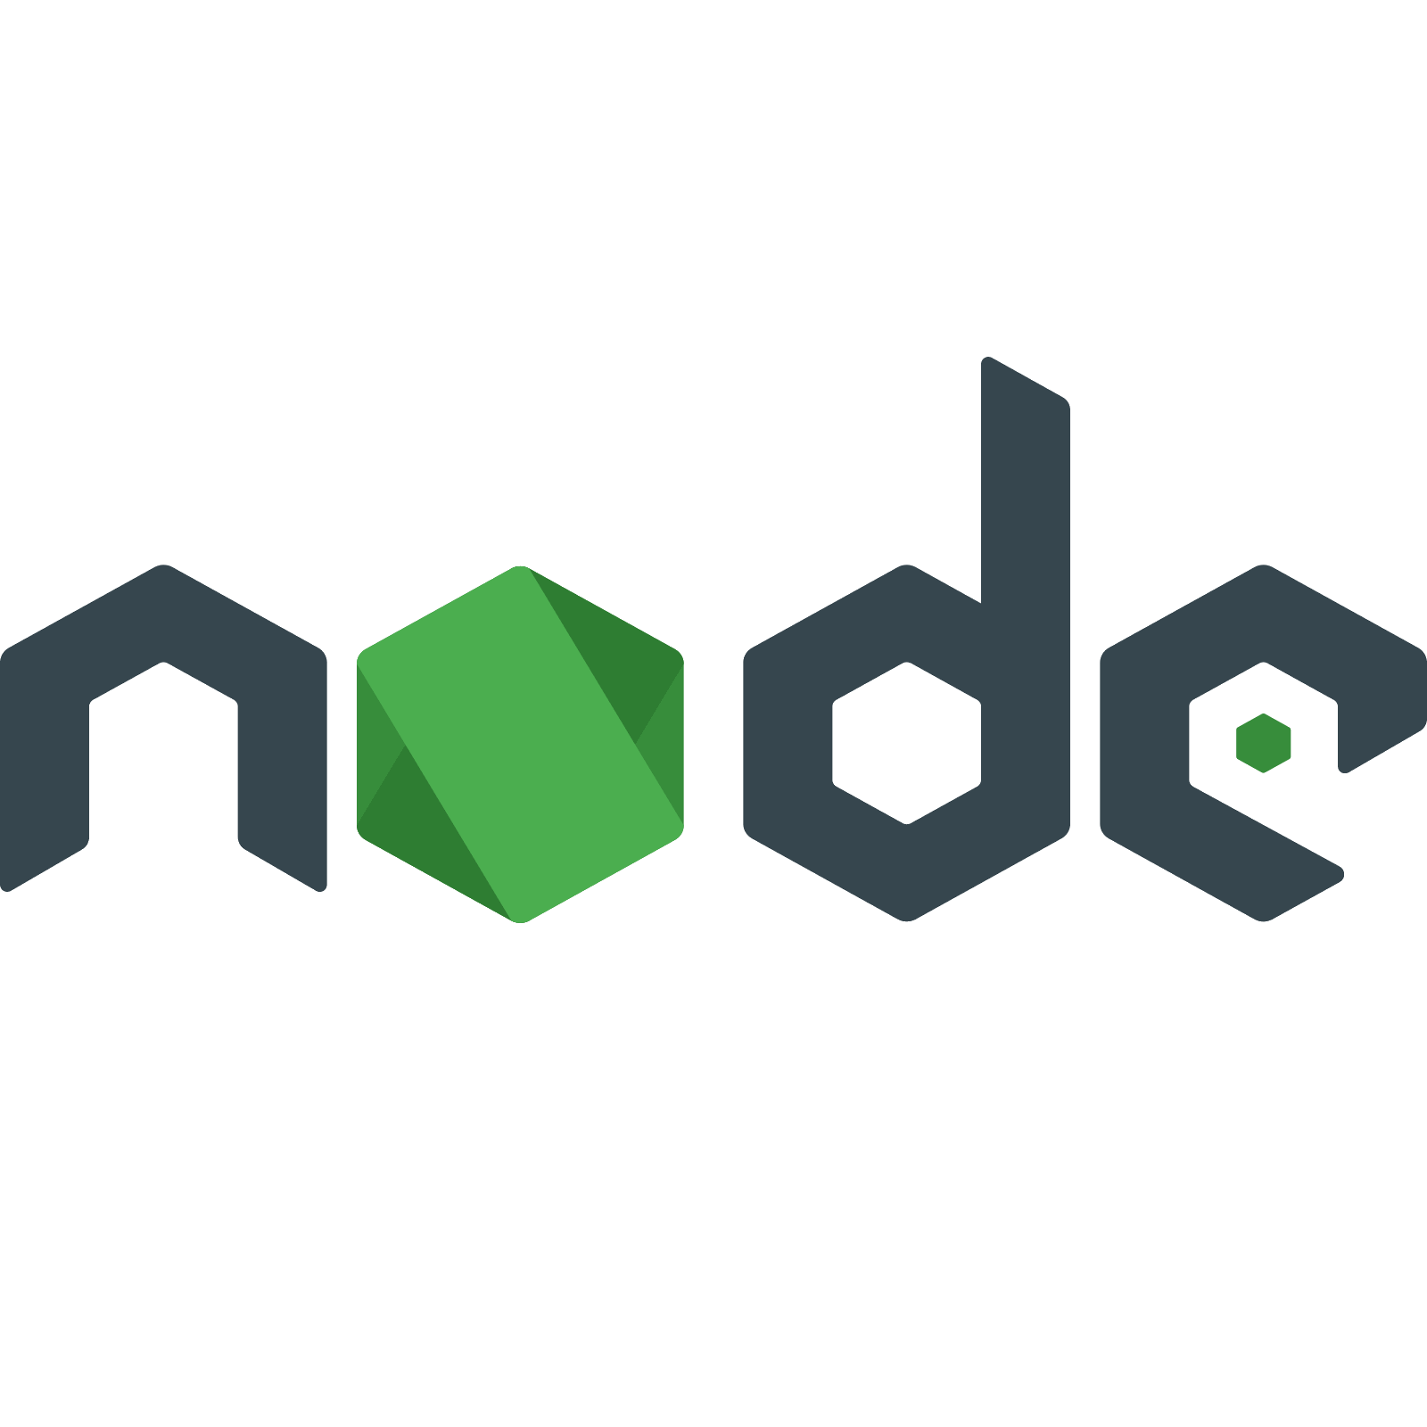



















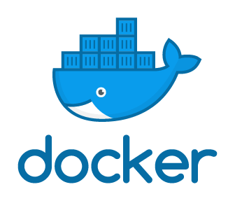

1. Webhook
2. Git Clone
3. Build
6. Notify the client, the events and vulnerabilities
7. Create tickets and issues
4. SAST
8. Check the dashboard
5. Deployment

