Slide 1
SecDevOps

Slide 2
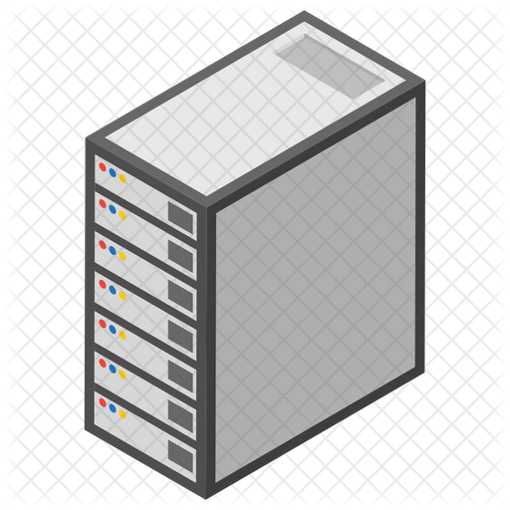


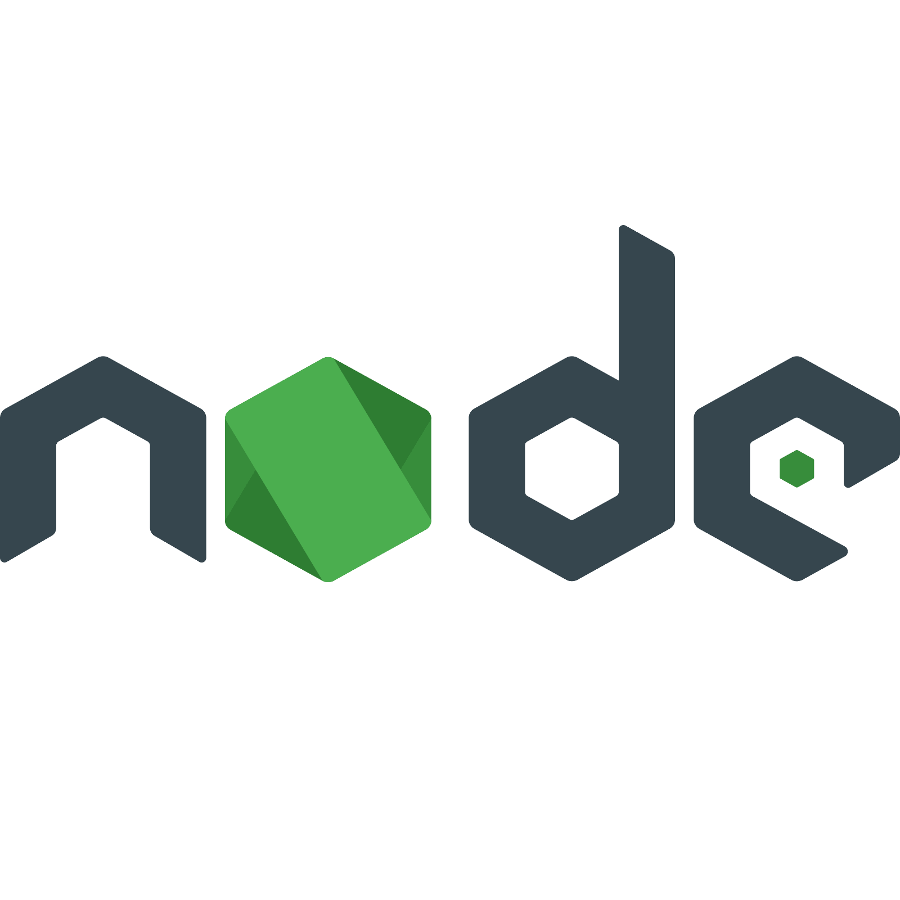





















1. Webhook
2. Git Clone
3. Build
6. Notify the client, the events and vulnerabilities
7. Create tickets and issues
4. SAST
8. Check the dashboard
5. Deployment

Slide 3



Sync
Orchestrator

Slide 4


1. Webhook
2. Git Clone
3. Get Repo

Slide 5
1. Deploy SAST
2. Build
3. Deploy App

Slide 6
1. Do SAST
2. Send Results
3. Destroy SAST

Slide 7
1. Post SAST Results
3. Scan
2. Do DAST
Orchestrator
4. Destroy

Slide 8
1. Create Issues
2. Feed Elastic
Orchestrator

Slide 9
MongoDB as a consolidated database with all vulnerabilities.
Orchestrator
Elastic search and Redmine synchronized with MongoDB.
Sync

