Slide 1

Sales Dashboard: Insights at a Glance
This comprehensive sales dashboard provides a clear, real-time view of your business's performance. Leveraging a variety of dynamic visualizations, you can easily track sales trends, monitor profit fluctuations, and uncover valuable insights to drive strategic decision-making.

Slide 2
Bar Charts: Visualizing Sales Trends
Track Sales Over Time
Segment by Product or Region
Bar charts allow you to easily visualize sales data across different time periods, enabling you to identify growth patterns and seasonal fluctuations.
Customize your bar charts to compare sales performance across different product lines, market segments, or geographical areas.

Slide 3
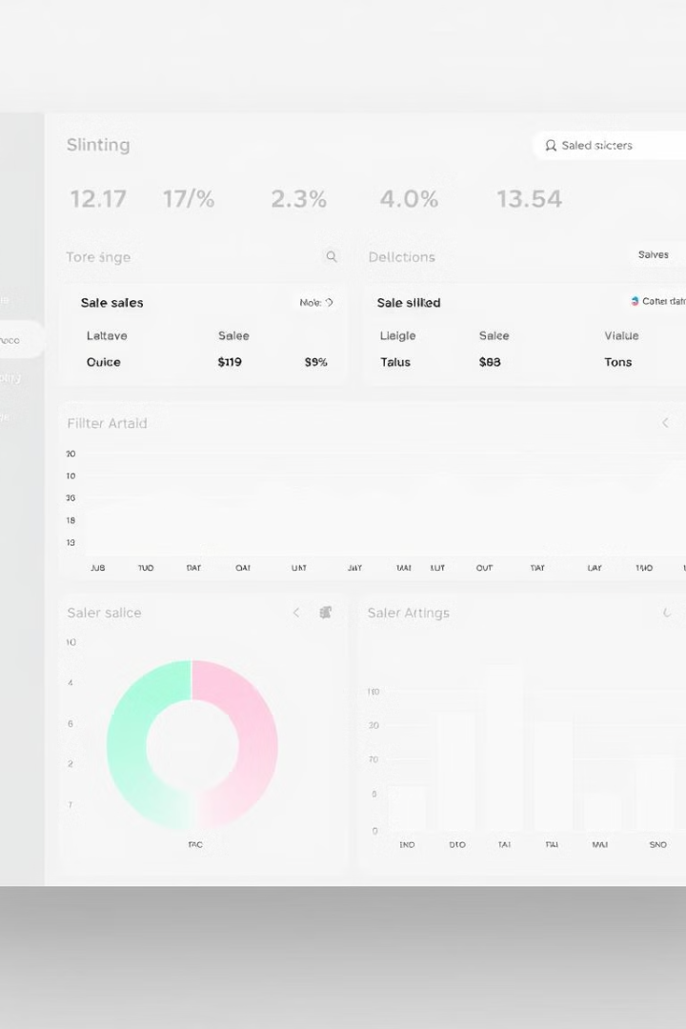
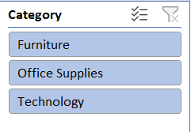
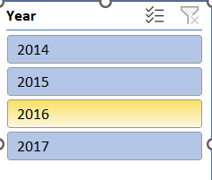
Slicers: Filtering for Deeper Analysis
Dynamic Exploration
Targeted Decision-Making
Quickly toggle between different data views to uncover patterns, identify outliers, and gain a comprehensive understanding of your business performance.
Use slicers to focus your analysis on specific areas of concern or opportunity, enabling you to make more informed, data-driven decisions.
Collaborative Insights
Share your dashboard with colleagues and allow them to explore the data using the slicers, fostering a culture of data-driven collaboration.

Slide 4
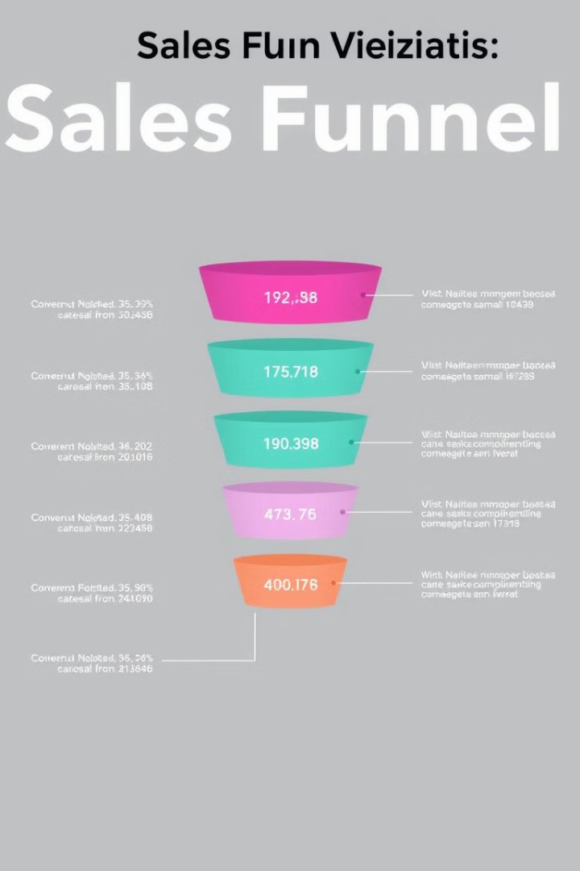
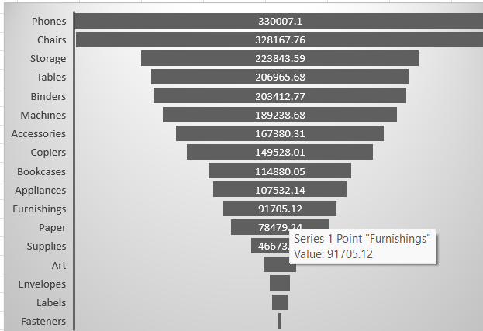
Funnel Chart: Tracking the Sales Funnel
1
Leads
Understand the number of potential customers entering your sales pipeline.
2
Qualified Leads
Identify the leads that meet your criteria for further engagement and nurturing.
3
Opportunities
Track the leads that have progressed to the active sales stage and are more likely to convert.

Slide 5
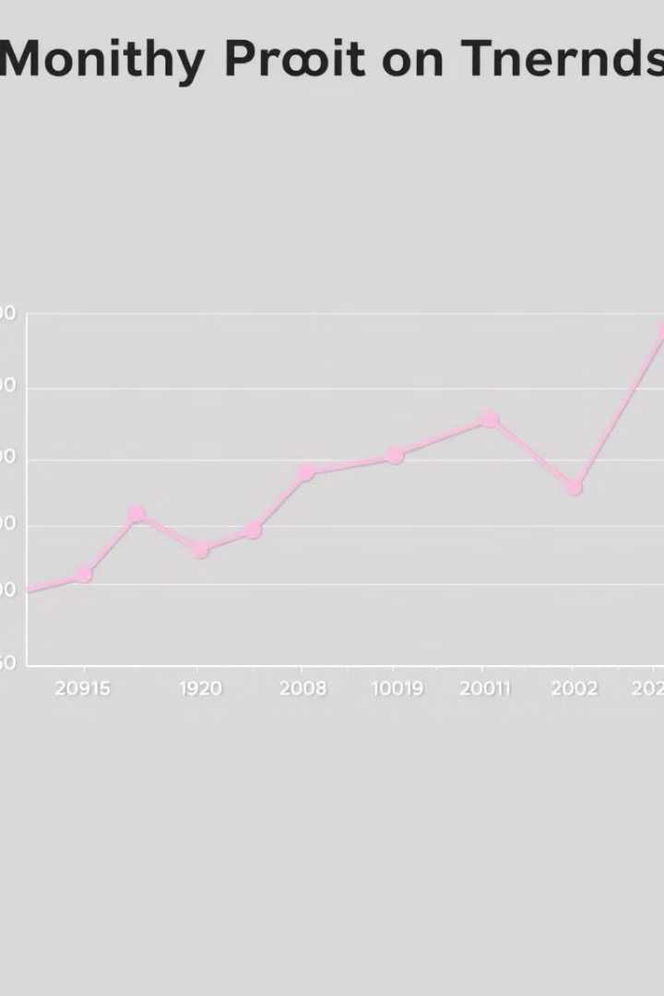

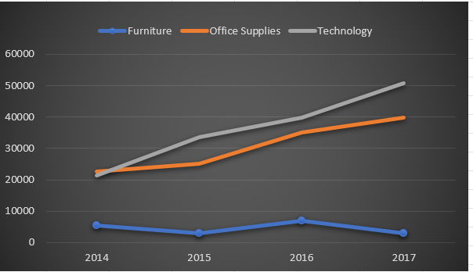


Line Chart: Monitoring Profit Fluctuations
Profit Trends
Seasonal Patterns
Critical Insights

Slide 6
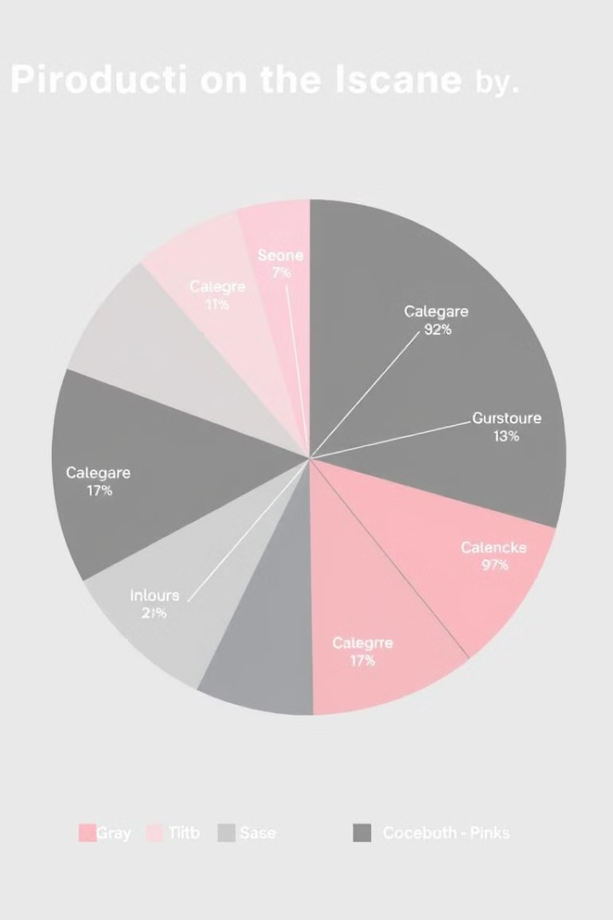
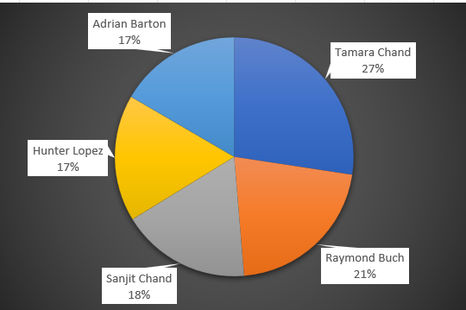


Pie Chart: Segmenting Sales by Category
Product Sales
Market Dynamics
Understand the relative contribution of different product categories to your overall sales revenue.
Analyze changes in the pie chart over time to spot emerging trends and shifting customer preferences.

Slide 7

Dashboarding Best Practices
1
Simplicity and Clarity
2
Customization and Interactivity
3
Actionable Insights
Design your dashboard to be intuitive and easy to navigate, focusing on the most critical metrics and insights.
Ensure that your dashboard provides clear, data-driven recommendations and next steps to drive business strategy and decision-making.
Allow users to personalize their views and interactions with the data, empowering them to explore and discover insights.

Slide 8

Actionable Insights and Next Steps
Identify Top-Performing Products
Allocate more resources to marketing and sales of your most profitable product lines.
Analyze Seasonal Trends
Adjust inventory and promotional strategies to capitalize on cyclical fluctuations in customer demand.
Optimize the Sales Funnel
Implement targeted lead nurturing and sales process improvements to increase conversion rates.
Explore New Market Opportunities
Use the dashboard insights to identify untapped market segments and potential areas for business expansion.

