Slide 1
EE746: Neuromorphic Engineering
Low SNR input LSM
Optimal Compression and Preprocessing
Group 8
Guided by
Badal Varshney (19D070015)
Akhila Krishna K (19D070006)
Manuraj P M (213230012)
Prof. Udayan Ganguly
Vivek Saraswat

Slide 2
Introduction
Spoken digit classification from noisy data - Accuracy studied against SNR
Subset of TI-46 speech corpus used to train LSM.
Additive white gaussian noise injected to study variation in accuracy.
We used a baseline liquid state machine model.
Noise desensitization is achieved by training from large data sets
16 speakers, 26 utterances each- 416 unique time-series data.
LSMs enable low power computation based on input availability and also provides high adaptability to noise by working on a compressed representation of audio inputs.
Allows near-real time detection of digits under noisy environments with low power consumption.

Slide 3
Schematic Diagram
Audio Signals
Lyon’s Ear Model
BSA Encoder
Hyper parameters:
1.Reservoir Size.
2.Reservoir shape.
3.Reservoir connection(series,parallel).
LSM Reservoir
Readout
Classification

Slide 4
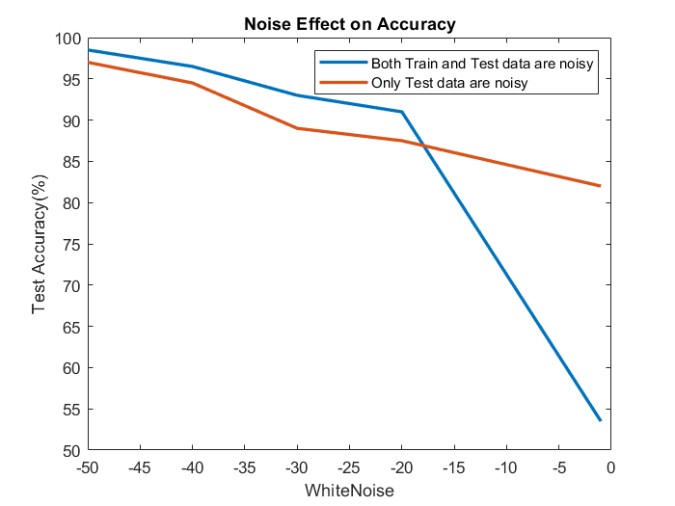
Accuracy in presence of Noise
When no noise is there - 99.5% accuracy
When only test data are noisy - 97% accuracy
When both train and test data are noisy - 98.5%
accuracy

Slide 5
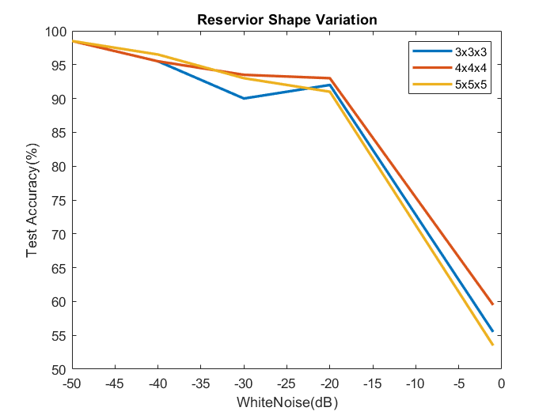
Variation of reservoir shape
Reservoir sizes taken are 3x3x3, 4*4*4, 5*5*5
but number of neurons are kept the same
We can see slight change in the accuracy.

Slide 6
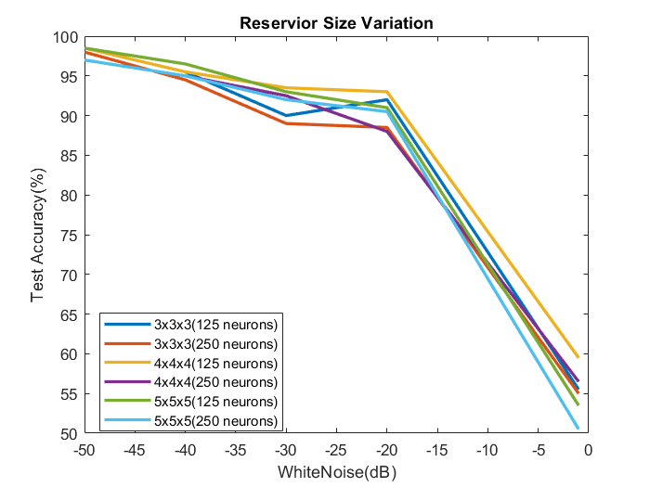
Variation of reservoir size
Reservoir size taken : 3*3*3, 4*4*4, 5*5*5
Number of reservoir neurons: 125, 250
A slight change in accuracy observed due to
Increase in number of neurons

Slide 7
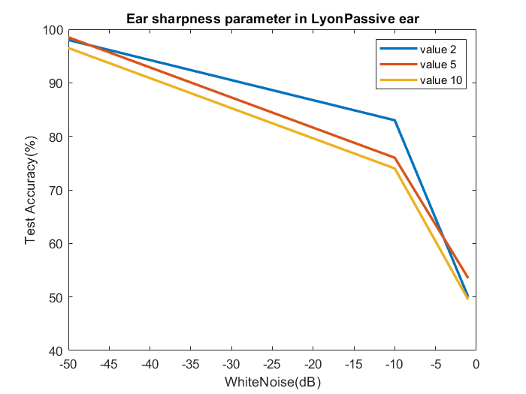
Ear Sharpness Parameter in LyonPassive Ear
Change in accuracy for different values of ear
sharpness parameter across different values
of white noise is observed
For various intensities of noise in the data
the, the optimum value of ear sharpness
parameter has to chosen

Slide 8
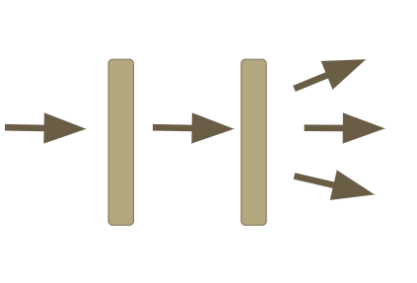
Series Network Reservoir
Reservoirs are connected serially
The readout function considers only the output of last reservoir.
The accuracy decreases as the number of layers of reservoirs increases s
From 1st to 2nd stage, accuracy is decreased from 98%
to 50% and from 2nd to 3rd stage, it is decreased to 45%.

Slide 9
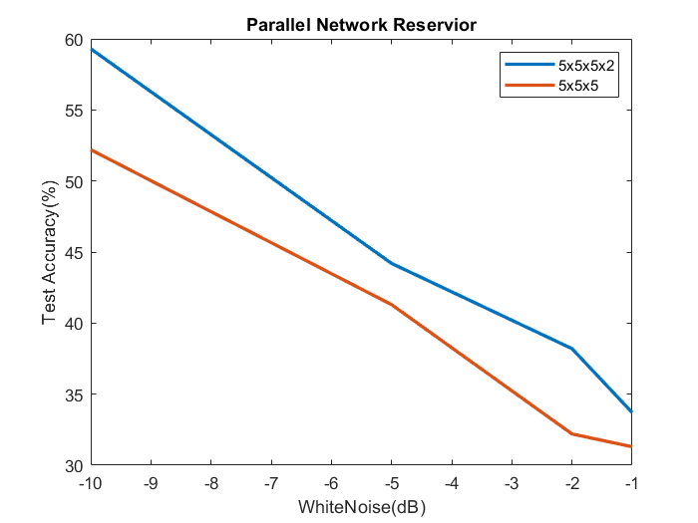
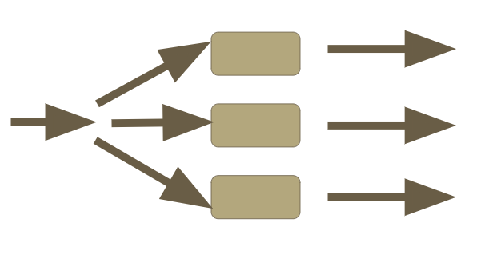
Parallel Network Reservoir
The reservoirs are parallely connected to the inputs.
As the number of parallel connections increase, the number of neurons increases. Hence the, accuracy increases
But the computation is very slow due to more
number of neurons

Slide 10
Results
Methods | Accuracy
Reservoir Size Variation | Slightly change
Reservoir Shape Variation | Slightly change
Series Network Reservoir | Decreases
Parallel Network Reservoir | Increases
Ear sharpness parameter in LyonPassive ear | Varies

Slide 11
Thank You

