Slide 1
Seasonal Agriculture
Performance Analysis
Data-driven insights across seasons, crops, irrigation, yield and profitability
PREPARED BY
BADAL CHAUDHARY
Roll No.: STU6a30b8115dd5c1781577745
Python • Pandas • Streamlit • Jupyter

Slide 2
Executive summary
02
What the analysis says at a glance
RECORDS ANALYSED
SEASONS
CROPS
NEGATIVE-PROFIT ROWS
120
3
8
21.67%
Zaid delivered the highest mean profit, closely followed by Kharif.
Sprinkler irrigation produced the highest mean yield in this sample.
Chilli led mean profit among crops; Wheat was the weakest profit performer.
Water efficiency improved from Kharif to Zaid while average water use declined.
Seasonal Agriculture Performance Analysis
Badal Chaudhary

Slide 3
Project scope and questions
03
The business questions behind the analysis
Primary objective
Decision use
Understand how season, crop choice and irrigation method influence agricultural yield, revenue, cost, profit and water efficiency.
Crop and season planning
Irrigation strategy comparison
Profitability screening
Reproducible reporting for future data
Questions answered
Which season is most profitable?
Which crops combine yield and profit?
Which irrigation method is most productive?
Where are the risk and data-quality gaps?
The included Streamlit dashboard makes the findings explorable rather than static.
Seasonal Agriculture Performance Analysis
Badal Chaudhary

Slide 4
Dataset overview
04
Schema and coverage used for the analysis
ROWS
FIELDS
IRRIGATION METHODS
DUPLICATE FARM IDS
120
28
4
0
Analytical dimensions
Key numeric measures
Season: Kharif, Rabi, Zaid
Crop: 8 crop categories
Irrigation: Drip, Flood, Rainfed, Sprinkler
Outcomes: yield, production, revenue, cost, profit, water efficiency
Yield in tonnes per hectare
Production and water used
Revenue, cost and profit in INR
Disease/pest risk percentage
Seasonal Agriculture Performance Analysis
Badal Chaudhary

Slide 5
Analysis workflow
05
A reproducible pipeline from raw data to decisions
1
2
3
4
5
Load
Clean
Analyse
Visualise
Report
Read CSV and validate fields
Normalize types and handle quality checks
Aggregate by season, crop and irrigation
Create charts and dashboard views
Export summaries, notebook and PPT
The same logic is available as Python code and a Jupyter notebook so the analysis can be rerun when the full dataset is added.
Seasonal Agriculture Performance Analysis
Badal Chaudhary

Slide 6
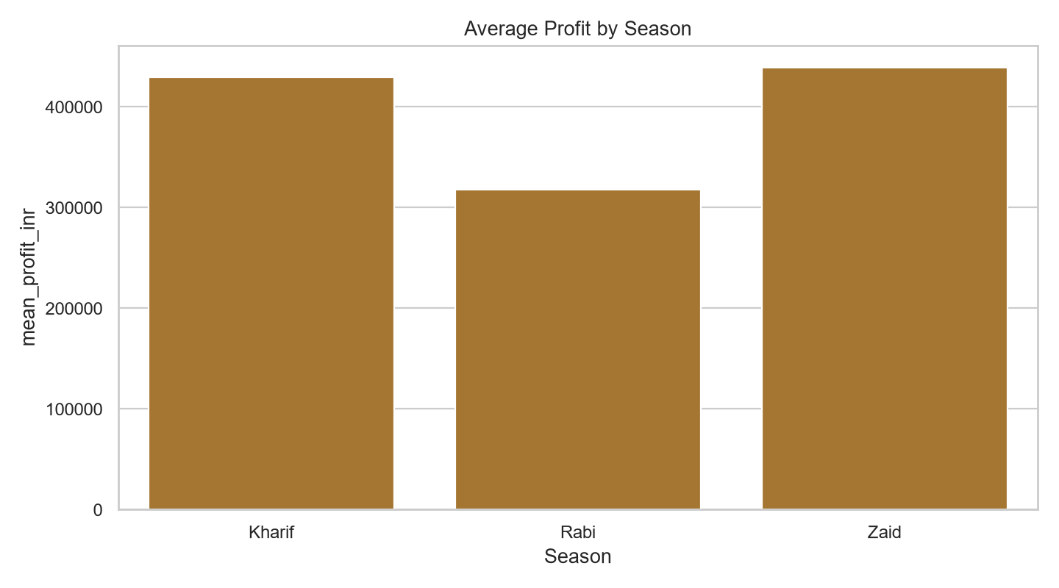
Seasonal profitability
06
Zaid and Kharif lead the profit comparison
Season | Mean profit (INR) | Mean revenue (INR) | Mean cost (INR)
Kharif | 429,538 | 584,175 | 154,638
Rabi | 318,057 | 526,593 | 208,535
Zaid | 439,153 | 630,516 | 191,363
Zaid: highest mean profit at INR 439,153. Kharif is close at INR 429,538.
Seasonal Agriculture Performance Analysis
Badal Chaudhary

Slide 7
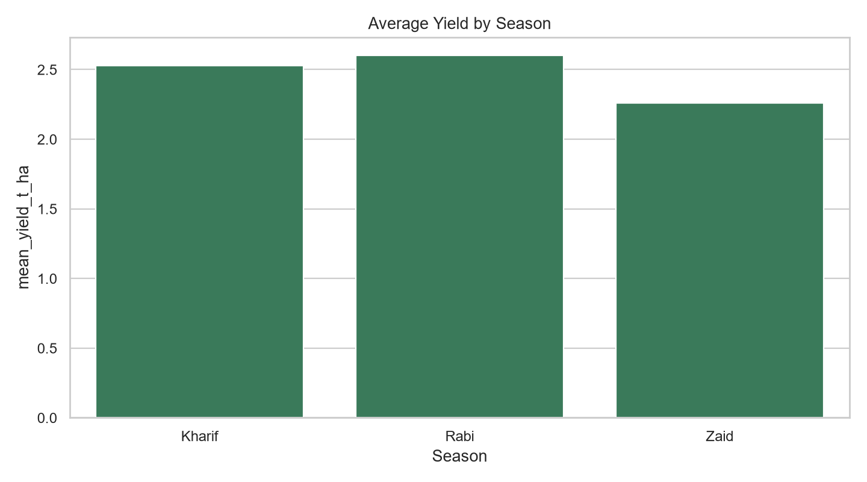
Yield and water efficiency
07
Zaid has the strongest water-efficiency profile
Season | Yield (t/ha) | Water efficiency | Water used (m³)
Kharif | 2.53 | 7.65 | 2,778
Rabi | 2.60 | 8.16 | 2,334
Zaid | 2.26 | 9.41 | 2,188
Zaid uses the least average water while achieving the highest water efficiency in the sample.
Seasonal Agriculture Performance Analysis
Badal Chaudhary

Slide 8
Crop comparison
08
Profitability differs materially across crops
Mean profit and yield by crop
Crop | Mean profit (INR) | Yield (t/ha) | Risk (%)
Chilli | 582,463 | 2.63 | 38.4
Rice | 486,725 | 2.91 | 38.5
Sugarcane | 415,531 | 2.49 | 40.5
Pulses | 401,023 | 2.73 | 38.8
Maize | 399,775 | 2.74 | 38.3
Cotton | 345,872 | 2.21 | 45.4
Groundnut | 345,203 | 2.01 | 39.5
Wheat | 179,772 | 2.03 | 35.8
Chilli ranks first on mean profit; Rice ranks first on yield.
Seasonal Agriculture Performance Analysis
Badal Chaudhary

Slide 9
Irrigation comparison
09
Sprinkler has the highest observed mean yield
Yield, profit and water efficiency by method
Method | Yield (t/ha) | Profit (INR) | Water efficiency | Water used (m³)
Sprinkler | 2.78 | 344,212 | 7.63 | 2,234
Flood | 2.43 | 503,341 | 7.43 | 2,285
Drip | 2.35 | 416,299 | 9.22 | 2,884
Rainfed | 2.33 | 344,463 | 8.79 | 2,269
Sprinkler has the highest observed yield; irrigation decisions should balance yield, profit and water efficiency—not yield alone.
Seasonal Agriculture Performance Analysis
Badal Chaudhary

Slide 10
Profitability risk
10
A meaningful share of records is unprofitable
NEGATIVE-PROFIT RECORDS
NEGATIVE-PROFIT SHARE
PROFIT METRIC
26
21.67%
Revenue − cost
Interpretation
The average results are positive, but averages hide downside cases.
Risk analysis should segment by crop, season and irrigation method.
Negative-profit rows deserve a targeted review of cost, disease/pest risk and water use.
Management implication
Do not select a crop or irrigation method using a single KPI. Use a balanced scorecard of yield, profit, water efficiency and risk.
Seasonal Agriculture Performance Analysis
Badal Chaudhary

Slide 11
Data quality and validation
11
Checks completed before reporting results
Duplicate farm IDs
0
PASS
Rows analysed
120
PASS
Columns available
28
PASS
Seasons found
3
PASS
Crops found
8
PASS
The sample is suitable for a reproducible smoke test. Replace it with the full CSV for final operational analysis.
Seasonal Agriculture Performance Analysis
Badal Chaudhary

Slide 12
Dashboard and deliverables
12
Everything needed to rerun and present the work
app.py
Interactive Streamlit dashboard
src/analysis.py
Reusable command-line analysis
notebooks/
Step-by-step Jupyter notebook
outputs/
Cleaned data and summary reports
data/sample/
Included smoke-test dataset
*.pptx
Presentation for submission
Run locally: pip install -r requirements.txt | streamlit run app.py
Seasonal Agriculture Performance Analysis
Badal Chaudhary

Slide 13
Recommendations
13
Practical actions suggested by the evidence
Prioritise profitable seasons
01
Use Zaid and Kharif results as benchmarks, while monitoring variability.
Test irrigation trade-offs
02
Sprinkler leads yield; compare its economics and water profile before scaling.
Review crop mix
03
Use Chilli for profit and Rice for yield only when risk and cost are acceptable.
Investigate loss cases
04
Segment the 21.67% negative-profit records to identify avoidable drivers.
Seasonal Agriculture Performance Analysis
Badal Chaudhary

Slide 14
Conclusion
The analysis turns 120 farm records into a clear decision framework for seasonal planning, crop selection, irrigation comparison and profitability risk.
NEXT STEP
Replace the sample data with the full dataset and rerun the same pipeline.
Thank you
Badal Chaudhary • STU6a30b8115dd5c1781577745

