Slide 1
Superstore Sales & Profitability Analysis
Python • Pandas • Matplotlib/Seaborn • SQL
Prepared by: BADAL CHAUDHARY | Student ID: STU6a30b8115dd5c1781577745

Slide 2
Project Overview
Turning retail transactions into practical profit recommendations
Objective
Identify sales drivers, loss risks, and regional opportunities.
Data
Sample Superstore transactional data: orders, products, customers, discounts, sales and profit.
Workflow
Clean data ? calculate KPIs ? analyze trends ? visualize insights ? write SQL queries.
Superstore Sales Analysis | 2

Slide 3
Executive KPI Snapshot
Overall performance across the transaction dataset
$2.30M
Total Sales
$286K
Total Profit
12.5%
Profit Margin
5,015
Orders
Superstore Sales Analysis | 3

Slide 4
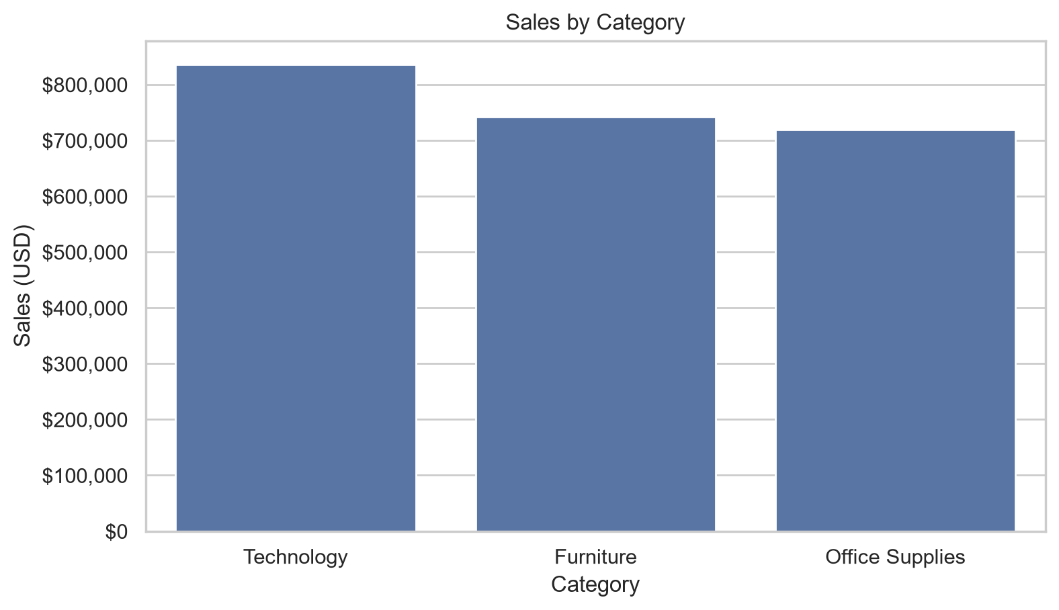
Category Sales Performance
Sales concentration by product category
Key takeaway
Technology is the top category by sales; profitability should be reviewed alongside revenue.
Superstore Sales Analysis | 4

Slide 5
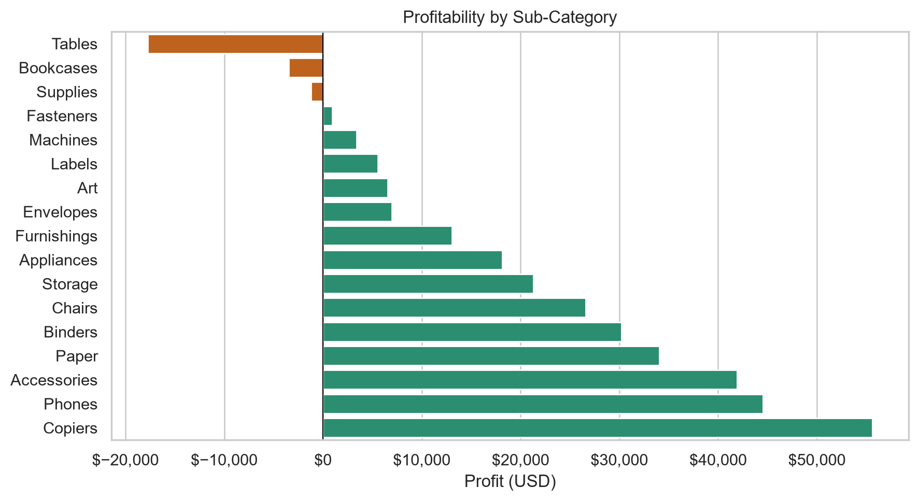
Sub-Category Profitability
Losses are concentrated in a small number of product groups
Key takeaway
Focus discount and assortment review on Tables, Bookcases, Supplies.
Superstore Sales Analysis | 5

Slide 6
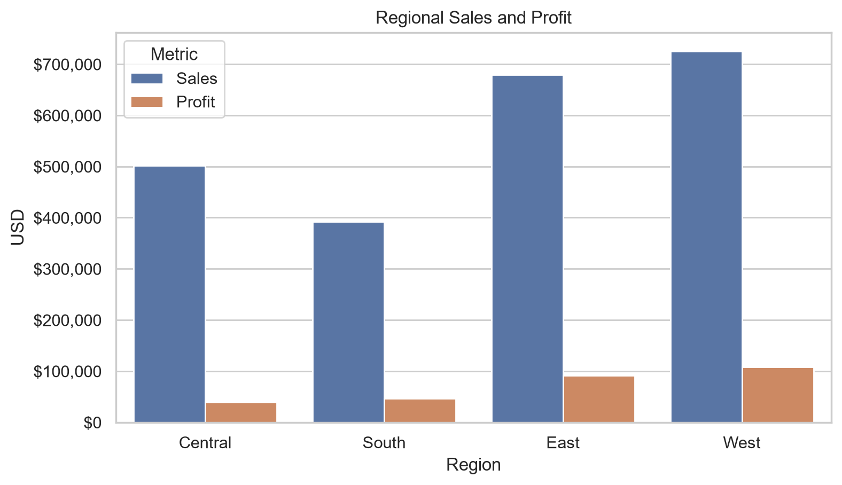
Regional Performance
Sales and profit vary materially across regions
Key takeaway
West leads profit; Central requires a deeper pricing and mix diagnostic.
Superstore Sales Analysis | 6

Slide 7
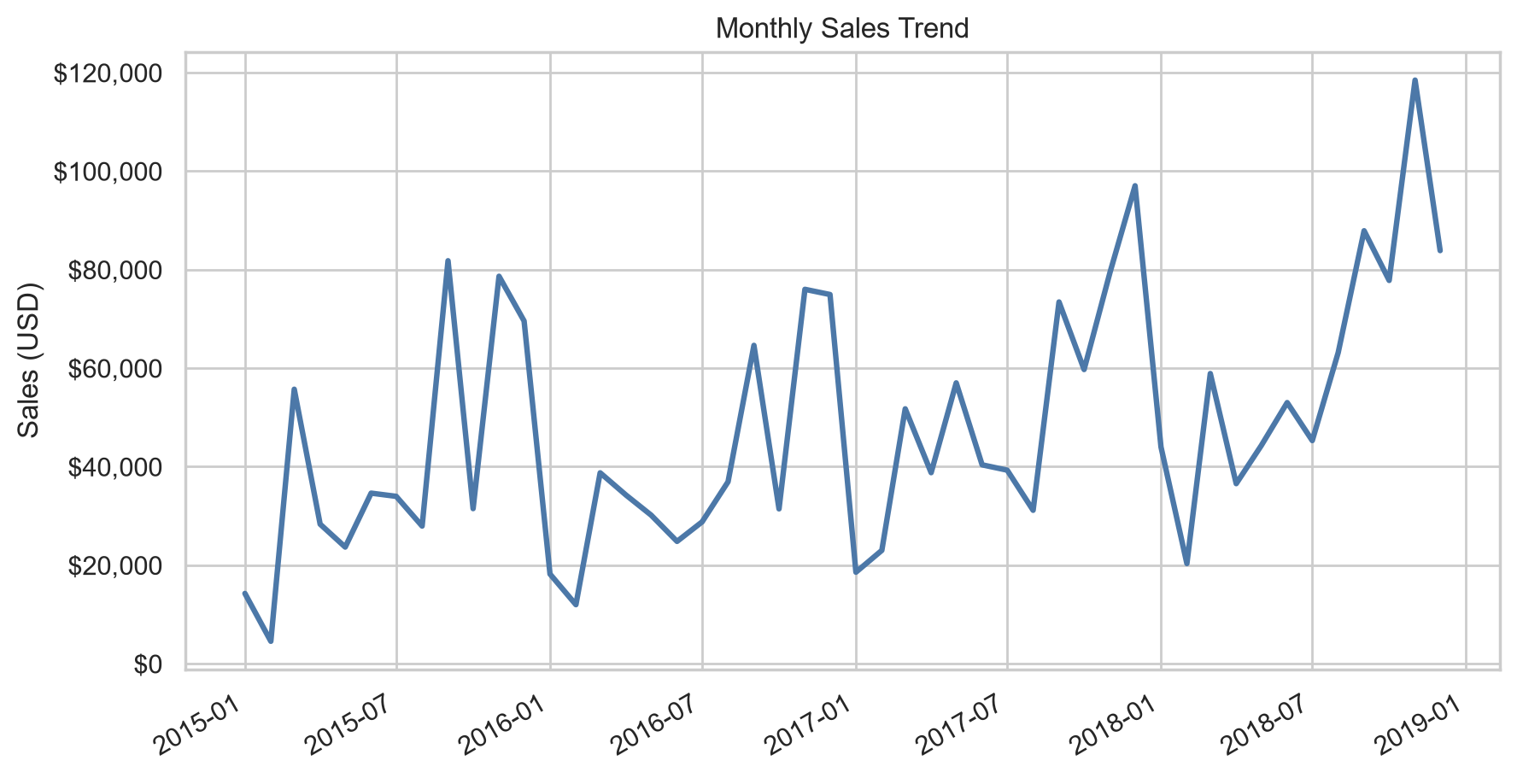
Sales Trend
Monthly performance helps identify seasonality and growth patterns
Key takeaway
Use this trend view to plan inventory, promotions, and sales targets.
Superstore Sales Analysis | 7

Slide 8
Recommendations
Actions supported by the analysis
1
Set discount guardrails for loss-making sub-categories.
2
Investigate the weakest-profit region by product, customer segment, and discount level.
3
Prioritize higher-margin products in campaign and inventory planning.
4
Monitor sales and profit together through recurring KPI reporting.
Superstore Sales Analysis | 8

