Slide 1
Spring Cloud Microservices

Slide 2
Spring Cloud
Based on spring boot
Supports many technology stacks…., clouds ….

Slide 3
Netflix Stack
Spring Cloud Netflix
      Zuul Routing
      Ribbon: Client Side Loadbalancing
      Eureka Service Discovery
      Hystrix Resilience

Slide 4
Coordinating Services
Service must discover/find each other
Service Discovery : Eureka

Slide 5
Eureka
REST based service registry
Supports replication
Cache on clients
Resilient
Fast
…… but not consistent
Foundation for other services

Slide 6
Eureka Client in Spring Cloud
@EnableDiscoveryClient
@EnableEurekaClient
Dependency to spring-cloud-starter-eureka
Automatically registers applications

Slide 7
application.properties
eureka.client.serviceUrl.defaultZone: http://${eureka.host:localhost}:${eureka.port:8761}/eureka/ → Eureka server, can include username and password
Spring.application.name: service-name → Used for registration

Slide 8
Eureka Server
@SpringBootApplication
@EnableEurekaServer
public class ServiceRegistryApplication {
public static void main(String[] args) {
SpringApplication.run(ServiceRegistryApplication.class, args);
}
}

Slide 9
Zuul Routing
Route call to services
One URL to outside
Internal: many microservices in perticular REST
Powered by filters

Slide 10
Zuul Routing
Automatically map route to server registered in Eureka like /book-service to BOOK-SERVICE
No configuration
Can add filters

Slide 11
Zuul Proxy
@SpringBootApplication
@EnableZuulProxy
@EnableDiscoveryClient
public class ApiGatewayApplication {
public static void main(String[] args) {
SpringApplication.run(ApiGatewayApplication.class, args);
}
}

Slide 12
Config Server
Spring Cloud Config
Central configuration
Dynamic updates
Can use git backend

Slide 13
Spring Cloud Security
Single Sign On via OAuth2.0
Forward token like via RestTemplate or FeignClient
Support Zuul

Slide 14
Load Balancing
Centralized Load Balancing
Can become bottle neck
Single point of failure
Configuration complex

Slide 15
Client Side Load Balancing: Ribbon

Slide 16
Hystrix
Enable resilient applications
Do call in other thread pool
Won’t block request handler
Can implement timeout

Slide 17
Hystrix
Circuit Breaker
Open circuit if call to a system fails
If open, do not forward call, forward after a certain time window
System will not be swamped with requests

Slide 18
Hystrix
@FeignClient(name = "inventory-service" , fallback=HystrixInventoryFallback.class)
public interface InventoryServiceClient {
@RequestMapping(method= RequestMethod.GET, value="/api/v1/books/{isbn}/inventory")
public Integer getInventory(@PathVariable("isbn") String isbn);
}

Slide 19
Hystrix Dashboard

Slide 20
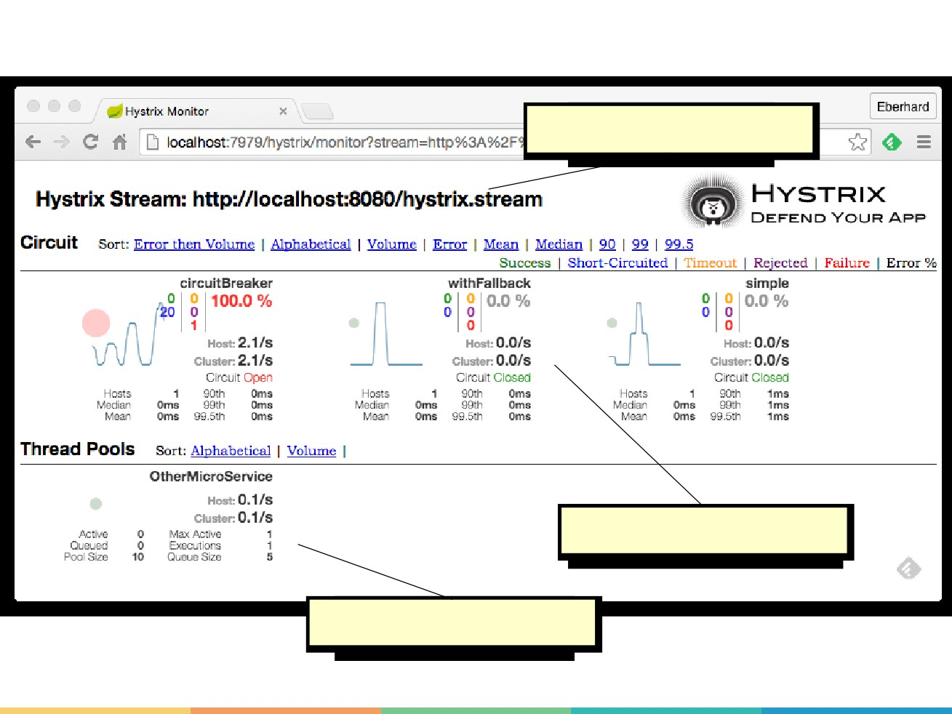

Slide 21
Questions ??

Slide 22
Thank You :)

