Slide 1
Education Consultancy System
An Online Platform for Guidance and Consultation
Group Members :
Mentor :
Suramya Biswas
Aparna Tiwari
Atul Verma
Varsha Arekalta
Badal Pathak
Pavishini

Slide 2
Introduction of Education Consultancy:
The edu consultancy system is a platform designed to assist students in making informed academic decisions. It enables users to register, subscribe to courses, and manage their learning journey efficiently. With secure authentication, and integrated payment processing, the system ensures a smooth and user-friendly experience. Admins can oversee user activities, manage subscriptions.
Making the platform a comprehensive solution for educational planning and guidance.

Slide 3
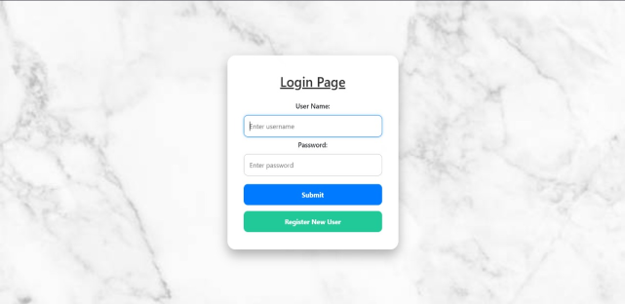
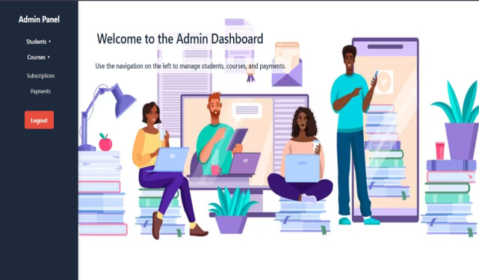

Key Features of the System:
The Education Consultancy System includes several key features:
User Authentication, ensuring secure access for students and admins.
Dashboard that displays relevant information for both students and administrators.
Subscription Management, allowing users to manage their premium services and Payment
management.

Slide 4

Admin Menu :
The Admin Menu in the Education Consultancy System provides essential tools for managing the platform efficiently. It includes:
Dashboard – Overview of system activities, user statistics, and pending tasks.
Manage Courses – Add, update, or remove courses available for students.
Student Management – View and manage student profiles, subscriptions, and progress.
Subscription Management – Track course subscriptions, update installment details, and manage payments..
User Access Control – Manage admin, consultant, and student access levels for security and efficiency.

Slide 5

Student menu:
The Student Menu in the Education Consultancy System provides easy access to essential features for students. It includes:
Dashboard – View personal details, enrolled courses, and upcoming schedules.
Course – Browse available courses, check details, and enroll in preferred programs.
My Subscriptions – Track active subscriptions, payment status, and renewal options.

Slide 6
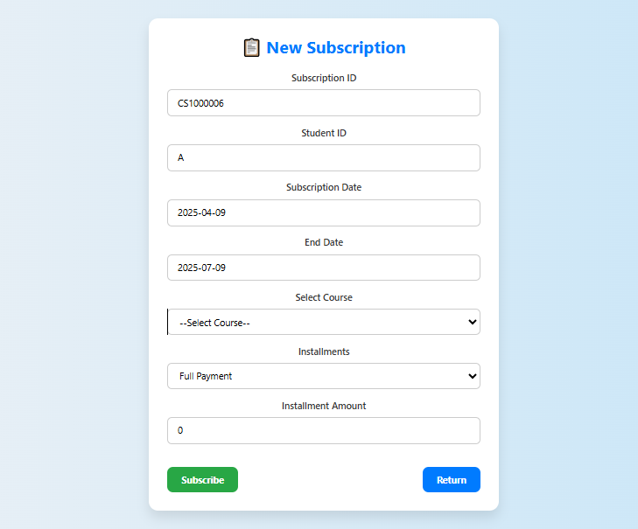
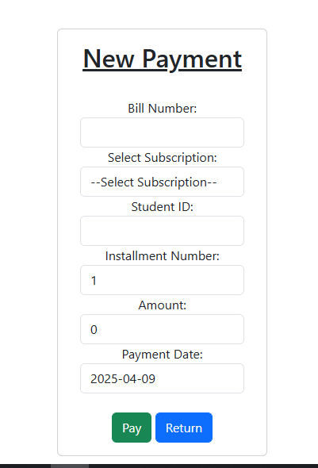
Subscription and Payment:
CurrentSubscription – Displays the student's active subscription details
SubscriptionAddition – Allows the admin to add new subscription plans with pricing and duration.
SubscriptionByStudent – Fetches and displays all subscriptions taken by a specific student.
SubscriptionList – Displays a list of all available subscriptions for students to choose from.
SubscriptionUpdate – Enables the admin to modify existing subscription details, such as price and duration.
Payment List- It contains all the payment records.
Payment Addition- New payment can be added through this feature

Slide 7
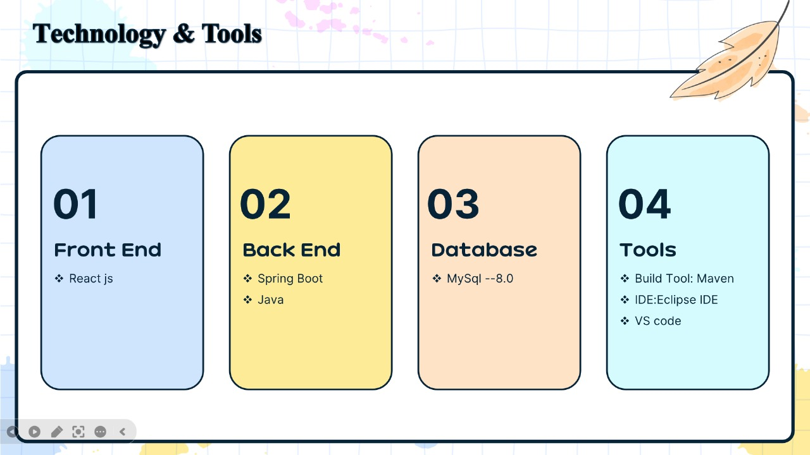
3
17

Slide 8
Thank you!
Please keep this slide for attribution

