Slide 1
Olist Ecommerce Data Analysis Project

Slide 2
GROUP-1
Apan kumar Singha
Chiranjeevi H G
Saswat Naik
Manmohan Jham
Monika Jangir
Rupam Keshri

Slide 3
KPI’S
Weekday Vs Weekend Payment Statistics
Number of Orders with review score 5 and payment type as credit card.
Average number of days taken for pet shop
Average price and payment values from customers of sao paulo city
Relationship between shipping days Vs review scores.

Slide 4


Slide 5
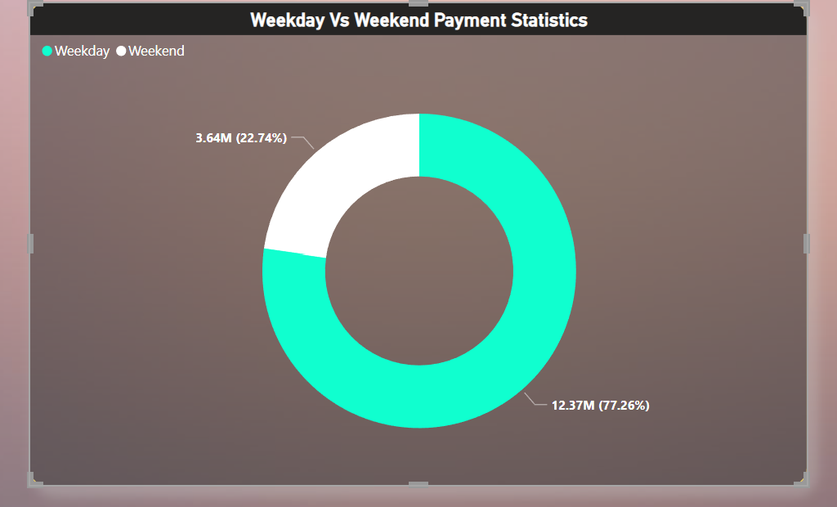
KPI-1
Weekday sales value is 12.37 M i.e 3.4 times more than weekend sales.
Weekend sales is contributing only 22% of the total sales.
Monday is contributing the most i.e 16.38% of the total payment where as Saturday has the least with 11.05%
Highest total sales is in the month of May with 1.75m and September has the lowest sales with 0.73m .

Slide 6
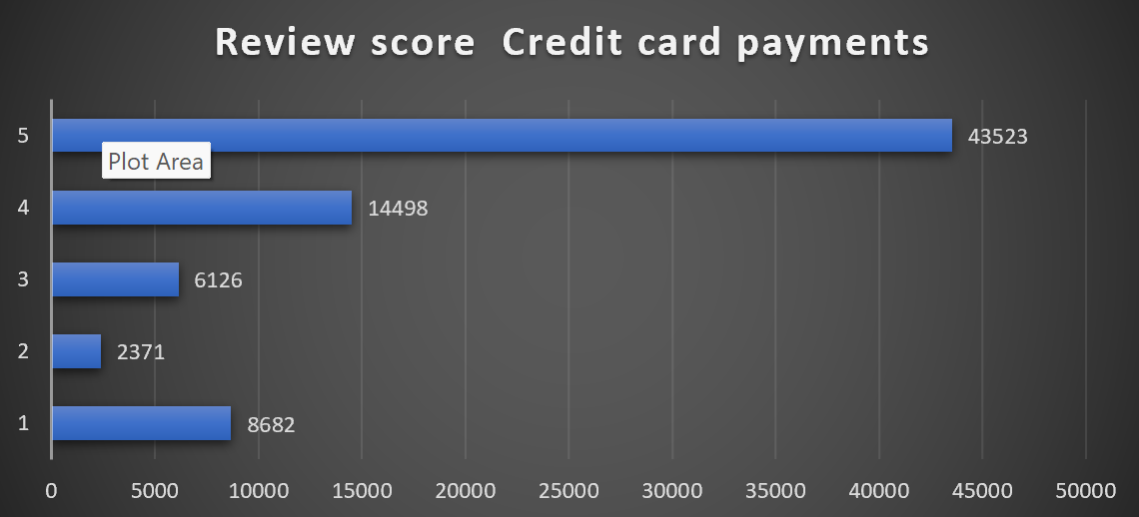
KPI-2
More than 78% People prefer credit card as the most convenient mode of payment .
States Sao Paulo And Rio de Janeiro are contributing 42% of the total Sales with review score 5.
Overall highest Sales is 8.53 M in Year 2018.
Most ordered product category Beleza saude order count of 4217.
For Credit Cards Payments the number of orders is 50354 are purchased on EMI and 24448 orders Are Purchased Through Credit Card on One time Payment.
As there are more number of payment instalments done in purchasing items, the people use credit card mode of payment only.

Slide 7
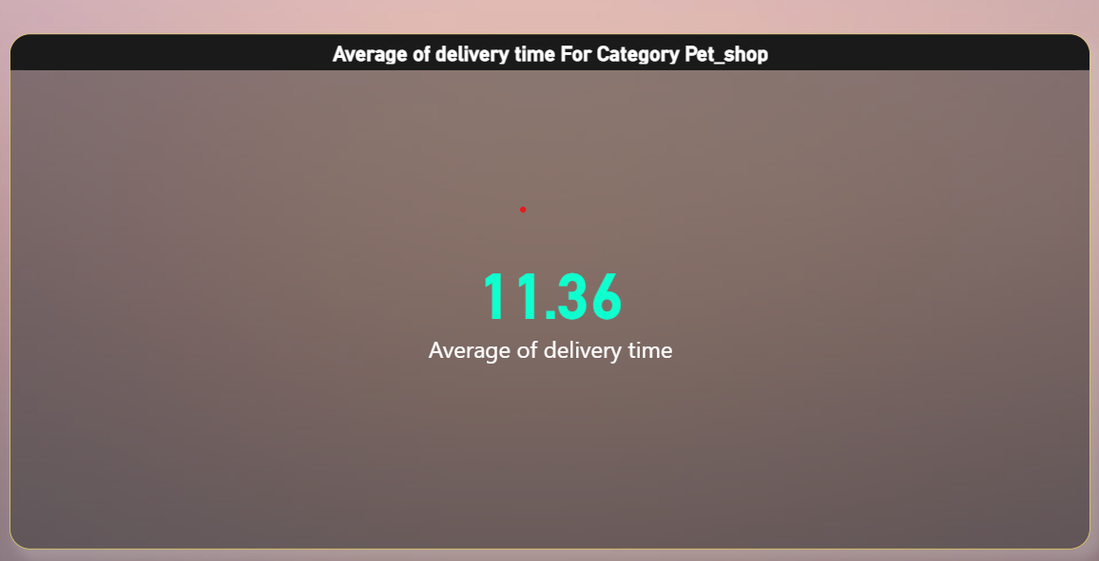
KPI-3
Average Delivery time For Pet Shop is 11 days
Artes e artesanato has the least avg delivery Days(6) indicates that a strong ability to fulfill orders efficiently while Moveis escritorio is taking More days(20).
SE State has the highest Delivery Time of 21 days indicating potential challenges with logistics and transportation in that state& State SP has the least delivery time of 9 days.
There may be chances of less delivery people in the SE state due to this reason the time taken to deliver the products is more in SE state.

Slide 8
KPI-4
Beleza Saude is the best selling Category with a Payment of 1.4 M and a Price of 1.26 M because this product is in demand and its requirement is very high therefore it’s sales has increased.
Seguros e Servicos is the least sold Category with Payment value 300 and Price of only 283 .
The city with the Highest Payment value is Sao Paulo And the city with the lowest payment value is demerval Lobao.
SP and RJ are the top 2 profitable states with Total Profit of 1.23 M.

Slide 9
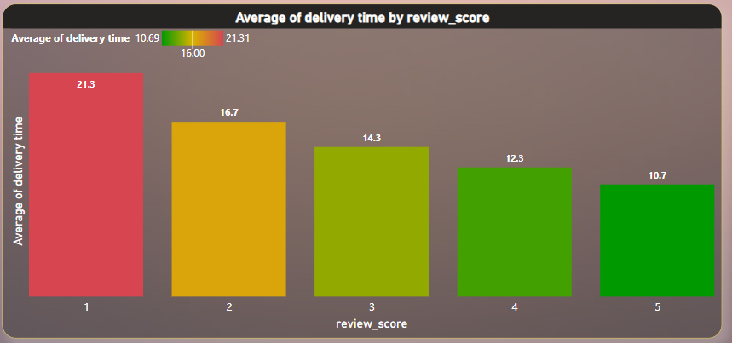
KPI-5
5 Star Rated products are Contributing 56.25 % of Total Payment value, Whereas 2 star rated Products have least Contribution with 3.39%.
More the review score , more people are attracted towards the particular product , and the more no.of customers purchase those products.
1 star rating is given by 11k Customers indicating that there might be Problem with the Product quality.
75% of People have given review score ratings 4 &5, Only 25% of People have given low Scores.

Slide 10
Conclusions
As observed that the weekend sales are low, so we can give special discounts and offers on weekends to Increase the sales
As per the Insights, the most preferred payment type is credit card which is 78 %. To increase its usage we can give more offers to this payment type.
SE State has the highest Delivery Time of 21 days which results in Losing the customers & receiving Negative Feedbacks. To counter this problem we Should improve our Logistics & supply chain Management in that area.
As we have seen the Product Seguros e Servicos has least contribution in sales in Future we should rectify these type of Products
Delivery Performance Could Influence the the review Scores, so we can work on logistics to improve Delivery Time.

Slide 11
Thank You
- By Group 1

