Slide 1



Project Title -Healthcare Analytics for Doctor Visits
Created by Badal Kumar Sahu
linkedin.com/in/badalsahu200ns | github.com/badalsahu200ns-png

Slide 2

PROBLEM STATEMENT
Healthcare Analytics for Doctor Visits
The Healthcare Analytics for Doctor Visits project is a data analytics study designed to understand patterns in healthcare utilization and how the number of doctor visits varies across different demographic, socioeconomic, health, illness, insurance, and chronic-condition factors.
The project uses a healthcare dataset containing information such as number of doctor visits, gender, age, income, illness level, activity reduction due to illness, general health status, private health insurance, free healthcare coverage, chronic conditions, and long-term chronic conditions. The analysis uses descriptive statistics, group-based comparisons, correlation analysis, and visualizations to examine patterns in doctor visits and understand how healthcare utilization differs across patient characteristics.

Slide 3
Project Overview
The Healthcare Analytics for Doctor Visits project is a data analytics study designed to understand patterns in healthcare utilization and examine how the number of doctor visits varies across different patient characteristics.
Dataset: The dataset contains healthcare-related information including:
    Doctor visits
    Gender and age
    Income
    Illness level
    Activity reduction due to illness
    General health status
    Private health insurance
    Free healthcare coverage
    Chronic and long-term chronic conditions
Objective: To identify patterns and relationships between doctor visits and demographic, socioeconomic, health, insurance, illness, and chronic-condition factors.

Slide 4

WHO ARE THE END USERS?
  Healthcare Providers : Analyze patient visit patterns and healthcare utilization.
  Doctors & Medical Professionals : Understand demographic and health-related visit patterns.
  Healthcare Analysts : Perform data-driven analysis of doctor visits and patient characteristics.
  Healthcare Administrators & Policymakers : Support planning and healthcare resource allocation.
  Researchers & Students : Study relationships between health, socioeconomic factors, and healthcare utilization.

Slide 5

Technology Used
Python – Primary programming language used for data analysis and visualization.
Google Colab – Cloud-based environment used to develop and execute the Python analysis.
Pandas – Used for data loading, cleaning, preprocessing, filtering, grouping, and statistical analysis.
NumPy – Used for numerical operations and data processing.
Matplotlib – Used to create charts and visualizations such as histograms, bar charts, scatter plots, and box plots.
Seaborn – Used for advanced statistical visualizations, including correlation heatmaps, violin plots, regression plots, and grouped comparisons.
Exploratory Data Analysis (EDA) – Used to understand data distributions, relationships, patterns, and unusual observations.
Descriptive Statistics – Used to calculate measures such as mean, median, standard deviation, minimum, and maximum.
Correlation Analysis – Used to examine relationships among doctor visits, age, income, illness, and chronic-condition variables.
Data Visualization – Used to communicate healthcare utilization patterns and comparisons between different patient groups.

Slide 6
RESULTS
Doctor visits vary across demographic groups, particularly by age and gender.
Age shows an important association with healthcare utilization, with visit patterns differing across age groups.
Income provides a socioeconomic perspective on differences in doctor visits.
Illness and health status are closely examined to understand variations in healthcare utilization.
Chronic conditions are associated with differences in doctor-visit patterns.
Insurance and free healthcare coverage help compare healthcare utilization across different coverage groups.
Data visualization and correlation analysis highlight relationships, distributions, and unusual doctor-visit observations.
Overall, the analysis provides a data-driven view of healthcare utilization based on demographic, socioeconomic, health, illness, insurance, and chronic-condition factors.
Demo Link: https://github.com/badalsahu200ns-png/Healthcare-Analytics-for-Doctor-Visits

Slide 7
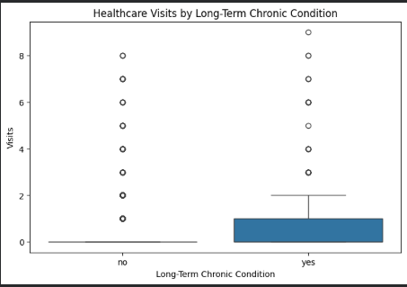
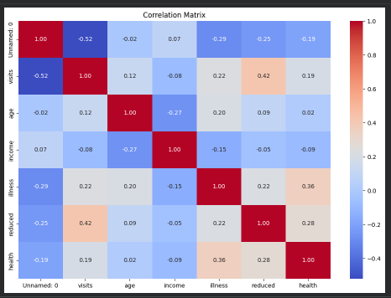
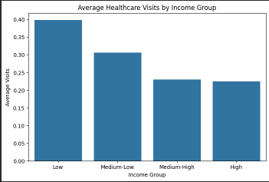
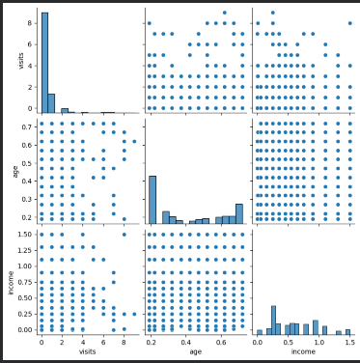
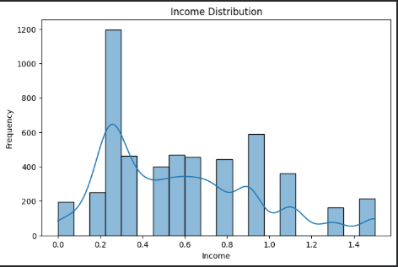
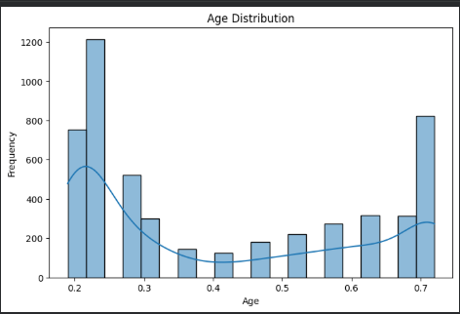
.
.

Slide 8
GitHub Link: https://github.com/badalsahu200ns-png/Healthcare-Analytics-for-Doctor-Visits
PROJECT SOURCE FILE Jupyter Notebook:Healthcare_Analytics_for_Doctor_Visits.ipynb
.
.
HEALTCARE DASHBOARD: healthcare_analytics_dashboard.html

Slide 9
Thank you
.
.

