Slide 1
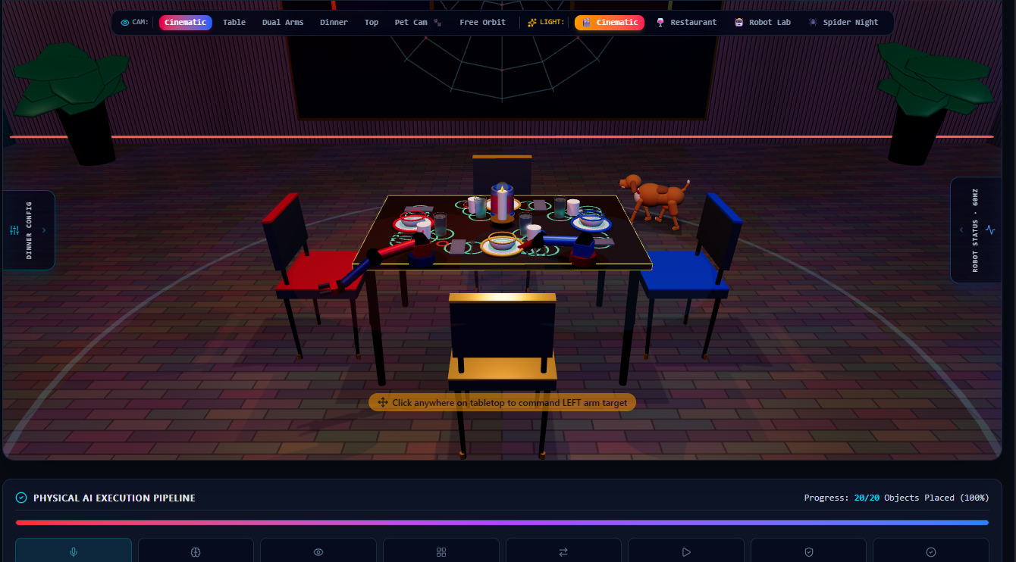
TwinHands-AI
Multimodal Physical AI for Coordinated Bimanual Robotic Manipulation
Natural Language → Vision → Task Planning → Dual-Arm Execution → Verification
Presented by Badal Kumar Sahu linkedin.com/in/badalsahu200ns github.com/badalsahu200ns-png
BUILT WITH • MuJoCo • Intel OpenVINO • Vision-Language-Action (VLA) • SO-101
TWINHANDS-AI // AI INFRA SUMMIT 2026
SLIDE 01

Slide 2




Vision: Intent to Physical Action
"Humans communicate through high-level goals and intent.
Robots traditionally communicate through coordinates and rigid trajectories."
— THE PHYSICAL AI PARADIGM SHIFT
Human Intent
Autonomous Execution
“Prepare the Spider-Man dinner table for four people.”
Understand • Plan • Coordinate • Act • Verify
TWINHANDS-AI // AI INFRA SUMMIT 2026
SLIDE 02

Slide 3


The Core Problem in Robotics
Traditional Industrial Automation
The TwinHands-AI Solution
Hardcoded Tasks: Fixed scripts and inflexible sequences designed for single scenarios only.
Intent-Driven VLA: Maps open natural language prompts directly to structured JSON task plans.
Rigid Layouts: Zero tolerance for object misplacement or altered environments.
Dynamic Layout Synthesis: Generates multi-object coordinates on the fly for 1 to 10 humans.
Manual Trajectories: Engineers must hand-tune waypoints and joint positions manually.
Dual-Arm Coordination: Balanced parallel workload across 🔴 Left & 🔵 Right arms.
Zero Recovery: Any grasp failure or obstacle halts the entire line indefinitely.
Closed-Loop Verification: Visual validation with autonomous re-localization and retry logic.
TWINHANDS-AI // AI INFRA SUMMIT 2026
SLIDE 03

Slide 4







Our Mission: Continuous Intelligence
STAGE 01
STAGE 02
STAGE 03
STAGE 04
Understand
See
Reason & Plan
Coordinate
Natural language & voice interpretation parsing intent, dinner group sizes, and contextual constraints.
Multi-camera vision pipeline identifying plates, bowls, cups, spoons, and table geometries.
Dynamic decomposition into structured JSON schemas, obstacle bounding, and collision boundaries.
Bimanual arm allocation optimizing reachability, cycle time, travel distance, and collision safety.
STAGE 05
STAGE 06
STAGE 07
Act (Primitives)
Verify
Recover
Safe physical execution via 5 core manipulation primitives: Reach, Grasp, Lift, Place, and Release.
Inspect final placement accuracy against the digital twin target tolerance (approx. 15 mm).
Autonomous closed-loop failure recovery: re-localize object, update trajectory, and retry seamlessly.
TWINHANDS-AI // AI INFRA SUMMIT 2026
SLIDE 04

Slide 5



System Architecture Overview
Multimodal VLA
Adaptive Planner
Intel OpenVINO Edge
Translates speech & visual perception into semantic intent. Uses zero-shot reasoning to comprehend complex dining requests.
Mathematical layout generator for arbitrary banquet sizes. Computes Euclidean distances and bimanual workloads dynamically.
High-throughput, ultra-low latency model quantization (FP32 → FP16 → INT8) accelerating on-device inference for real-time safety.
TWINHANDS-AI // AI INFRA SUMMIT 2026
SLIDE 05

Slide 6




How It Works: End-to-End Pipeline
1. User Input
2. Perception
3. Task Plan
4. Bimanual Exec
5. Verify & Done
"Prepare dinner table for four people"
Identify tableware, bowls, cups & staging area
Generate 16-object coordinate map
🔴 Left + 🔵 Right coordinate manipulation
Visual check within ~15 mm tolerance
TWINHANDS-AI // AI INFRA SUMMIT 2026
SLIDE 06

Slide 7







Adaptive Dynamic Table Planning
Generalized Table Primitive
Rather than hardcoding separate scripts for 2, 4, or 8 people, the planner uses parametric spatial synthesis:
TOTAL OBJECT SCALING
For N = 4 people, system coordinates exactly 16 objects (4 plates, 4 bowls, 4 cups, 4 spoons) autonomously.
N Plates
N Bowls
N Cups
N Spoons
PRIMARY BASE
CENTERED STACK
TOP-RIGHT OFFSET
LATERAL OFFSET
TWINHANDS-AI // AI INFRA SUMMIT 2026
SLIDE 07

Slide 8


Coordinated Bimanual Intelligence
🔴 LEFT ARM (SO-101)
🔵 RIGHT ARM (SO-101)
Assigned to left-quadrant table items and staging logistics.
Handles right-quadrant table accessories and parallel handoffs.
Responsible for grasping deep-left plates, water jugs, and positioning base silverware with collision evasion.
Responsible for glass placement, bowl stacking, and simultaneous napkin distribution without mutual interference.
Planner Solves: Reachability Bounds
•
Travel Distance Minima
•
Collision Avoidance
•
Cycle Time Optimization
TWINHANDS-AI // AI INFRA SUMMIT 2026
SLIDE 08

Slide 9




Robotics and Safety Architecture
Control Hierarchy
Hard Safety Envelopes
Physical AI must never run open-loop without deterministic boundaries:
≥ 0.18 m
0.58 m
MIN TCP CLEARANCE
MAX RADIAL REACH
Zero-Latency Emergency Stop
Hard-wired software E-Stop triggers instantaneous freeze in 0 timesteps, halting Cartesian velocity immediately upon obstacle detection.
TWINHANDS-AI // AI INFRA SUMMIT 2026
SLIDE 09

Slide 10

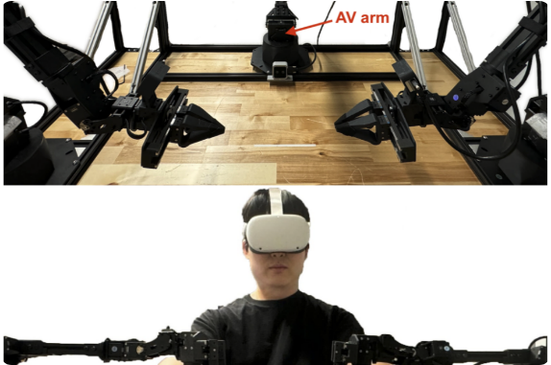

MuJoCo Digital Twin Simulation
Simulation Before Physical Execution
A full-fidelity digital twin environment modeling the Spider-Man themed restaurant, dual SO-101 bimanual arms, dynamic lighting, and friction-accurate tableware.
Zero-Risk Prototyping: Rapid kinematic and trajectory validation prior to hardware deployment.
Tableware Physics: Exact modeling of plates, bowls, cups, spoons, glasses, and jugs.
High-Rate Physics: Operating at over 48,000 simulated physics steps per second.
TWINHANDS-AI // AI INFRA SUMMIT 2026
SLIDE 10

Slide 11
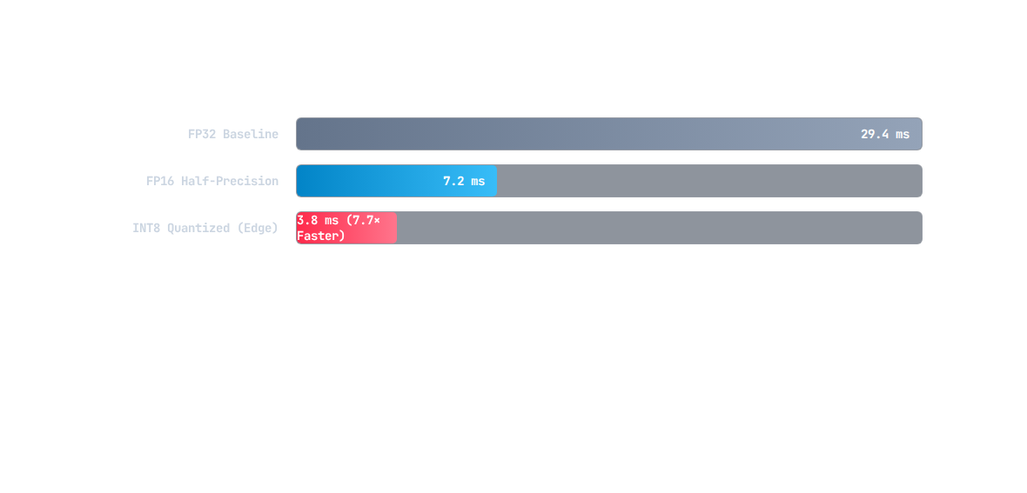



Intel OpenVINO Edge Benchmarks
7.7×
263.1
99.4%
TOTAL SPEEDUP FACTOR
INT8 BENCHMARK FPS
ACCURACY RETENTION
*Verified project benchmark results on edge CPU/iGPU architectures running Intel OpenVINO 2026.
TWINHANDS-AI // AI INFRA SUMMIT 2026
SLIDE 11

Slide 12
Simulation Engineering Results
Metric / Subsystem | Empirical Measured Value | Design Target / Spec | Status
Simulation Foundation Tests | 6 / 6 Test Suites Passed | 100% Suite Validation | PASS
Verified Robotic Actuators | 12 Servos (Dual SO-101) | Dual 6-DOF Synchronized | VERIFIED
Physics Step Latency | 20.68 microseconds (μs) | ≤ 50 μs per step | OPTIMAL
Simulated Throughput | 48,353 steps / second | > 800× 60 Hz Equivalent | 805× REALTIME
Nominal FK / IK Error | < 0.01 mm | ≤ 1.00 mm tolerance | SUB-MILLIMETER
Emergency Freeze Latency | 0 timesteps response | Instantaneous freeze | HARD-STOP
TWINHANDS-AI // AI INFRA SUMMIT 2026
SLIDE 12

Slide 13






Cross-Industry Physical AI Uses
Hospitality & Dining
Light Manufacturing
Laboratory Prep
Dynamic table layout preparation, adaptive banquet configuration, and automated dish busing.
Coordinated dual-arm parts assembly, kitting, electronics packaging, and flexible bin picking.
Pipette and test tube sequencing, chemical mixing protocol execution, and sterile sample handling.
Healthcare Logistics
Smart Warehousing
Assistive Domestic
Surgical tray preparation, sterile kit organization, and pharmacy medication distribution.
Mixed-SKU parcel sorting, carton sealing, fragile good boxing, and returns re-binning.
Routine daily object manipulation, pantry organization, and high-level physical assistance.
TWINHANDS-AI // AI INFRA SUMMIT 2026
SLIDE 13

Slide 14




Comprehensive Technology Stack
Multimodal AI
Robotics Engine
Edge Acceleration
UI & Telemetry
• Gemini-style VLA Model
• MuJoCo Physics Kernel
• Intel OpenVINO 2026
• React Robotics Cockpit
• Speech-to-Intent NLP
• Dual SO-101 Arms
• INT8 Post-Training Quant
• 3D Interactive Twin
• Multi-view RGB-D Vision
• Jacobian IK Solvers
• On-Device CPU/iGPU
• Real-Time Joint Telemetry
• Object Segmentation
• Cartesian Trajectories
• Zero-copy Shared Memory
• Emergency Hardware E-Stop
TWINHANDS-AI // AI INFRA SUMMIT 2026
SLIDE 14

Slide 15



Creator Spotlight: Badal Kumar Sahu
About the Project
Created for the AI Infra Summit Hackathon 2026, TwinHands-AI demonstrates how modern Vision-Language-Action models coupled with high-speed physics simulation and Intel OpenVINO edge acceleration can redefine autonomous bimanual robotics.
https://www.linkedin.com/in/badalsahu200ns/
https://github.com/badalsahu200ns-png
Badal Kumar Sahu
Physical AI & Robotics Innovator
TWINHANDS-AI // AI INFRA SUMMIT 2026
SLIDE 15

Slide 16


Questions & Discussion
"The future of robotics shouldn't start with hardcoded coordinates.
It should start with human intent."
Connect on LinkedIn Star on GitHub
TwinHands-AI • Badal Kumar Sahu • AI Infra Summit 2026
TWINHANDS-AI // AI INFRA SUMMIT 2026
SLIDE 16

