Slide 1

Program Synthesis
Bartosz Adamczewski
@badamczewski01

Slide 2
Program Synthesis is indistinguishable from magic*
* If done correctly

Slide 3
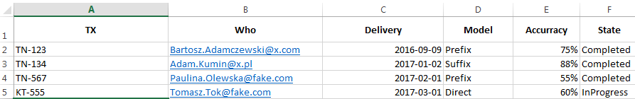
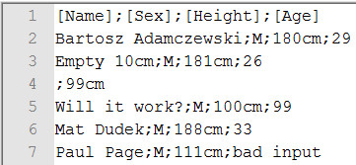
Problem
Notes:
Show Transformations + Excel example.

Slide 4
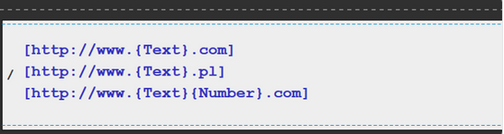
Road To Program Synthesis
Proved to be very hard

Slide 5
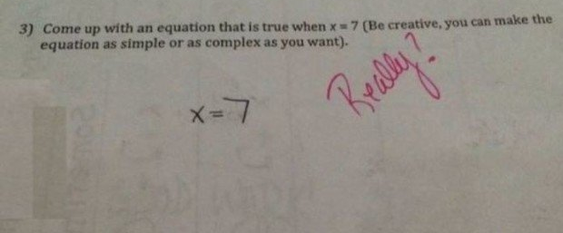
What is Program Synthesis?
Notes:
Demo Here. (Excel)

Slide 6
History
From 60s To 70s
Lack of Success ☹
2010 Gaining Traction ☺
2017-03-28 DeepCode 😐

Slide 7
Soo What is Program Synthesis?
Generate program from high level specification
Regex | DSLs | Tools (Like Excel) | Almost Everything

Slide 8
“The Ultimate Dream” of Computer Science. - Dijkstra's dream
Specification
Search Space
Program
User Intent

Slide 9
Synthesis Models
Sketching
Examples
Predictive

Slide 10
Programming by Sketching
Node p = root, n = null;
while ({??}) {
Node tmp = p.next;
p.next = n;
n = {??};
p = tmp;
}
root = n;
Notes:
Linked list Reverse.

Slide 11
Programming by Sketching
Simple Functions
Solvers (SMT Lv2)
Awesome For Concurrency
Test Driven Sketching
Notes:
SMT (Stability Modulo Theory)– Posiadając pewną formułę z constraintami oraz zmiennymi czy można dobrać jej parametry tak aby formuła była prawdą.

Slide 12
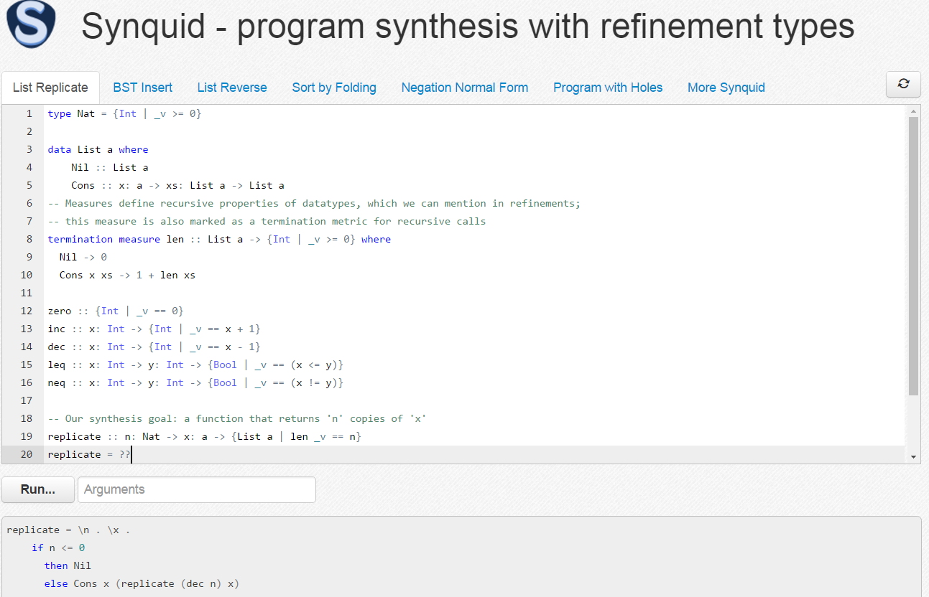
Programming by Sketching
Nadia Polikarpova ☺

Slide 13
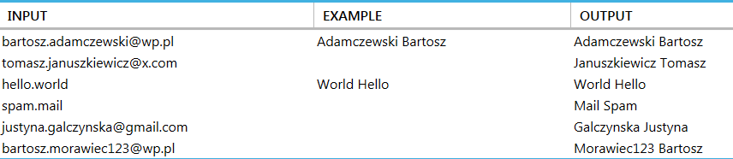
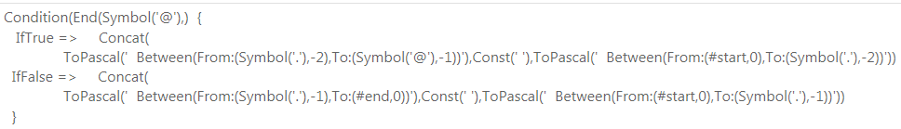
Programming by Example
Notes:
Demo Here.

Slide 14
Programming by Example
Sequence Prediction
Text Extraction
Text Transformation

Slide 15
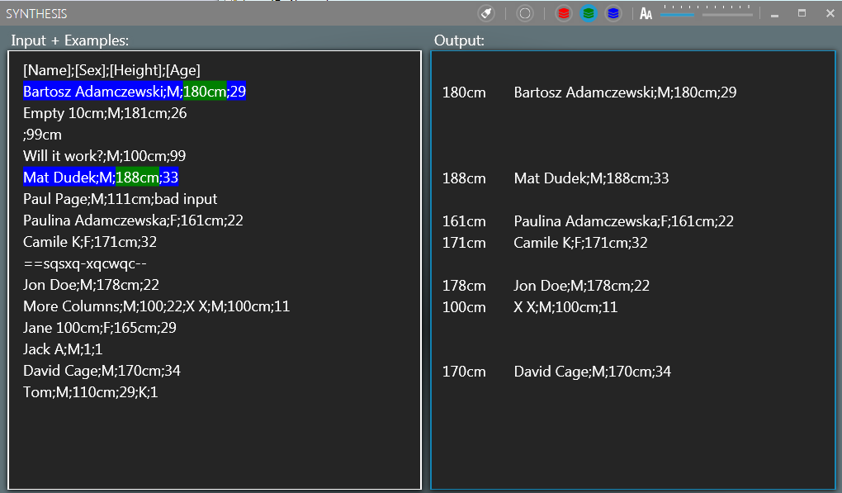
Programming by Example
Notes:
Demo 2 Here.

Slide 16
Programming by Example
Input Spec Example(s)
Tokens
Trace Expressions
(Rank)
Output Spec(s)
(Rank)
Partition(s)
Top K Programs
(By Rank)
Notes:
Code Here.

Slide 17
Programming by Example
Trace
Bartosz_Adamczewski@wp.pl
Adamczewski Bartosz
Bartosz (Ø,Symbol)
Bartosz (Ø,’_’)
Bartosz (Ø,Symbol, Text)
Bartosz (Ø,’_Adamczewski’)
Bartosz (Ø,Symbol, Text, Symbol)
Bartosz (Ø,’_Adamczewski@’)
Bartosz (Ø,Symbol, Text, Symbol, Text)
Notes:
Demo Here.

Slide 18
Programming by Example
Backpropagation
Bartosz_Adamczewski@wp.pl
Adamczewski Bartosz
Concat(S,T)
S => „A” v „Ad” v „Ada” v „Adam” v „Adamc” v „Adamcz” ...
Given S find T that satisfies the example: „ewski Bartosz”

Slide 19

Programming by Example
Backpropagation $∈$ Trace

Slide 20
Programming by Example
Version Space Algebra
A search through a (version) space of possibilities.
P
Statement
Statement
Bilions of solutions :-/
Concat

Slide 21
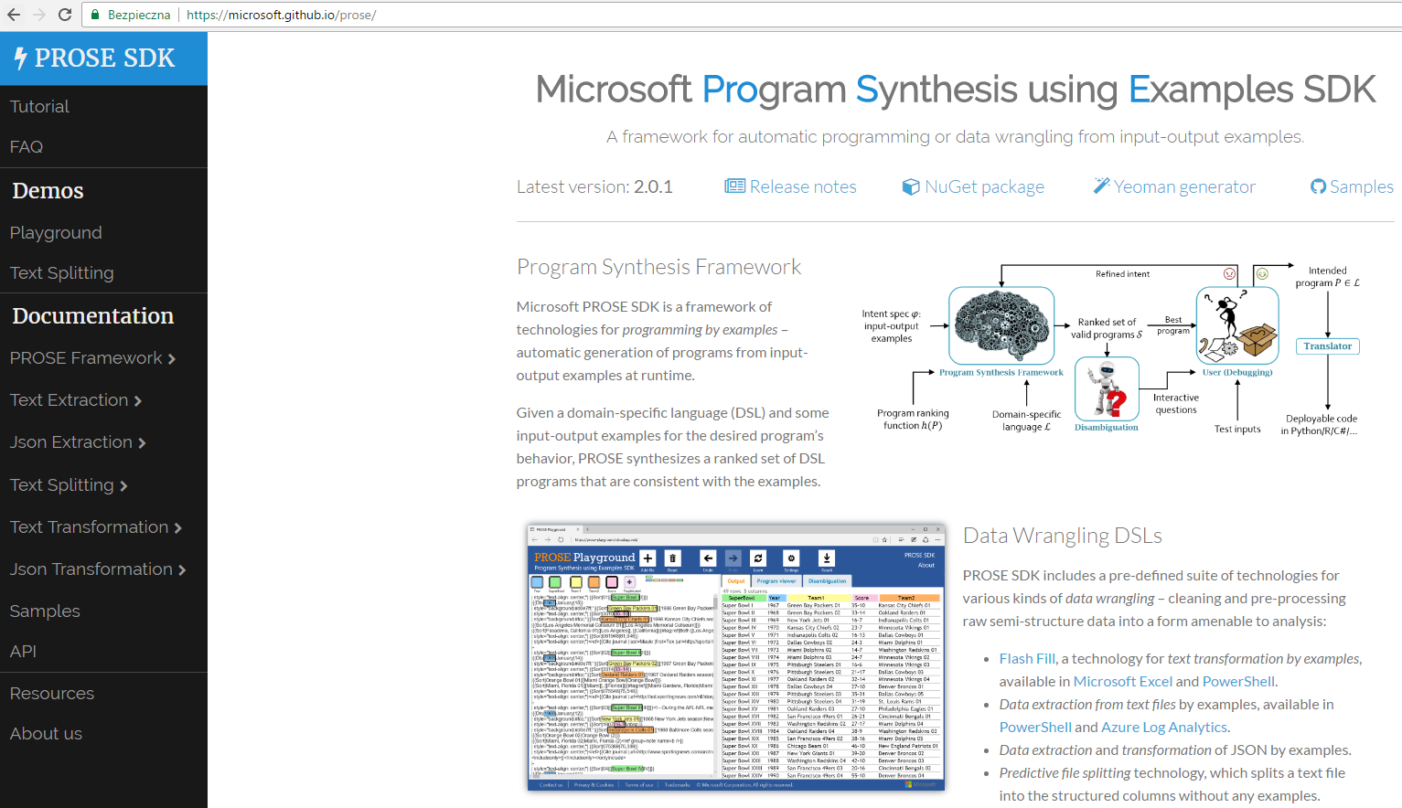
Programming by Example

Slide 22
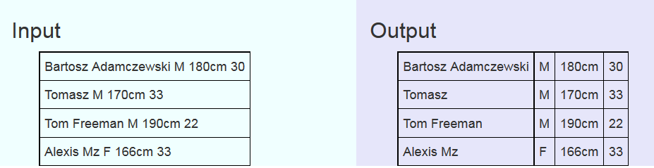
Predictive Synthesis

Slide 23
Predictive Synthesis
Text Splitting
Text Slicing
Data Analysis

Slide 24
The Future & Ideas
NLP Synthesis
Test Driven Synthesis
Program Slicing Synthesis
AI/ML Driven Synthesis
AI + ML + Program Synthesis = Machine Uprising ???

Slide 25
Thank You ☺
Questions ?
Special Thanks to Microsoft PROSE Team for materials and support.
Nadia Polikarpova, Ivan Kuraj, Armando Solar-Lezama – Syncquid

